Slide 1
Clinical Data Wrangling: Introduction
HIP523
Ted Laderas, PhD

Slide 2
Acknowledgements
Some of these slides are adapted from Nicole Weiskopf from our clinical data wrangling workshop
This dataset is adapted from the synthetic patient cohort used in BMI 569 Data Analytics

Slide 3
Please Note
This session is subject to the BioData Club Code of Conduct: https://biodata-club.github.io/code_of_conduct/
This session is meant to be a psychologically safe space to ask questions
Please respect each other and interact with each other respectfully, or I will mute you or ask you to leave.

Slide 4

Introduction
Assistant Professor, DMICE
Bioinformatics and Interactive visualization
Certified RStudio Instructor
Founder, BioData Club and Cascadia R conference
BMI 569 – Data Analytics
BMI 507 – Ready for R

Slide 5
Short Introduction
In Chat type:
Your Name
Your Department
Why are you interested in Data Analysis?
What do you hope to get out of this session?

Slide 6
Learning Objectives
Understand basic issues with using clinical data and how it is collected
Learn and Apply Basic Principles of Exploratory Data Analysis to assess whether data is fit for reuse
Identify when missing values in data may affect using clinical data for reuse
Identify possible predictors of an outcome using exploratory data analysis

Slide 7
Our Big Goal
Reduce unnecessary hospital readmissions from poor inpatient or outpatient care
Reduce overall costs
Improve overall outcomes of our patient population
Our metric: whether a patient has be readmitted to the hospital within 30 days

Slide 8
Our Analytic Goal
Can we predict which patients in our cohort had 30 day hospital readmissions?
Is our data fit for predicting this?
Can we understand which of these predictors is helpful?
Comorbidities (diabetes complications and/or myocardial complications)
Length of Stay in Hospital
Age

Slide 9
Your Turn
In chat, construct a hypothesis about one of these:
length of stay
History of diabetes complications
History of myocardial infarctions
Age
And how they would impact whether a patient is readmitted to the hospital within 30 days

Slide 10
Using a systematic but flexible approach to “wrangling” your clinical data, combined with basic competencies in exploratory data analysis, will get you where you want to go.
Data Exploration and Availability Assessment
ETL and Curation
ETL Quality Assurance
Fitness for Use Assessment

Slide 11
Defining “Clinical” Data
Clinical documentation
Unstructured: Progress notes, Medical Hx, etc
Structured: Labs, Medications, Orders, Dx, etc
Administrative data (often included in this definition)
Billing
CMS, Insurance
Primary purpose is not research

Slide 12
Benefits of Clinical Data in Research
Decrease costs (time and money)
Enable recruitment and retention
Underrepresented populations
Rare diseases
Volume, variety, and velocity of data https://www.gartner.com/it-glossary/big-data
Increased representativeness (aka, generalizability or external validity)

Slide 13
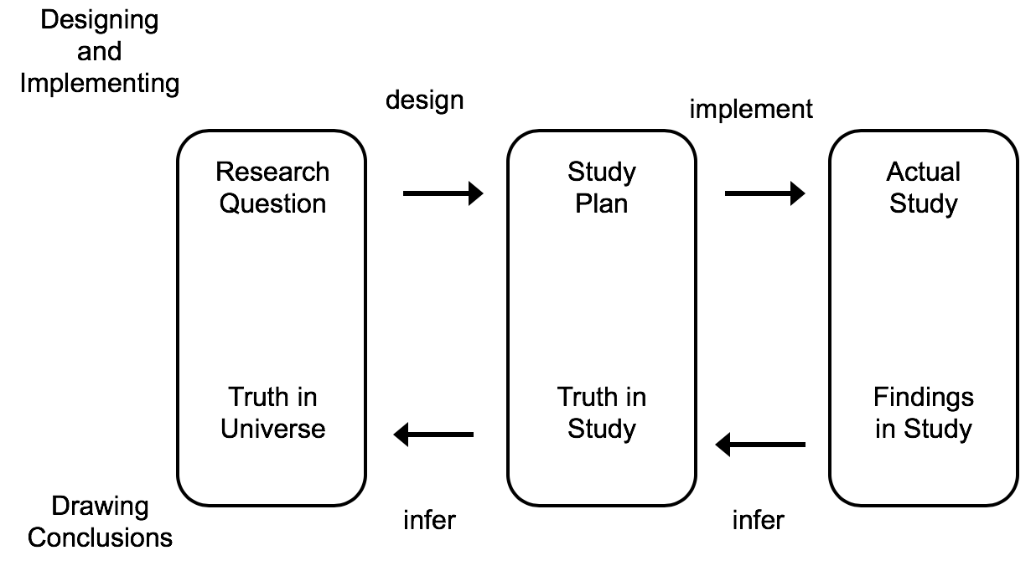
Good research should give us broadly applicable truths
External validity
Internal validity
Thanks to Adam Wilcox
Credit to Designing Clinical Research: An Epidemiologic Approach, Hulley SB, Cummings SR, Browner WS, Grady DG, Newman TB. Third edition, 2006

Slide 14
What is the quality of EHR data?
Hogan and Wagner (1997)
Correctness: 44% - 100%
Completeness: 1.1% - 100%
Chan et al. (2010)
Completeness of BP: 0.1% – 51%
Hogan & Wagner (1997) Accuracy of data in computer-based patient records.
Chan et al. (2010) EHRs and the reliability and validity of quality measures: a review of the literature.

Slide 15
Why are EHR data of such variable and often poor quality?
The quality of the data is defined with respect to the intended use of the data (fitness for use)
Clinical data are collected for patient care and billing purposes, not for research
The processes involved in taking a clinical truth about a patient all the way to a dataset being used for research is fraught with pitfalls

Slide 16
Not all clinical concepts are observed, and not all observations are recorded.
Observations
Recordings
Clinician
Longitudinal patient state
EHR
Weiskopf et al. (2013) Defining and measuring completeness of EHRs for secondary use

Slide 17



Metoprolol succinate ER 50mg, 1x
Lisinopril 25mg, 1x
Metoprolol succinate ER 25mg, 1x
Lisinopril 25mg, 1x
Metoprolol succinate ER 50mg, 1x
Lisinopril 25mg, 2x
Make
Observations
Record
Observations
Multi-vitamin, 1x
Metoprolol succinate ER 50mg, 1x
Lisinopril 25mg, 2x

Slide 18
A quick intro to missingness
There are three types of missingness, defined by Rubin.
MCAR (missing completely at random): pattern of missingness is not related to any other data
MAR (missing at random): the pattern of missingness is related to data that are present
MNAR (missing not at random): the pattern of missingness is related to the values of the data that are missing
Rubin (1976) Inference and missing data

Slide 19
An overly simple example of missingness
 | Population | Sample | MCAR | MAR | MNAR
Men | 70.0 | 70.2 | 70.3 | 70.5 | 71.3
Women | 64.0 | 64.2 | 64.1 | 64.2 | 65.4
Overall | 67.0 | 67.2 | 67.1 | 66.3 | 68.4

Slide 20
An overly simple example of missingness
 | Population | Sample | MCAR | MAR | MNAR
Men | 70.0 | 70.2 | 70.3 | 70.5 | 71.3
Women | 64.0 | 64.2 | 64.1 | 64.2 | 65.4
Overall | 67.0 | 67.2 | 67.1 | 66.3 | 68.4
Sample of 200 men, 200 women
Rubin (1976) Inference and missing data

Slide 21
An overly simple example of missingness
MCAR (missing completely at random): pattern of missingness is not related to any other data
 | Population | Sample | MCAR | MAR | MNAR
Men | 70.0 | 70.2 | 70.3 | 70.5 | 71.3
Women | 64.0 | 64.2 | 64.1 | 64.2 | 65.4
Overall | 67.0 | 67.2 | 67.1 | 66.3 | 68.4
25% of men and women didn’t want to share their height
Rubin (1976) Inference and missing data

Slide 22
An overly simple example of missingness
MAR (missing at random): the pattern of missingness is related to data that are present
 | Population | Sample | MCAR | MAR | MNAR
Men | 70.0 | 70.2 | 70.3 | 70.5 | 71.3
Women | 64.0 | 64.2 | 64.1 | 64.2 | 65.4
Overall | 67.0 | 67.2 | 67.1 | 66.3 | 68.4
50% of men didn’t want to share their height
Rubin (1976) Inference and missing data

Slide 23
An overly simple example of missingness
MNAR (missing not at random): the pattern of missingness is related to the values of the data that are missing
 | Population | Sample | MCAR | MAR | MNAR
Men | 70.0 | 70.2 | 70.3 | 70.5 | 71.3
Women | 64.0 | 64.2 | 64.1 | 64.2 | 65.4
Overall | 67.0 | 67.2 | 67.1 | 66.3 | 68.4
Half of the shortest 25% of men and women didn’t share their height
Rubin (1976) Inference and missing data

Slide 24
Data quality is a large problem area that is still mostly unsolved. Ultimately we need to improve the source data, but until then:
Understand the provenance of your data, especially in terms of system complexities and potential failure points
Don’t think of data quality as an issue of right versus wrong values– the problem is generally more subjective (fitness for use)
Data that are “bad” at random aren’t always an issue in research, but systematic data quality problems can drastically alter your results
When you uncover potential data quality problems, be thoughtful in your attempts to compensate

Slide 25
Using a systematic but flexible approach to “wrangling” your clinical data, combined with basic competencies in exploratory data analysis, will get you part of the way there.
Data Exploration and Availability Assessment
ETL and Curation
ETL Quality Assurance
Fitness for Use Assessment

