Slide 1

App Trader Labor Day Debut

Slide 2
Price Effect on
Downloads and Reviews

Slide 3
Price Effect on
Downloads and Reviews
[1]

Slide 4
Price Effect on
Downloads and Reviews
[2]

Slide 5
Average Rating
by Genre

Slide 6
Average Rating
by Genre
[3]

Slide 7
Average Rating by
Content Rating
[4]

Slide 8
Average Rating by
Content Rating
[4]

Slide 9
Average Rating By
Review Count

Slide 10
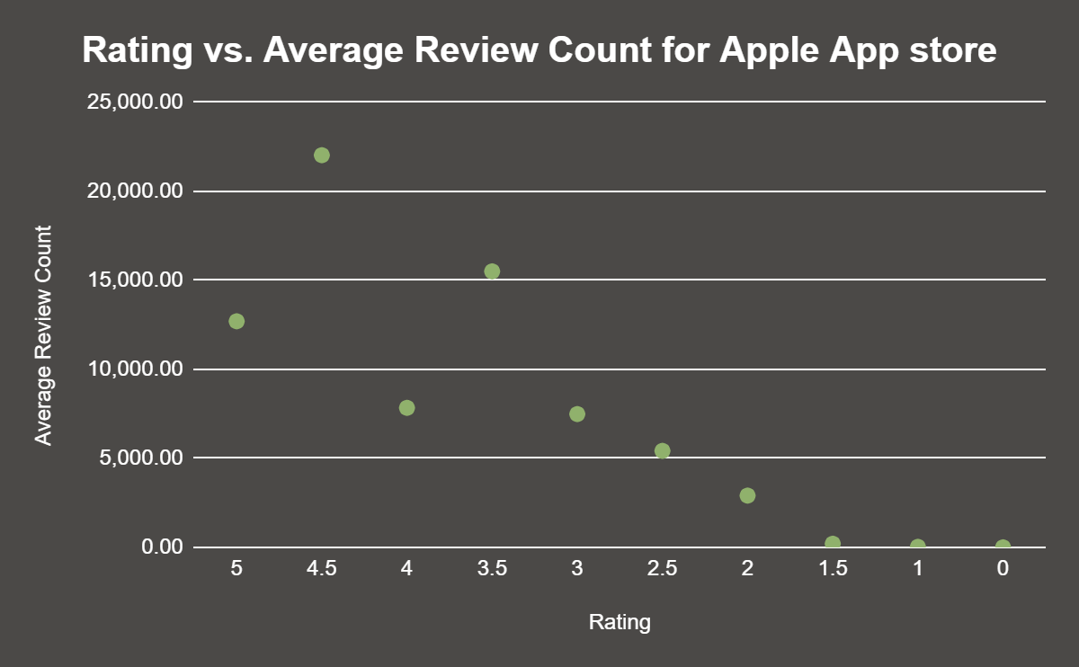
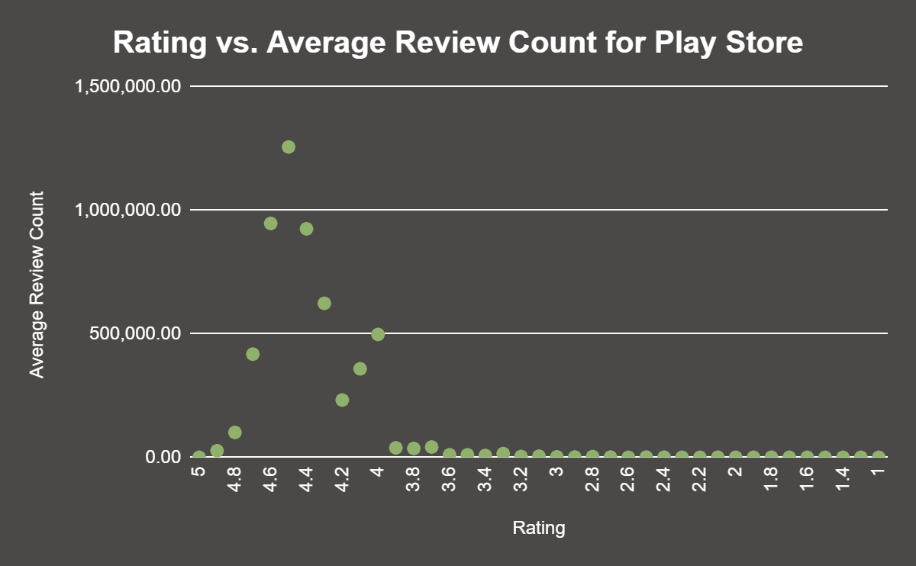
Average Rating By
Review Count
[5]

Slide 11
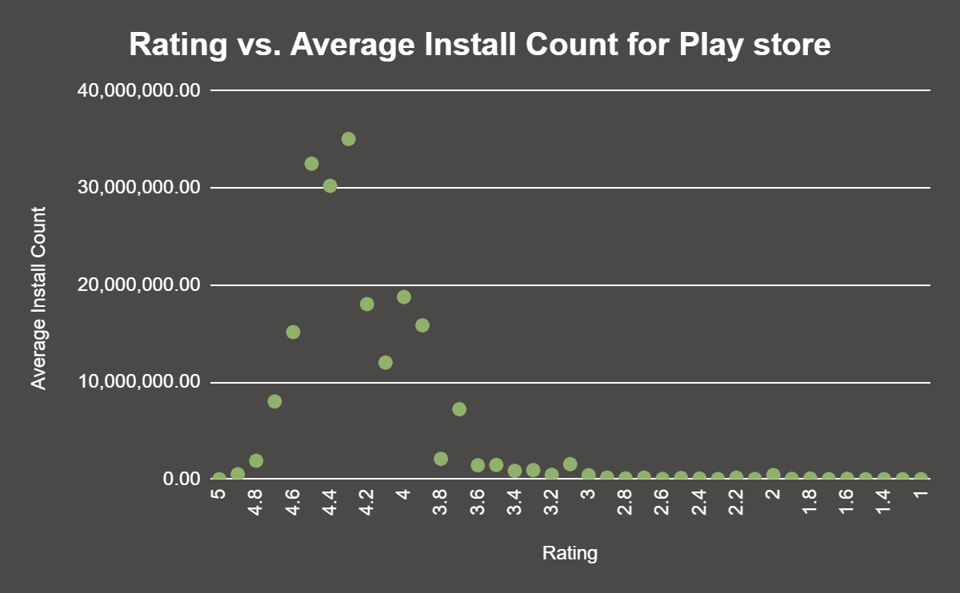
Average Rating By
Install Count
[6]

Slide 12
Our Top 10 Recommendations

Slide 13
Our Top 10 Recommendations
5 Star Rated Apps
Geometry Dash Lite
Domino's Pizza USA
PewDiePie's Tuber Simulator
Egg, Inc.
ASOS
The Guardian
4.5 Star Rated Apps
Instagram
Clash of Clans
Temple Run
Pinterest
[7,8]

Slide 14
App Trader Profit!

Slide 15
App Trader Profit!
Net Profit Per App Month Year
$4,500 $54,000

Slide 16
App Trader Profit!
Net Profit Per App Month Year
$4,500 $54,000
Net Profit for All Apps Month Year
$45,000 $540,000

Slide 17
App Trader Profit!
Net Profit Per App Month Year
$4,500 $54,000
Net Profit for All Apps Month Year
$45,000 $540,000
Net Profit for the Life of the Apps $5,508,000!
[9]

Slide 18
Any Questions?

Slide 19
Queries
[1]
--star rating vs price SELECT FLOOR(a.price/1), round(avg(a.rating),2) FROM app_store_apps a GROUP BY FLOOR(a.price/1) order by FLOOR(a.price/1) desc --star rating vs price SELECT FLOOR(cast(replace(p.price,'$','') as decimal(5,2))/1), round(AVG(p.rating),2) FROM play_store_apps p GROUP BY FLOOR(cast(replace(p.price,'$','') as decimal(5,2))/1) ORDER BY FLOOR(cast(replace(p.price,'$','') as decimal(5,2))/1) DESC
[4]
-- app store
SELECT
(SELECT (ROUND(AVG(rating),2))
FROM app_store_apps
WHERE content_rating = '4+') AS app_over4,
(SELECT (ROUND(AVG(rating),2))
FROM app_store_apps
WHERE content_rating = '9+') AS app_over9,
(SELECT (ROUND(AVG(rating),2))
FROM app_store_apps
WHERE content_rating = '12+') AS app_over12,
(SELECT (ROUND(AVG(rating),2))
FROM app_store_apps
WHERE content_rating = '17+') AS app_over17
FROM app_store_apps
LIMIT 1
-- play store
SELECT
(SELECT (ROUND(AVG(rating),2))
FROM play_store_apps
WHERE content_rating = 'Everyone') AS play_everyone,
(SELECT (ROUND(AVG(rating),2))
FROM play_store_apps
WHERE content_rating = 'Everyone 10+') AS play_everyone10,
(SELECT (ROUND(AVG(rating),2))
FROM play_store_apps
WHERE content_rating = 'Teen') AS play_teen,
(SELECT (ROUND(AVG(rating),2))
FROM play_store_apps
WHERE content_rating = 'Mature 17+') AS play_mature
FROM play_store_apps
LIMIT 1
[2]
--install count vs price SELECT p.price AS price, round(AVG(CAST(REPLACE(REPLACE(p.install_count,'+',''),',','') AS integer)),2) AS install_count FROM play_store_apps p GROUP BY price --review count vs price select a.price as price, round(avg(cast(a.review_count as decimal(10,2))),2) as review_count from app_store_apps a group by price order by price
[3]
SELECT DISTINCT genre_clean, ROUND(AVG(avg_rating),2) AS total_avg_rating FROM (SELECT DISTINCT REPLACE(REPLACE(TRIM(UPPER(primary_genre)),' ','_'),'&','AND') AS genre_clean, ROUND(AVG(rating),2) AS avg_rating FROM app_store_apps WHERE price <= '1.00' AND rating IS NOT NULL GROUP BY primary_genre UNION SELECT DISTINCT category, ROUND(AVG(rating),2) FROM play_store_apps WHERE price <= '1.00' AND rating IS NOT NULL GROUP BY category) AS subq GROUP BY genre_clean ORDER BY ROUND(AVG(avg_rating),2) DESC LIMIT 10;*/

Slide 20
Queries
[8]
select a.name, round((((a.rating + p.rating)/2)/.5),0)*.5 as avg_rating, a.primary_genre as A_primary_genre, p.genres as P_genre, p.category as P_category, a.content_rating as A_content_rating, p.content_rating as P_content_rating, cast(a.review_count as integer) as A_review_count, p.review_count as P_review_count, p.install_count as P_install_count from (select distinct(name) as name, max(category) as category, max(rating) as rating, max(review_count) as review_count, max(install_count) as install_count,max(price) as price,max(content_rating) as content_rating,max(genres) as genres from play_store_apps group by name) as p inner join (select distinct(name) as name, max(price) as price, max(review_count) as review_count, max(rating) as rating, max(content_rating) as content_rating, max(primary_genre) as primary_genre from app_store_apps group by name) as a on p.name = a.name where (cast(replace(p.price,'$','') as decimal(5,2))) < 1.01 and a.price < 1.01 and (a.content_rating in (select content_rating from app_store_apps group by content_rating having count(*)>10 order by count(*) desc limit 3) or p.content_rating in (select content_rating from play_store_apps group by content_rating having count(*)>10 order by avg(rating) desc limit 3)) and (a.primary_genre in (select primary_genre from app_store_apps group by primary_genre having count(*)>10 order by avg(rating) desc limit 10) or p.category in (select category from play_store_apps group by category having count(*)>10 order by avg(rating) desc limit 10)) and p.genres in (select genres from play_store_apps where genres not like '%;%' group by genres having count(*)>10 order by avg(rating) desc limit 20) and round((((a.rating + p.rating)/2)/.5),0)*.5 = 4.5 order by a_review_count desc limit 4;
[5]
select round(avg(review_count),2) as avg_rc, rating from play_store_apps where rating IS NOT NULL group by rating order by rating desc
select round(avg(cast(review_count as int)),2) as avg_rc, rating from app_store_apps group by rating order by rating desc
[6]
select round(avg(cast(replace(replace(install_count,'+',''),',','') as integer)),2) as avg_inc, rating from play_store_apps where rating IS NOT NULL group by rating order by rating desc
[7]
select a.name, round((((a.rating + p.rating)/2)/.5),0)*.5 as avg_rating, a.primary_genre as A_primary_genre, p.genres as P_genre, p.category as P_category, a.content_rating as A_content_rating, p.content_rating as P_content_rating, cast(a.review_count as integer) as A_review_count, p.review_count as P_review_count, p.install_count as P_install_count from (select distinct(name) as name, max(category) as category, max(rating) as rating, max(review_count) as review_count, max(install_count) as install_count,max(price) as price,max(content_rating) as content_rating,max(genres) as genres from play_store_apps group by name) as p inner join (select distinct(name) as name, max(price) as price, max(review_count) as review_count, max(rating) as rating, max(content_rating) as content_rating, max(primary_genre) as primary_genre from app_store_apps group by name) as a on p.name = a.name where (cast(replace(p.price,'$','') as decimal(5,2))) < 1.01 and a.price < 1.01 and round((((a.rating + p.rating)/2)/.5),0)*.5 = 5 order by a_review_count desc;

Slide 21
Profit analysis
[9]
General Info
price per app | $ 10,000
apps purchased | 10
total spent | $ 100,000
Per App | Month | Year
$ spent on advertising | $ 1,000 | $ 12,000
$ earned from advertising | $ 10,000 | $ 120,000
profit over all | $ 9,000 | $ 108,000
profit for App Trader | $ 4,500 | $ 54,000
All Apps Purchased | Month | Year
$ spent on advertising | $ 10,000 | $ 120,000
$ earned from advertising | $ 100,000 | $ 1,200,000
profit over all | $ 90,000 | $ 1,080,000
profit for App Trader | $ 45,000 | $ 540,000
Totals for the Six 5 Star Rated Apps | Month | Year
$ spent on advertising | $ 6,000 | $ 72,000
$ earned from advertising | $ 60,000 | $ 720,000
profit over all | $ 54,000 | $ 648,000
profit for App Trader | $ 27,000 | $ 324,000
profit for the life of the apps (11 yrs) |  | $ 3,564,000
Totals for the Four 4.5 Rated Apps | Month | Year
$ spent on advertising | $ 4,000 | $ 48,000
$ earned from advertising | $ 40,000 | $ 480,000
profit over all | $ 36,000 | $ 432,000
profit for App Trader | $ 18,000 | $ 216,000
profit for the life of the apps (9 yrs) |  | $ 1,944,000
Total Per year (for the first 9 years) |  | $ 540,000
Grand Total |  | $ 5,508,000

