Slide 1

App Trader Labor Day Debut

Slide 2
Price Effect on Downloads and Reviews

Slide 4
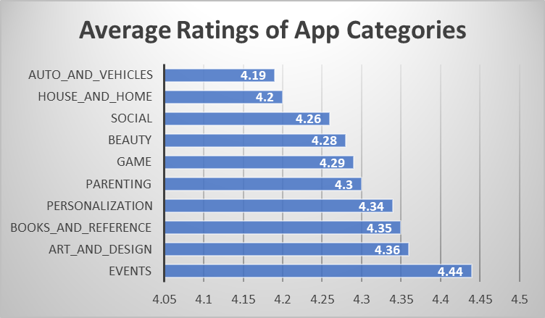
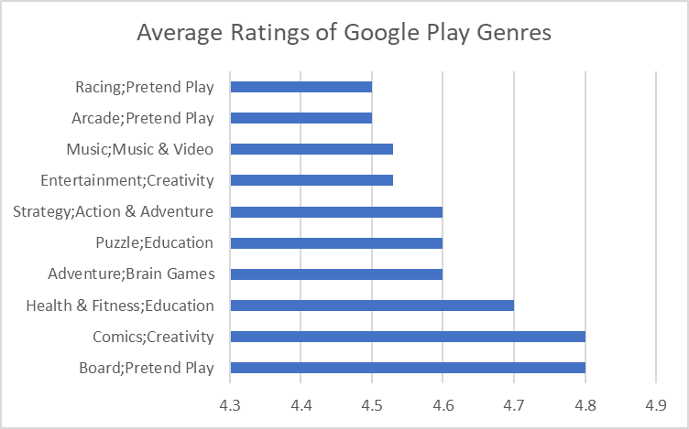

Slide 6
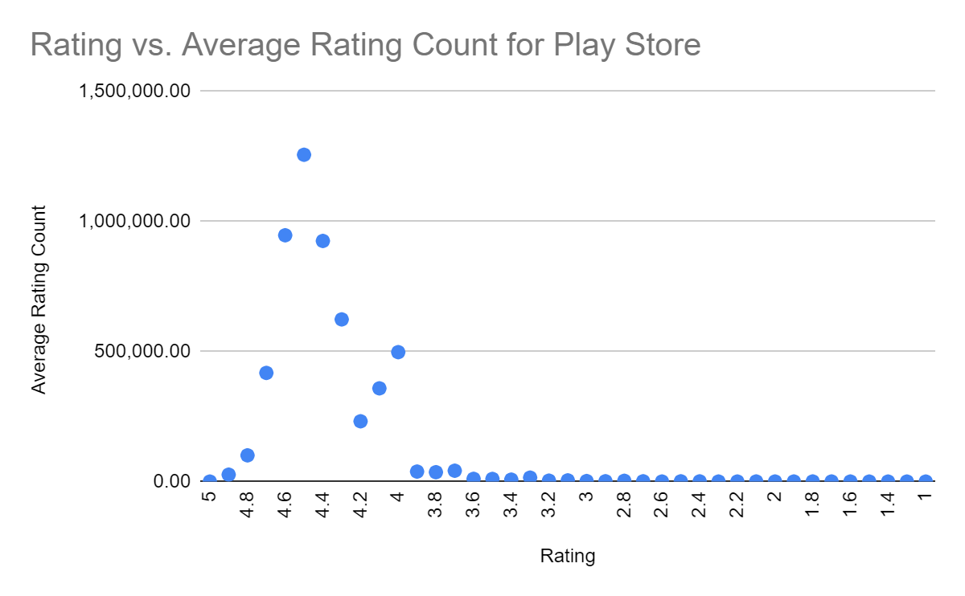

Slide 7
Top 10 recs

Slide 8
Profit Page

