Slide 1
Nashville Rock and Roll Marathon
Aaron Plunkett

Slide 2
Last 4 Years Half and Full Marathon Times
Formulas Used:
MIN(‘sheet_name’!times_column),
MAX(‘sheet_name'!times_column), MEDIAN(‘sheet_name'!times_column),
AVERAGE(‘sheet_name'!times_column)

Slide 3
Beating Oprah’s Marathon Time
 | 2016 | 2017 | 2018 | 2019
Beat Oprah | 1099 | 615 | 756 | 793
Lost to Oprah | 1853 | 1851 | 1344 | 1231
Percent Beat | 37.23% | 24.94% | 36.00% | 39.18%
Formulas Used:
COUNTIF(‘sheet_name'!times_column,"<04:29:20"),
MAX(‘sheet_name ‘!ID_column)-beat_oprah_count,
beat_oprah_count/MAX(‘sheet_name’!ID_column)

Slide 4
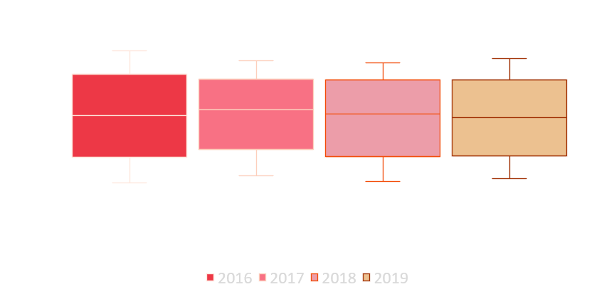
Quartile Full Marathon Finish Times
Formulas Used:
MIN(‘sheet_name'!times_column),
MAX(‘sheet_name ‘!times_column),
QUARTILE.EXC(‘sheet_name'!times_column,quartile_#)

Slide 5
Scott vs The World
 | 2016 | 2017 | 2018 | 2019
Scott | 2:25:42 | 2:40:25 | 2:28:16 | 2:34:59
2nd Place | 2:34:43 | 2:56:28 | 2:29:52 | 2:35:24
Difference | 0:09:01 | 0:16:03 | 0:01:36 | 0:00:25
Formulas Used:
VLOOKUP(MIN(‘sheet_name’!ID_column),’sheet_name’!full_data_range, #_of_cell_in_range_to_return),
VLOOKUP(MIN(‘sheet_name'!ID_column)+1,’sheet_name’!full_data_range , #_of_cell_in_range_to_return),
2nd_place_time – 1st_place_time

Slide 6
If You Aren’t Top 3, You’re Last
 | Top 3 Each Year |  | Unique Distinct Top 3 | Top 3 Placement Count |  | 2016 | 2017 | 2018 | 2019
2016 | Scott Wietecha |  | Scott Wietecha | 4 |  | 2:25:42 | 2:40:25 | 2:28:16 | 2:34:59
 | Brian Shelton |  | Brian Shelton | 1 |  | 2:34:43 | DNP | DNP | DNP
 | Christopher Capps |  | Christopher Capps | 1 |  | 2:38:43 | DNP | DNP | DNP
2017 | Scott Wietecha |  | Ryan Regnier | 1 |  | DNP | 2:56:28 | DNP | DNP
 | Ryan Regnier |  | Daniel Everett | 1 |  | DNP | 3:00:55 | DNP | DNP
 | Daniel Everett |  | Garang Madut | 1 |  | DNP | DNP | 2:29:52 | DNP
2018 | Scott Wietecha |  | Kevin Fink | 1 |  | DNP | DNP | 2:38:59 | DNP
 | Garang Madut |  | Jordan Wilson | 1 |  | DNP | DNP | DNP | 2:35:24
 | Kevin Fink |  | Steelton Flynn | 1 |  | DNP | DNP | DNP | 2:39:59
2019 | Scott Wietecha
 | Jordan Wilson
 | Steelton Flynn
Formulas Used:
FILTER(‘sheet_name’!name_range,('sheet_name’!ID_range<MIN(‘sheet_name’!ID_range)+3)*(‘sheet_name’!ID_range<>"")), UNIQUE(range_of_top_3), IFERROR(VLOOKUP(name_cell, ‘sheet_name’!name_and_time_range, #_of_cell_in_range_to_return,FALSE),"DNP")

Slide 7
Insights
Most people are slower than Oprah
2017 was an unusually bad year for finish times
Could have been a course change, but that happens almost yearly
2017 race was 10 degrees hotter than any time in the past decade¹
It’s only a matter of time before someone catches Scott Wietecha
Why did none of the other top 3 participate again?
50% of Chicago Marathon runners finishing <180 minutes are repeating the race²
Perhaps ask top finishers for feedback
Sources:
1) https://findmymarathon.com/weather-detail.php?zname=Rock%20n%20Roll%20Nashville%20Marathon&year= 2) https://medium.com/running-with-data/the-data-of-the-chicago-marathon-cd216a3601aa

