Slide 1

Market Map
Key
BF Business Finance CC Corporate Counsel CS Corporate Secretary
CW Compliance Week
FEI Fin. Exec. International IA Internal Auditor T&R Treasury & Risk
E Event
P Print
W Website
Target Audience
8,000 Audited Companies +1,000 Service Companies 9,000 x 15 employees
135,000 Potential Subscribers
Seniority
Target Audience
CFO
E | P | W
BF
E | P | W
Ethisphere
E | P | W
CW
E | P | W
IA
E | P | W
CC
E | P | W
T&R
P | W
FEI
E | P | W
CS
E | P | W
Finance
Senior Management
Executive Management
C-level & Board
Executive Management
Senior Management
Legal

Slide 2
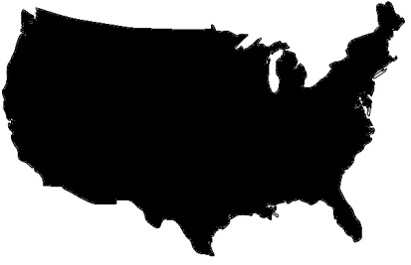
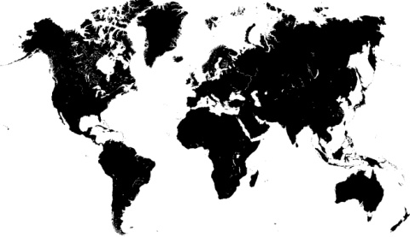
Audience | Subscriber Profile
The CW subscriber list has 344 Fortune 1000 accounts. The distribution is weighted toward the top-end: Penetration is greatest for the largest companies, and declines with company revenue.
We count 4,000 users within our F1K subscribing accounts
Approximately 12 users per multi account
Of the 12,000 active subscribers . . .
2,745 (23%) work for the Big Four: PwC, Deloitte, Ernst & Young, and KPMG
Job Function
20% Legal
22% Audit
12% Financial
16% Compliance & Governance
4% Ethics and Risk
1,120 Active Accounts
Fortune 1 – 250
Penetration |
49%
740 Single-Subs
380 Multi-Subs
Job Level
7% Board Member / C-Level
14% Executive Management
15% Senior Management
12,000 Users
Domestic | 88%
International| 12%
Single Multi
Average Tenure of Subscriber

Slide 3

Audience | Subscriber Profile
Karen Nelson
Chief Compliance Officer, AIG
Time working in corporate compliance: 18 Years
AIG has been a multi-user subscriber since 2004, contributing more than $40,000 in subscription revenue and $10,000 in event registrant revenue. The company recently sent two employees to Compliance Week’s annual conference and upgraded their subscription from 25 to 200 end-users.
Why is AIG such a long-term client? A compliant workplace requires access to—and an understanding of—the constantly evolving global regulations and standards to which public companies must adhere. Karen keeps informed through a variety of information sources, including trade magazines and websites, client alerts from outside counsel, the business sections of daily newspapers and individual columnists and bloggers.
Karen’s team is also a consumer of continuing education, and will typically earn credits from live events (two team members attended last year’s Compliance Week conference) and hosted webcasts.

