Slide 1
Creating a Multimodal Design Environment Using Speech and Sketching
Aaron Adler
Student Oxygen Workshop
September 12, 2003

Slide 2
Goals for System
Create a natural user interface for a design environment
Not command based
Create a natural multimodal UI by combining speech and sketching
Some things more easily expressed with sketching and speaking
Notes:
Not command based ie not “block here” type commands
(Say: want user to feel like they are interacting with another human)

Slide 3
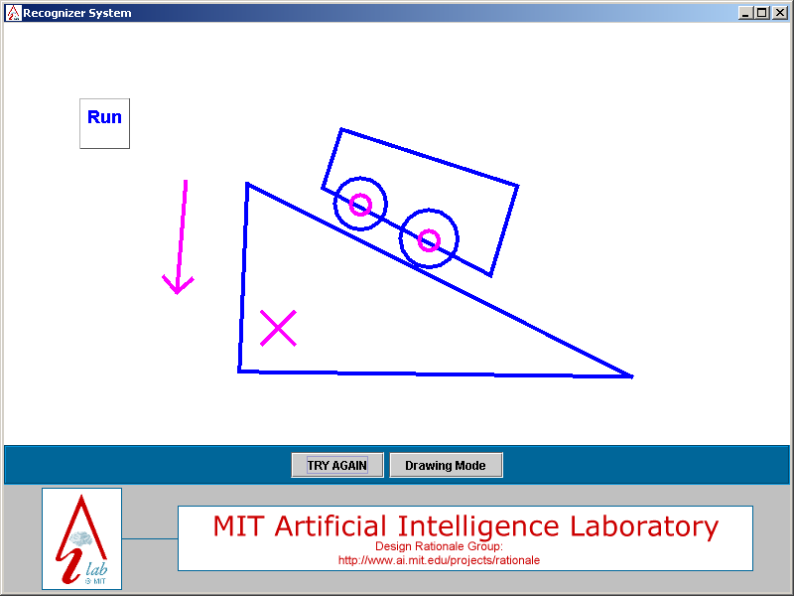
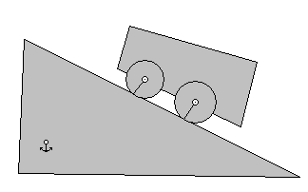
ASSIST
Natural sketching tool for mechanical engineering designs
Stylus-style input devices
Notes:
Christine’s work
Physics simulator – Working Model

Slide 4
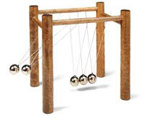
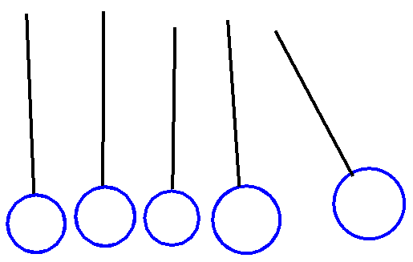
Motivating Example
Newton’s Cradle
Notes:
Explain why it’s hard
Explain how speech makes it easier
Describe how it’s supposed to work
Some things more easily expressed with sketching and speaking
Nearly elastic collision

Slide 5
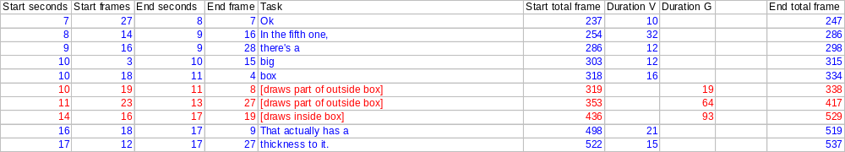
Natural Language
Need to determine how users naturally talk about the devices
Videotaped 6 users sketching 6 drawings at a non-interactive whiteboard
Transcribed data and produced time-stamped speech and sketching events
Notes:
Given hardcopy drawings. Sketch like talking to a small group of people, ie physics tutorial. Marks to indicate identical components and identical distances. Used these marks to avoid biasing subjects to any particular words.
BE CLEAR ABOUT CHART!

Slide 6
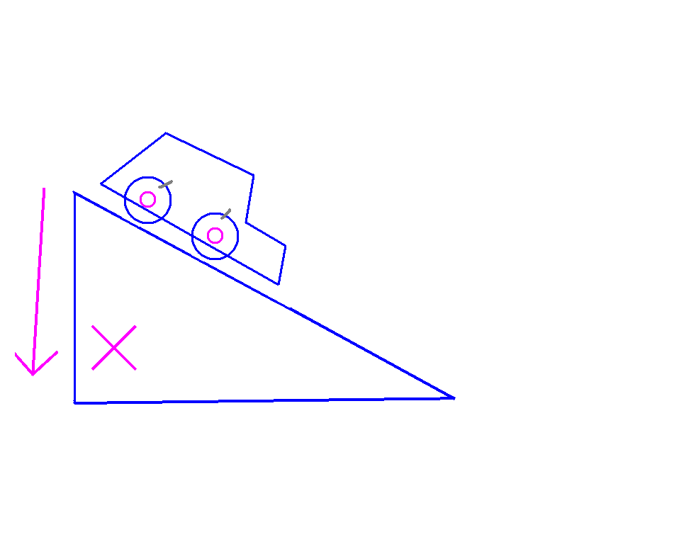
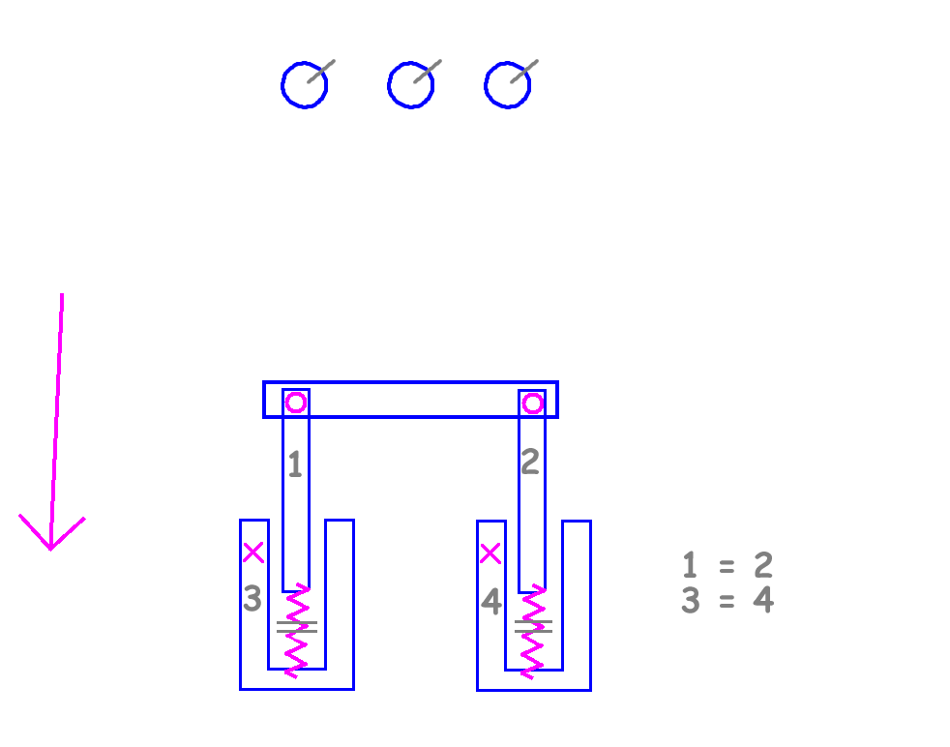
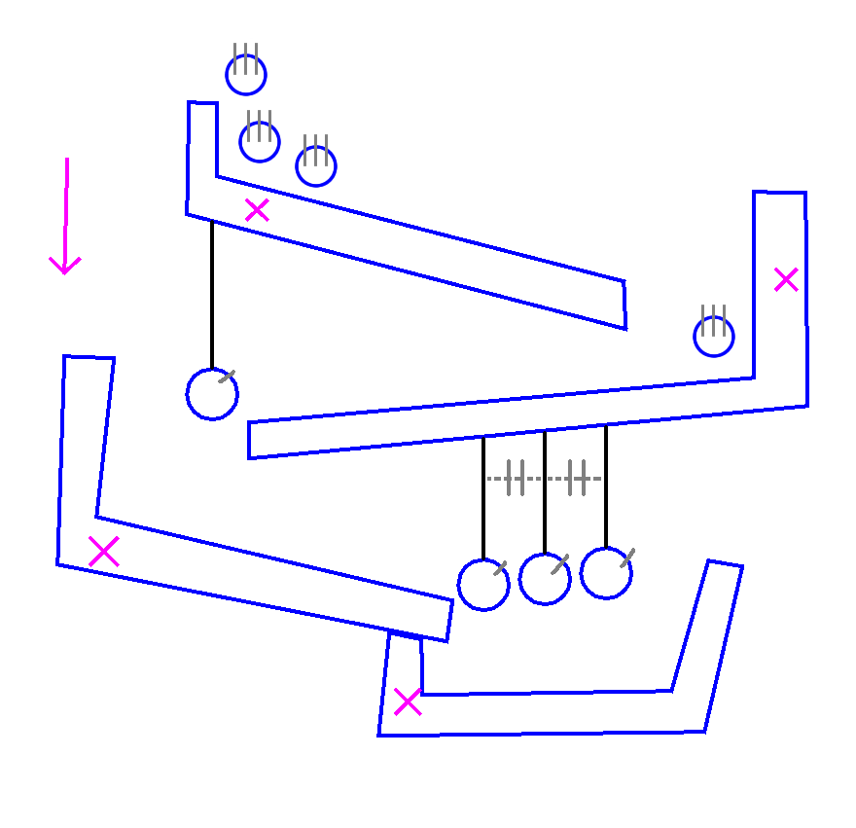
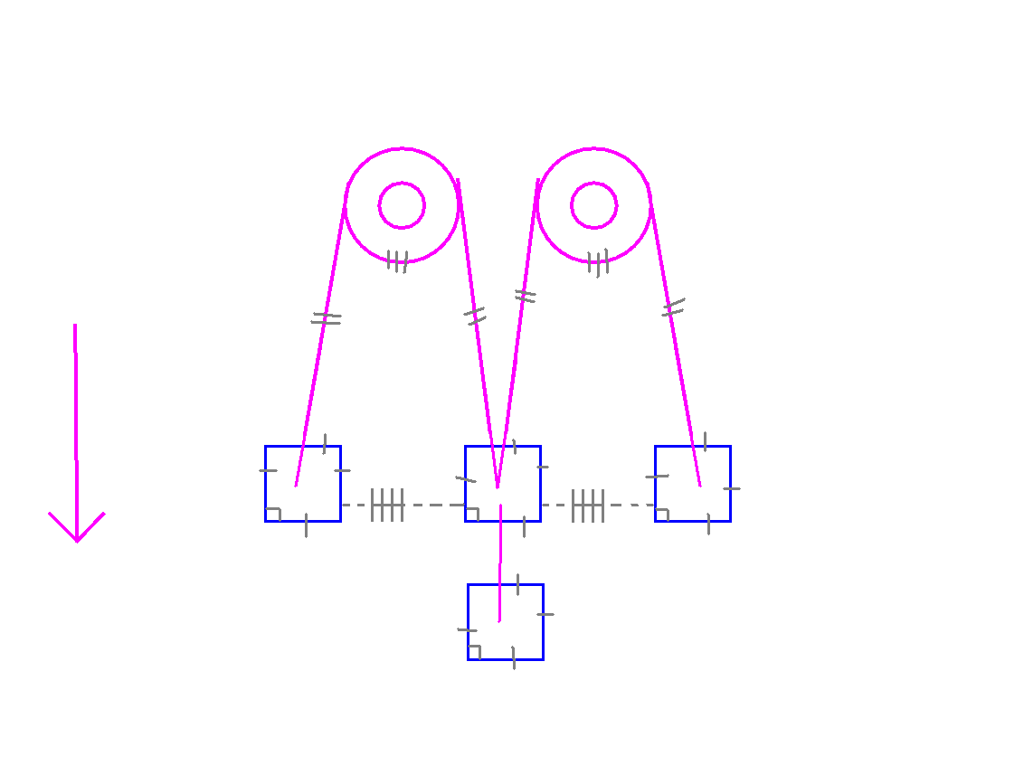
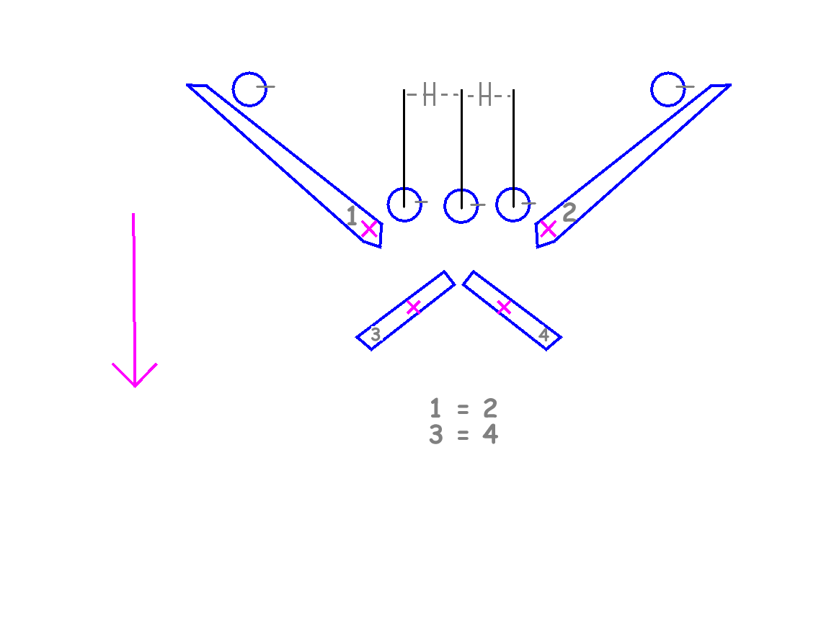
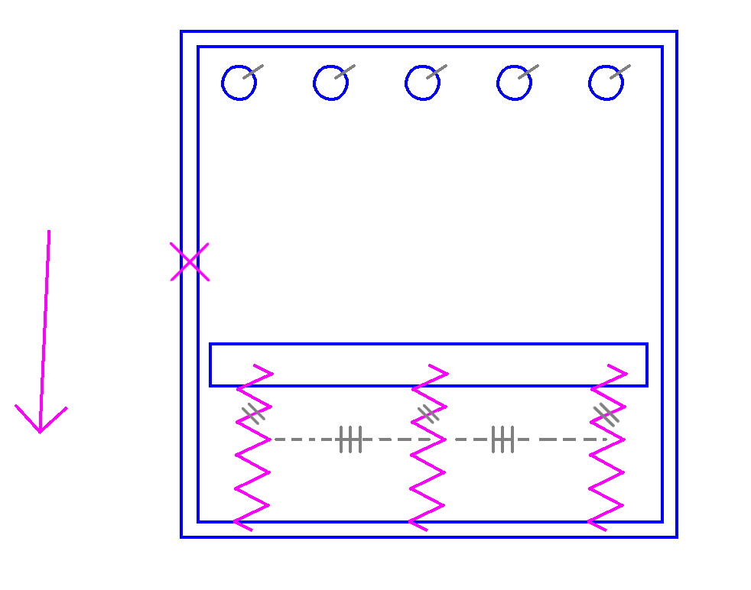

Slide 7
Video of People Sketching

Slide 8
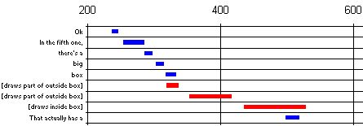
Segmenting the Data
Once the data was transcribed, graphs and charts were created to help analyze the data
Rules were created to encapsulate the knowledge about segmentation
Notes:
Users never talked about one thing and sketched another

Slide 9
Rules
Three types of rules
  Rules about the text of the speech
    Repeated words, mumbled words, key words
  Rules about gaps between speech and sketching
    Long pauses, timing of speech and sketching events
  Rules about groups of sketched items
    Similarly shaped objects
Notes:
Speech utterances that have repeated words are grouped. Phrases that have mumbled words are linked to the next phrase (people ahhh and umm when they are thinking about what comes next). Long pauses where there is not speech or sketching can indicate a new topic. The same shape repeated can indicate that the objects should be grouped together. And pieces of the same object should be grouped together. Higher level combining rules FORMING BREAK POINTS!!! Mention Jess! Used JESS (java expert system shell) if you want to know more about it – talk to me later

Slide 10
Some Key Words from the Speech
And
And then
Then
So
Next
Also mumbled words, ahhh and ummm, are important
We have
There is
We’ve got
It’s
I’ll

Slide 11
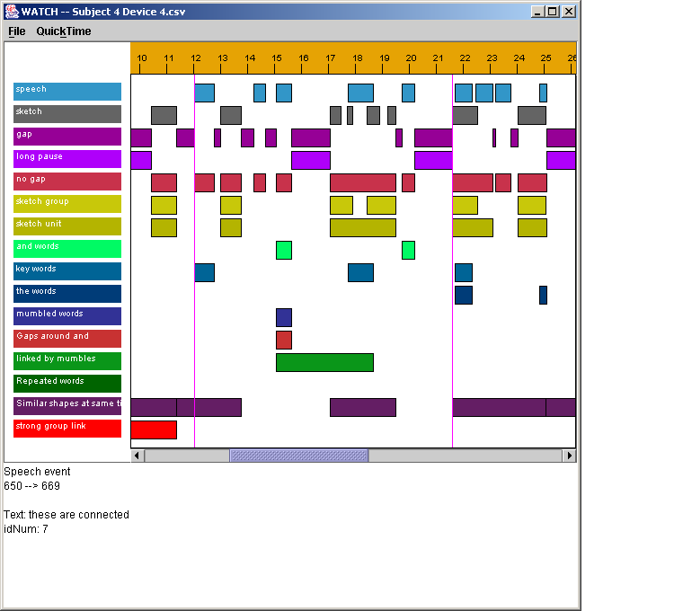
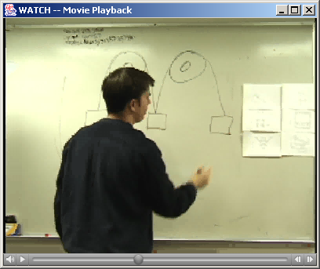
WATCH
Rule output too large, need tool to view relationships between rules
WATCH created to view output of rules as a timeline
Notes:
Can view clips of the movies that correspond to the rules

Slide 12
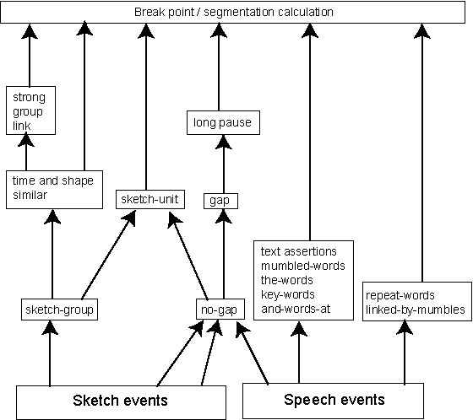
Rule Layout
Notes:
Simplify this at all?

Slide 13
Results
Software matched 24 of 29 break points
Found an additional 18 break points, 10 which were harmless, 7 were ambiguous, and 1 was wrong
Hand segmentation had all events to examine at once, spatial relationships
Rules kept general to avoid over fitting
Notes:
Why they are okay even if they look bad
Doesn’t have to be perfect, just serve as a basis for further analysis and recognition
Transcripts feed into the hand segmentations

Slide 14
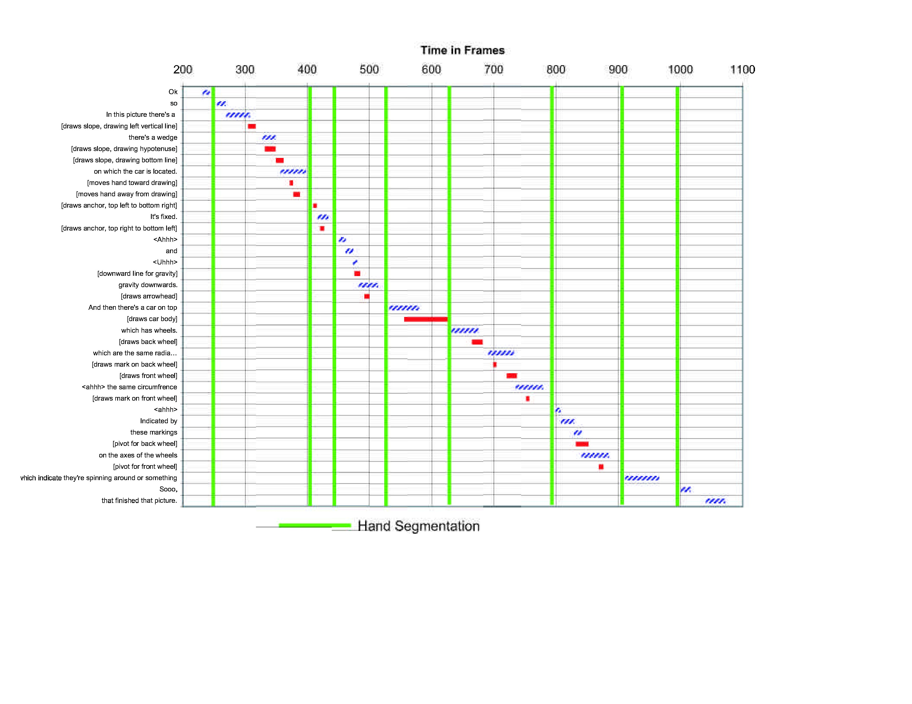

Slide 15
Harmless
“<hmm>”
“I’m puzzled as to how to indicate that”
<<extra break>>
“equal size of”
“the suspended balls”
Notes:
Many of the extra breaks that the computer had occurred at the beginning (because of a false long break) or sometimes, right after where the hand segmentation had the break point

Slide 16
Ambiguous
[draws top anchor]
“The slopes are fixed in position”
[draws middle ramp]
[draws middle anchor]
<<extra break>>
[draws bottom ramp]
“slope”

Slide 17
Speech System
Speech done by SLS Sapphire system
The transcribed speech was used as a basis to generate a recognizer (missing words were added)
Speaker independent
Open microphone, continuous recognition
Notes:
developed by the SLS group

Slide 18
ASSIST Modifications
ASSIST needed some modification to allow the system to manipulate the widgets
  Identical, touching, equally spaced functions
Also needed to send the current widgets to the rule system to be combined with the speech input
Notes:
Drawing direction – polygon drawing direction important – need to align the points of different widgets
Also needed to know what a pendulum was – namely a rod connected to a circular body

Slide 19
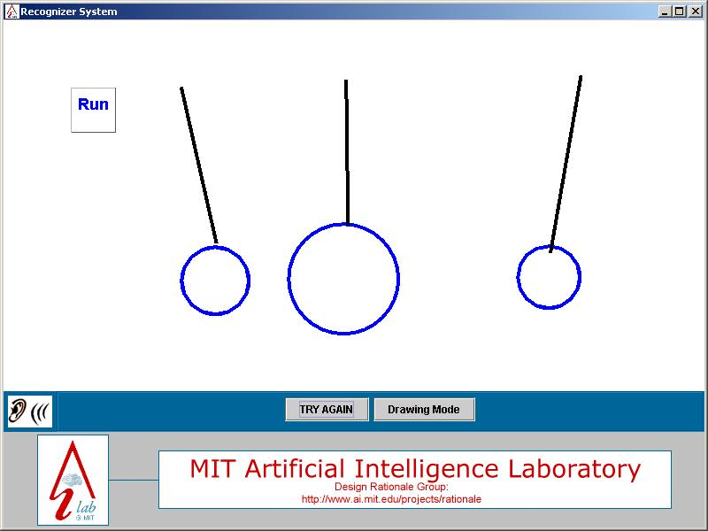
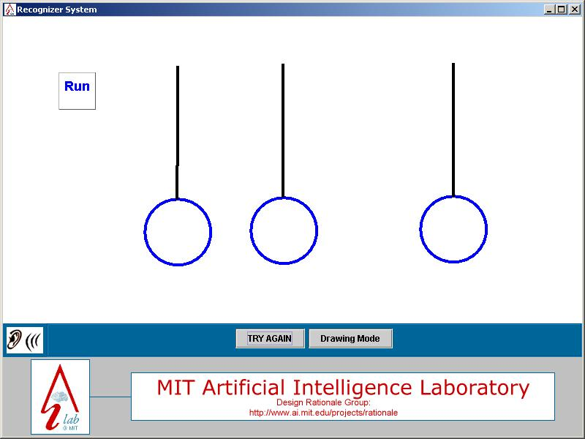
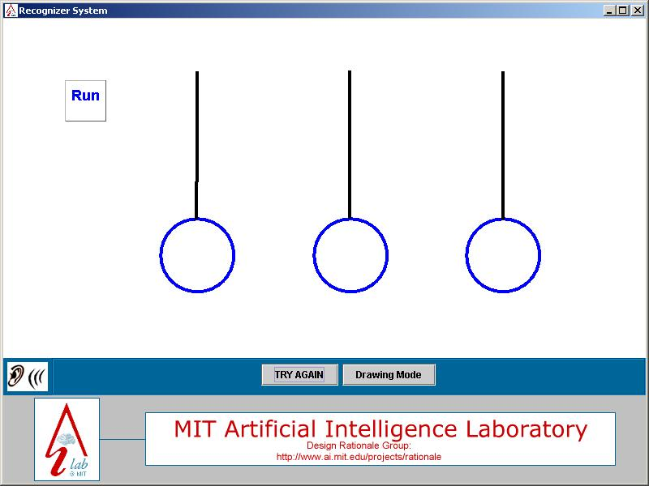
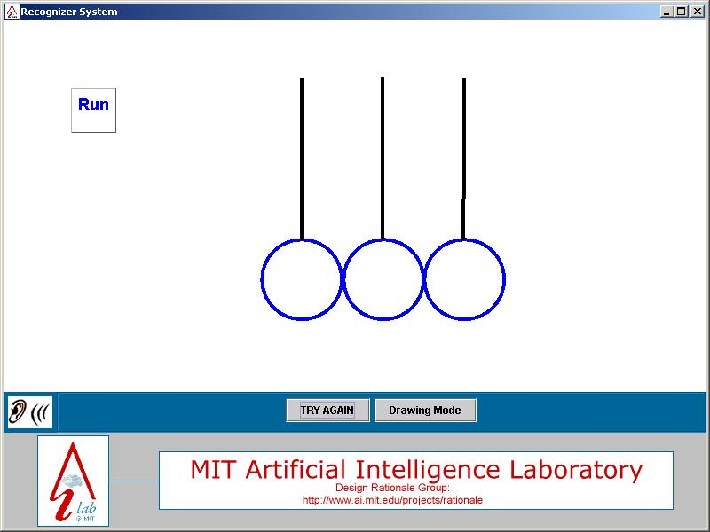
System Overview
Combines ASSIST and speech recognizer using the developed rules

Slide 20
Ambiguity
Need some inherent knowledge of pendulums, wheels, etc.
Car on ramp example
  “Two identical wheels”
    Need to know what a wheel is!
Where should this knowledge go?
  Top down view – speech triggers search for pendulum
Notes:
Which distance is the user talking about?

Slide 21
How it Finds the Pendulums
Based around nouns and adjectives
Speech like: “There are three identical touching pendulums.”
  Look though widgets around that time
  Extract pendulums from group of possible widgets
    Looking for an attached rod and circle
  If the speech and the sketch disagree about the number of pendulums, don’t do anything
Notes:
Describe what is done with the different words. pendulums is a key word, three and identical and touching. Look for numbers and words like “identical” then modify the nouns that were found appropriately

Slide 22
The System in Action

Slide 23
Related work
Work at OGI by Oviatt and Cohen
ASSISTANCE
Several other command-based systems
Notes:
Mike’s work is an additional phase that allows users to describe the behavior of the device, mine is a way to say things more easily with speech and sketching simultaneously
QuickSet from OGI
System from ATT Labs speech and pen interface to NY city subways and restaurants MATCH
nuSketch COA, from NorthWestern does again command based.

Slide 24
Future Work
Larger vocabulary
Using Joshua instead of JESS
Learning new vocabulary and corresponding sketches
Next generation Blackboard-based system

