Slide 1
Deep Learning Music Classifier
Applying deep learning to create a Spotify recommendation engine.
Aaron M. Del Giudice
Thinkful final capstone

Slide 2
Table of Contents
Data Wrangling | Get audio data and lyrics Clean and Parse Lyrics Feature Extraction (Bag-of-Words)
Model Spotify Data | Data preprocessing Supervised Model Selection Tuning Final Model
Feature Clustering | Cluster lyrics and audio features Model Comparison (clustering and supervised)
Contextual Embeddings | ELMo Embedding Vectors Model selection (neural network, supervised)
Recommendation Engine | Computing Similarity Generate recommendations

Slide 3

Context
It’s undeniable that music makes us feel something. Sad songs make us feel sad and upbeat songs make us feel happy.
Spotify hopes to be at the center of this. Giving users access to perfectly curated list of music tuned their specific preferences.
Spotify is so dedicated to this, their entire advertising model around it:
From Spotify: “Spotify for Brands gets your message in front of your audience as they stream what they love. ”
Spotify’s approach is to create associations between brands and users through music.
Listening to your playlist to pump you up for the day? Why not try Starbucks’ new energizing coffee drink?
Chilling out day at home while you listen to some mellow tunes? Why not check out Hulu’s moody new season of The Handmaid’s Tale?

Slide 4
Data
Audio data sourced from two user-generated Spotify playlists. lyric data sourced from LyricsGenius.
Data : | Samples: 2990 (3489 before data cleaning).
Audio Features: | 15 numerical features generated by Spotify: acousticness, danceability, duration, energy, explicit boolean, instrumentalness, key, liveness, loudness, mode, popularity, speechiness, tempo, time signature, valence
Lyrics: | Raw text retrieved from the LyricsGenius API. Generates 1024 NLP features and 1024 context embeddings vectors.
Target variable: | Binary value determined by source of the track (playlist A vs. playlist B) Distribution: Class A: 48.5284% Class B: 51.4716%

Slide 5
Data Wrangling

Slide 6
Spotify Data
Get song IDs from Spotify.
Use spotiPy wrapper for Spotify API and song IDs from two user-generated playlists (liked/disliked songs).
Playlists simulate user preference data Spotify collects for all users.
Assign target values to each song based on preference:
Song "likes" will be assigned target value of 0, and song "dislikes" will have a target value of 1.
Pass song IDs spotiPy and get audio features.
Features include numeric measures ("acousticness", "energy", "dancability") and musical qualities ("mode" and "tempo").
spotiPy can get additional information: "popularity" score (numeric), "explicit" boolean, artist and track names.

Slide 7
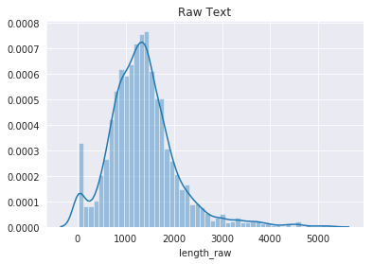
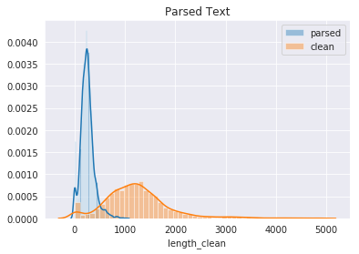
Lyric NLP
Get raw lyrics from LyricsGenius, then clean and parse lyrics with spaCy.
Remove music terminology (“radio edit”, “remix”, “featuring”, “recorded live at…” etc.)
Multiple versions of songs (covers, live recordings, etc)
LyricsGenius API occasionally returns very long text files instead of lyrics: (text from Angela's Ashes and Venus in Furs, script of Pulp Fiction)

Slide 8
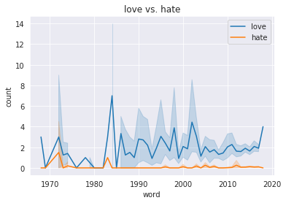
NLP Feature Extraction
Generate NLP features with spaCy.
Bag of Words method with the 1024 most common words.

Slide 9
As a Supervised Problem.

Slide 10
Modeling Process
Preprocess data
Model selection:
  L1/L2 Regularization, Decision Tree, K-Nearest Neighbors, Random Forest, Multilayer Perceptron, Gradient Boosting
Tune model parameters with grid search
Success metrics:
Accuracy score: 5-fold cross validated (cross_val_score)
Variance: 2x standard deviation of accuracy scores

Slide 11
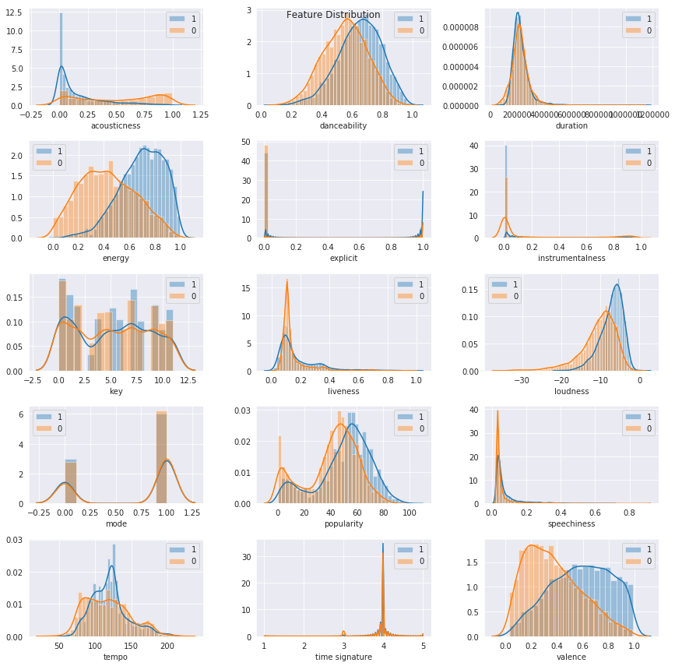
Audio Features
Acousticness - is the track acoustic?
Danceability - tempo, rhythm stability, beat strength, regularity.
Duration - in milliseconds.
Energy - dynamic range, perceived loudness, timbre, onset rate, general entropy.
Explicitness - boolean.
Instrumentalness - track contain vocals?
Key - estimated overall key of the track.
Liveness - presence of an audience.
Loudness - decibels averaged across entire track.
Mode - modality (major or minor).
Popularity - 0-100 score.
Speechiness - presence of spoken words.
Tempo - tempo in beats per minute.
Time Signature - how many beats in each bar.
Valence - positiveness conveyed by a track.

Slide 12
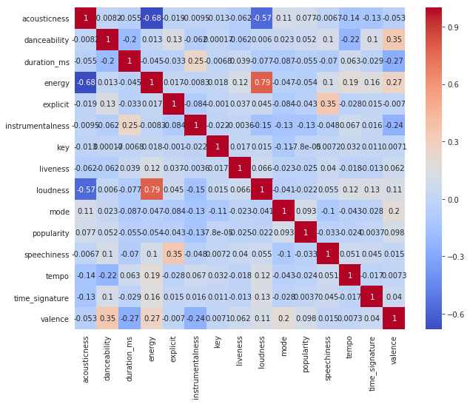
Audio Feature Preprocessing
Balanced Target classes:
  Class A: 48.5284%
  Class B: 51.4716%
Check for correlation
Scale data (scikit-learn MinMax scaler)

Slide 13
Model Selection
model: | Accuracy (CV) | Variance
L1 Regularization* | 0.8074 | +/- 0.1031
L2 Regularization* | 0.8051 | +/- 0.1168
Decision Tree | 0.7241 | +/- 0.074
K-Nearest Neighbors | 0.7613 | +/- 0.1148
Random Forest | 0.8187 | +/- 0.0865
Multilayer Perceptron* | 0.8127 | +/- 0.0825
Gradient Boosting | 0.8291 | +/- 0.0899
*Model did not converge

Slide 14
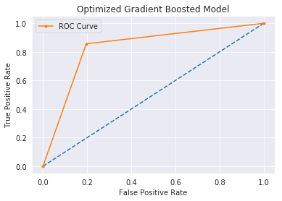
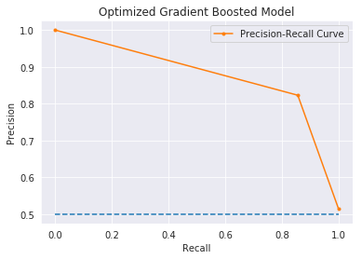
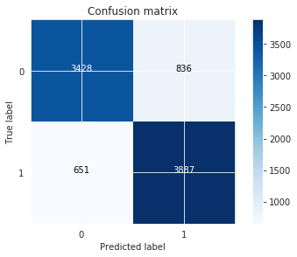
Optimized Model
Final model: Gradient boosting classifier
Accuracy (CV): 0.8117 +/- 0.0766
Recall: 90.48931771192281%
Precision: 90.84880636604774%
ROC-AUC: 0.898
F1 score: 0.895
AUC: 0.919
Average Precision: 0.848

Slide 15
As an Unsupervised Problem

Slide 16
Clustering Process
Cluster feature sets (Spotify audio features, lyric bag of words) to generate labels
Create new supervised model with cluster labels and target value
Compare performance to previous supervised model
Success metrics, clustering:
Adjusted Rand Index: five fold cross validation (cross_val_score and make_scorer)
Variance: 2x standard deviation of ARI
Success metrics, supervised:
Accuracy score: 5-fold cross validated (cross_val_score)
Variance: 2x standard deviation of accuracy scores

Slide 17
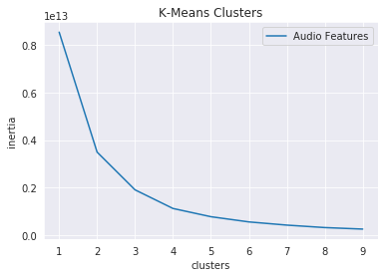
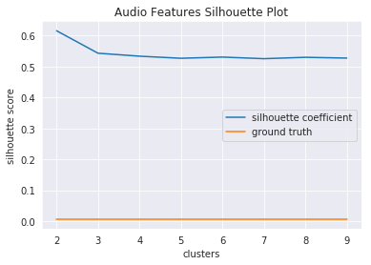
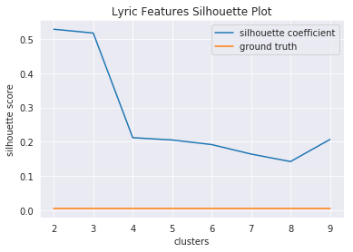
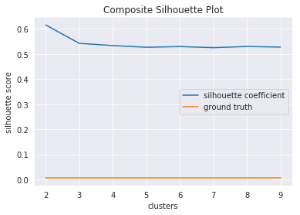
Clustering with K-Means
Clustering model: K-Means
Adjusted Rand Index (CV): 0.0035 +/- 0.0086 *
Optimal number of clusters
Inertia plot: 3 clusters
Silhouette plot: 2 clusters
Best feature set: audio data
* This is very poor.

Slide 18
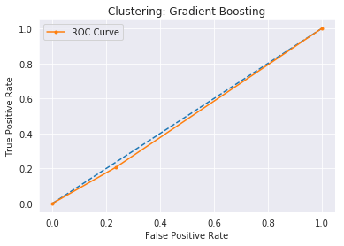
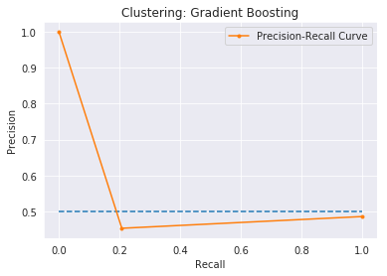
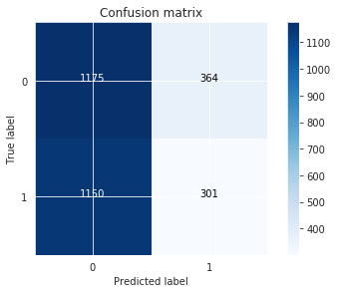
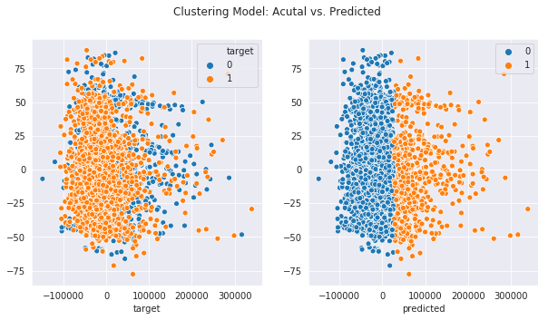
Results
Fit cluster labels to supervised model
Accuracy: 0.799 +/- 0.039
Recall: 20.744314266023434%
Precision: 50.53763440860215%
ROC-AUC: 0.485
F1 score: 0.284
AUC: 0.522
Average Precision: 0.479

Slide 19
As a Deep Learning Problem

Slide 20
Modeling Process
Get contextual embeddings from lyrics
1024 dimension embedding vectors generated with ELMo
Supervised model:
Gradient boosting classifier, 25% train/test split of data.
Neural network:
3-layer sequential model, dense layers
Success metrics:
Accuracy score: 5-fold cross validated (cross_val_score, StratifiedKFold)
Variance: 2x standard deviation of accuracy scores

Slide 21
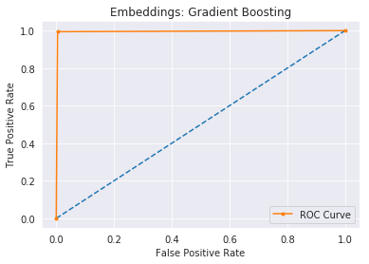
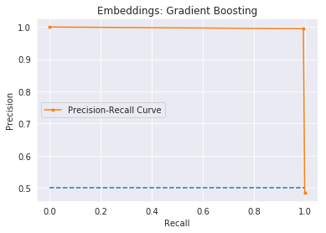
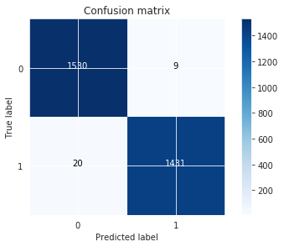
Contextual Embeddings
Supervised Model
Best Model: embeddings and audio data *
Accuracy (CV): 0.8448 +/- 0.159
Recall: 98.62164024810475%
Precision: 98.70967741935483%
ROC-AUC: 0.995
F1 score: 0.995
AUC: 0.996
Average Precision: 0.992
* Model exhibits very high
accuracy, but in reality this is
not practical. Likely due to
overfitting.
More data is required.

Slide 22
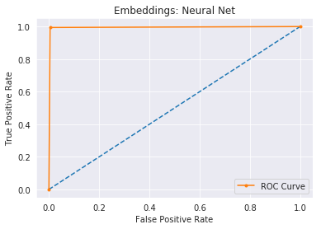
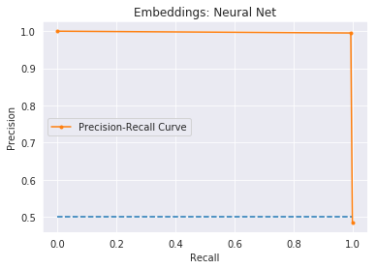

Contextual Embeddings
Neural Network
Best Model: embeddings *
Accuracy (CV): 0.8993 +/- 0.3846 **
Recall: 99.4486560992419%
Precision: 99.48051948051948%
ROC-AUC: 0.995
F1 score: 0.995
AUC: 0.996
Average Precision: 0.992
* Model exhibits VERY high
Accuracy, but in reality this is
not practical. Likely product of
Overfitting.
More data is required.
** Very high variance during
cross validation.

Slide 23
Recommendation Engine

Slide 24
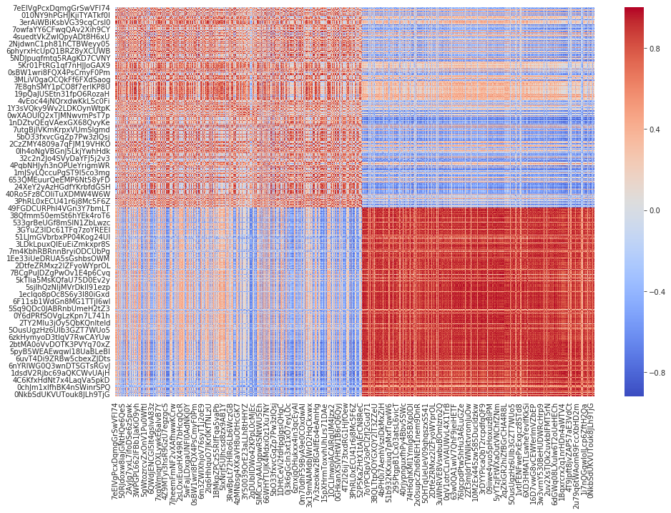
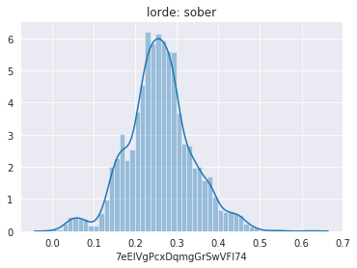
Compute Similarity
Audio Features
Create cosine similarity matrix of songs using audio features to determine song similarity.

Slide 25

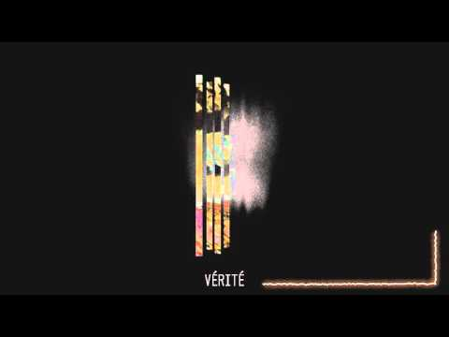


Compute Similarity
Audio Features
Seed artist, track: Lorde, Homemade Dynamite
Top similar:
([0]) Homemade Dynamite by Lorde
([0]) Underdressed by Vérité
([0]) Rather Be by Clean Bandit
([0]) Drinking About You by Ryan Oakes
([0]) Matches by Cash Cash

Slide 26



Compute Similarity
Audio Features
Seed artist, track: Lorde, Homemade Dynamite
Least Similar:
([0]) Swoon by Daydreamer
([1]) Fix by Chris Lane
([0]) Desolation Wilderness by Kodak To Graph
([1]) Loud And Heavy by Cody Jinks
([0]) Oculus by Luke Howard

Slide 27
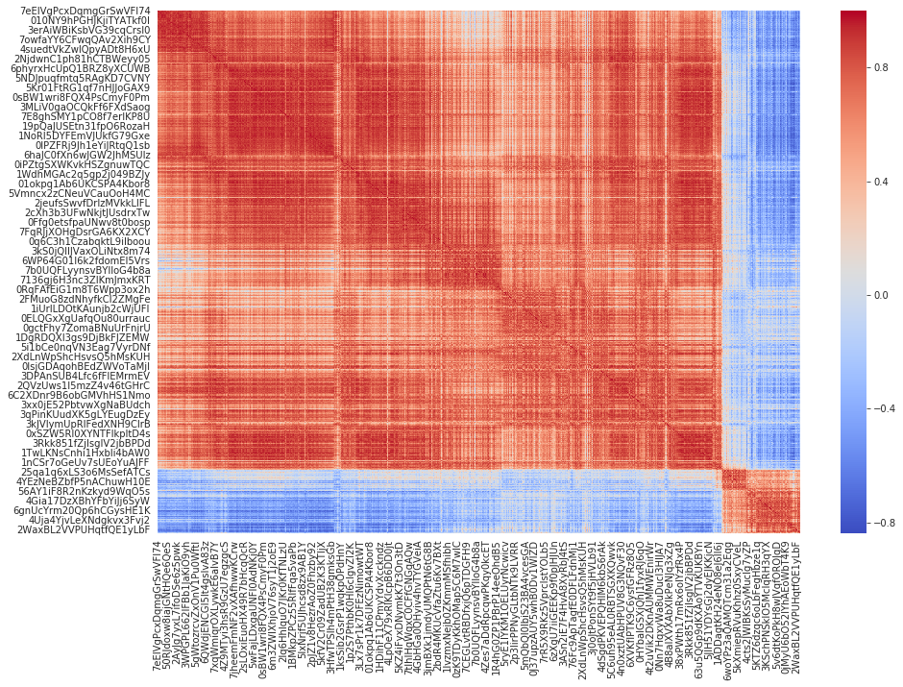
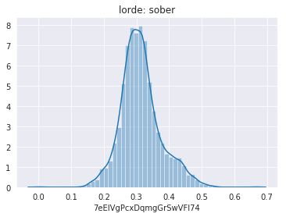
Compute Similarity
Embeddings
Create cosine similarity matrix of songs using contextual embeddings to determine song similarity.

Slide 28
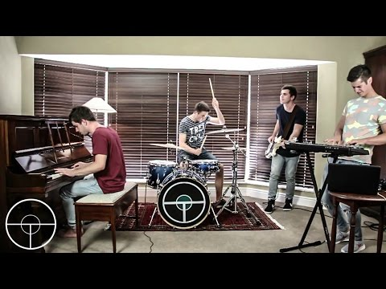


Compute Similarity
Embeddings
Seed artist, track: Lorde, Homemade Dynamite
Top similar:
([0]) Homemade Dynamite by Lorde
([0]) Heavy by Oh Wonder
([0]) Ride Away by Opposite The Other
([0]) Liability by Lorde
([0]) Waste by Oh Wonder

Slide 29

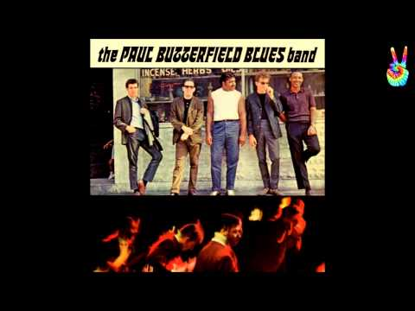
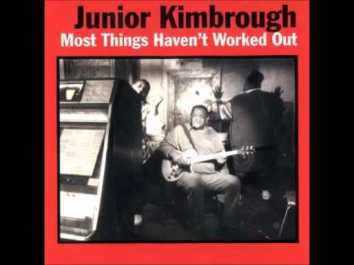
Compute Similarity
Embeddings
Seed artist, track: Lorde, Homemade Dynamite
Least Similar:
([1]) Kiss An Angel Good Mornin by Charley Pride
([1]) Most Things Haven’t Worked Out by Junior Kimbrough
([1]) If I Never Stop Loving You by David Kersh
([1]) Saint James Infirmary by Snooks Eaglin
([]) I Got My Mojo Working by The Paul Butterfield Blues Band

Slide 30
Takeaways
Supervised classifier of Spotify features had a good base accuracy rate: 0.8117 +/- 0.0766.
Clustering lyric and Spotify data was not an effective method of classifying music.
Deep learning approach with contextual embeddings and Spotify data was the most accurate: 0.8448 +/- 0.159.
Both ELMo generated contextual embeddings and Spotify data were an effective way of determining song similarity.
Business application: use optimized classifier to predict music preference (like/dislike), then rank music based on similarity of contextual embeddings of lyrics. This will allow Spotify to make better music recommendations to each user, creating more value in their product.

Slide 31
Further Work
Test model on more data without target labels:
Original data set was small and cleaning processes elminited a large portion of the data.
Getting more data was very time and labor intensive (API is limiting and data requires labeling target variable by hand)
More data would decrease likelihood of overfitting
Increase span of recommendation engine:
Music preference is not binary, it can depend on time, mood, what you’re doing, who you’re with.
Music data can be classified by genre, date, location, etc. Adding this feature to a classifier would greatly increase the specificity of the model.
Spotify classifies much of their music by mood (happy/excited vs. chill or sad). Adding this feature would dramatically increase the business value of this model.

Slide 32
Thank you.

