Slide 1
Git-hub
What is it for a biologist?

Slide 2

What is Github?
Website that hosts a git server
Git: Version control system that helps to keep track of programs and files
Based mainly on: https://swcarpentry.github.io/git-novice/

Slide 3
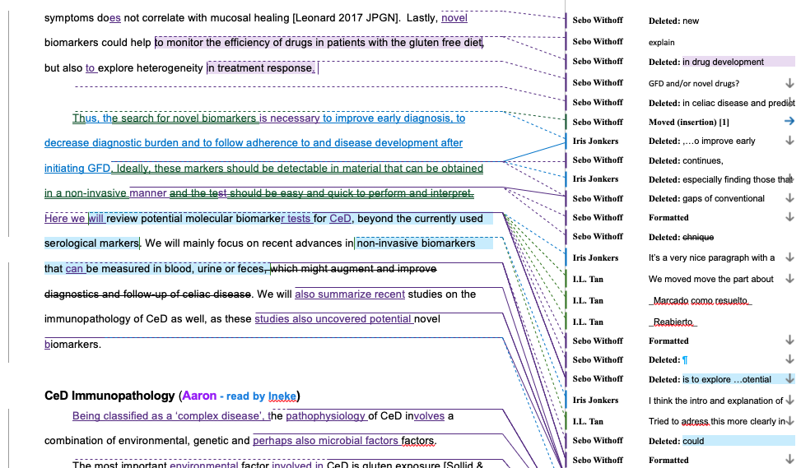
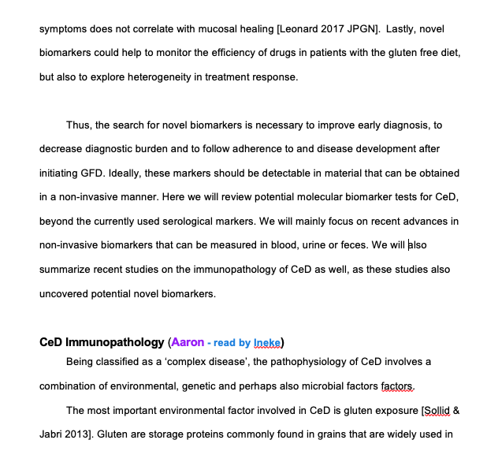
What is Github?
Website that hosts a git server
Git: Version control system that helps to keep track of programs and files
Based mainly on: https://swcarpentry.github.io/git-novice/

Slide 4
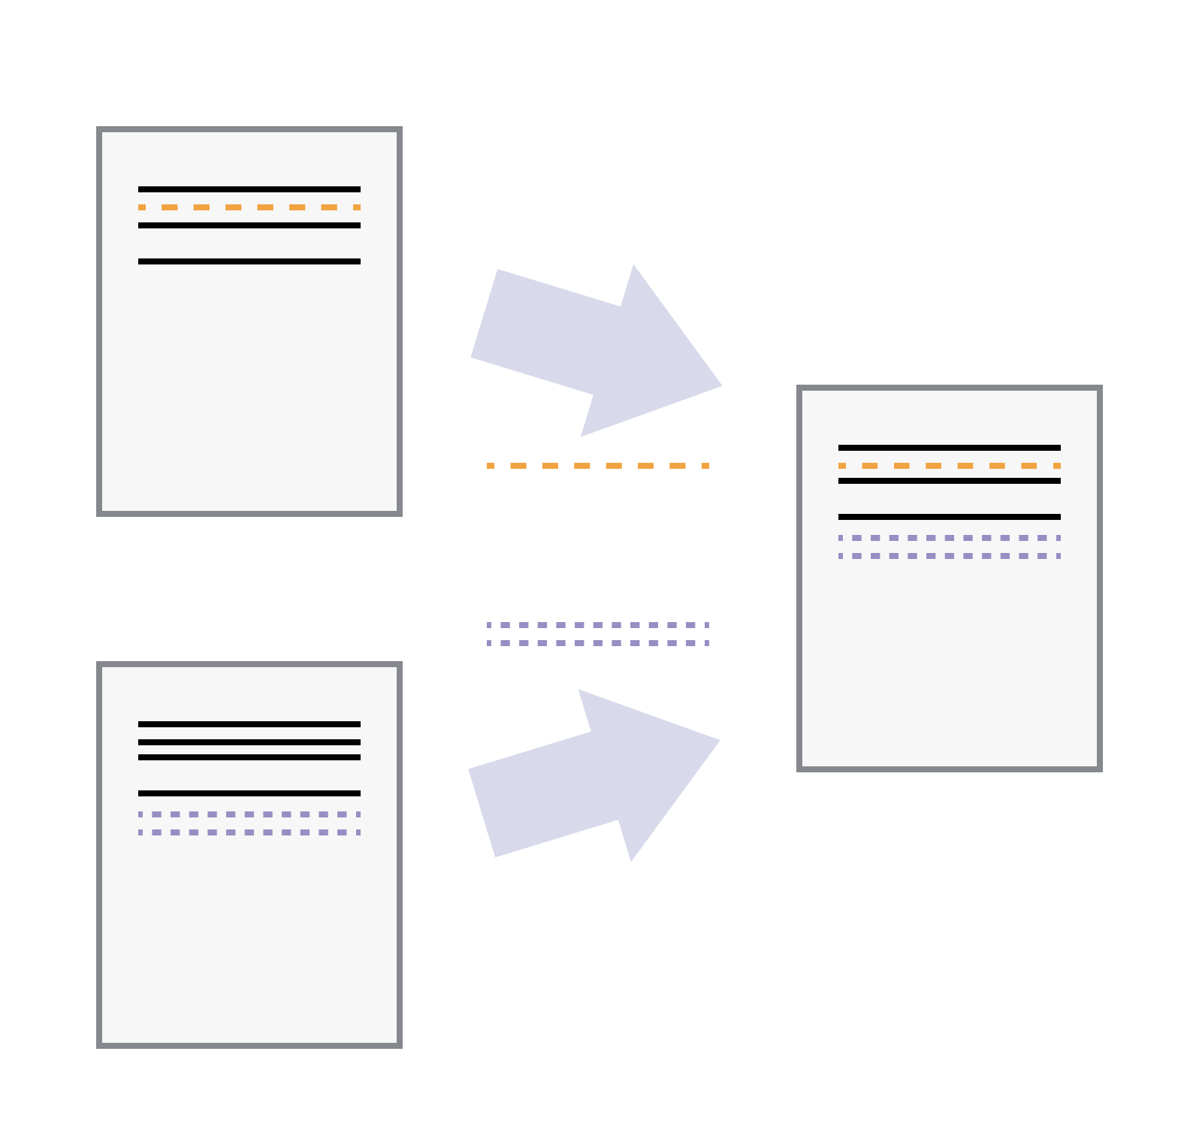
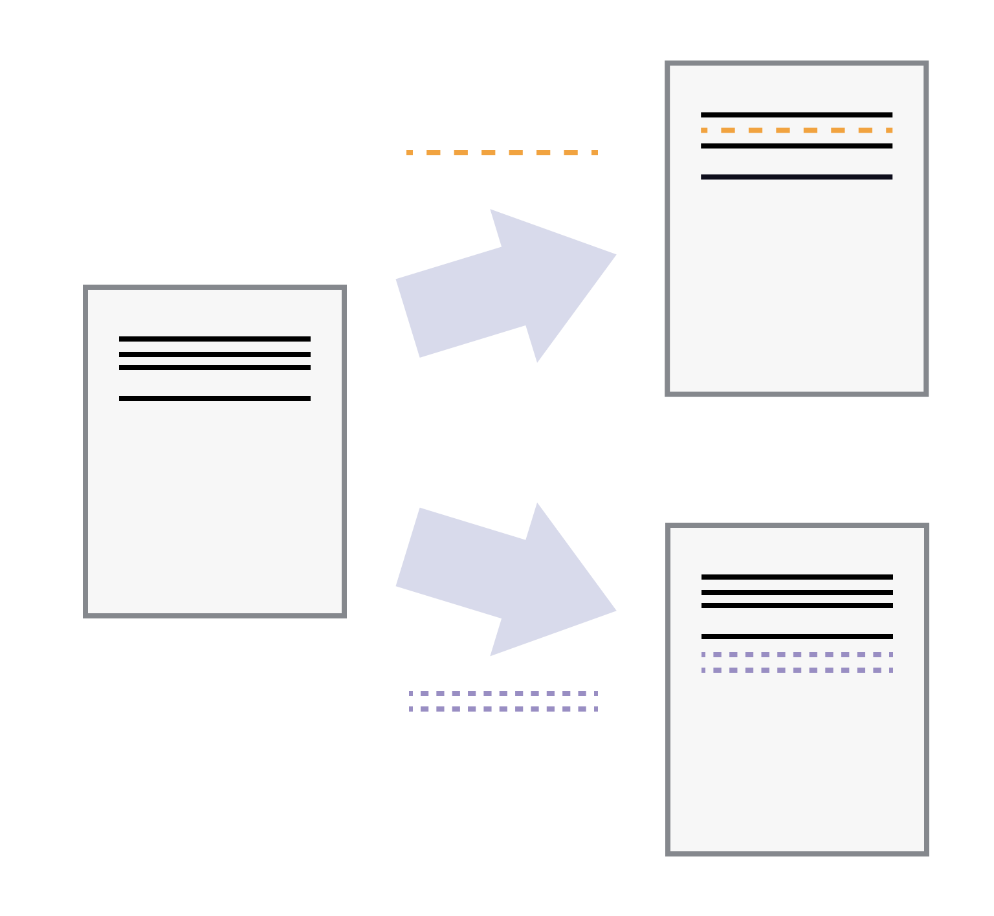
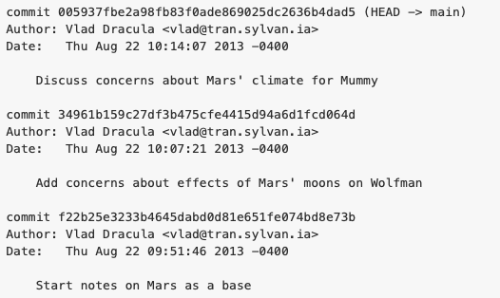
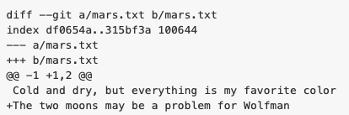
What is Github?
Website that hosts a git server
Git: Version control system that helps to keep track of programs and files
Iris
Sebo
Based mainly on: https://swcarpentry.github.io/git-novice/

Slide 5
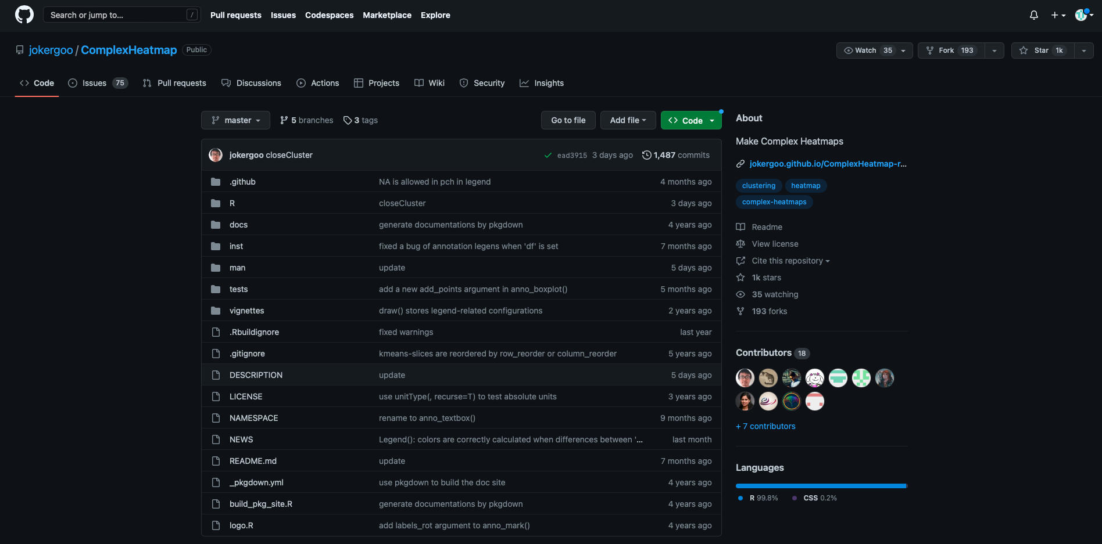
How does it look like?
https://github.com/jokergoo/ComplexHeatmap

Slide 6
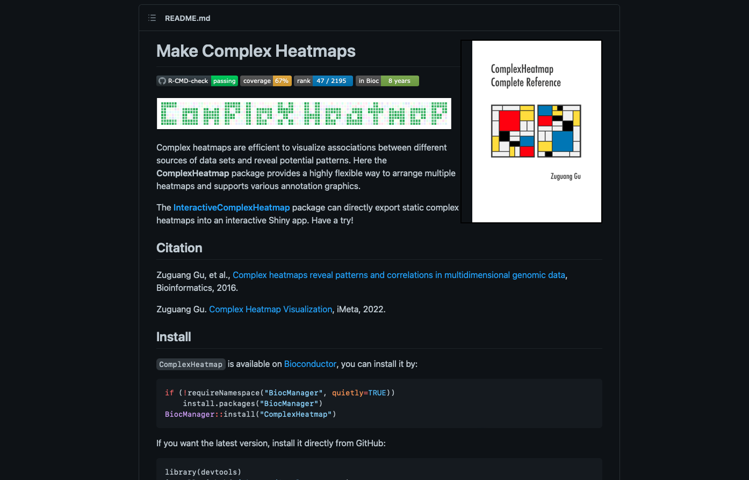
How does it look like?
https://github.com/jokergoo/ComplexHeatmap

Slide 7
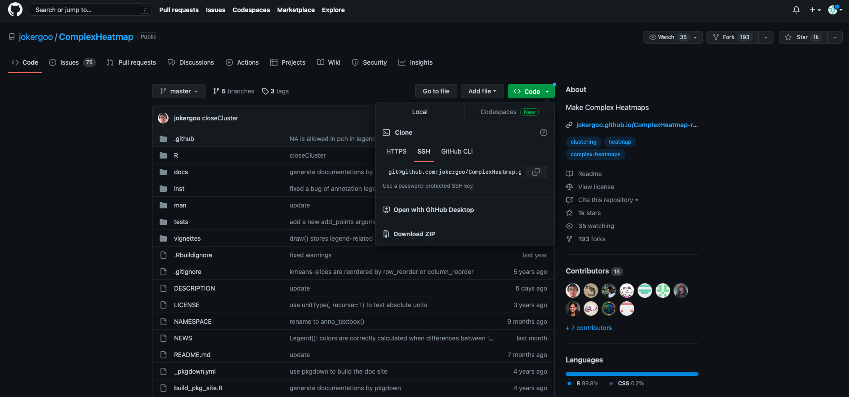
How does it look like?
https://github.com/jokergoo/ComplexHeatmap

Slide 8
How does it look like?
pull request
Cloud (Github)
Cloud (Fork to main)
pull
push
push
(clone)
pull
Project Creator
Collaborator or user

Slide 9
Why is version control important?
“Unlimited Undo”, with trackable control of changes
Collaboration
FAIR data: Findability, Accessibility, Interoperability and Reusability
Publishing
Open source code
Portfolio

Slide 10
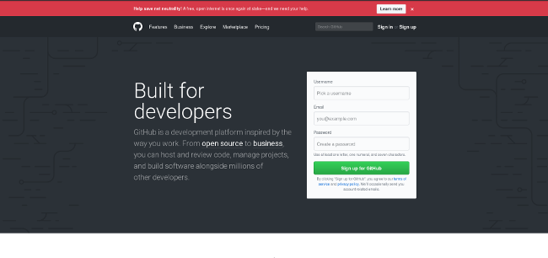
How can I start?
Open an account in Github
Setup your account in your local machine:
>git config --global user.name "Aaron Ramirez"
>git config --global user.email a.d.ramirez.sanchez@umcg.nl
In your local machine:
Go to your project folder
> git init
READY! (in your local machine)

Slide 11
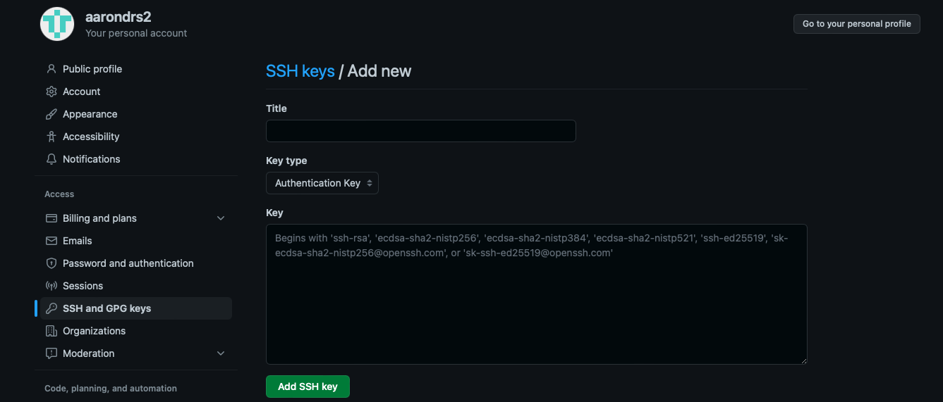
How do I connect my local project to cloud (remote directory)?
Get credentials of identification in your local machine (SSH keys)
ls -al ~/.ssh #To verify whether they already exist, otherwise check link
Share the PUBLIC key to Github
In Gihub, go to settings > SSH and GPG keys >> New SSH key
https://swcarpentry.github.io/git-novice/07-github/index.html

Slide 12
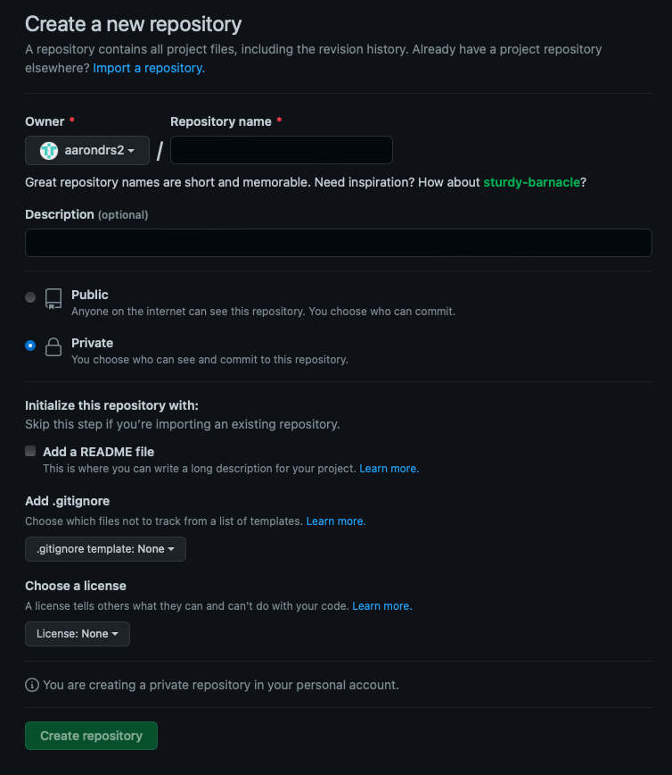
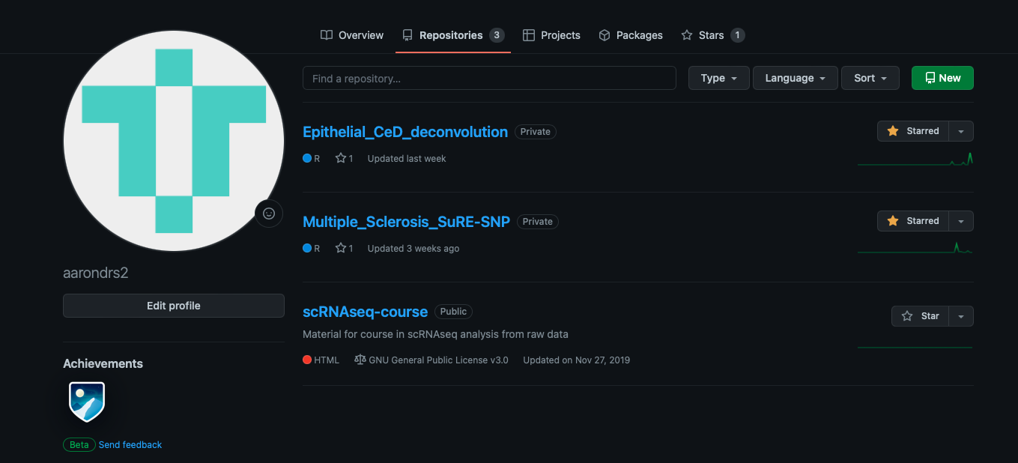
How do I connect my local project to cloud (remote directory)?
Start a new repository in your Github account

Slide 13
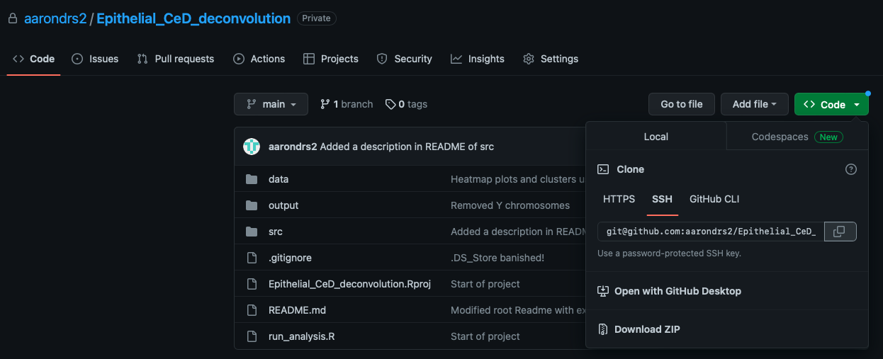
How do I connect my local project to cloud (remote directory)?
Get the link from your project (in SSH)

Slide 14
How do I connect my local project to cloud (remote directory)?
While in your local project folder:
git remote add origin git@github.com:aarondrs2/Epithelial_CeD_deconvolution.git
git branch -M main
git push -u origin main
Verify that it worked:
git remote –v

Slide 15
How to use the triforce?
Cloud (Github)
Working area
Stagging area
Repository
pull
push
add
commit
Project Creator

Slide 16
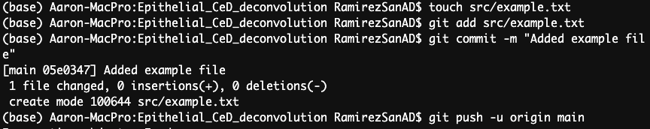
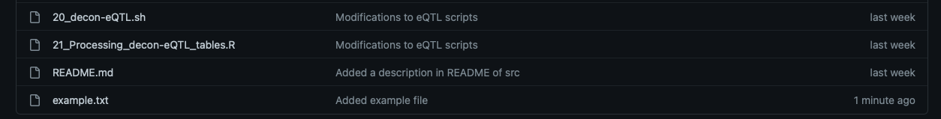
How to use the triforce?
#Adding a file
git add FILE
#Committing new changes
git commit -m “”
#Pushing new changes to GitHub
git push -u origin main

Slide 17
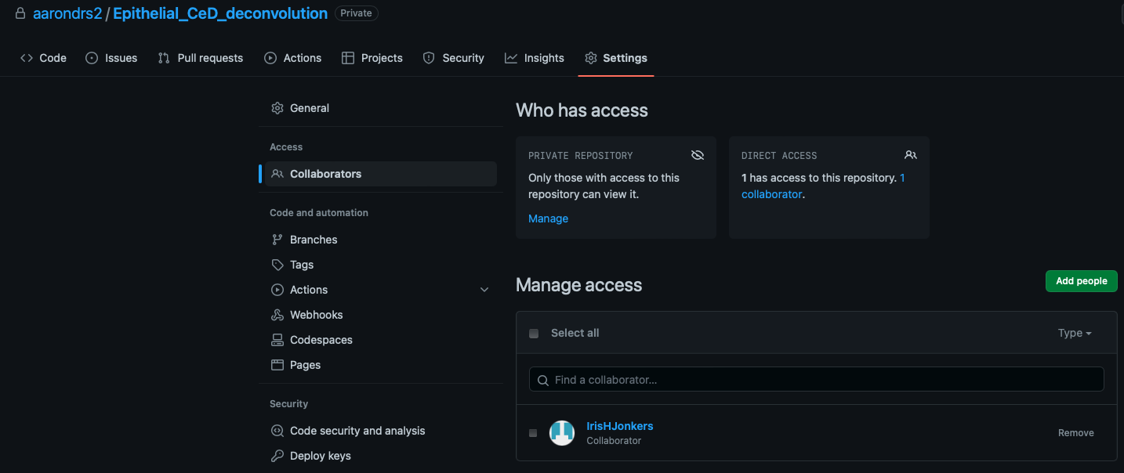
Collaborating?
Invite collaborator to your repository

Slide 18
Collaborating?
Now this person can modify/add/remove files
A good practice is that this person works in a “fork”, so main project person can review the code before commiting in the main repository
pull request
Cloud (Github)
Cloud (Fork to main)
push
(clone)
pull
Collaborator or user

Slide 19
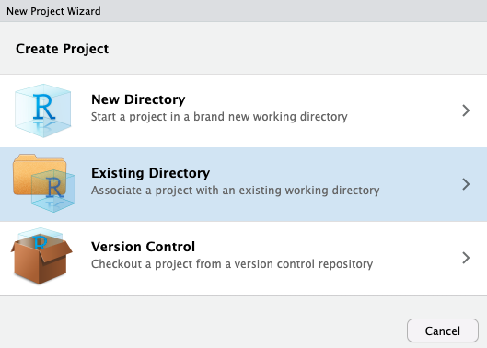
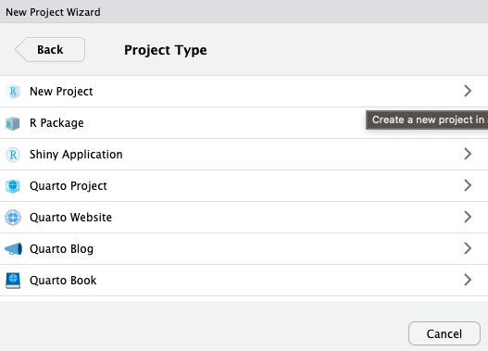
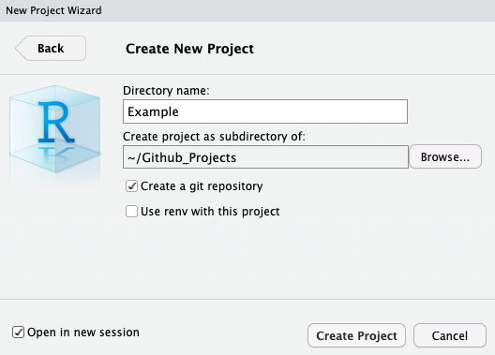
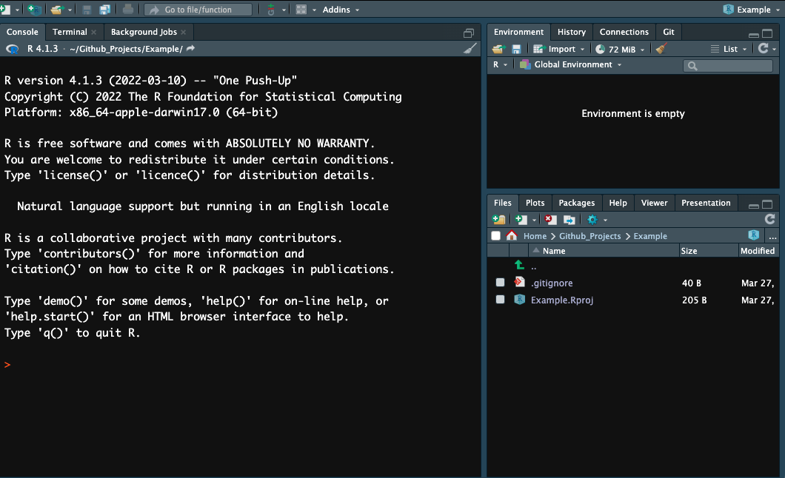
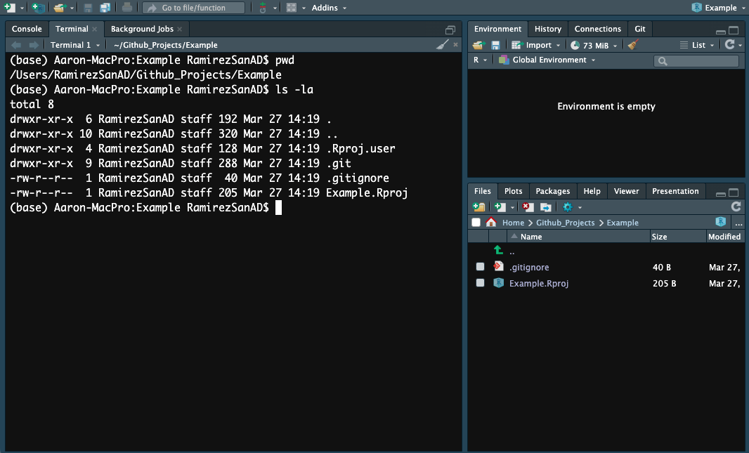
Rstudio and GitHub

Slide 20
Rstudio and GitHub
Follow the steps to setup a remote project
Start a new repository in Github (it should be empty)
Copy the link SSH
Run in the terminal of Rstudio (it should be in the project folder, verify with pwd)
git remote add origin git@github.com:aarondrs2/Example.git
READY

Slide 21
Not discussed here
How to ”undo” and go to a previous version
How to explore changes done to files (diff & checkout)
How to ignore files (.gitignore)
How to create an SSH key
How to set up a fork
How to review and accept “pull requests”
How to resolve conflicts
How to add licensing

Slide 22
Precautions
Better to add and commit small changes at the time
If working with someone else, always “pull” before starting, in order to have the most updated version
Use “forks” when collaborating with someone
You can ignore folders in your project, useful for results that are going to change a lot, since they may require from a lot of memory to keep track
ALWAYS DOBLE, TRIPLE CHECK YOU ARE NOT ADDING/COMMITING/PUSHING CONFIDENTIAL DATA (specially if you decided to add a full folder, using correctly .gitignore may also make it very hard to do this error)

Slide 23
Project organization
Data analysis

Slide 24
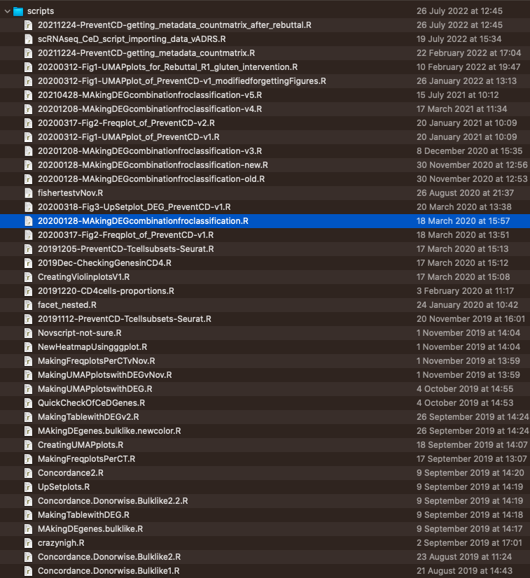
Why to organize project analysis?
Do you remember?
Know imagine this for a full project

Slide 25
How can I start?
With a clear outline of your project
What is your goal?
What is your input?
What is your final result?
How is your plan of analysis?
Are your analysis independent from each other?
Do you expect results to be dynamic?

Slide 26
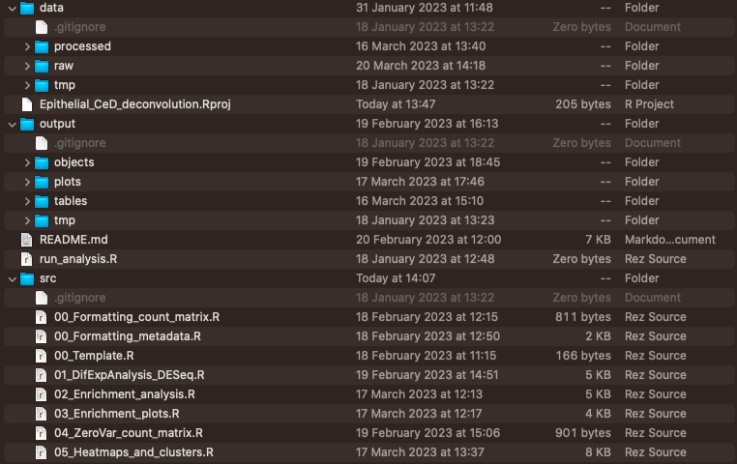
One example

Slide 27
How we can benefit?
Immunogenetics group

Slide 28
Work in private and release in public?
Start projects in private access with personal accounts
Once in submission process, clone repository or copy final freeze in a open repository belonging to the Group
This should be the repository used in the manuscript
New changes done should occur in Group repository (rebuttal, bug fixing)

