Slide 1
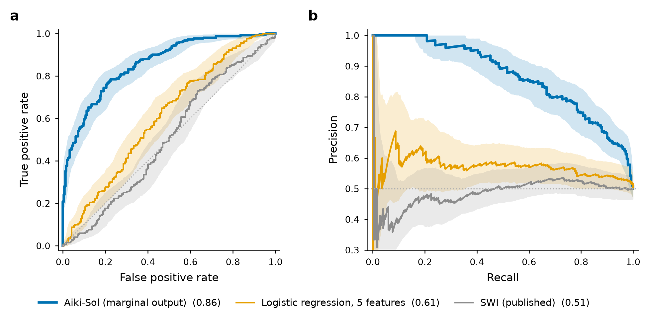
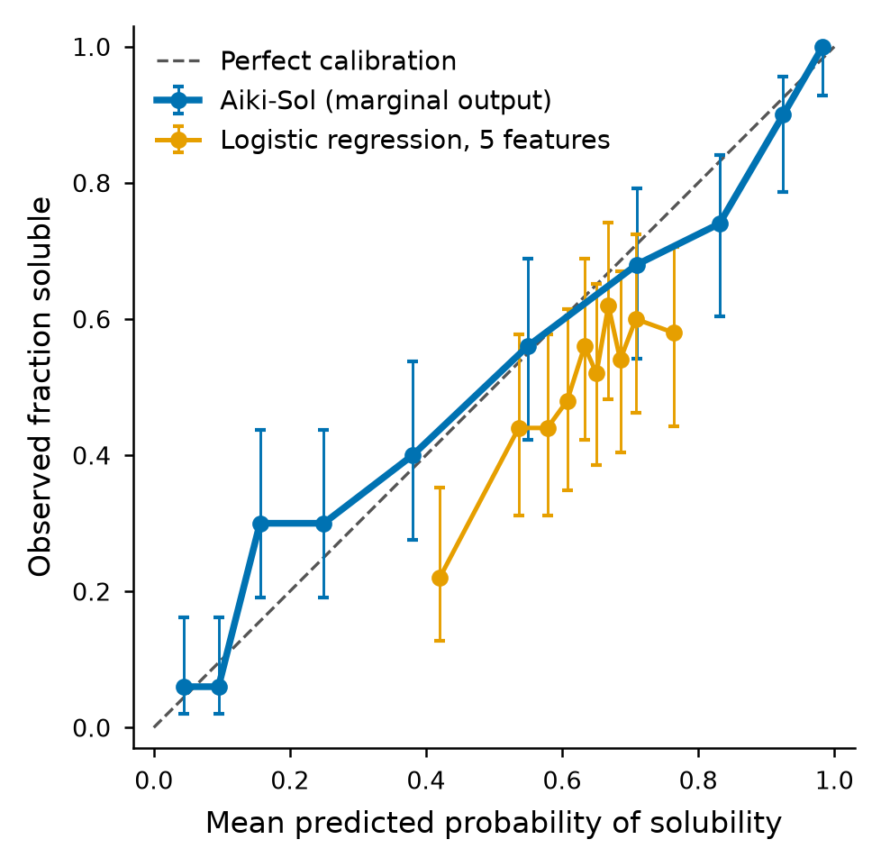
Aiki-Sol external check: AUROC 0.858 (0.823–0.891) on 500 test-split proteins; simple baselines 0.608 and 0.506
Left: ROC and precision–recall, shaded bands = 95% bootstrap intervals. Right: reliability of the marginal output (Brier 0.156).
Caveat: 64.8% of the 500 test sequences exactly match Aiki-Sol’s published training list, so 0.858 is an upper bound; AUROC is 0.741 (0.668–0.807) on the 176 sequences that do not match. One benchmark, N = 500.

