Slide 1


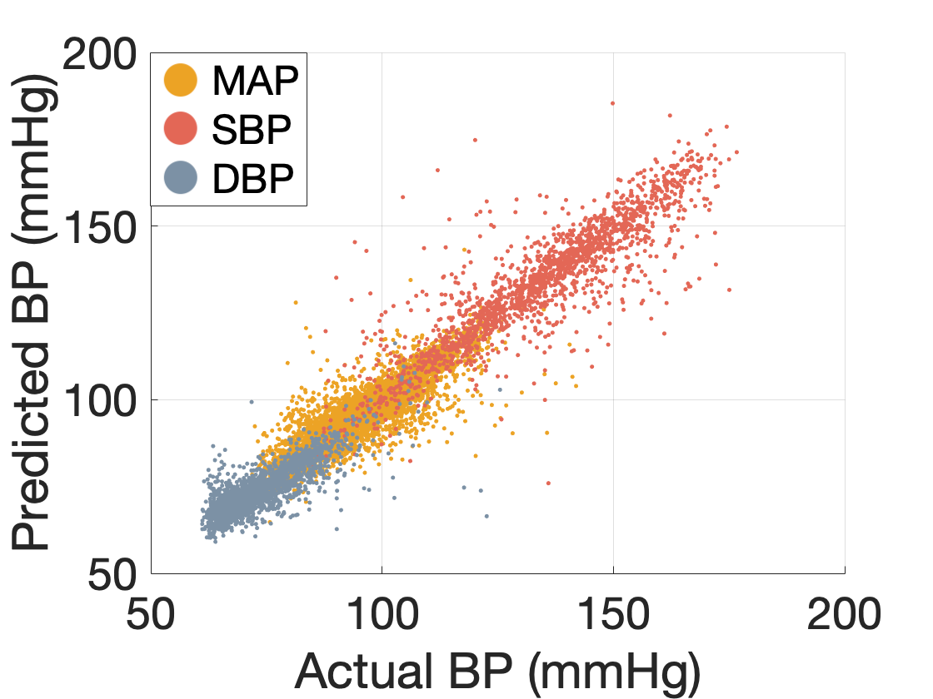
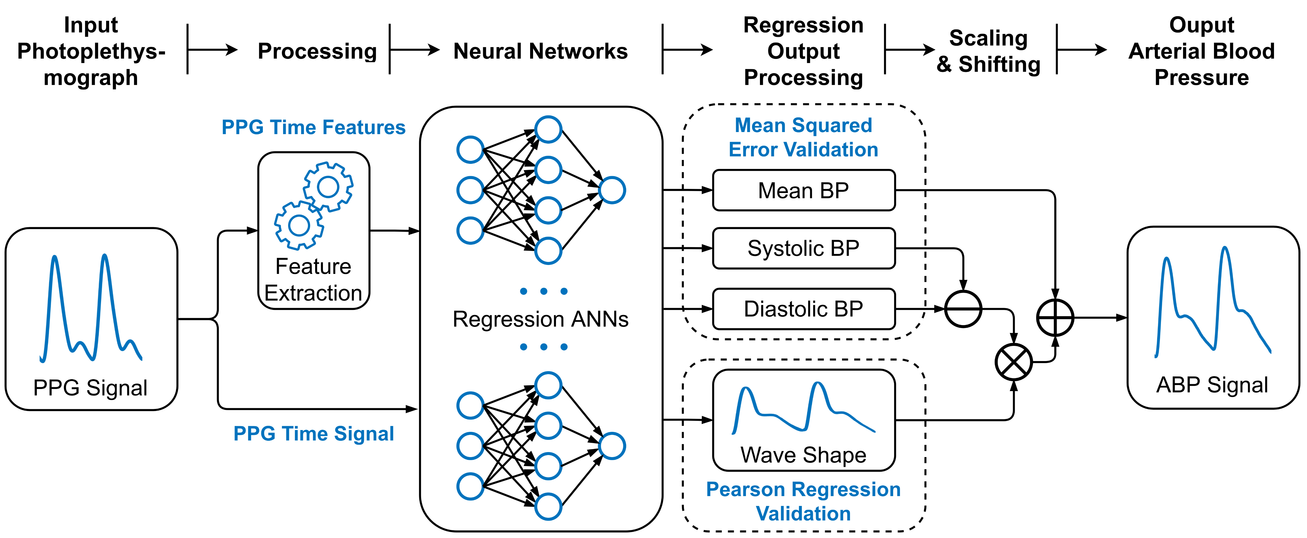
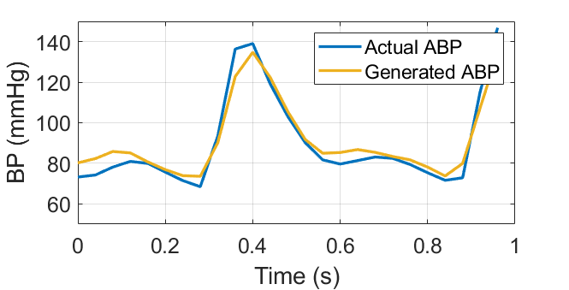
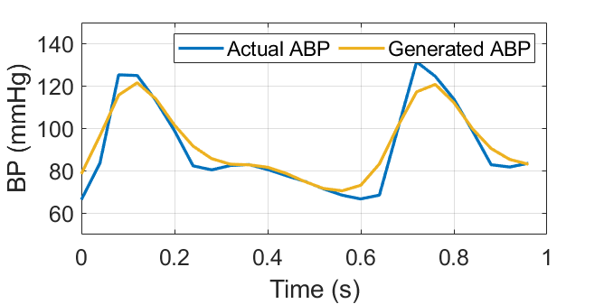
21P78
Smart Sensing of Blood Pressure Using Photoplethysmography
Aaron Fainman (1386259), Basheq Tarifi (1696842)
RESULTS
INTRODUCTION
The results for DBP, MAP and SBP are shown in Figure 2, with mean errors of 3.50, 3.65 and 5.32 mmHg respectively. The waveform is generated using a Pearson regression loss function to minimise errors in shape, yielding wave correlation of 86%. Examples of predicted and actual ABP waves are presented in Figure 3.
HARDWARE IMPLEMENTATION
Photoplethysmography (PPG) uses light to detect changes in blood volume [1]. The aim of this project is to investigate the use of PPG as a means of developing a cuffless, non-invasive blood pressure (BP) monitor.
A basic device using the MAX30102 pulse oximetry IC and an ESP32 MCU was developed, interfaced with a MATLAB application. ABP Waveforms are generated, however the PPG requires calibration to the standard of the training database.
METHODS
Figure 2: BP Prediction Results
Arterial BP (ABP) waveforms and PPG waveforms were extracted from 4064 patients from the MIMIC-III database [2].
Multiple neural network architectures were investigated. The final models consist of two sets of networks. Diastolic BP (DBP), Systolic BP (SBP) and Mean Arterial Pressure (MAP) are all predicted using separate 3-layered artificial neural networks (ANNs), with 512 nodes per layer.
A 3-layered ANN with 1024 nodes per layer is used to determine the wave shape. This wave shape is then shifted and scaled by the BP values. This process is shown in Figure 1.
CONCLUSION
The use of PPG can reliably predict blood pressure. Results have 86% correlation and meet standards for blood pressure measurement (<10mmHg error for over 85% of samples). However, accuracy should be improved for hypertensive patients.
Figure 1: System overview
REFERENCES
[1] G. Slapničar, N. Mlakar, and M. Luštrek, “Blood pressure estimation from photoplethys-mogram using a spectro-temporal deep neural network,” Sensors, vol. 19, no. 15, 2019.
[2] Moody, B., Moody, G., Villarroel, M., Clifford, G., & Silva, I. (2020). MIMIC-III Waveform Database (version 1.0). PhysioNet. https://doi.org/10.13026/c2607m.
Figure 3: Actual vs Generated BP

