Slide 1
A Gamified and Multiplayer-Networked Discrete Simulation
for Cellular Automata
Mentoring Faculty: Dr. Adel Elmaghraby
Student: Aaron Fox
University of Louisville Spring 2021

Slide 2
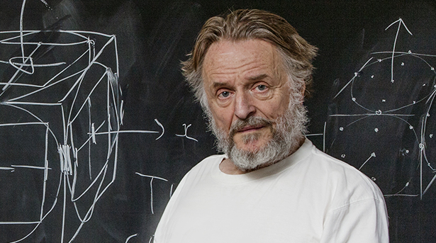
Introduction
Task: Design a networked-multiplayer, interactive and playable cellular automata simulation.
Inspiration: The late John Conway’s Game of Life, a discrete and Turing complete “zero-player” simulation, so called because a user sets the initial configuration and then only watches the simulation progress.
Playable Simulation Link: http://www.aaronfox.me/game_of_life
Repository Link: https://github.com/aaronfox/Multiplayer-Game-of-Life
This project was made in honor of the late John Conway, who passed away in 2020 as an early victim of COVID-19.

Slide 3
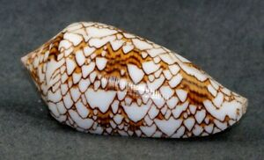
System Description
Why is this project needed? Several of the zero-player Game of Life simulations are on the web, but there is a clear lack of truly n-player networked versions. This version of the game can provide further research and applications to biology, chemistry, physics, and beyond than the original version of the simulation. (Plus, it can serve as a fun and educational game for those who otherwise would have no interest in mathematical simulations.)
This sea snail’s cone pattern can be simulated using cellular automata [1].

Slide 4
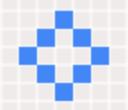
System Requirements
Requirements of this system include:
Ability for multiple players to access a grid of cells to simulate variable rules of the Game of Life
Each player can click on empty cells to outline the cells they would like to place, and they can place their cells by clicking a button.
A five-second server timer keeps the clients in sync for each discrete step in the simulation.
Players can see all other player’s living cells which are defined in random colors.
A UI is provided to give the each user the most up-to-date information of their alive cells, cells left to place, and a link to the rules.

Slide 5

Core Rules of Game of Life
The simplified rules of the game of life are:
that any living cell with two or three neighbors moves onto the next level (at the right population)
that any dead cell with three neighbors at the prior discrete step will become living in the next step (also at the right population), and
that all the other cells not fitting with the first two rules become dead if not already by either underpopulation or overpopulation.
These rules are applied at every discrete step and each player is alerted of every other player’s and their next step in the simulation.

Slide 6
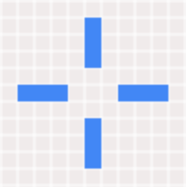






Tools Used for Development
Some of the tools and languages used to develop this system are:
NodeJS and Express.js for the backend server communication and network hosting logic.
WebSockets for real-time bidirectional communication between clients and the server.
Phaser game framework used with the JavaScript language for the core game logic.
HTML5 and CSS for Visual UI.
Heroku for hosting the web application over the Internet.

Slide 7
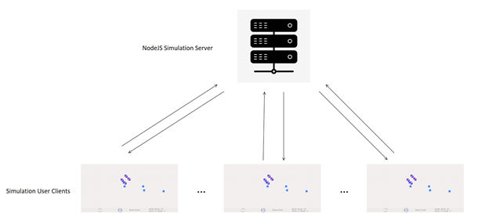
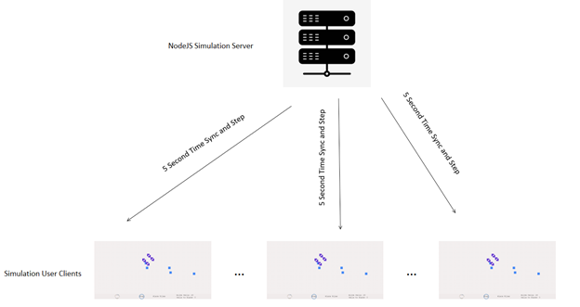
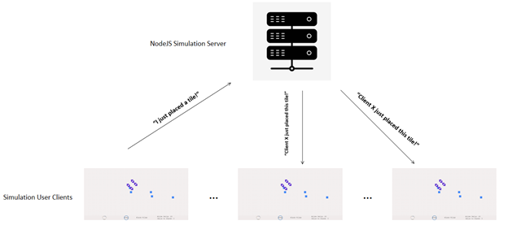
System Design Diagrams
For networking between each client and server, the client-server architecture is used to allow n clients to join and send and receive information from the main simulation server hosted by Heroku. Some examples of the information transfers can be seen in this slide.
Overarching client-server architecture of the simulation
Unidirectional time synchronization messages sent for every 5-second step.
Example of a player communicating their cell/tile placements to other clients.

Slide 8

Design Constraints
Some constraints of this systems are:
Economical: Heroku’s free dyno was used for their cloud hosting platform. This limits the capacity of the current client-server architecture and the number of users that can play at one time. This could be improved on a paid dyno to improve the capacities and the processing power of the server.
Technical: Given the nature of the slower processing time of JavaScript (when compared with C or C++, for example), a lot of time and thought had to be given to the data structures and algorithms used to optimize the performance at each discrete step to improve performance, speed, and communication.
Temporal: The JavaScript language and the Phaser game framework were chosen for their ability to rapidly prototype and develop this project. Given a larger time budget than a semester, a language and framework combination such as Unity and C#, Godot and C++, or Unreal Engine and C++ could have been used to improve overall performance and capabilities of the system.

Slide 9

Software Implementation
There are three main components to the design, deployment, and appearance of this network simulation. The relevant files are server.js, game.js, and index.html.
Server.js controls the backend networking aspect of the simulation between all the clients and itself as well as the time synchronization and discrete stepping across all clients.
It is implemented using NodeJS for the backend JavaScript environment for ease of hosting in Heroku.
Uses WebSockets for real-time client-server communication.
Uses Express.js for communicating with the other files and routing to index.html.
Communicates every time a cell’s placement is changed in one client’s simulation with all the other clients.

Slide 10

Software Implementation Continued
Game.js contains the game logic and actions involved in the gamified simulation.
Uses the Phaser game framework for abstracting away the displaying of the UI and coordinating the game logic.
Communicates with the HTML canvas for displaying the visuals to each user.
Uses WebSockets and listens for communication from server.js at all times.
Emits changes from each client to server.js so that it can alert all other clients of changes.
Takes in input information from the user via mouse, touchscreen, trackpad, or any other means of input.
Implements the core logic of the Game of Life in the applyGoLRules function.
Index.js provides the visual appearance of the game itself and displays the UI via HTML canvas to the user.

Slide 11

Contributions to Society
The study of cellular automata has many different applications for research into real-life systems in chemistry, physics, biology, computer science, and beyond. Many patterns in nature, for example, can be almost exactly simulated using cellular automata.
Along with the previously mentioned sea snail shell simulation, Other applications of study of cellular automata include cephalopods, botanical stomas, and fibroblasts [2][3][4].
Besides this already striking research applications into simulating nature, many other aspects of the natural sciences can also be explored, including chemistry, physics, computer science, and communication [5][6][7].
Much of the previous research into these applications has been focused on the zero-player simulations and have not considered multiplayer networked simulations.
Studying this version of cellular automata will allow for even more applications and possibilities to be explored by researchers and curious minds.

Slide 12
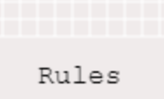
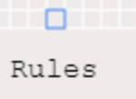

How to Play the Simulation
The ruleset as copied from the in-game manual looks like:
The rules of the game are pretty straight forward. To place a potential cell, click on any cell that you do not already have a cell on to place it. For example, a cell that looks like
will become
If you click on the empty cell above the ‘L’ in rules. A cell outlined in blue will mean that you have a potential cell placement. Notice how this reduces the number of cells you have to place in the UI to 11, as seen in the UI below:
This indicates the number of cells that you may place at a time. You begin with 12, and you will get one more cell to place every 5 steps as long as the sum of the potential tiles to place plus the outlined cells does not exceed 12.

Slide 13
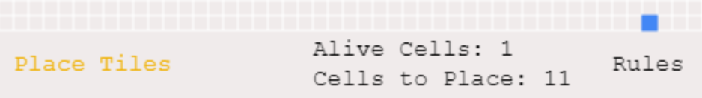
How to Play the Simulation Continued
Click the ‘Place Tiles’ button to place a cell. This will turn the outlined cell completely shaded blue, like so:
Note how the number of alive cells incremented as you added a new alive cell. Did your single cell die right away at the next step? That’s expected behavior, because this simulation is following the rules of the late John Conway’s Game of Life. The game works in discrete steps of 5 which are indicated by the Bubble animation. When the bubble reaches the ‘Step’ circle, a new discrete step occurs. To elaborate on the rules of the game, they are:
• that any living cell with two or three neighbors moves onto the next level (at the right population)
• that any dead cell with three neighbors at the prior discrete step will become living in the next step (also at the right population), and
• that all the other cells not fitting with the first two rules become dead if not already by either underpopulation or overpopulation.

Slide 14
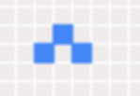

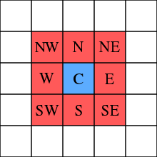
How to Play the Simulation Continued
To explain each rule, for example, picture these three cells:
What is the next step? Well, it will become:
That is because the topmost alive (blue) cell of the first image has two neighbors according to a Moore neighborhood, which looks like:
Note how the topmost blue cell has a neighbor at SW and SE according to its Moore Neighborhood. The topmost blue cell in the original image will therefore survive. The leftmost and rightmost blue cells, however, die as they only have one neighbor.
Additionally, note how a brand new cell was born in the second image! This was because it had exactly three neighbors, ones at N, W, and E at the chart above. All other cells die or remain dead that don’t follow these rules.

Slide 15
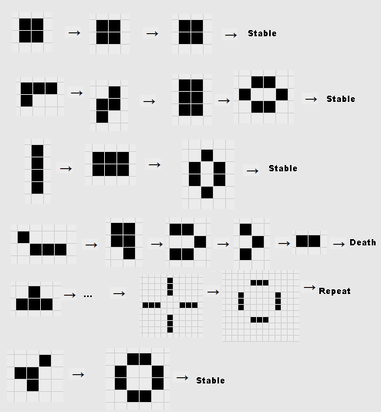
How to Play the Simulation Continued
These simple rules can lead to many amazing and complex figures and simulations that have applications in biology, chemistry, physics, and beyond! For example, cone snail shells can be simulated with this cellular automata in this way!
Some examples of cool shapes you can make can be seen below:

Slide 16
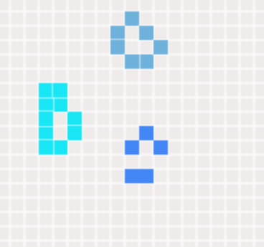
How to Play the Simulation Continued
Other players will show up as randomly generated colors, like so:
I encourage you to explore your own shapes, patterns, and to compete with others to find the the maximum number of alive cells you can achieve!

Slide 17
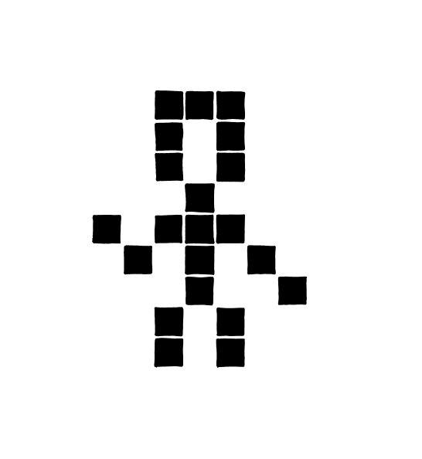

Conclusion
This project certainly aided in bringing together much of what I learned in undergrad, including how to use optimal data structures, which algorithms to use, networking using a client-server architecture, the basics of automata theory, how to bring together complex software engineering systems successfully, and, of course, creating simulations in my simulation and modeling of discrete systems courses.
While many of these courses taught me a breadth of their respective subjects, this project really helped me to understand the depth of bringing all these concepts together.
Further extensions to this project could include security analysis, more complex distributed cloud systems and servers, and the inclusion of a database to provide further integrations and extensions to the excellent undergrad classes and experiences that UofL has to offer.
Lastly, I would like to thank UofL for the amazing education, opportunities, professors, and organizations that I have had the pleasure to learn from and to learn with throughout my time at UofL. It has been an incredibly rewarding experience, and I am forever grateful to the faculty, staff, and fellow students for this experience.

Slide 18
References
[1] Coombs, Stephen, “The Geometry and Pigmentation of Seashells”, pp. 3–4, 2009.
[2] Peak D, West JD, Messinger SM, Mott KA, “Evidence for complex, collective dynamics and emergent, distributed computation in plants,” Proc Natl Acad Sci U S A. 2004.
[3] Andrew Packard, “A ‘neural’ net that can be seen with the naked eye,” Neuronal Coding Of Perceptual Systems, pp. 397–402, 2001.
[4] Y. Bouligand, “Disordered Systems and Biological Organization,” 1986.
[5] A. K. Dewdney, “The hodgepodge machine makes waves,” Scientific American, p. 104, 1988.
[6] Sethna, James P. “Statistical Mechanics: Entropy, Order Parameters, and Complexity.” Oxford University Press, 2008.
[7] Chowdhury, D. Roy; Basu, S.; Gupta, I. Sen; Chaudhuri, P. Pal, "Design of CAECC - cellular automata based error correcting code," 1994

