Slide 1


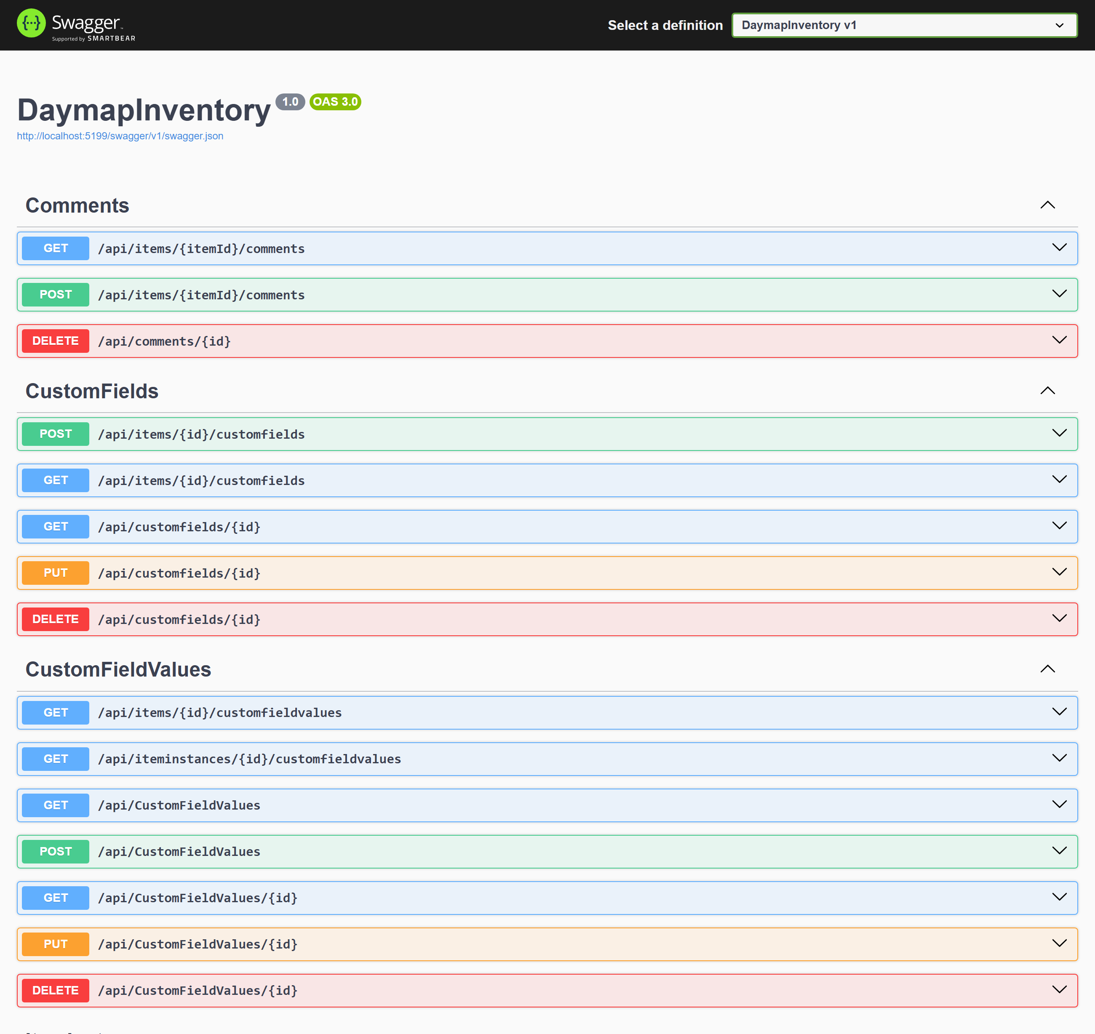
×
localhost/swagger · DaymapInventory API
Daymap Inventory
Stop asking "who has the projector?" Know where every school asset is, who has it, and when it's due back.
THE PROBLEM
Schools track laptops, lab kits and instruments with spreadsheets, paper and memory, so items go missing and stock expires unnoticed.
WHAT WE BUILT
An inventory system for Civica's Daymap platform: every item and unit, loans and returns, custom fields, tags, expiry alerts and search.
WHAT SCHOOLS GAIN
Save staff time
See who has any item and when it's due back.
Fewer losses
Overdue loans and expiring stock are flagged early.
One trusted record
Every item on every campus, set up the way each school works.
40
REST endpoints across the full item lifecycle
105
passing unit tests
Any item
custom fields fit a violin or an iPad
Our working API, documented in Swagger
ASP.NET Core · .NET 8
SQL Server + EF Core
Docker
MSTest
6 Scrum sprints
Team UG_ICT_P01 · Swinburne ICT Project B · CapEx26
Client: Harry Macheda, Civica

