Slide 1



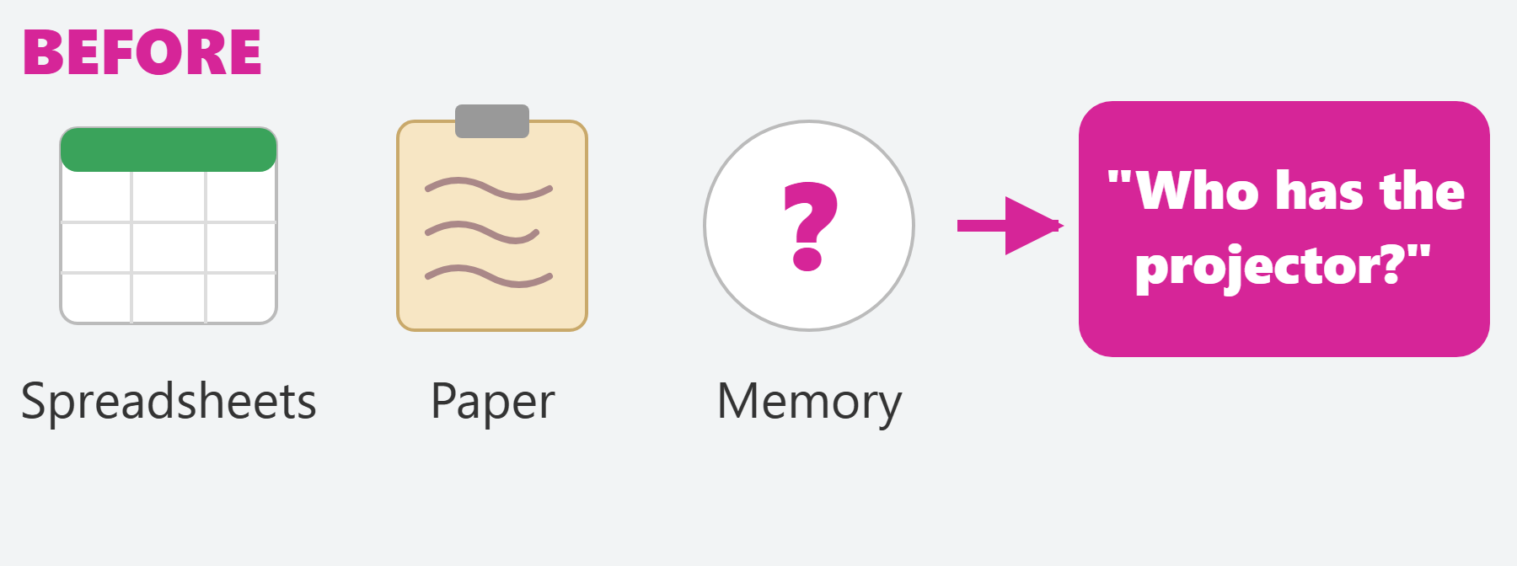
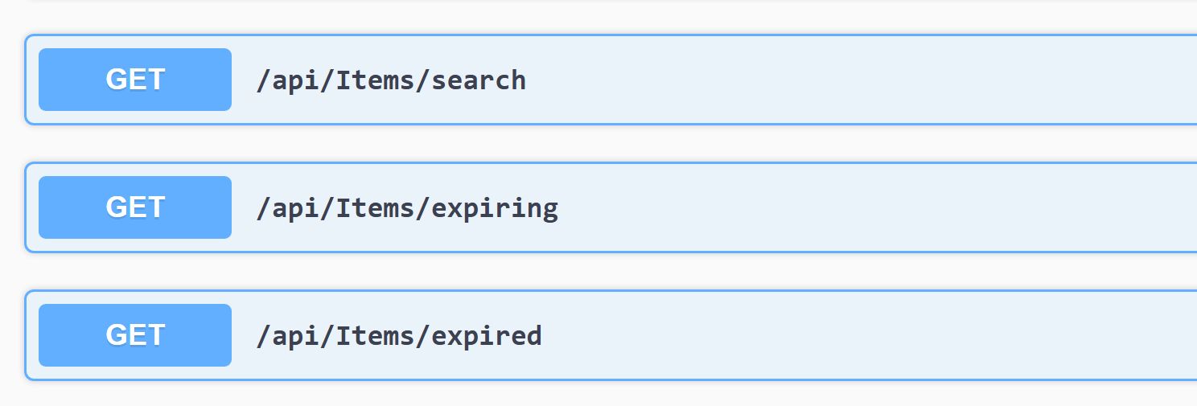
×
Daymap Inventory
Every laptop, lab kit and loan, tracked in one place.
A school inventory system built for Civica's Daymap platform.
01 THE PROBLEM
What are we addressing?
Schools track thousands of shared items with spreadsheets, paper and memory.
Items go missing
No one knows who borrowed what.
Stock expires
First-aid kits and chemicals go out of date.
No single view
Stock is spread across rooms and campuses.
One size doesn't fit
A violin and an iPad need different details.
02 THE PROCESS
How did we approach it?
S1
S2
S3
S4
S5
S6
Foundations
Real data
Custom fields
Loans & tags
Expiry & search
Testing & Docker
Agile Scrum in six sprints, reviewed with our client every sprint.
03 THE SOLUTION
What did we develop?
Track every item
Each laptop or kit, one by one
Loans & returns
Stock updates automatically
Our live API (Swagger)
Custom fields
Each school adds its own
Expiry alerts
Catch out-of-date stock
40 API endpoints
105 passing tests
Search, expiring and expired items, live
WHAT SCHOOLS GAIN
1
2
3
Save staff time
See who has any item and when it's due back.
Fewer losses
Overdue loans and expiring stock are flagged early.
One trusted record
Every item on every campus, set up the way each school works.
TEAM P01
Aaron Francis · Sarah Agate · Shreyas Cheguri
Pak Kiu Cheung · Thivyaaharan Parthiepan · Antonio Prince
SUPERVISOR
Naveed Ali
CLIENT
Harry Macheda
Civica (Daymap)
UG_ICT_P01

