Slide 1
IMDS System (Aaron)

Slide 2





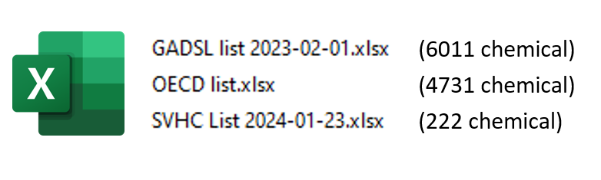
Automatic checking of product of harmful substances again Standards (IMDS)
How the automatic logic?
Login the IMDS Web Site
Downloaded the IMDS Reports
Excels with IMDS ID no. to be downloaded with 40000+ row of data
Generation of Summary Report
Compare Standards

Slide 3
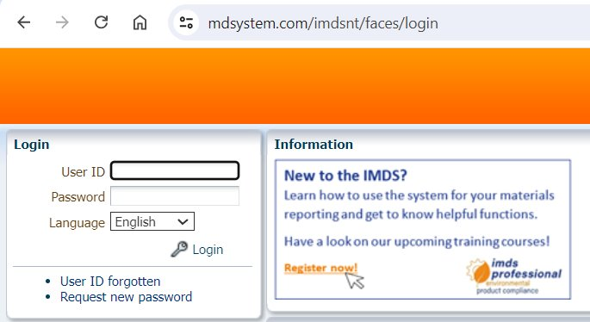
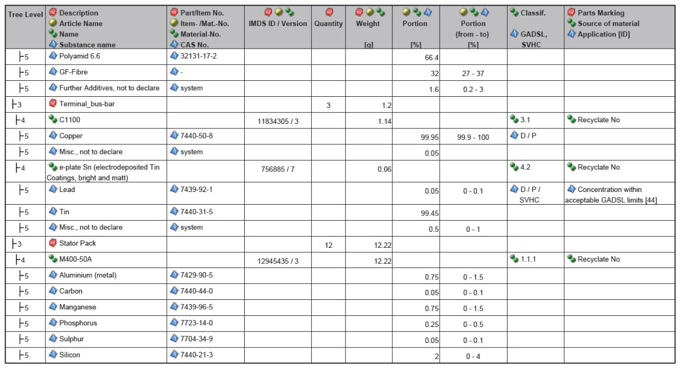
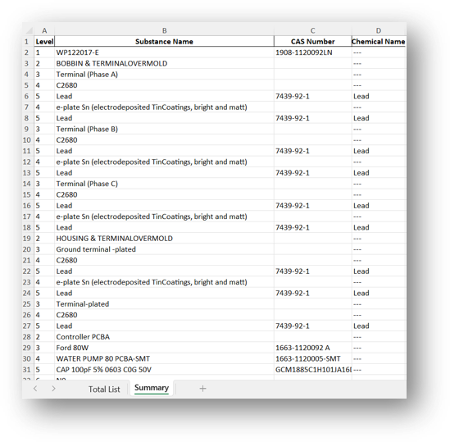
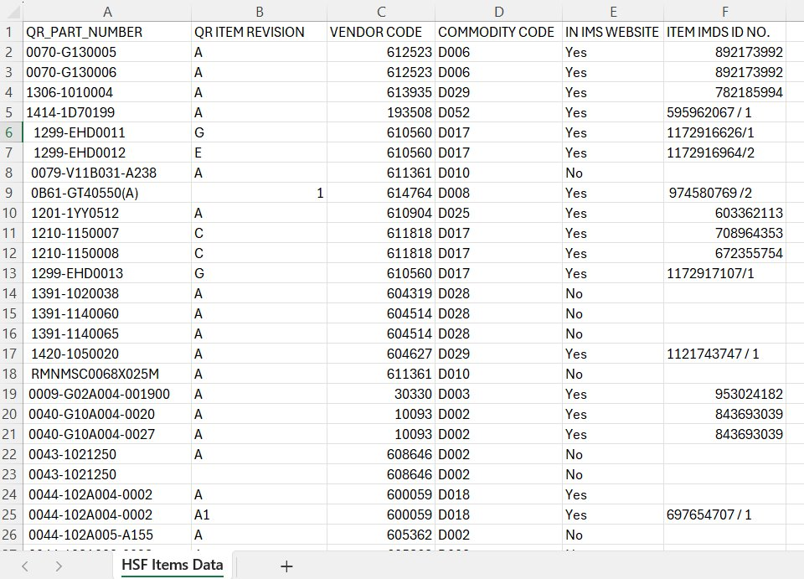
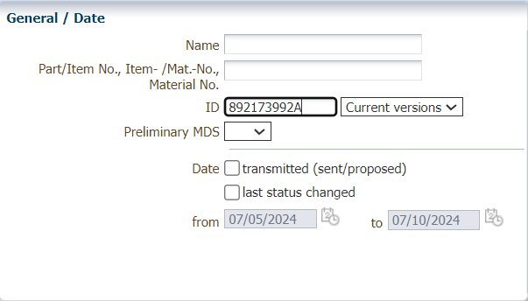
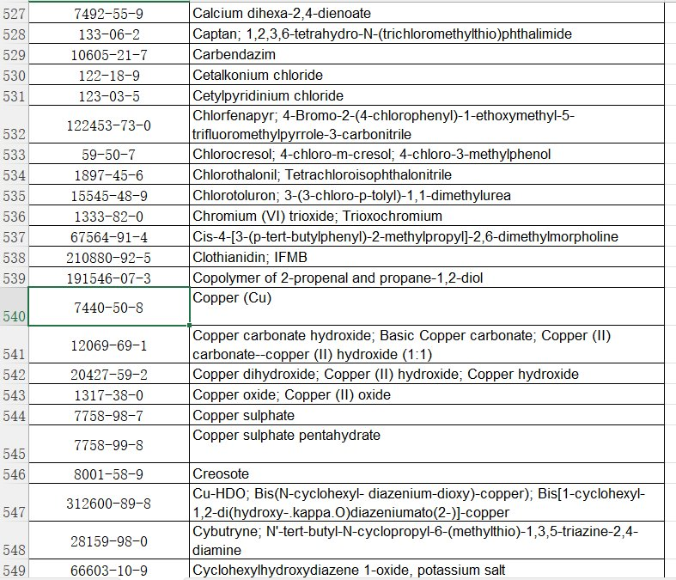
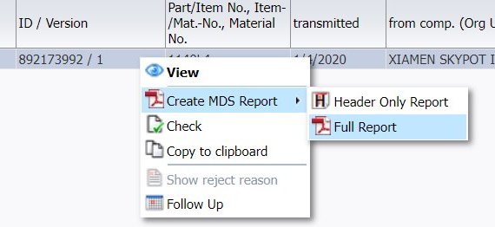
Automatic checking of product of harmful substances again Standards (IMDS)
What is the process step before?
Retrieve IMDS Report IDs from JE Database
Manually search and extract required IMDS IDs.
Search IDs and Download Reports in IMDS System
Enter each ID into the IMDS System and download the files one by one
Compare Reports with Standard
Manually compare each report with relevant standards
Identify Matching CAS Numbers
Generate report of matched CAS numbers
Excels with IMDS ID no. to be downloaded with 40000+ row of data

Slide 4
Automatic checking of product of harmful substances again Standards (IMDS)
What is the process step before?
Fully Automated
1. Open excel file and retrieve the IMDS ID.
2. Login the IMDS system and navigate to report download page.
3. Search the IMDS ID.
6. Generation of report of matched CAS numbers
4. Click multiple times to download the report.
5. Compare the CAS number (>350 rows of data) with the Standards (>5000 rows of Data)

Slide 5
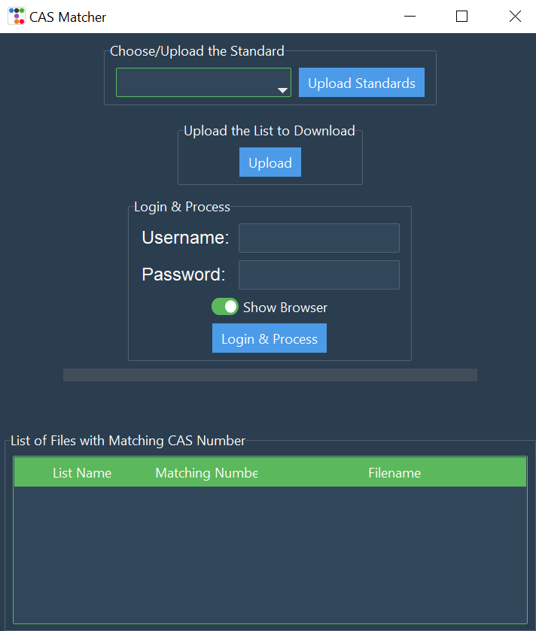
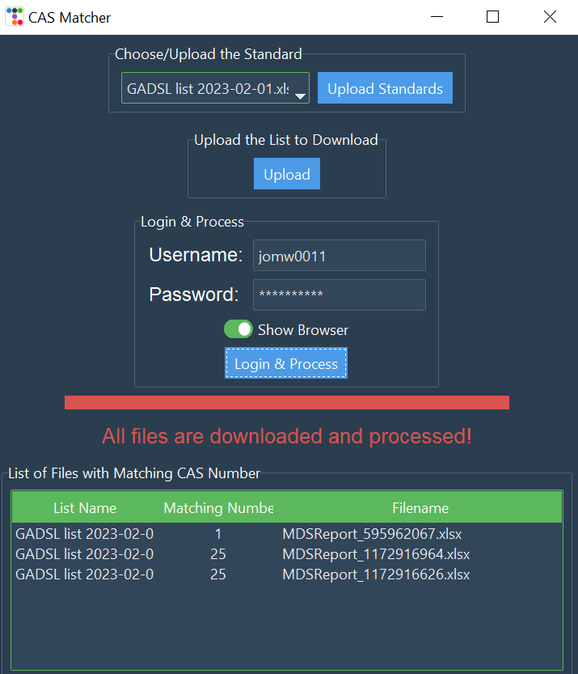
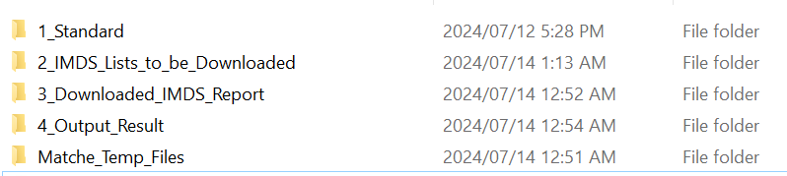

Automatic checking of product of harmful substances again Standards (IMDS)
What is the process step after?
Generation of report of matched CAS numbers
Compared Standard Name
Input Report Name
The number of matched CAS

Slide 6







What is IMDS System Enhancement ?
No. | Title | Objective | Result | Methodology
3 | IMDS System Enhancement | - Auto sync latest_standard → 1_Standard folders - Remove manual file copying - Use current standards for compliance | - 100% accurate file transfer - Update time: 3 min → 10 sec - Better error handling with user feedback | - Configurable paths via config.ini - Auto filter temp files (~$, .tmp) - Robust error recovery with validation
Python
File System Setup
Standard Sync
Data Processing
Auto Download

Slide 7
Problem - Challenges with CASMatcher v3.1.3
Python
File System Setup
Standard Sync
Data Processing
Auto Download
Key aspect | Description
Spaghetti Code & Maintenance Issues | ❌Spaghetti code structure makes UI and function modifications difficult and time-consuming. ❌Lack of modular design causes changes in one area to affect the entire system. ❌Difficult to locate and debug errors due to intertwined code structure.
Data Integrity & Compliance Issues | ❌Manual file download and placement process is error-prone, leading to outdated standards usage. ❌Risk of using obsolete standard files resulting in non-compliant material declarations.
Process Inefficiencies & Configuration Problems | ❌Manual file synchronization requires 5+ minutes of preparation work before each processing session. ❌Hard-coded file paths limit system flexibility across different environments.
File Management & System Stability Issues | ❌No systematic approach to handle temporary files (~$, .tmp) that can corrupt standard data. ❌Lack of file type validation mechanism may process incorrect file types.
User Experience & Error Handling Limitations | ❌No user feedback system to confirm successful updates or notify of sync failures. ❌Lack of error recovery mechanisms when standard files are missing or corrupted.

Slide 8

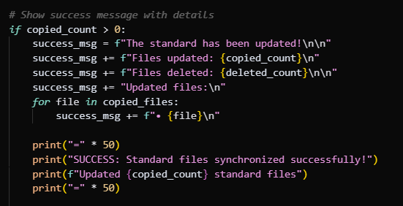

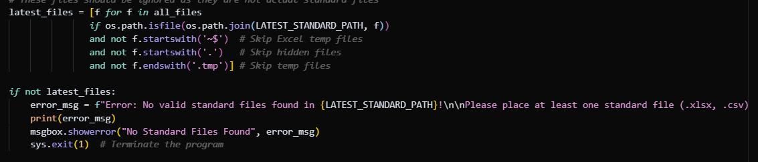
Solution - Automated Standard File Synchronization System
Overview
Implement automatic standard file sync from latest_standard to 1_Standard folder, eliminating manual updates and ensuring current compliance standards.
Key Components :
Smart Confuguration Management
File Sync Function
User Experience System

Slide 9
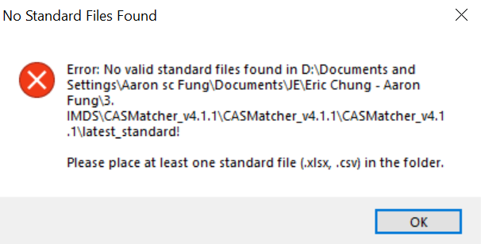
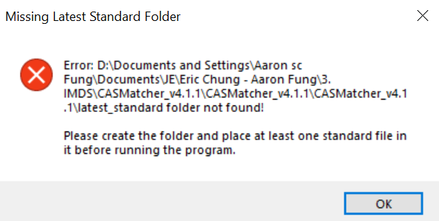
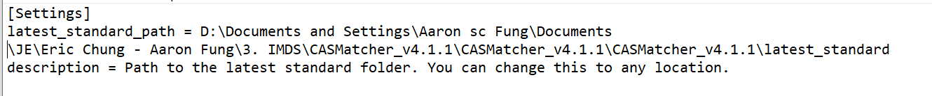
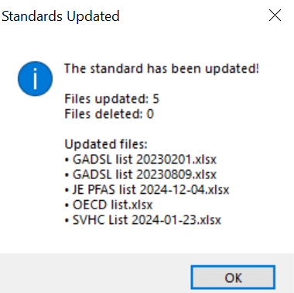
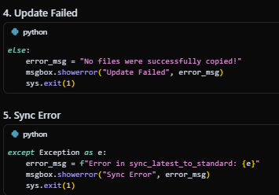
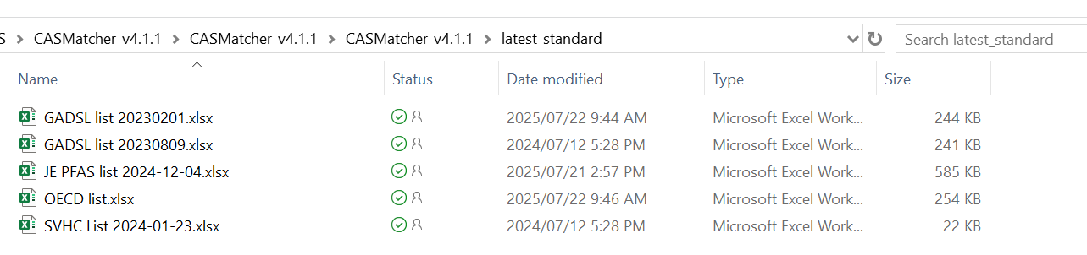
Demo
Situation 1️⃣ : Missing Latest Standard Folder
Situation 2️⃣: No Standard Files Found
Situation 3️⃣: Standards Updated Successfully
Other Situations:

Slide 10
User Experience - Before vs After
Without Standard Sync
With Standard Sync
Manual file synchronization
Operators must manually download latest standard files and copy to local computers, prone to forgetting updates or placing files in wrong location
Automated standard synchronization
All standard files are automatically synced from latest_standard folder to 1_Standard folder with around 95 % improvement
Difficult to track
No easy way to know which standard files were used for specific compliance checks or if files are up-to-date.
Basic sync tracking
Message box which shows files were updated and deleted during synchronization process
Hard-coded file paths
System can only work with fixed folder locations, making it difficult to adapt to different environments
Configurable file paths
Standard files can be placed in any location (different drives, network paths, cloud folders) via config.ini settings

Slide 11
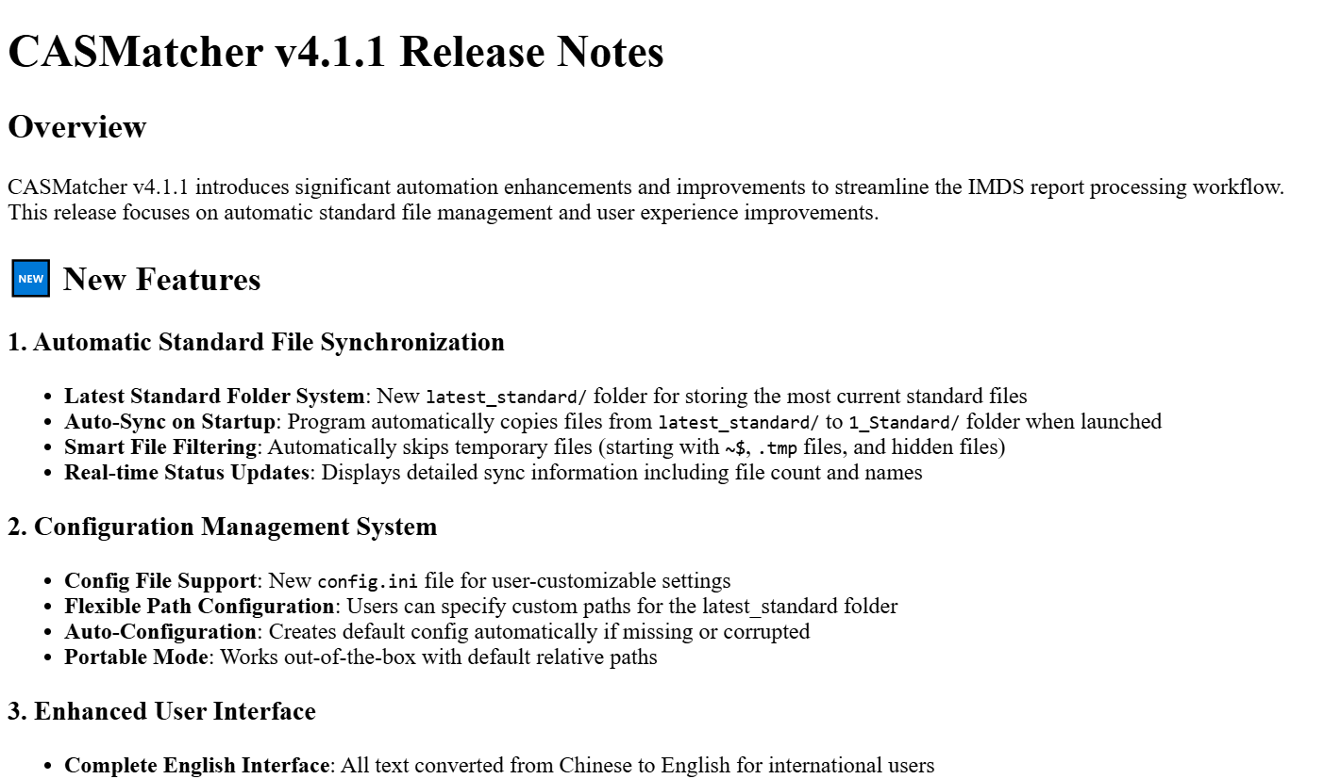
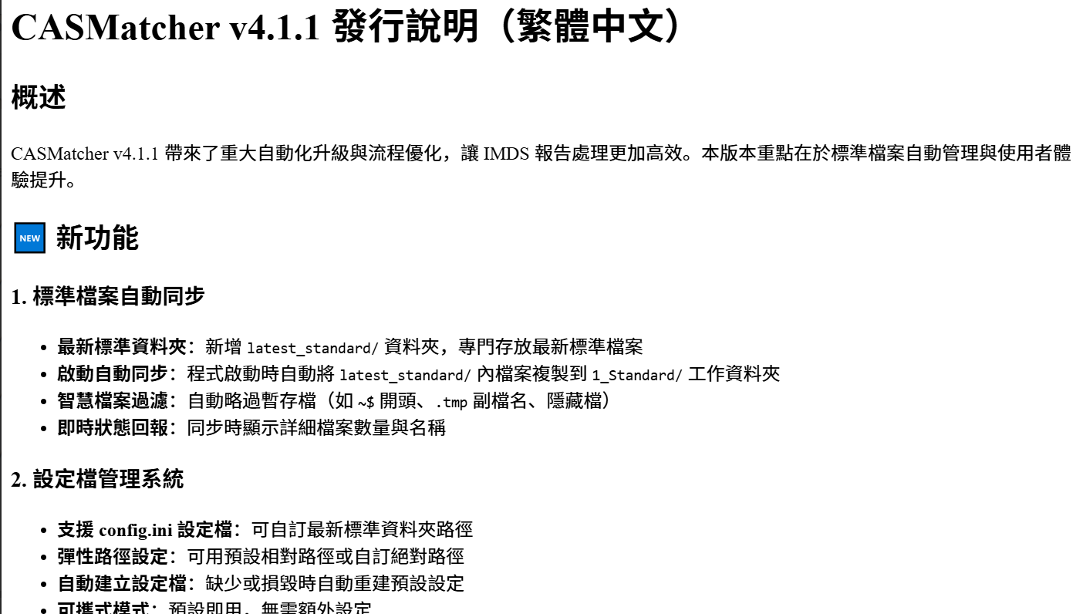

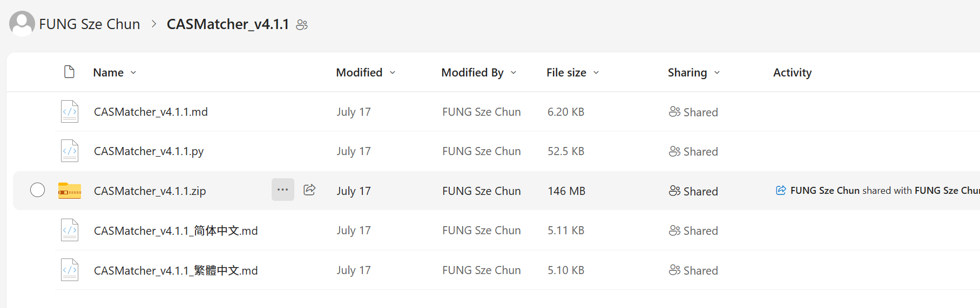
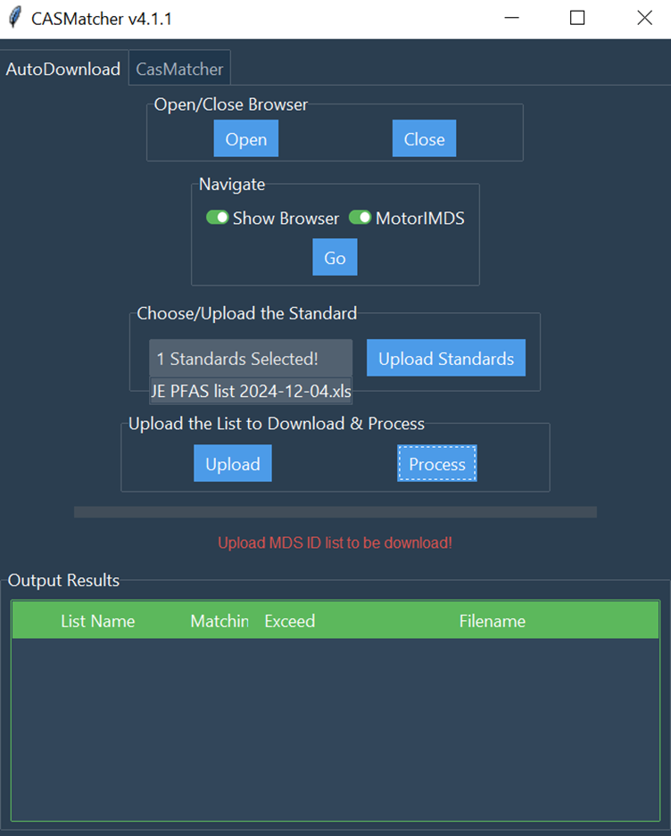
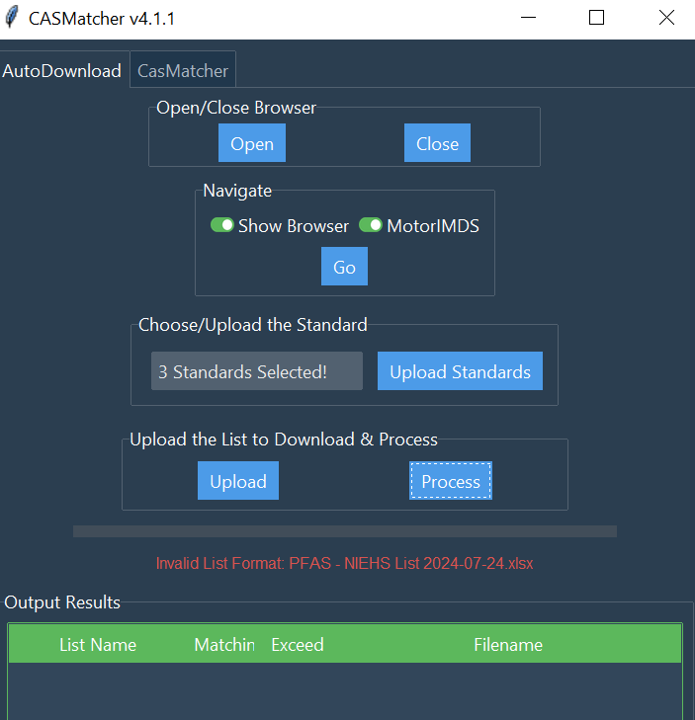
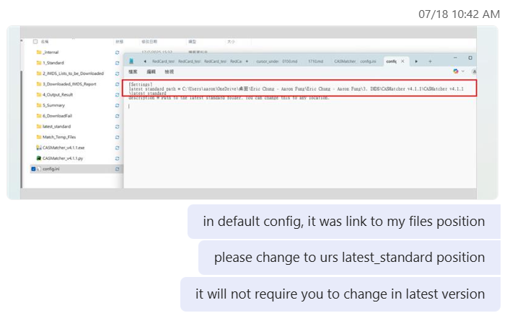
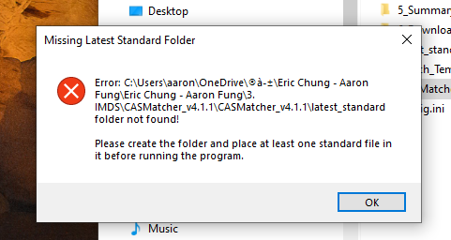

Internal Testing
Step 1️⃣ : Update files on drive with markdowns
Step 2️⃣: Solve users’ problems in Teams ( All solved)
Wrong config.ini
Invalid list format

Slide 12



Future Planning
Code Modularization
Excel Conversion Function
3. Dynamic
Version Retrieval
Isolate functionality into discrete modules
Enhance adaptability to IMDS website changes
Facilitate testing and future expansion
New: Convert IMDS PDF reports to Excel
Maintain automated standards comparison
Generate Excel outputs post-comparison
- Implement validation systems and oversight
- Use simple NLP and chatbot tools
- Streamline tasks with user-friendly tools

