Slide 1
OIR Digital Inspection Report (Aaron)

Slide 2
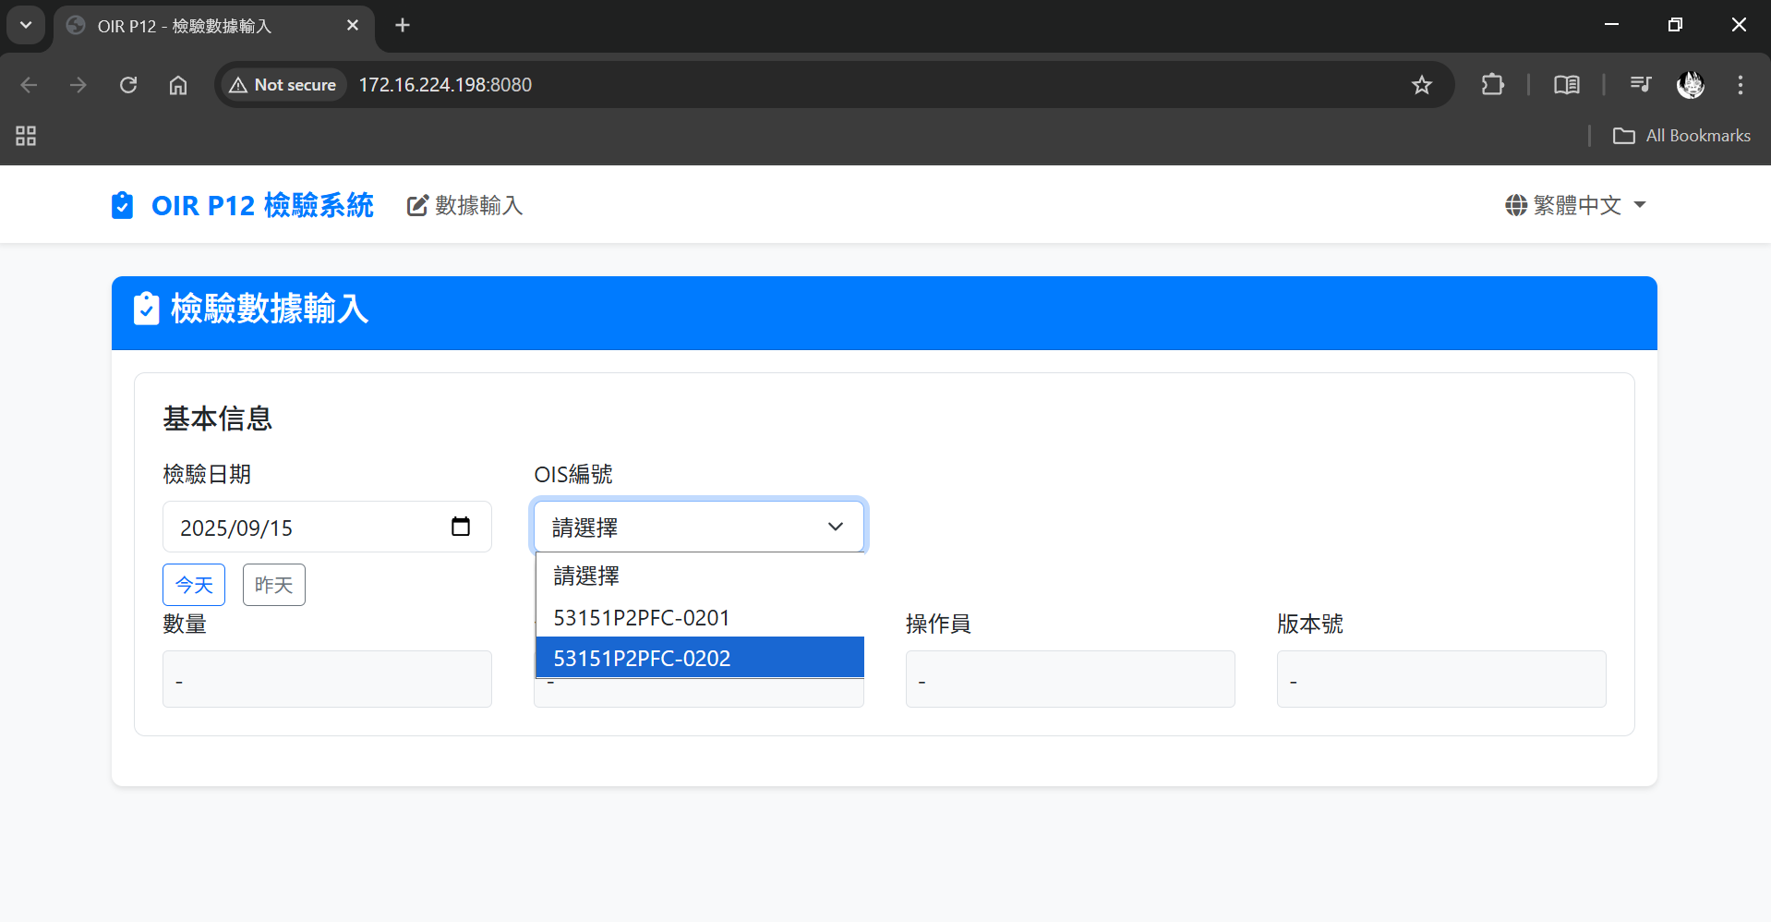
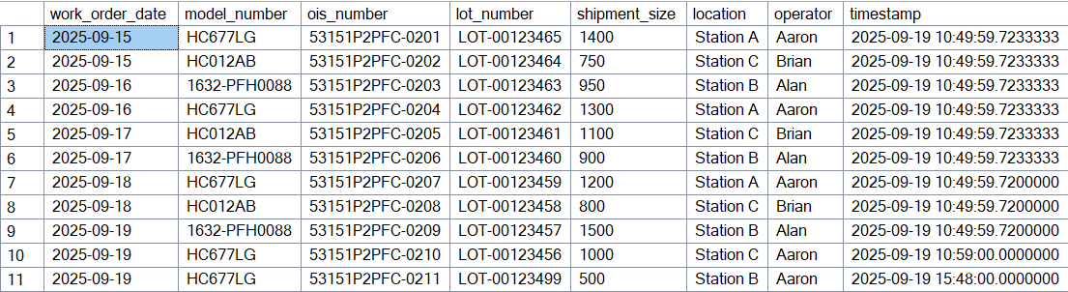
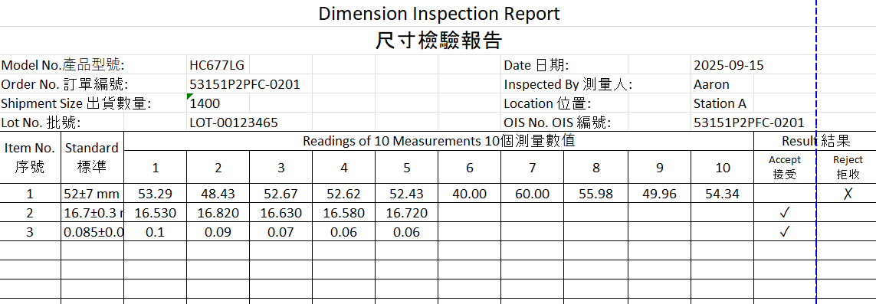
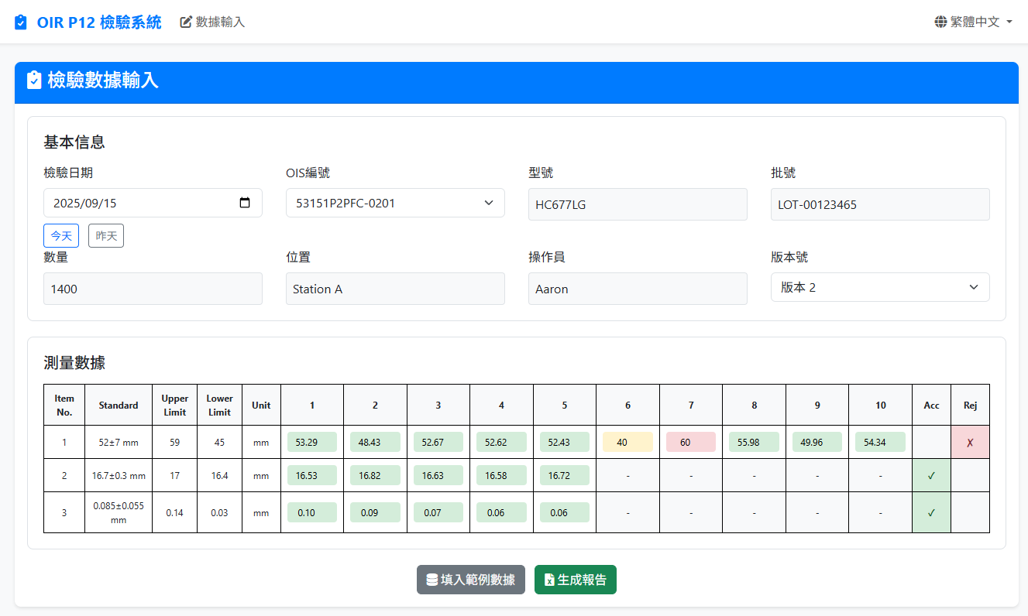
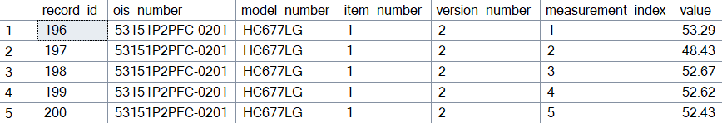
What is the OIR System?
No. | Project Name | Objective | Result | Methodology
7 | OIR (Outgoing Inspection Report) Digital Inspection Report System v6 | - Eliminate handwritten reports through digital input. - Automatically generate standardized inspection reports. - Establish centralized data management system. | Efficiency: Reduced inspection time from 30 min to 5-10 min Accuracy: Automatic validation mechanisms reduce human errors Standardization: Unified format ensures consistency and professionalism Traceability: Support multi-criteria search and report regeneration | Data Structure Design: Established Excel database to store inspection standards and records Core Function Development: Developed data processing, report generation, and historical query functions User Interface Design: Created intuitive and user-friendly web operation interface System Integration & Testing: Integrated all modules and conducted rigorous testing
Report generate base on database
User Interface for data input
Data store in the centralize database

Slide 3
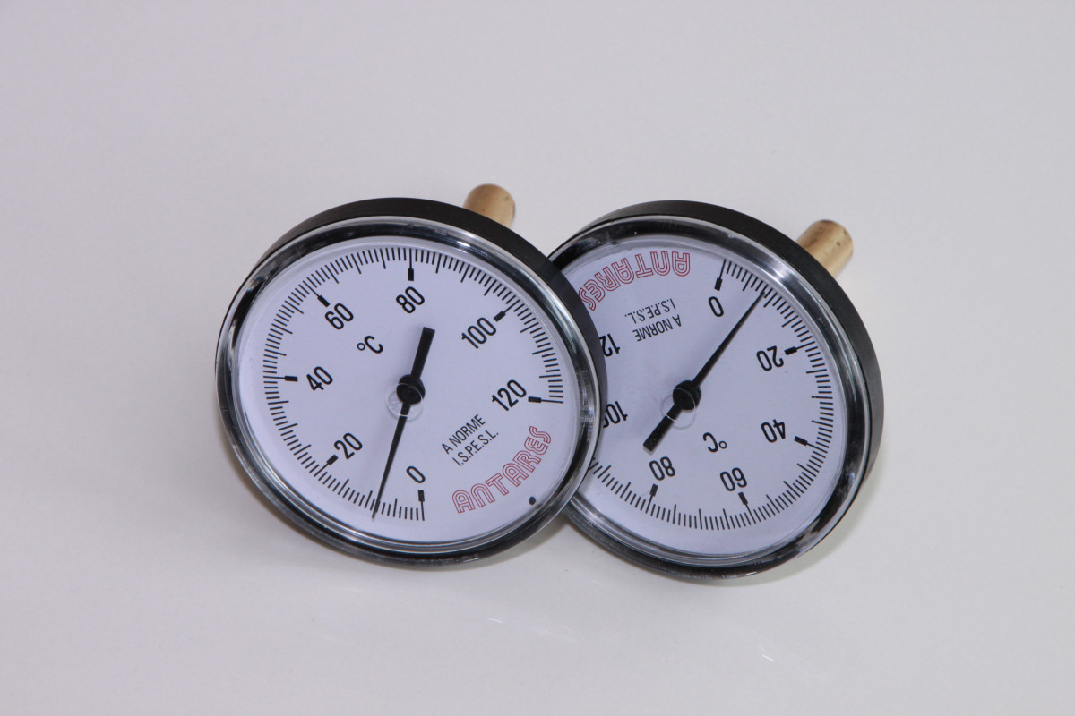
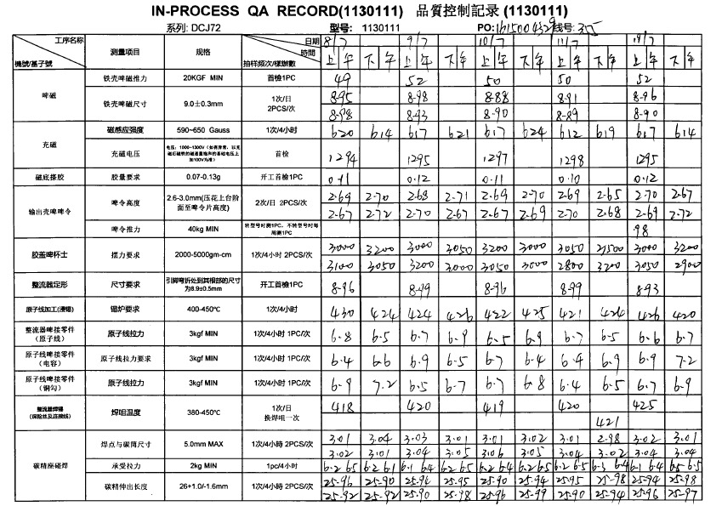
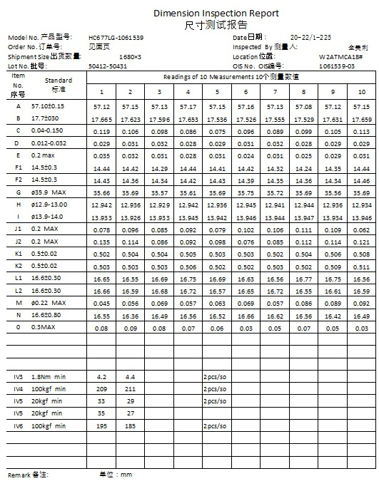
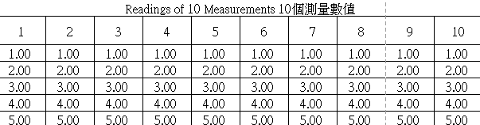
Problem - Challenges with manual report
Use tools and record on paper manually.
Handwrite measurements and calculate manually.
Type data manually into Excel spreadsheet.
Copy template and fill data manually.
Key aspect | Description
Manual Process Inefficiencies | ❌ Time-consuming manual data entry from paper forms to Excel spreadsheet. ❌ Human error occurs during manual data input process leading to inaccuracies. ❌ No automated validation system to ensure data accuracy and completeness
Report Generation Problems | ❌ Manual copying and pasting of data into report templates takes significant time. ❌ Inconsistent formatting and layout across different reports and operators. ❌ No standardized process for report creation leads to quality variations.
Historical Data Management Issues | ❌ Difficult to search and retrieve historical inspection records from paper files. ❌ No centralized database for storing and organizing past inspection data. ❌ Risk of losing important historical data due to physical file damage or misplacement.
Calculation and Analysis Problems | ❌ Manual calculations for statistics (average, min, max) are time-consuming and error-prone. ❌ No real-time data analysis available during inspection process. ❌ Inconsistent calculation methods across different operators and reports.

Slide 4
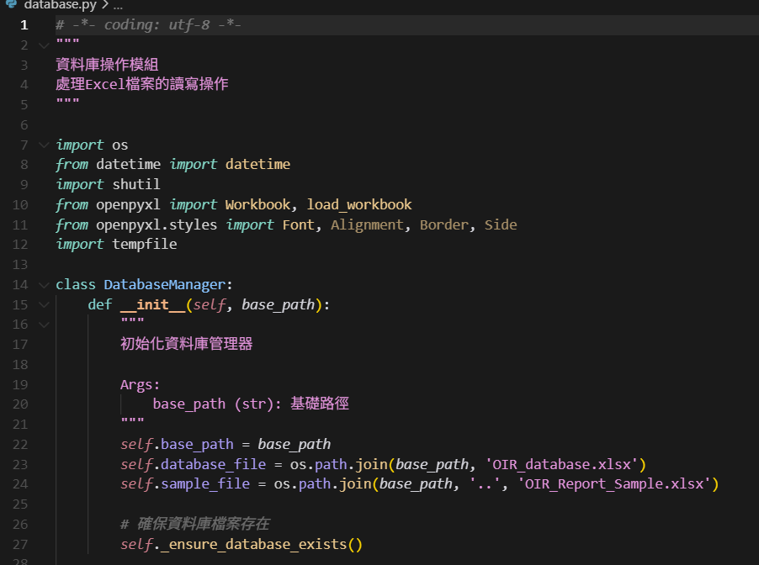
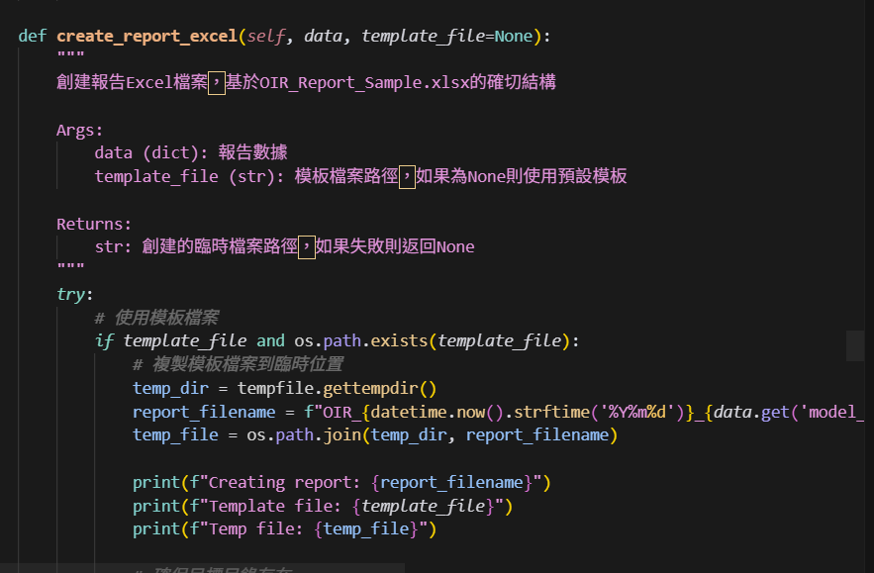
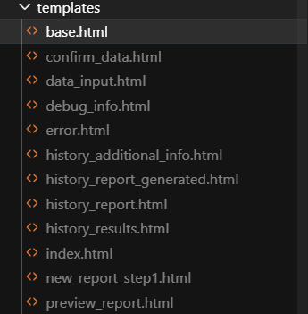
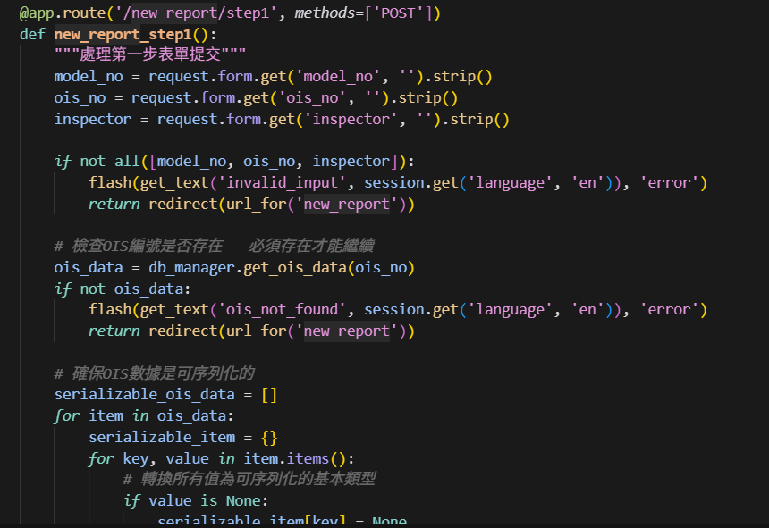
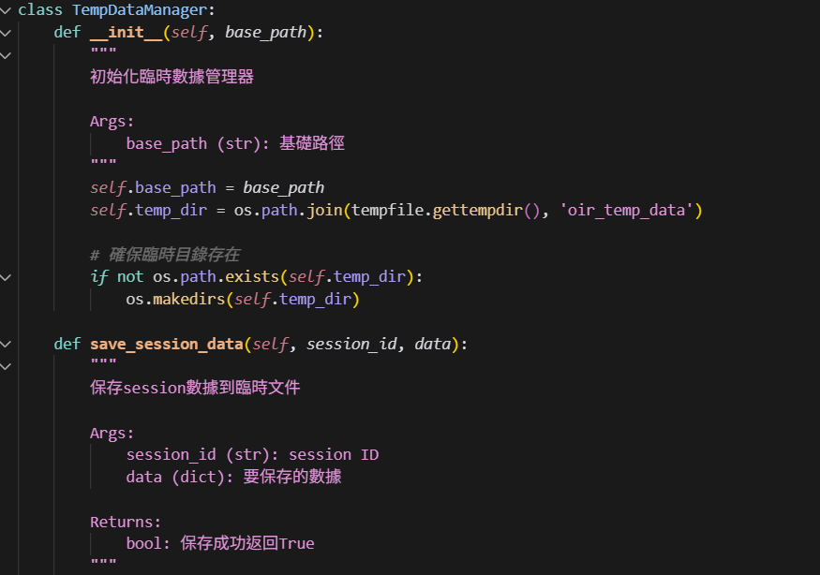
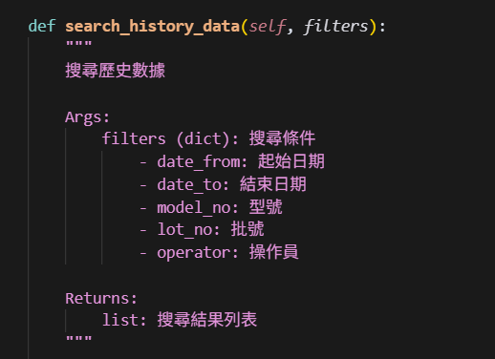
Solution – Online Data Input System
Overview
Transform manual inspection processes into digital web application with automated data
entry and report generation.
Key Components :
Web Application Interface
Data Management System
Report Generation Engine
Search and Query System
Data Validation Module
Session Management

Slide 5
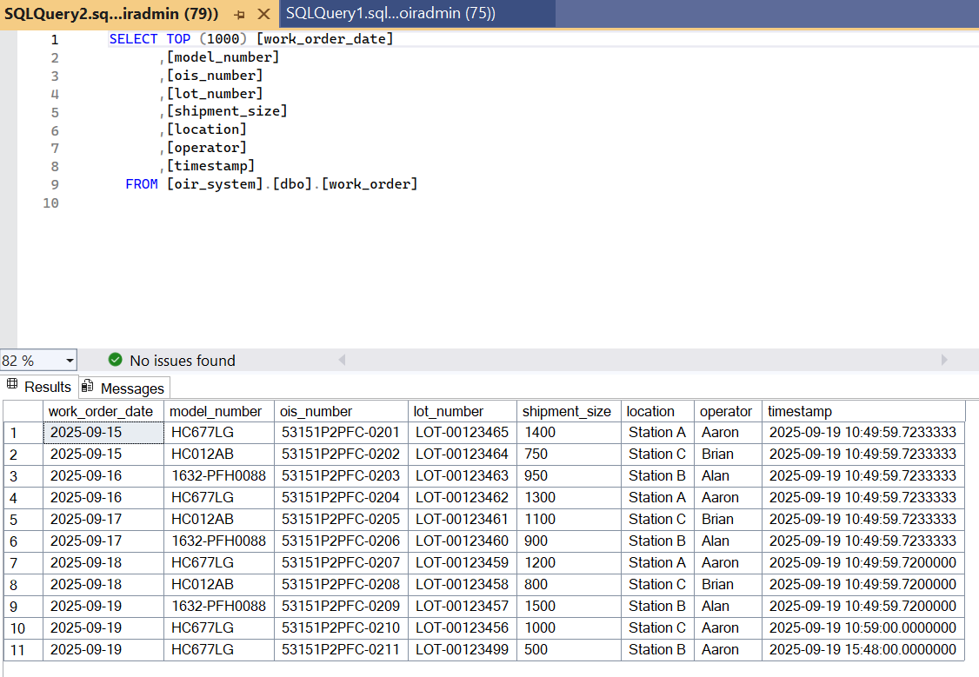
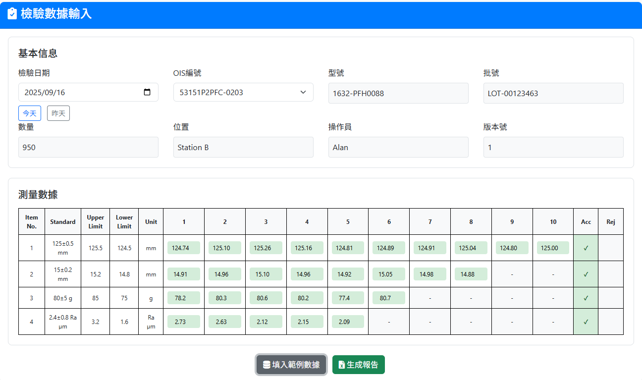
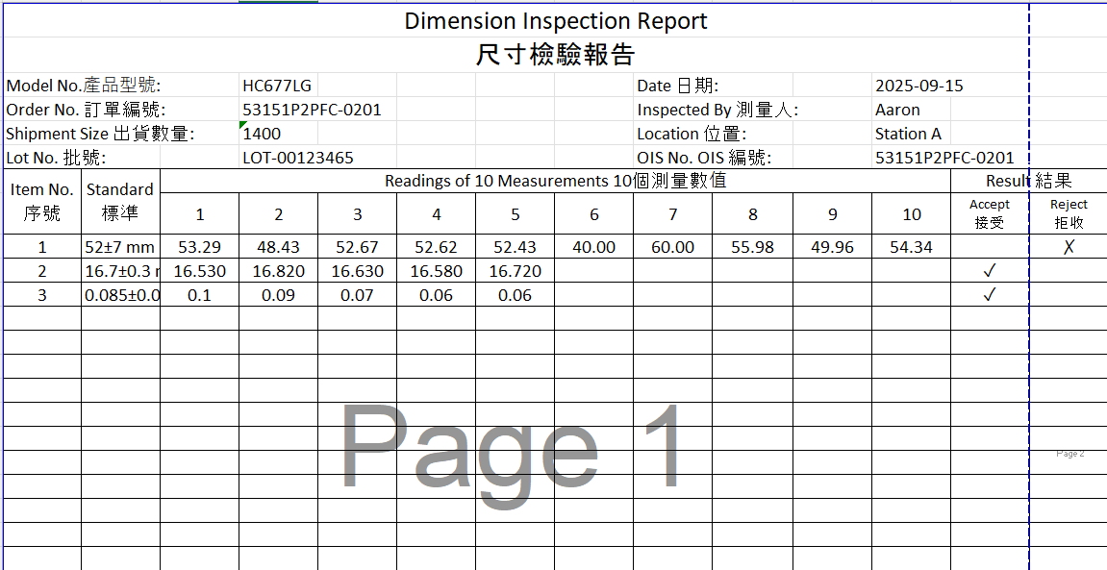
Screen Shot for the developed user interface
SQL database:
User Interface:
Excel report:

Slide 6
User Experience - Before vs After
Without OIR v6
With OIR v6
Manual form handling
Staff must navigate through multiple paper forms and manually transfer data between systems.
Automated web interface
Single web application handles all data input with multi-language support and responsive design.
Manual report creation
Staff must copy data manually into templates and format reports by hand..
Automated report generation
System automatically creates standardized Excel reports using predefined templates.
Manual Excel file management
Staff manually create and maintain Excel files with risk of corruption and version conflicts.
Structured database system
Centralized Excel database with automated data organization and standardized storage format.

Slide 7
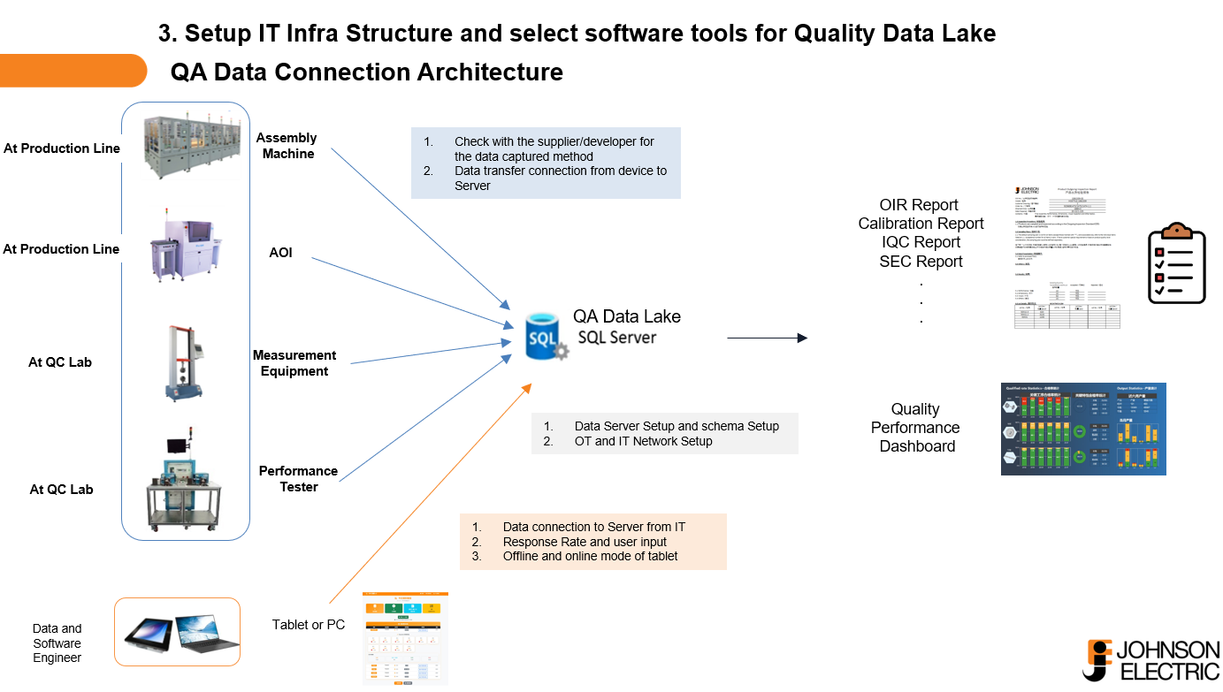
This Program is part of the QA Digitalization Project which is the orange part

Slide 8
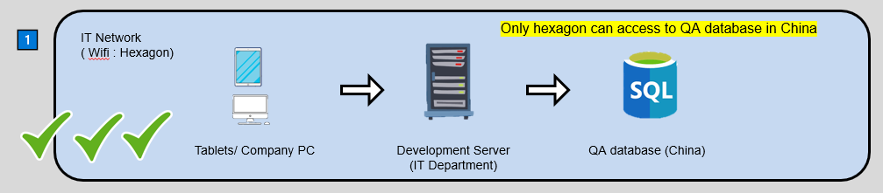
Request for the development server in KM
We would like to apply a Development Server in KM for the test purpose.
In the development Server, we will install the python run the html and SQL Server Management Studio to access the China QA Database

Slide 9




Current Data Workflow
1️⃣
IT Network ( Wifi : Hexagon)
Company PC
QA database (China)
2️⃣
OT Network ( Wifi : Phone hotspot)
Tablets/ Company PC
Personal PC
Local database

Slide 10


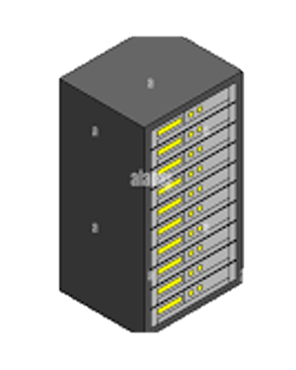
Ideal Data Workflow
1️⃣
IT Network ( Wifi : Hexagon)
Only hexagon can access to QA database in China
Tablets/ Company PC
Development Server
(IT Department)
QA database (China)
2️⃣
OT Network ( Wifi : router)
Location A
IT Network
Location B
Tablets/ Company PC
Location C
Development Server
(IT Department)
QA database (China)
Other users can access to OT servers when they are in the same wifi.

Slide 11
Back Up

Slide 12
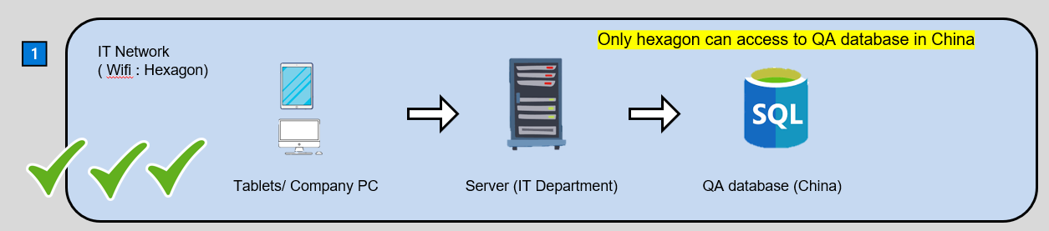
Request for the development server in KM
In order to use the program in China, an IT virtual server in KM needs to be set.
After that, tablets should be Windows. ( IOS is a potential solution with a more affordable price)

Slide 13
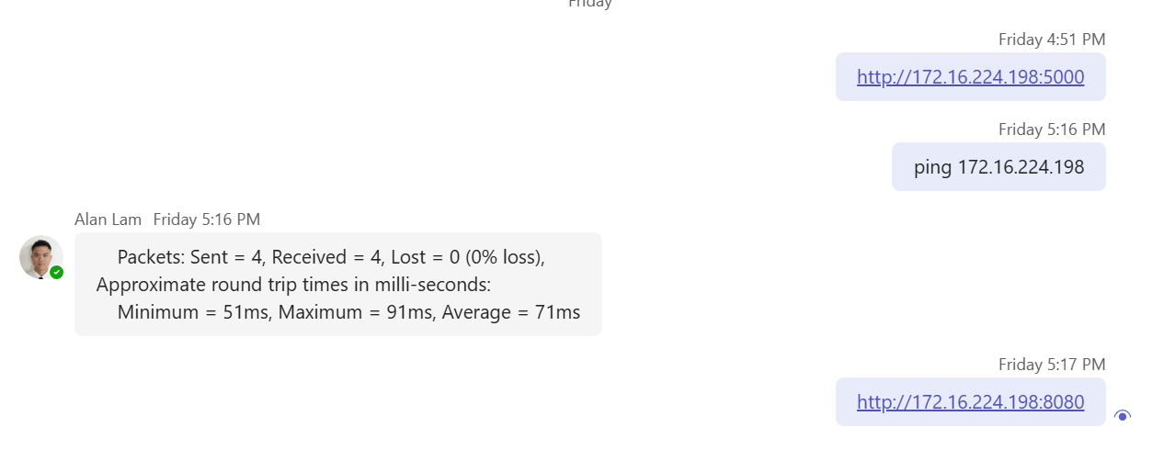
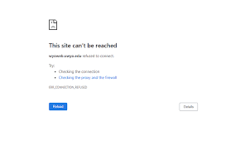

Problem – No access to firewall
Other users can ping IT computer (172.16.224.198).
✅ The network connection is working - both computers are on the same network (Hexagon)
✅ The firewall allows ICMP - ping packets can pass
but block HTTP
✅ The IP address is correct - computer's IP address is correct
http://172.16.224.198:5000 or http://172.16.224.198:8080 is not accessible to IT server. As endpoints are blocked due to security concerns.

Slide 14

SQL Database Design
Table 1: work_order
Table 2: standards
Table 3: records
Table 4: files

