Slide 1
Predictive Analytic of RGB Production Line (Aaron)

Slide 2

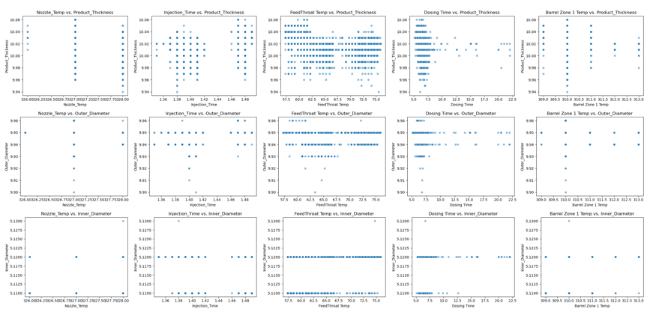
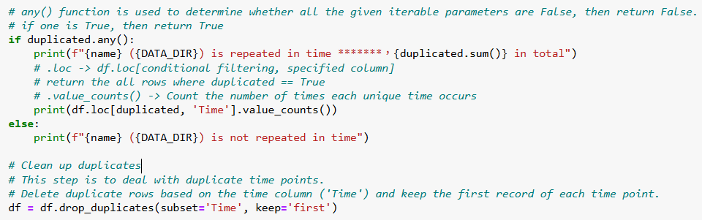
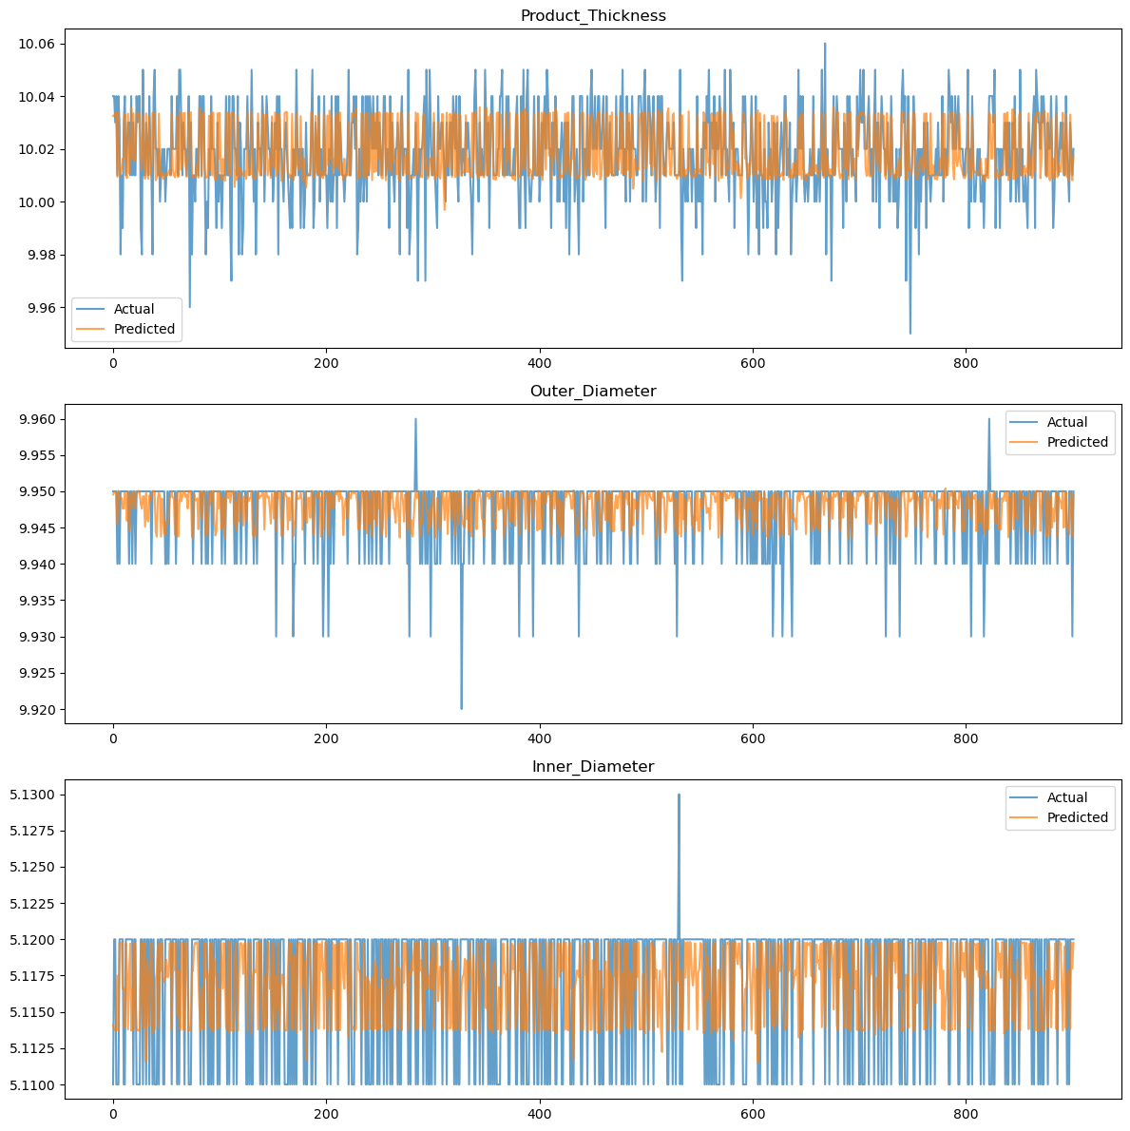
What is Predictive Analytic of RGB Production Line ?
No. | Title | Objective | Result | Methodology
2 | What is Predictive Analytic of RGB Production Line ? | - Improve product result prediction accuracy - Enable data-driven business decisions | - Data is stratified and discrete - No clear linear relationship found - Measurement accuracy is limited - Values are highly concentrated - Data quality and characteristics still limit results - Recommend improving data accuracy and richness | - Data cleaning and preprocessing - Descriptive statistics (mean, median, range, SD) - Distribution and correlation analysis - Outlier detection - Train-test split (70% train, 30% test) - Random Forest Regressor model - LightGBM quantile regression model - Evaluate with MAE, RMSE, not R²
Raw data from machine
Data cleaning
Statistical analysis
Machine learning model

Slide 3
Data analysis
Data Cleaning
Transform raw data into clean datasets.
Statistical analysis
Explore patterns to guide model selection.
Machine learning model
Random Forest and LightGBM for robust predictions.
Summary & Suggestion
From data to predictions.
1️⃣
2️⃣
4️⃣
3️⃣

Slide 4
Data Cleaning
Aspect | Details
Data Structure | 5 input variables: Temperature, dosing time, and 3 other parameters 3 output variables: Thickness, inner diameter, outer diameter Machine source: Production equipment generating continuous measurements
Why Exact Time Alignment? | Maximize data retention - Preserve all 5 input variables (temp, dosing time, etc.) Retain small changes - Capture subtle temperature and pressure variations Keep noises - Maintain natural machine operation patterns
Time Alignment Challenge | Input frequency: Data collected every 17 seconds Output frequency: Results generated every 30 seconds Mismatch resolution: Exact alignment despite 13-second difference Data completeness priority: Focus on preserving all measurements
Alignment Strategy | Exact matching approach - Most suitable for 30-second real delay Time element trade-off - Neglects temporal precision for data completeness Volume preservation - Maintain maximum available data points

Slide 5
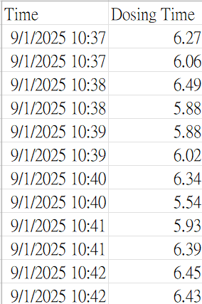
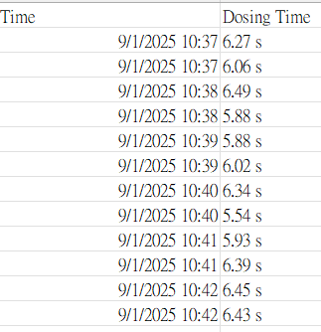




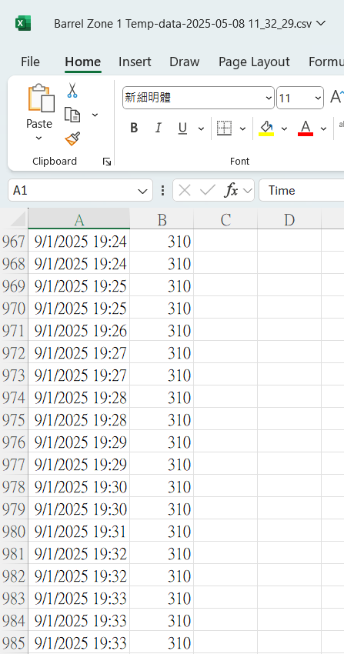
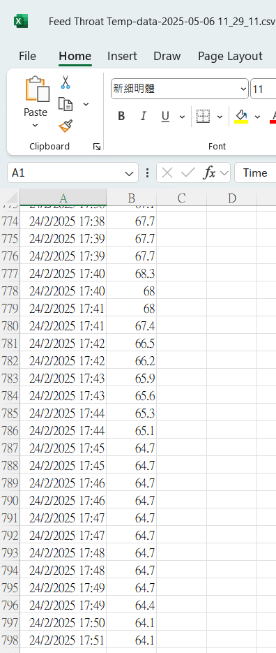
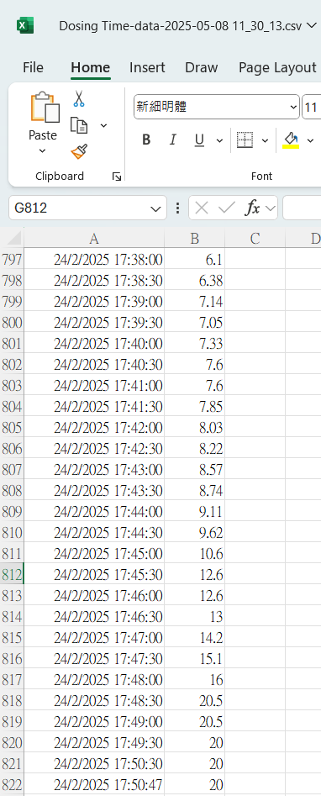
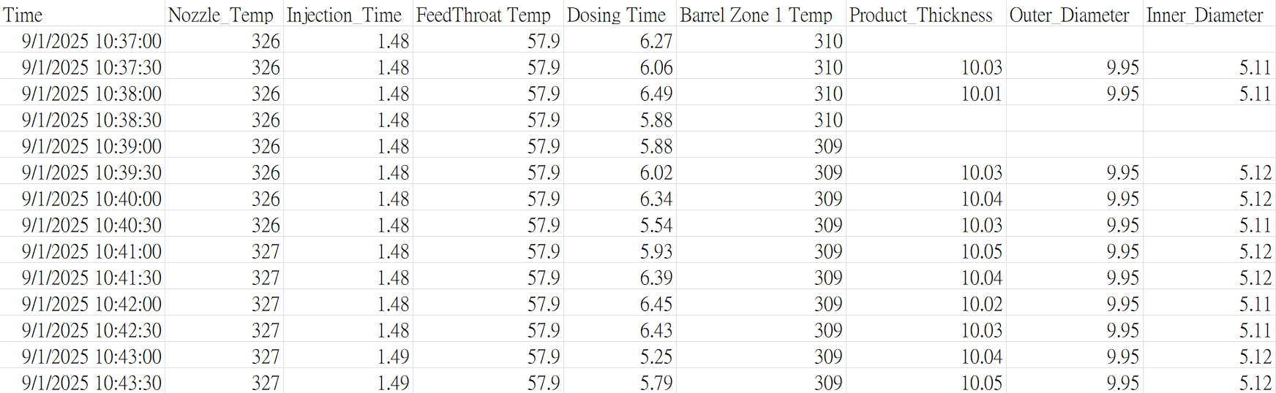
Data Cleaning - Steps
1️⃣ Remove the digit
2️⃣ merge all the files by time (d/m/yyyy h:mm:ss)
3️⃣ Delete duplicate rows based on the time column ('Time') and keep the first record of each time point.
4️⃣ Checking for null value

Slide 6
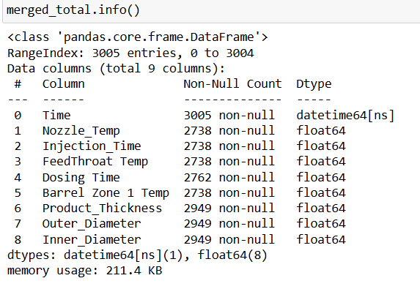
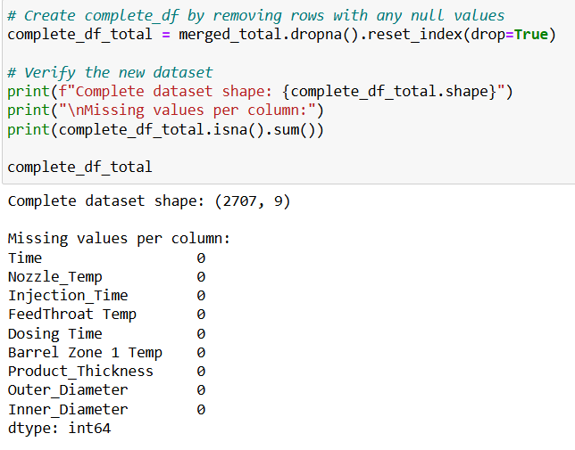
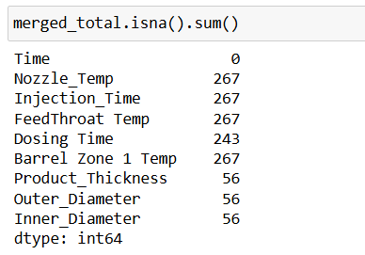
Data Cleaning - Steps
5️⃣ Checking data info
6️⃣ complete_df_total -> data without null value &
data proportion

Slide 7
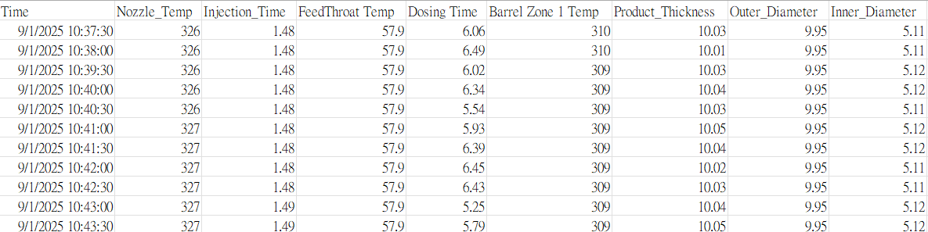
Data Cleaning
complete_df_total
merged_total
Delete all rows with null values
With a smaller sample size
Cleaned data
Keep the original sample structure
With a larger sample size
With null values
Remove null values ​​and keep the original association between variables
Random forests require a large number of samples to build a robust decision tree
Remove null values ​​and keep the original association between variables
Notes:
SLMs response depends on Device ( GPUs)

Slide 8
Data Cleaning - Result
2️⃣
Data Cleaning
Statistical analysis
3️⃣
complete_df_total
1️⃣
Raw Data
merged_total
Machine learning model
3️⃣

Slide 9
Statistical analysis
Aspect | Details
Key Variable Characteristics | FeedThroat temperature (SD >5.6) and dosing time (SD >1.7) show high variability Other input parameters remain stable with low standard deviation (<0.5) Temperature and dosing time ranges (18.6°C, 16.9s) far exceed other parameters (≤2) Data exhibits discrete distribution with limited measurement precision
Correlation Analysis | Injection time shows strongest correlation (r=0.61) with product thickness Increased injection time leads to significant thickness increase Pearson correlation reflects average trends between data layers, not detailed structure Spearman correlation recommended for analyzing nonlinear relationships in discrete data
Output Variable Analysis | Inner diameter displays consistent output values across measurements Product thickness and outer diameter show small output ranges Kernel density estimation reveals similar distribution patterns across all targets Outliers likely caused by external factors, measurement errors, or data quality issues
Data Quality Observations | Measurement precision limited to few decimal places (0.01 accuracy) Automatic rounding may convert results to integer values Data concentrates at specific discrete measurement points

Slide 10
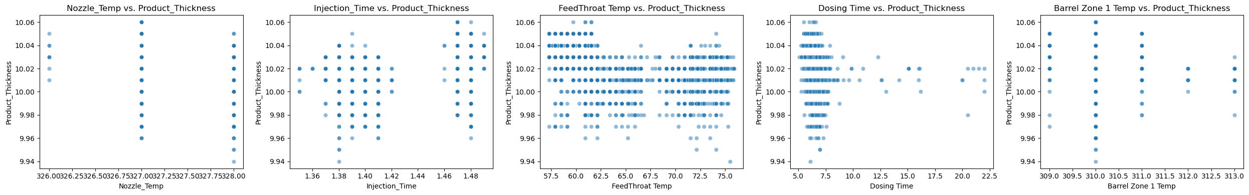
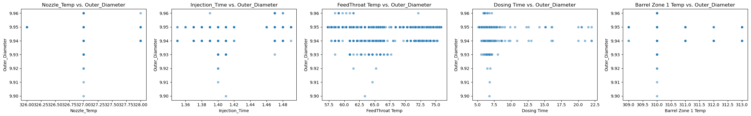
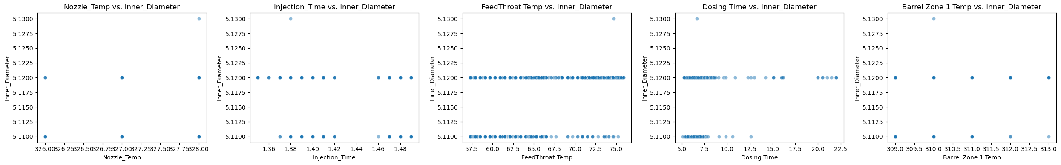
Statistical analysis
Distribution
Real-time dashboards provide actionable insights for all stakeholders.
There is no linear relationship.
Data is in discrete distribution and concentrated at a few discrete values

Slide 11
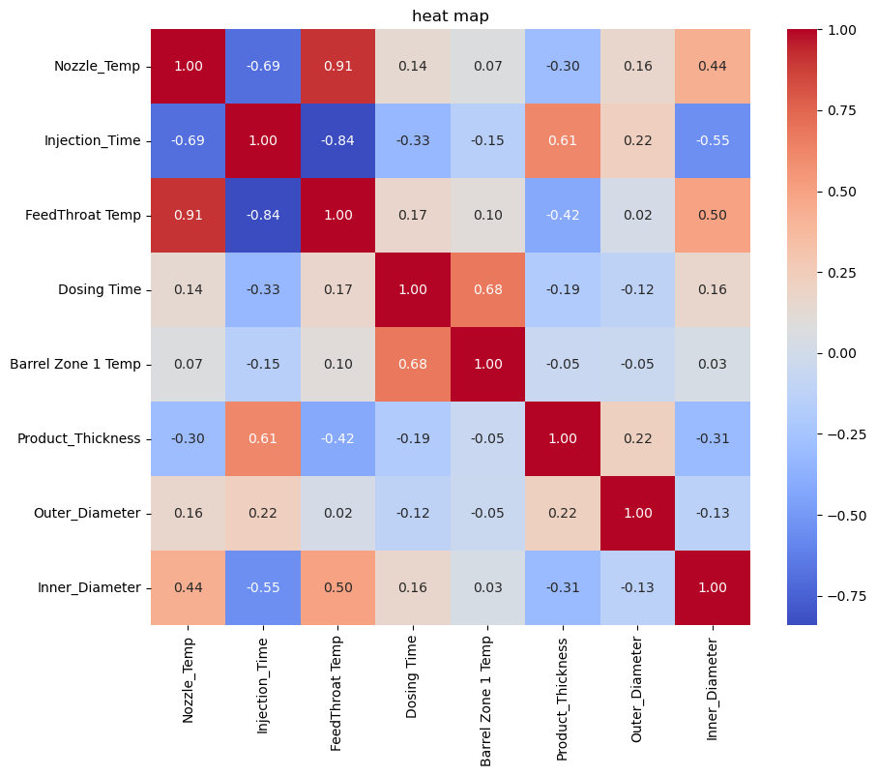
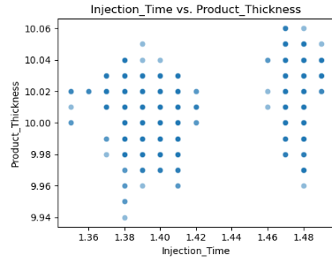

Statistical analysis
Pearson Correlation
Represent the strength of linear relationship.
Pearson correlation coefficient represents the strength of linear relationship. However, this value only reflects the average trend "between layers" and cannot reflect the detailed structure of the data.
It is suggested to use Spearman correlation as it is able to analyze nonlinear relationships.
Linear Relationship

Slide 12
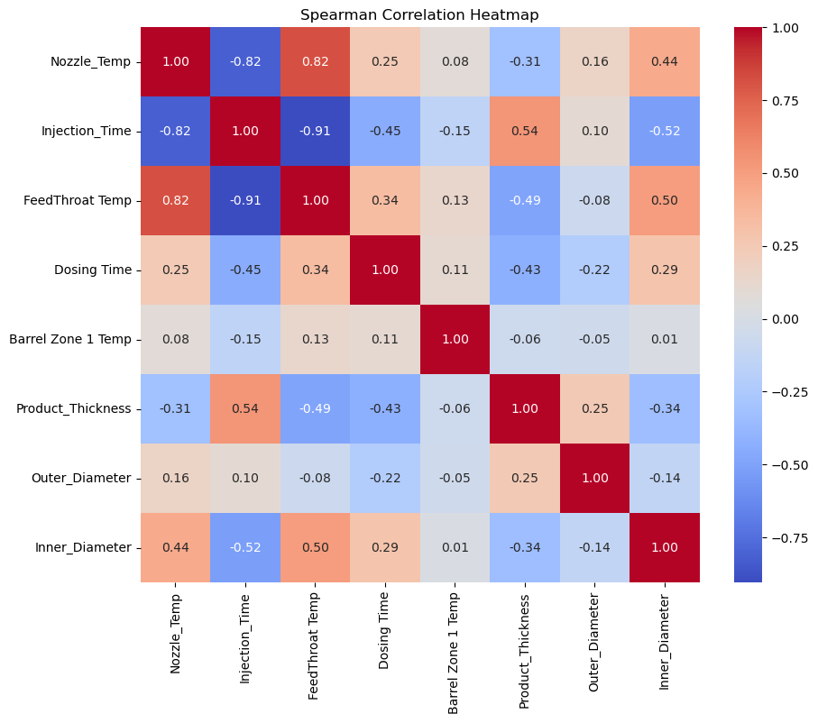
Statistical analysis
Spearman Correlation
Analyze nonlinear relationships.
Result | meaning
Pearson r=0.61 > Spearman ρ=0.54 | The linear model overestimates the actual influence
Spearman is still significant (ρ=0.54) | There is a stable nonlinear trend (Longer time→ Larger thickness)
monotonically increasing

Slide 13
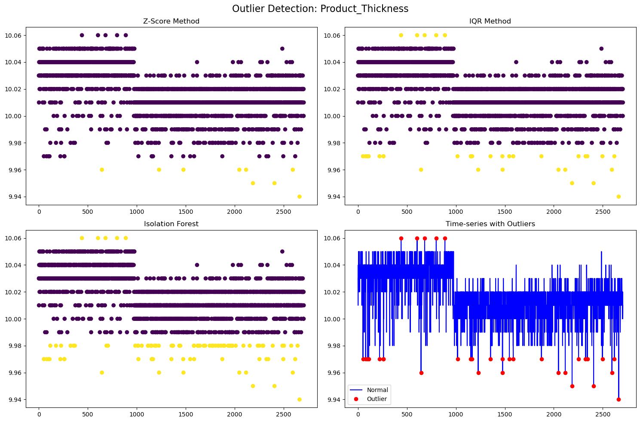
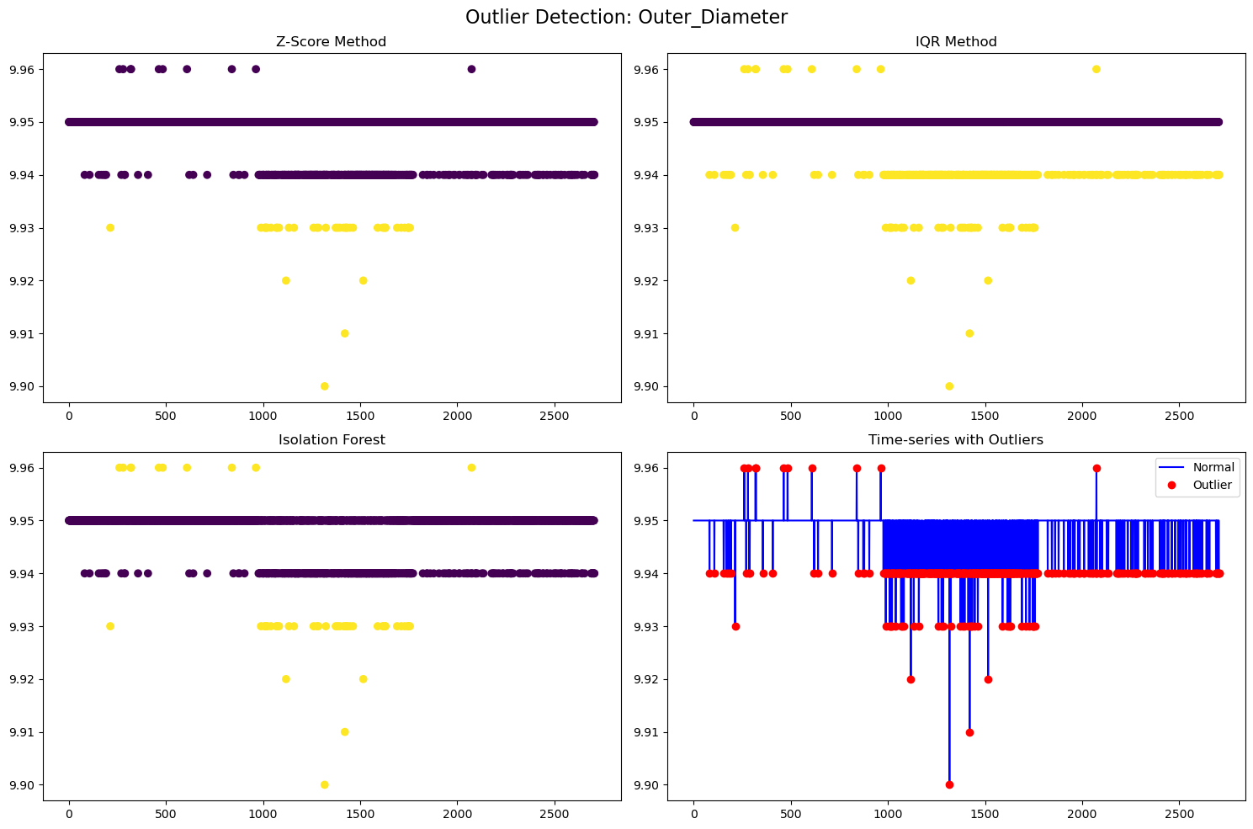
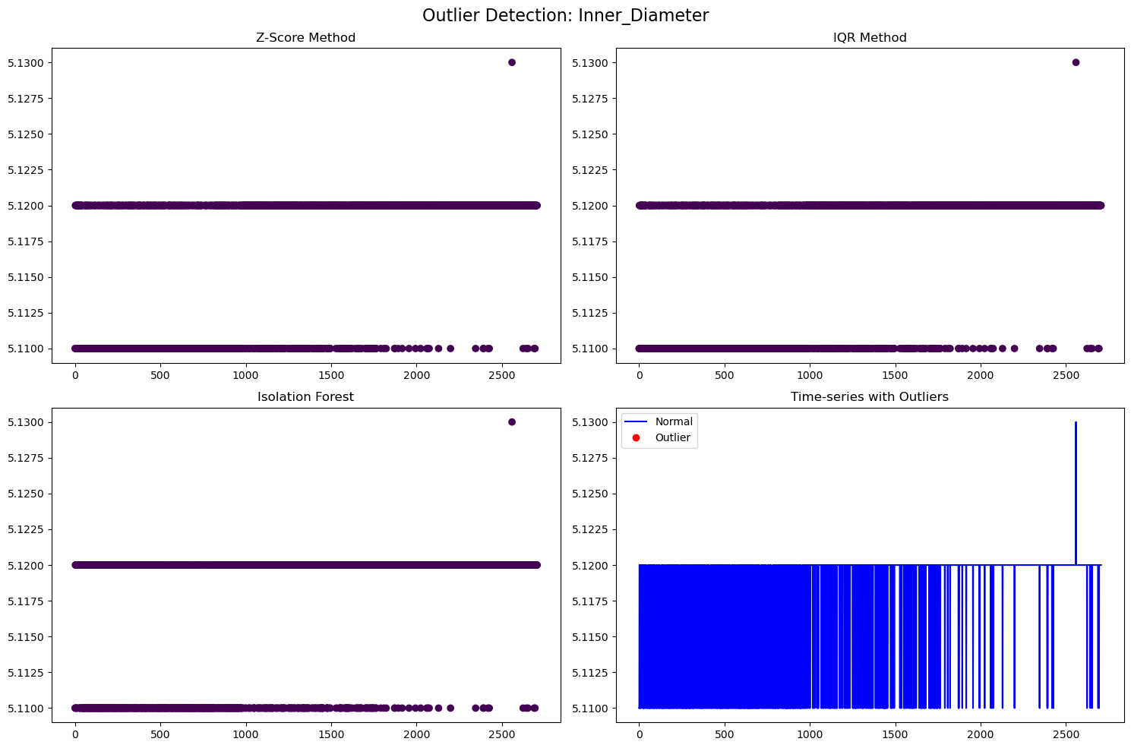
Statistical analysis
Outlier Analysis
Detect Outliers by Z-score method, IQR method, or Times-series.
Product_Thickness
Outer_Diameter
Inner_Diameter

Slide 14
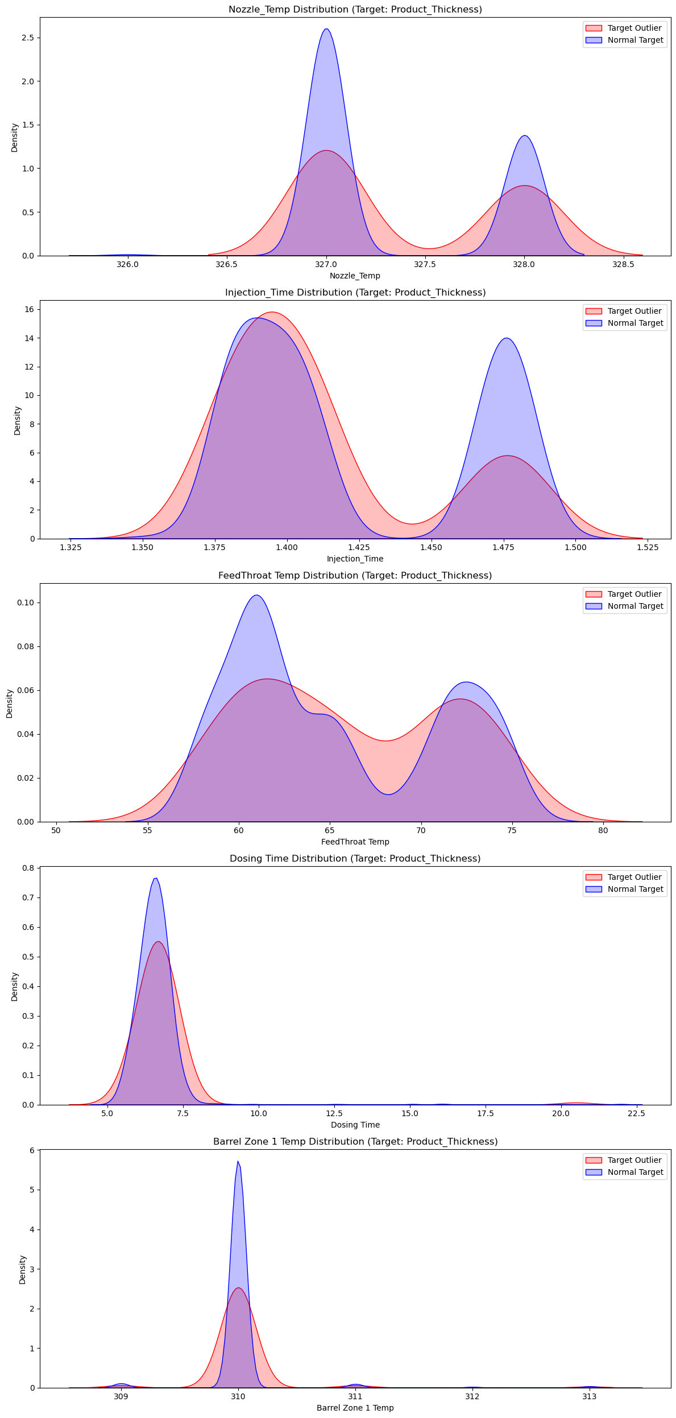
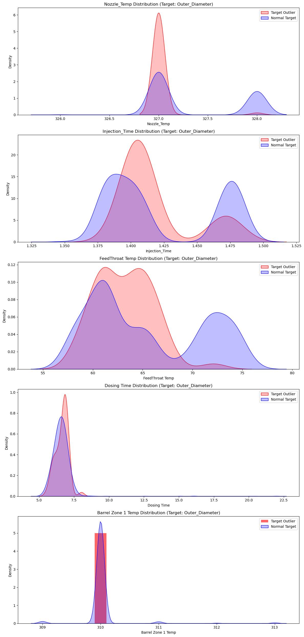
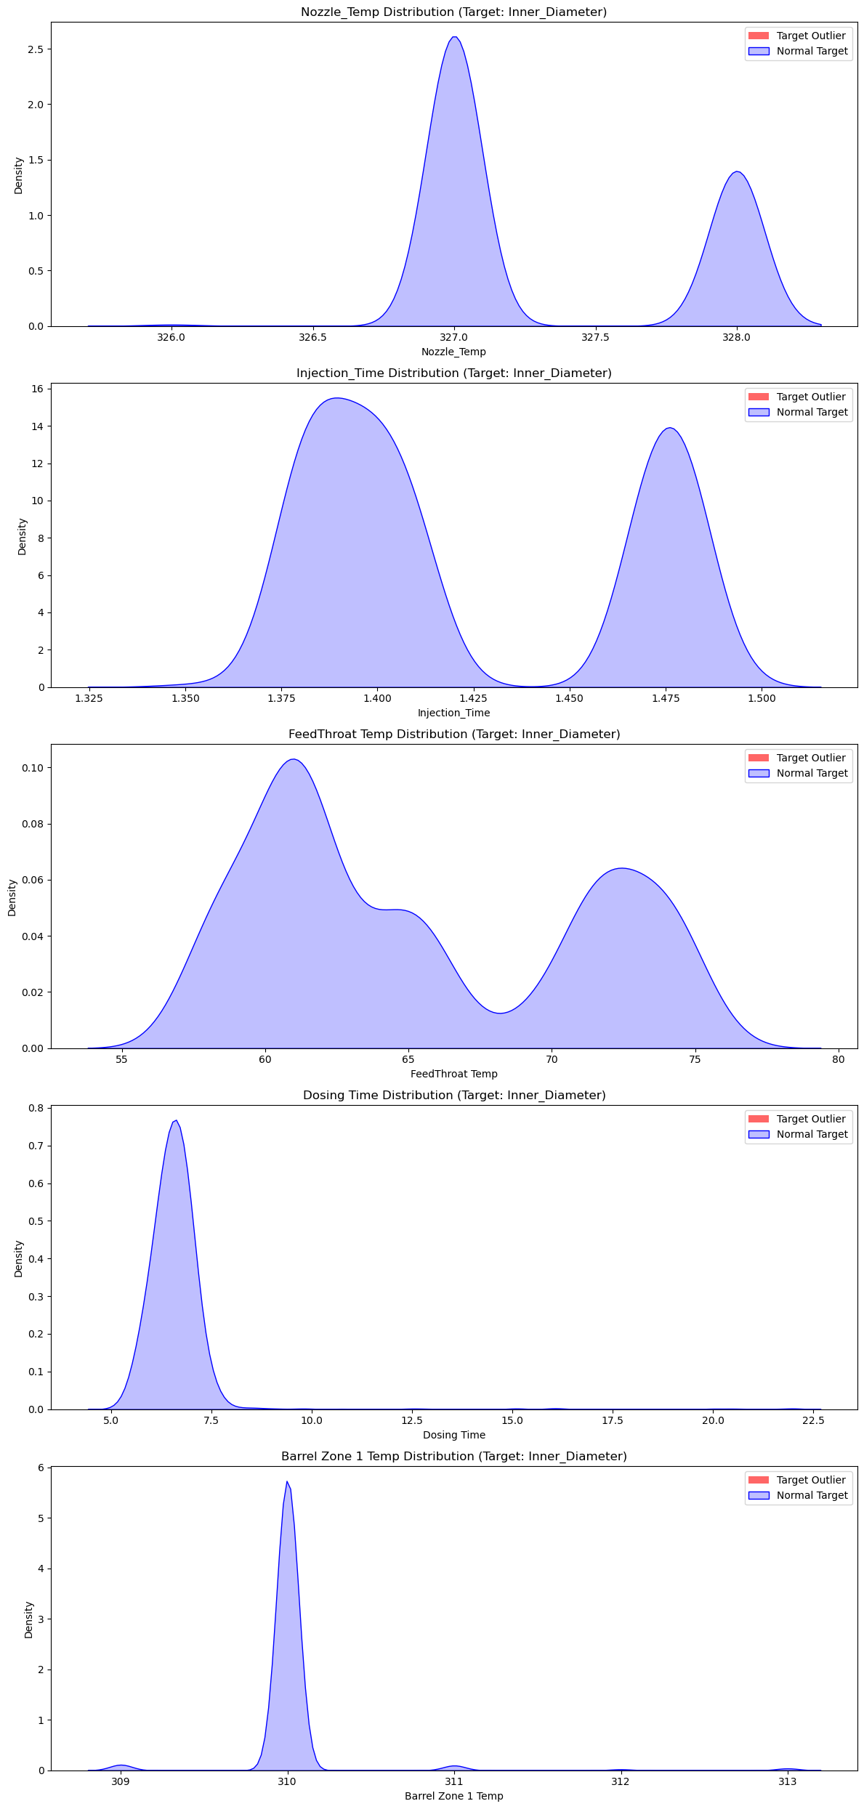
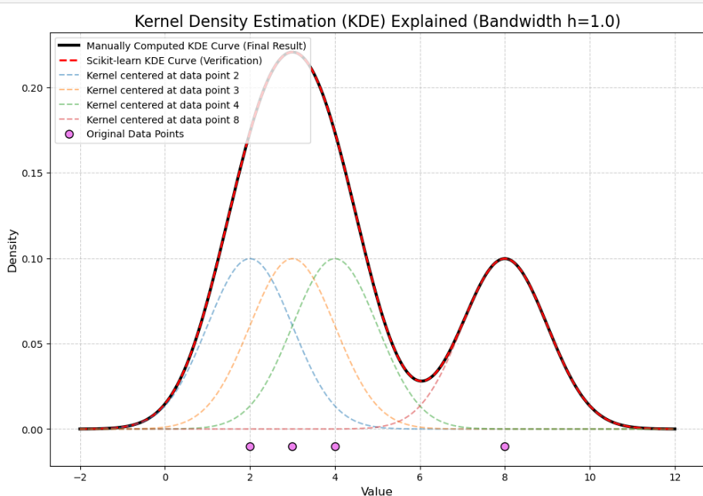
Statistical analysis
Outlier Distribution
Distribution of Outlier and Regular samples by Kernel Density Estimation
Product_Thickness
Outer_Diameter
Inner_Diameter

Slide 15
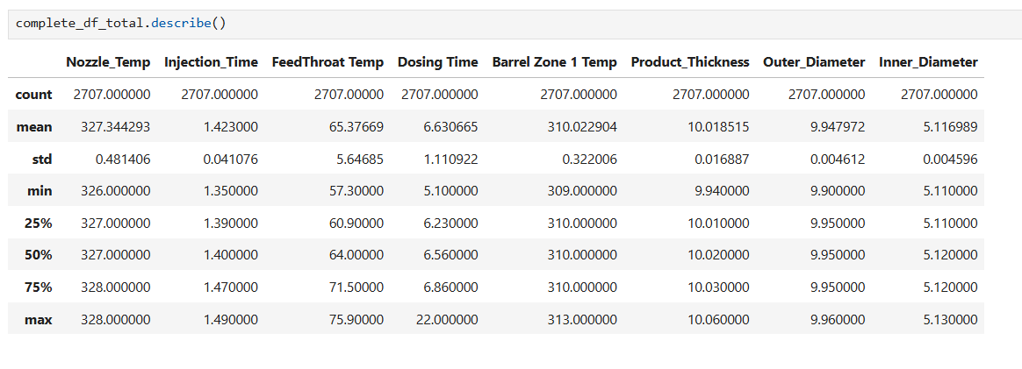
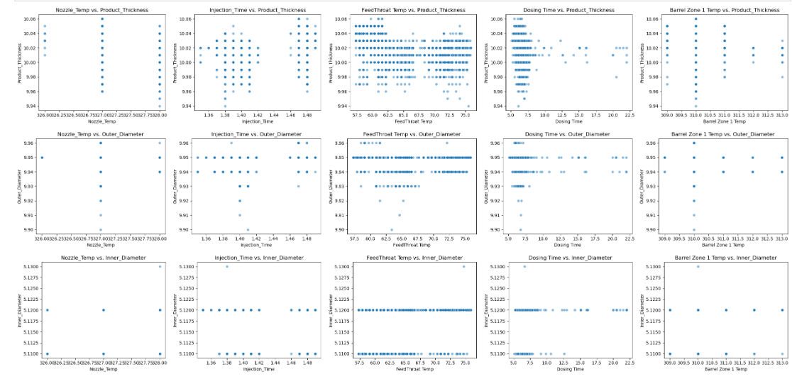
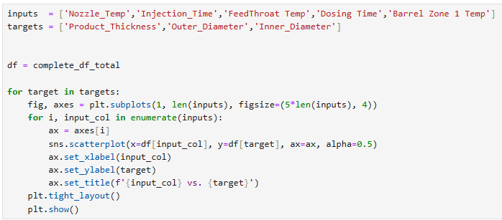
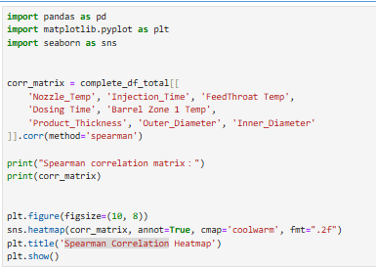
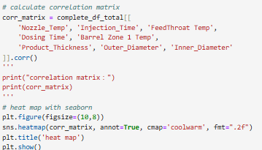
Statistical analysis – Steps (complete_df_total)
1️⃣ Descriptive analysis (e.g. mean, median, s.d.)
2️⃣ Visually analyze the relationship between multiple input parameters and target parameters
3️⃣ Pearson Correlation
4️⃣ Spearman Correlation

Slide 16
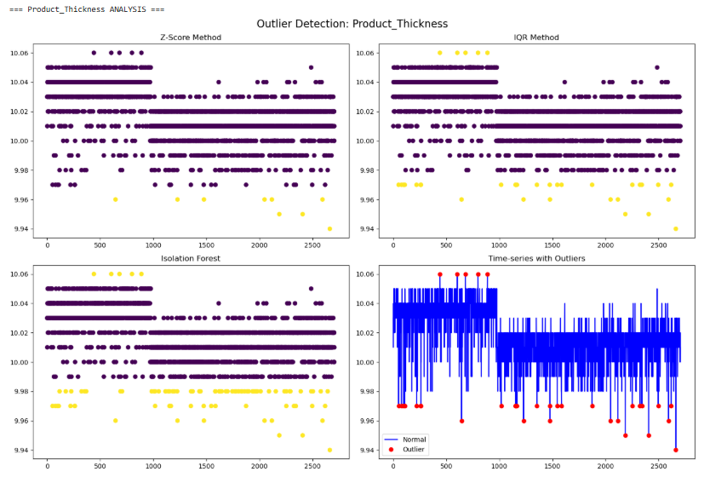
Statistical analysis – Steps (complete_df_total)
5️⃣ Outlier analysis
6️⃣ Target Outlier vs Normal Target Distribution

Slide 17
Machine Learning Model
Aspect | Details
Random Forest Regression Selection Rationale | - Addresses discrete data distribution and measurement precision limitations - Handles nonlinear relationships without linear assumptions - Robust to outliers/noise via ensemble integration
Random Forest Regression Performance | MAE reductions vs. baseline: Feature importance for thickness: - Product Thickness: 27.5% (0.0131 → 0.0095) - Injection_Time: 54.79% - Outer Diameter: 23.5% (0.0034 → 0.0026) - FeedThroat Temp: 31.00% - Inner Diameter: 28.6% (0.0042 → 0.0030)
LightGBM Quantile Regression Selection Rationale | Predicts quantiles (median, 90%) instead of averages Generates prediction intervals for risk assessment Addresses industrial needs: - Probability of exceeding specifications, Worst-case scenario forecasting, Quality warning systems
LightGBM Quantile Regression Performance | 80% prediction interval coverage: 76.27% Coverage gap (-3.73%) attributed to: - 688 values inside interval - Discrete data concentration points - 214 values outside interval - Automatic rounding effects

Slide 18

Machine learning Model
Random
Forest Regression
Multiple decision trees are constructed, and their predictions are aggregated (typically by averaging) to produce a final continuous output.
Target | Baseline MAE | RF MAE | MAE Improvement (%)
Product_Thickness | 0.0131 | 0.0095 | 27.5%
Outer_Diameter | 0.0034 | 0.0026 | 23.5%
Inner_Diameter | 0.0042 | 0.0030 | 28.6%
Feature Importances for first target:
Nozzle_Temp: 0.0395
Injection_Time: 0.5479
FeedThroat Temp: 0.3100
Dosing Time: 0.0999
Barrel Zone 1 Temp: 0.0027
Optimization with GridSearchCV

Slide 19
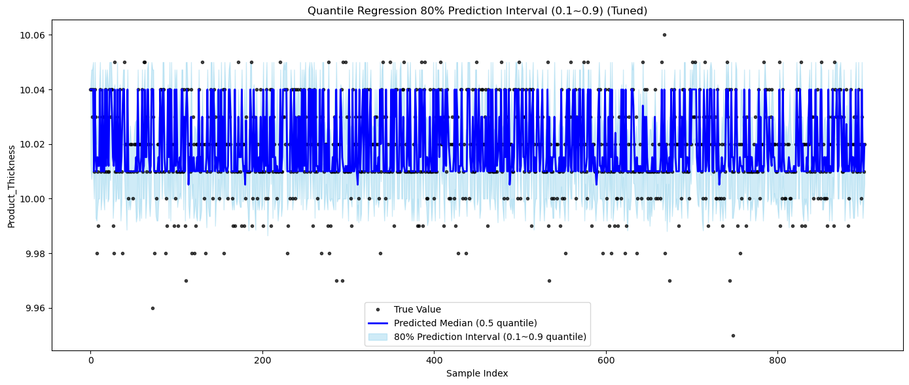
Machine learning Model
LightGBM Quantile Regression
Support quantile regression, which allows for the direct prediction of conditional quantiles of a target variable.
0.1 quantile (lower bound): 10% chance that the true value in the future will be lower than this predicted value.
0.9 quantile (upper bound): 10% chance that the true value in the future will be higher than this predicted value.
0.1~0.9 interval: The model believes that there is an 80% chance that the true value in the future will fall within this interval.
0.1
0.9
Optimization with GridSearchCV
80%
76.27% of true values fall within the 80% prediction interval
Total: 688 values inside the interval, 214 values outside

Slide 20
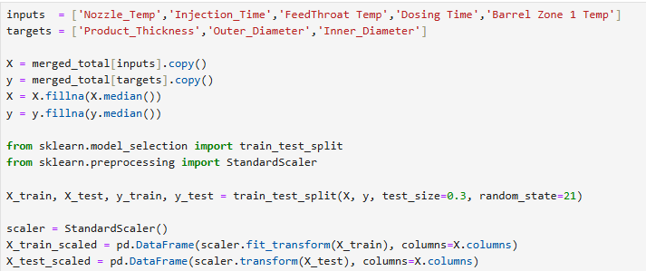
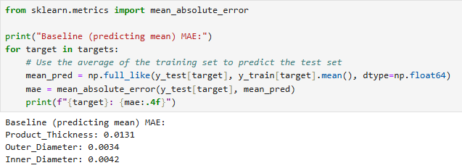
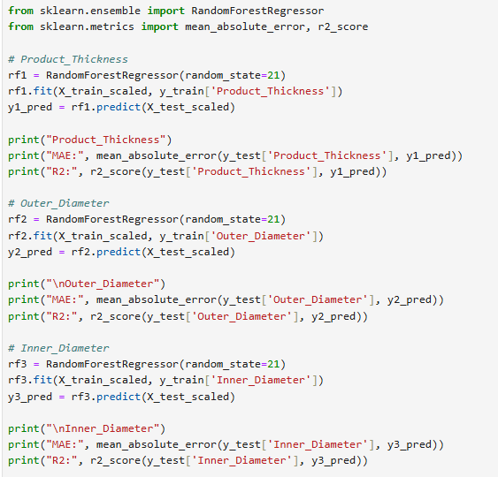
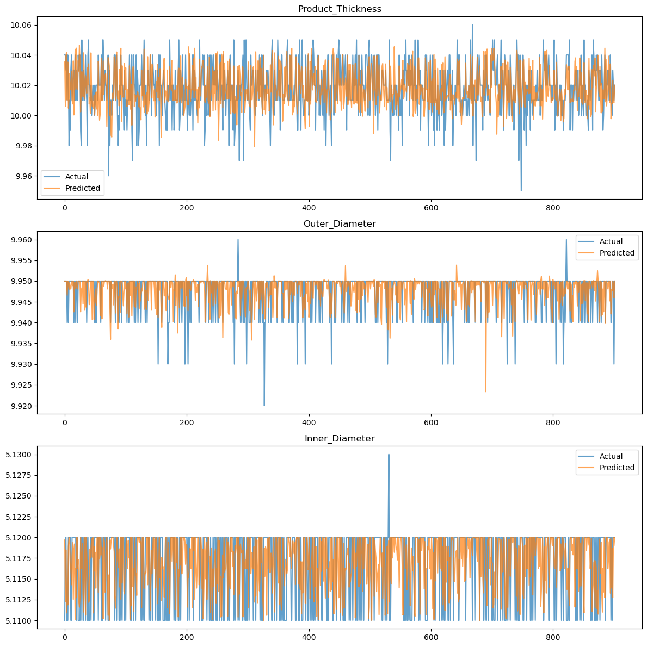
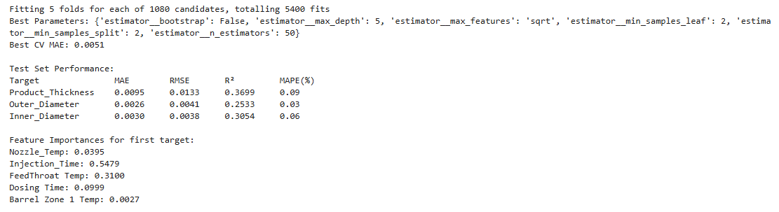
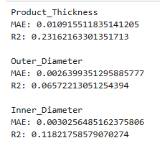
Machine Learning Model – Steps (merged_total)
1️⃣ Test Train Split
2️⃣ Use the average of the training set to predict the test set
3️⃣ Random Forest Regression
4️⃣ Random Forest Regression with GridSearchCV

Slide 21

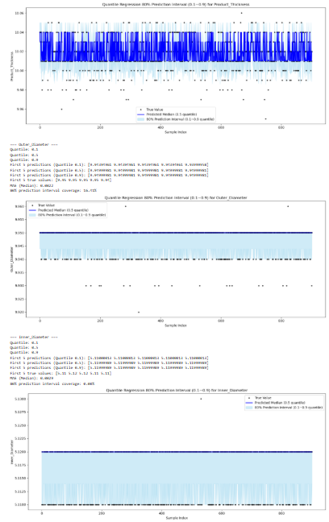
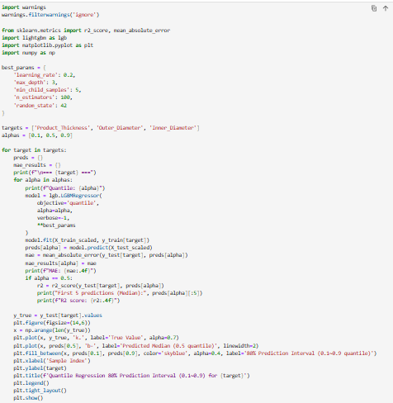
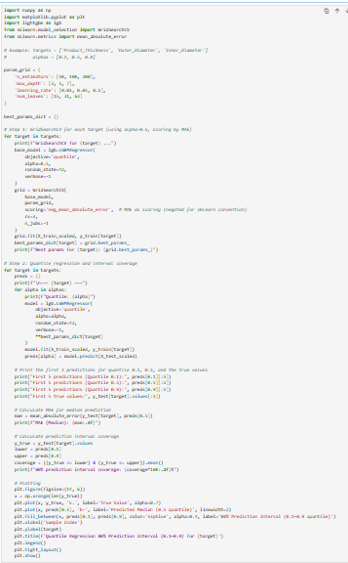
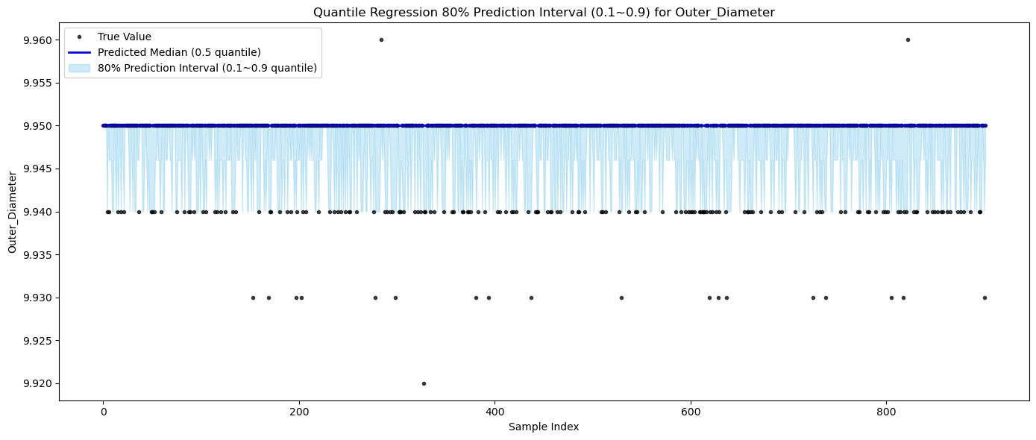
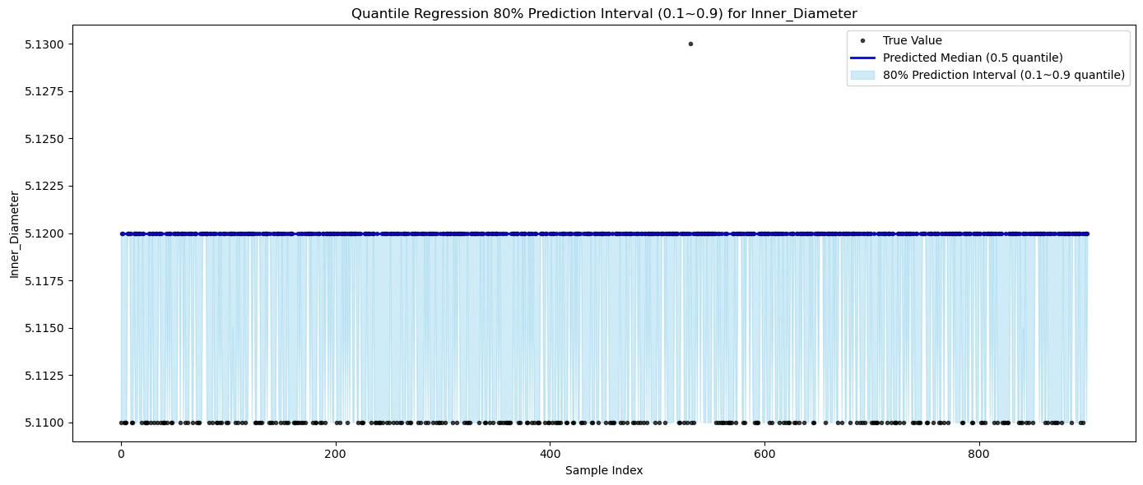
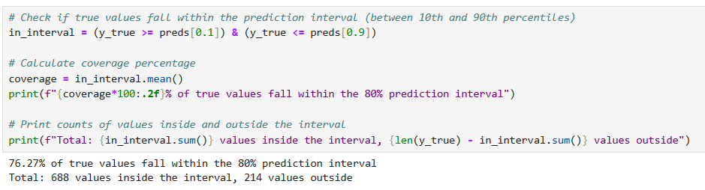
Machine Learning Model – Steps (merged_total)
5️⃣ LightGBM Quantile Regression
6️⃣ LightGBM Quantile Regression with GridSearchCV
7️⃣ Check if true values fall within the prediction
interval (between 10th and 90th percentiles)

Slide 22
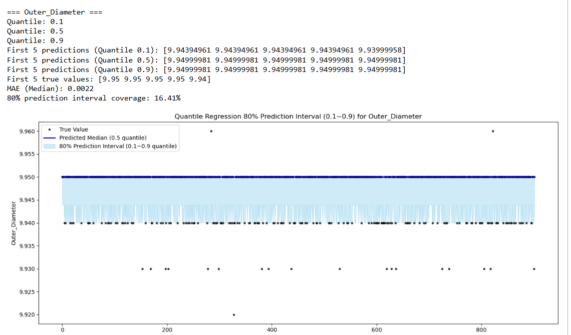
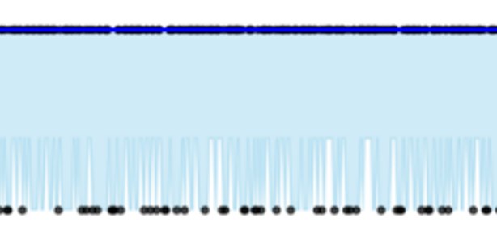
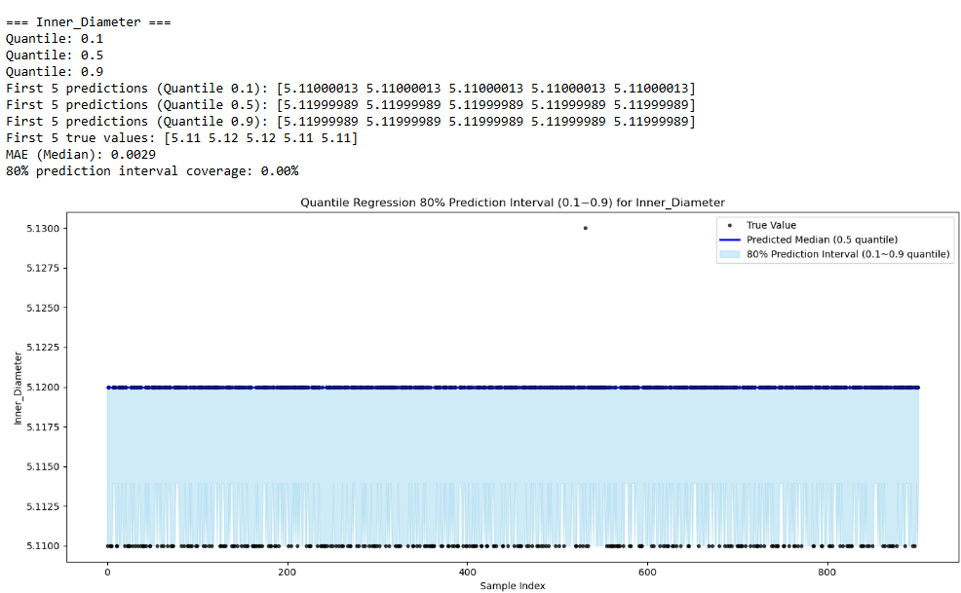
Problems
Ture values aren’t within the prediction interval.
The upper and lower bounds (0.1 quantile and 0.9 quantile) predicted by your model are almost the same, and the prediction intervals are very narrow or even overlap.
The model cannot learn the relationship between features and targets, and can only predict a constant, resulting in the prediction interval not covering the true value.
It may also be that the data itself is discrete and stratified, and the model cannot learn uncertainty.The interval predicted by the model has no reference value and cannot be used for risk management or quality warning. (classification)
Notes:
SLMs response depends on Device ( GPUs)

Slide 23
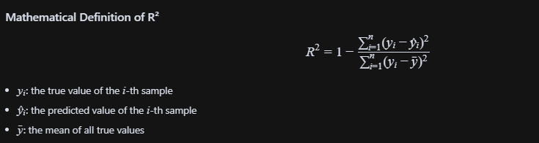
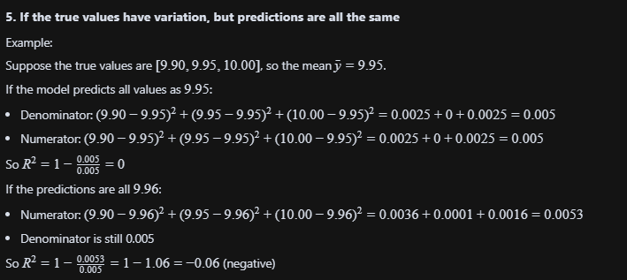
Problems
Notes:
SLMs response depends on Device ( GPUs)

Slide 24

Suggestions
Add/supplement more meaningful features
Improve measurement accuracy
Feature engineering
Try other models
Perform model interpretation and anomaly analysis
Notes:
SLMs response depends on Device ( GPUs)

Slide 25
Summary
- Data is stratified, discrete, and has no linear relationship
- Measurement accuracy is limited, and the value distribution is concentrated
- Still limited by data quality and characteristics
- Suggestions to improve data accuracy and richness
Notes:
SLMs response depends on Device ( GPUs)

