Slide 1

Appraising Homes in King County, Washington
A project for The Hazel Paisley Appraisal Corporation
Aaron Galbraith • 2023

Slide 2
Project Goal:
a fast and reliable formula for home appraisal in King County

Slide 3
The Data:
roughly 30,000 home sales
June 10, 2021 — June 10, 2022
King County, Washington, (the Seattle metro area)

Slide 4
Which features contribute most to a fair market
value appraisal of a home in the Seattle area?
median neighborhood price
living area (in square feet)
zip code
waterfront
view
sewer system

Slide 5
Baseline home price for our model:
$806,800
living area: 2,000 ft²
view: none
waterfront: no
zip code: lowest level (more details soon)
This baseline assumes …
median neighborhood price: $1,000,000
sewer system: public

Slide 6

Private Sewer Systems
Baseline: $806,800
Price estimate decreases by $68,500 for properties that use private sewer systems.

Slide 7

View
Baseline: $806,800
“None” | + $0
“Fair” | + $115,000
“Good” | + $230,000
“Excellent” | + $345,000

Slide 8
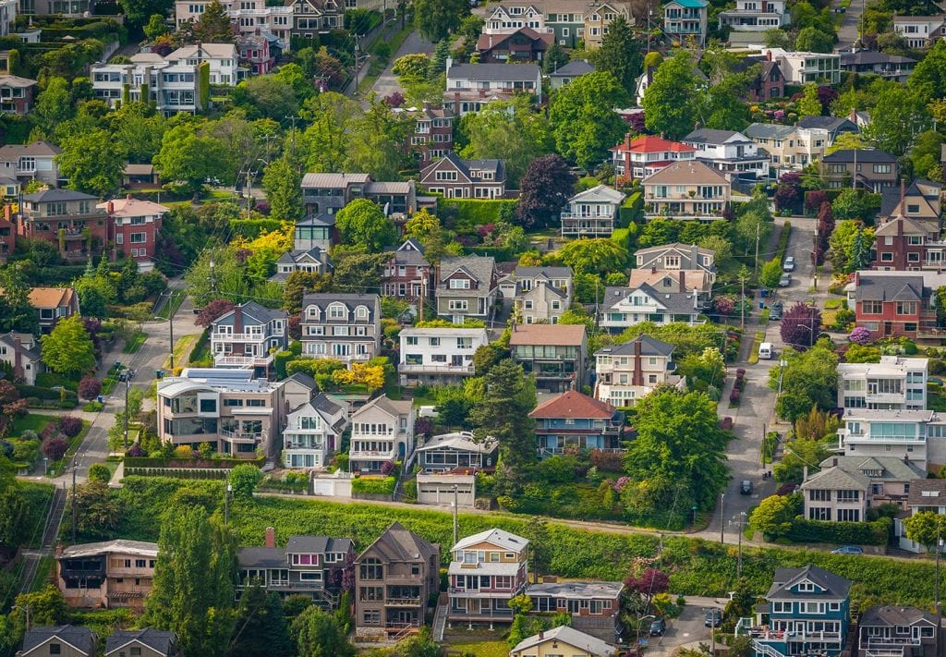
Neighborhood Median Price
Baseline: $806,800
Price estimate increases (decreases) 63 cents for every dollar
above (below) a neighborhood median price of $1,000,000

Slide 9
Neighborhood
EXAMPLE
Example
neighborhood mean: $1,050,000
benchmark: – $1,000,000
difference: $50,000
…
multiplier: x 0.63
neighborhood premium: $31,500
baseline: $806,800
neighborhood premium: + $31,500
appraised value: $838,300
Baseline: $806,800
Neighborhood benchmark:
$1,000,000
Multiplier: 0.63

Slide 10
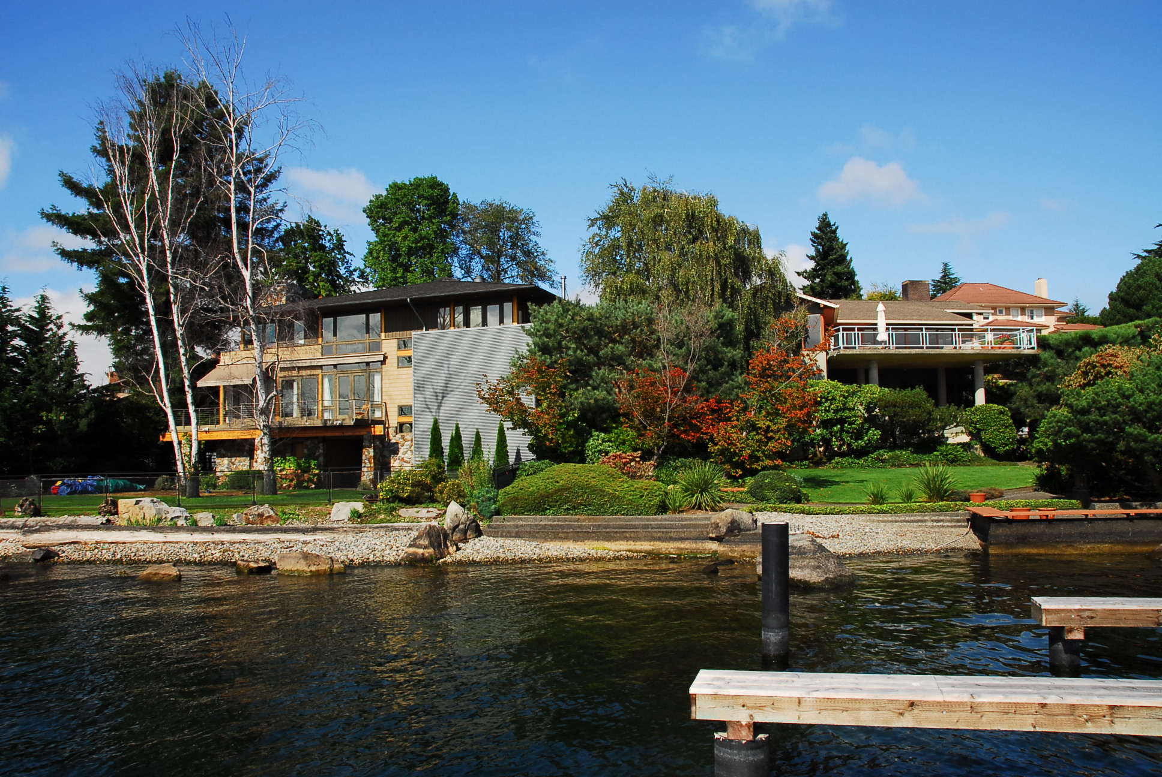
Waterfront
Area Premium
Baseline: $806,800
Price estimate increases (decreases) $529 per square foot
above (below) 2,000 ft²

Slide 11
Waterfront
EXAMPLE
living area: 2,300
benchmark: – 2,000
difference: 300
…
multiplier: x $529
waterfront premium: $158,700
baseline: $806,800
waterfront premium: + $158,700
appraised value: $965,500
Baseline: $806,800
Area benchmark: 2,000 ft²
Multiplier: $529

Slide 12
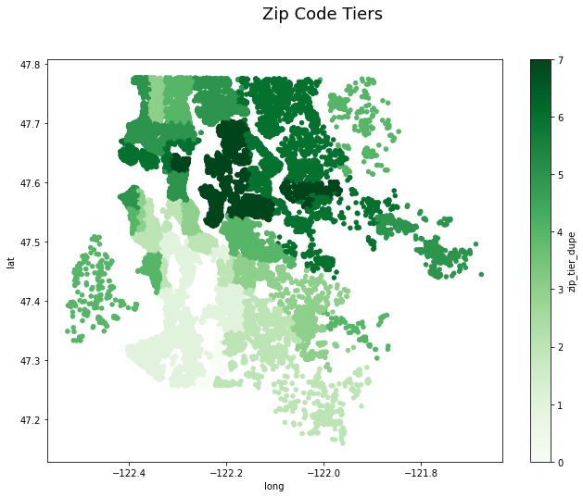
Zip Code
Level Premium
Baseline: $806,800
Price estimate increases
$50,000 per zip code level
Level 0 +$0 | Level 1 +$50k | Level 2 +$100k | Level 3 +$150k | Level 4 +$200k | Level 5 +$250k | Level 6 +$300k | Level 7 +$350k

Slide 13
Zip Code
Area Premium
Baseline: $806,800
Price estimate increases (decreases)
$61 per zip code level, per square foot,
above (below) 2,000 ft²
Level 0 +$0 | Level 1 +$61 | Level 2 +$122 | Level 3 +$183 | Level 4 +$244 | Level 5 +$305 | Level 6 +$366 | Level 7 +$427

Slide 14
Zip Code
EXAMPLE
zip code level: 5
level multiplier: x $50,000
level premium: $250,000
living area: 2,300
benchmark: – 2,000
difference: 300
…
area multiplier: x 5 x $61
area: premium: $91,500
baseline: $806,800
level premium: + $250,000
area premium: + $91,500
appraised value: $1,148,300
Baseline: $806,800
Area benchmark: 2,000 ft²
Level multiplier: $50,000
Area multiplier: $61 (per level)

Slide 15
Limitations:
mean absolute error ~ $225,000
best performance between +/- 2 standard deviations

Slide 16
Recommendation #1:
Starting from a baseline of $806,800, add (or subtract) 64 cents for every $1 that the median home value (nearest 20-30 recent listings) exceeds (or falls short of) $1 million.

Slide 17
Recommendation #2:
Starting from a baseline of $806,800, add (or subtract) $60 per zip code level for every square foot that the home’s living area exceeds (or falls short of) 2,000 square feet.

Slide 18
Thank you
Aaron Galbraith • 2023
www.linkedin.com/in/aarongalbraith

