Slide 1
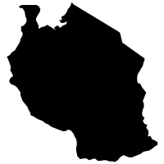
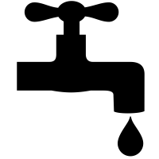
Predicting Pump Failure in Tanzanian Water Wells
A project for The Government of Tanzania
Aaron Galbraith • 2023

Slide 2
Background
23 million people in Tanzania lack access to safe drinking water
59% of government-funded wells fail, compared to 43% of wells funded by other orgs

Slide 3
Project Goal
to help the Government of Tanzania identify trends associated with wells that become non-functional
1. adjust plans before installation
2. monitor at-risk wells after installation

Slide 4
Success Metrics
1. “recall”: identification of non-functional wells
2. overall accuracy

Slide 5
Data Overview
location data
natural conditions
well structure
installation and management

Slide 6
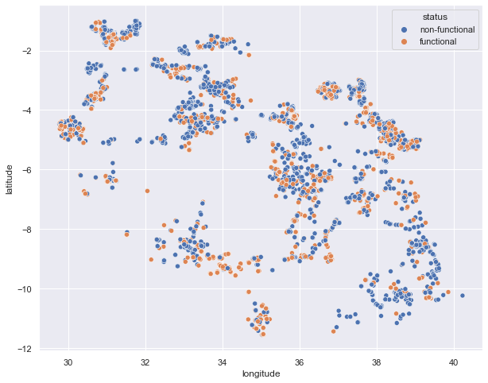
Data Overview

Slide 7
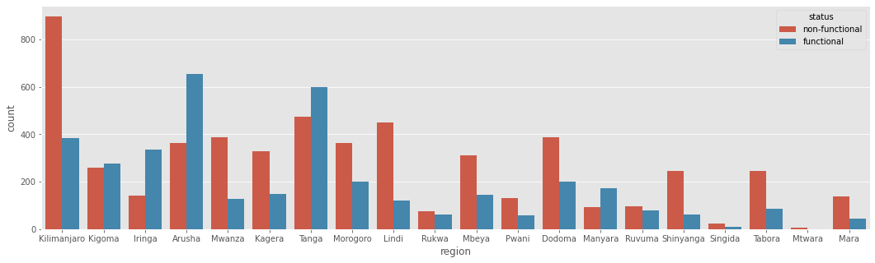
Data Overview
performance by region

Slide 8
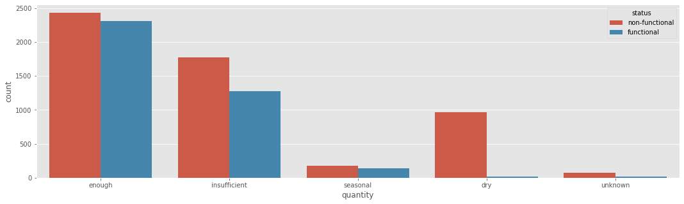
Data Overview
performance by water quantity

Slide 9
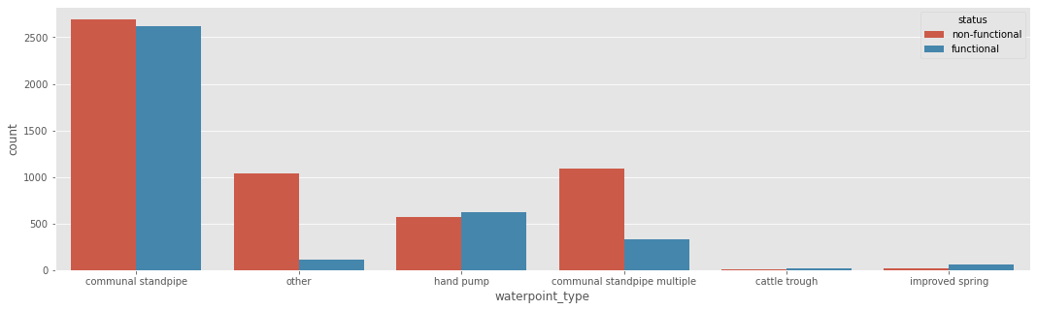
Data Overview
performance by well structure

Slide 10
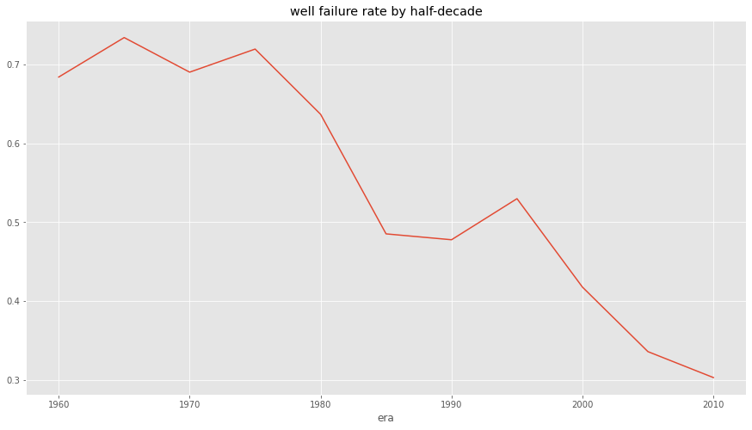
Data Overview
failure rate over time

Slide 11
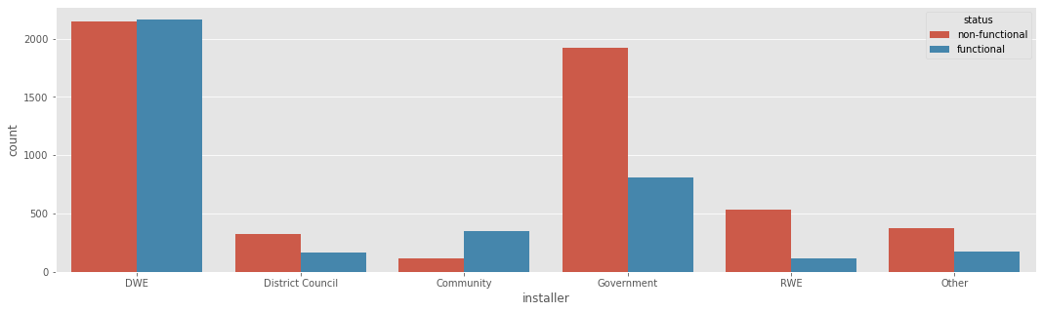
Data Overview
performance by installer

Slide 12
Modeling
model | recall | accuracy
logistic | 77% | 75%
XG boost | 78% | 78%
random forest | 81% | 76%

Slide 13

Results
most predictive features
1. water quantity

Slide 14


Results
most predictive features
2. waterpoint type

Slide 15


Results
most predictive features
3. installer

Slide 16
Recommendations
1. before installing wells, prioritize, if possible
a. sufficient water quantity
b. using handpump or communal standpipe
c. installation by community or DWE

Slide 17
Recommendations
2. after installing wells, commit resources to monitoring
a. wells with low water quantity
b. communal standpipe multiple types
c. government-installed wells
d. wells installed before 1985

Slide 18
Further Inquiry
gather more complete data, particularly in water quantity, waterpoint type, and installer identity
acquire data on cost and availability of options

Slide 19
Thank you
Aaron Galbraith • 2023
www.linkedin.com/in/aarongalbraith

