Slide 1
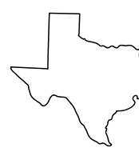

Apple at SXSW 2011
A project to capitalize on a successful product launch
Aaron Galbraith • 2023

Slide 2
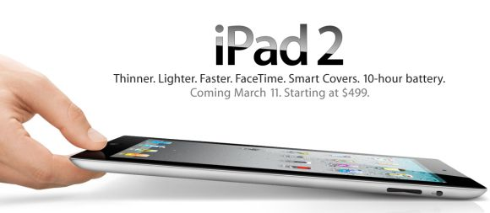

Background

Slide 3
Project Goal
1. to help Apple understand how their presence at SXSW was received
2. to give Apple a tool to interpret public sentiment

Slide 4




Data
#sxsw × 9,000

Slide 5
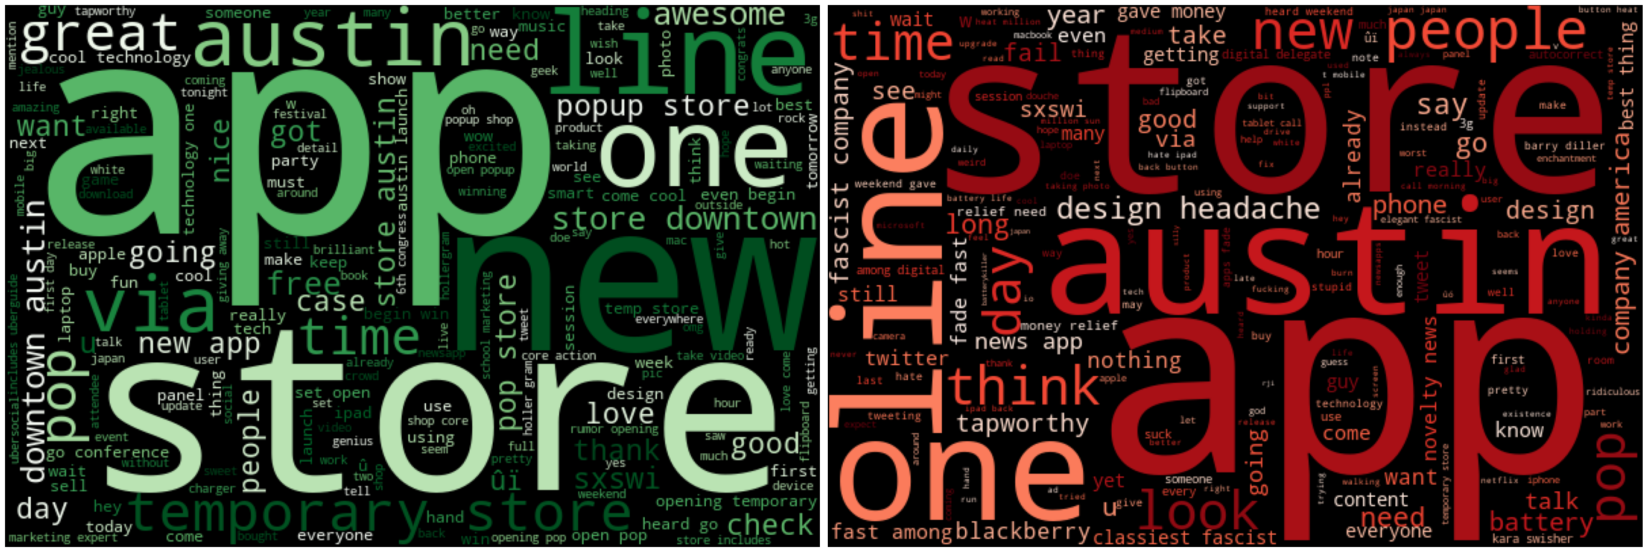
Apple Overview

Slide 6
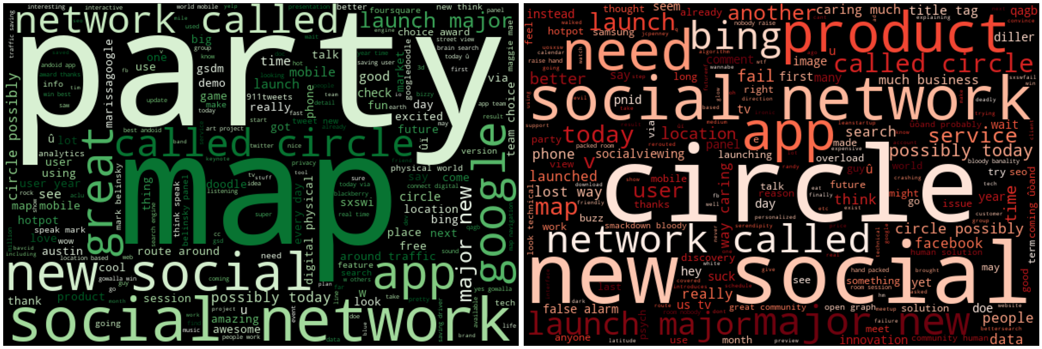
Google Overview

Slide 7
Methods
tokenize + remove common words + vectorize tweets
binary classification: positive / NON-positive
ML classifiers: Naïve Bayes, Random Forest, Gradient Boost
metric: simple accuracy

Slide 8
Results
model | training score | test score
Naïve Bayes (BASELINE) | 79.4% | 71.5%
… with hyperparameter tuning | 89.0% | 72.2%
… with over sampling | 86.7% | 68.0%
Random Forest | 96.5% | 73.2%
… with hyperparameter tuning | 86.4% | 72.5%
Gradient Boost (FINAL) | 74.9% | 72.3%

Slide 9
Recommendations
pop-up store + event synergy = great idea
throw a party
address battery life and design issues

Slide 10
Further Inquiry
analyze all three sentiments
incorporate more features to the model (e.g. tweet length)
get to the bottom of overfitting issues

Slide 11
Thank you
Aaron Galbraith • 2023
www.linkedin.com/in/aarongalbraith

