Slide 1
Apple at SXSW 2011
A project to capitalize on a successful product launch
Aaron Galbraith • 2023

Slide 2
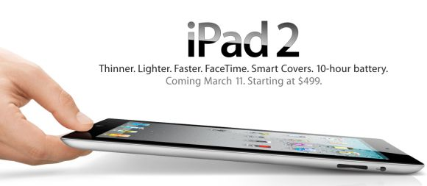

Background

Slide 3
Project Goal
1. to help Apple understand how their presence at SXSW was received
2. to give Apple a tool to interpret public sentiment

Slide 4




Data
#sxsw ×9,000

Slide 5
Methods
#sxsw ×9,000

Slide 6
Methods

Slide 7
Results

