Slide 1
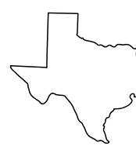

Apple at SXSW 2011
A project to capitalize on a successful product launch
Aaron Galbraith • 2023

Slide 2
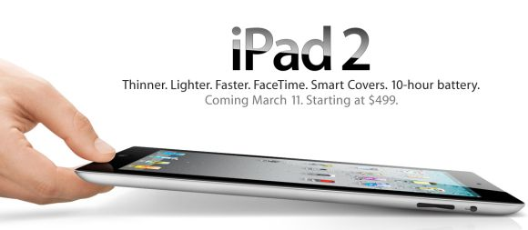

Background

Slide 3
Project Goal
1. to help Apple understand how their presence at SXSW was received
2. to give Apple a tool to interpret public sentiment

Slide 4

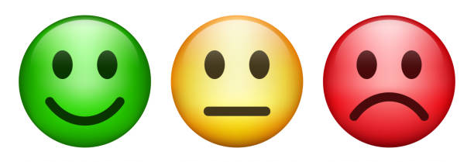


Data
content: #sxsw × 9,000
sentiment:
brand:

Slide 5
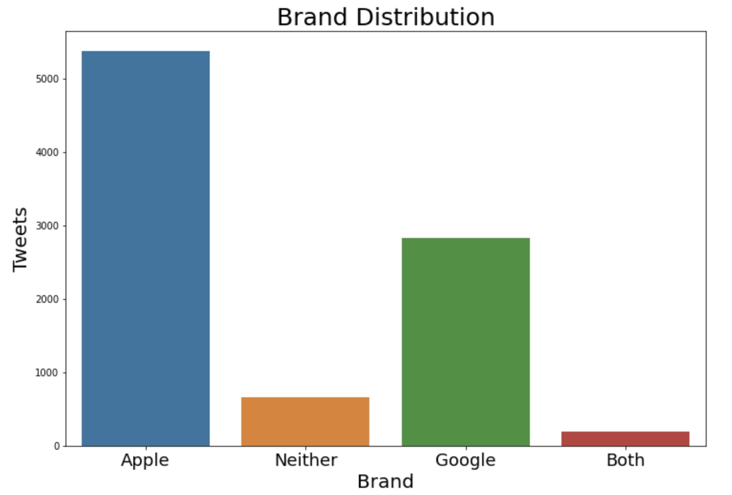
Data
more tweets about Apple than Google by 2 : 1

Slide 6
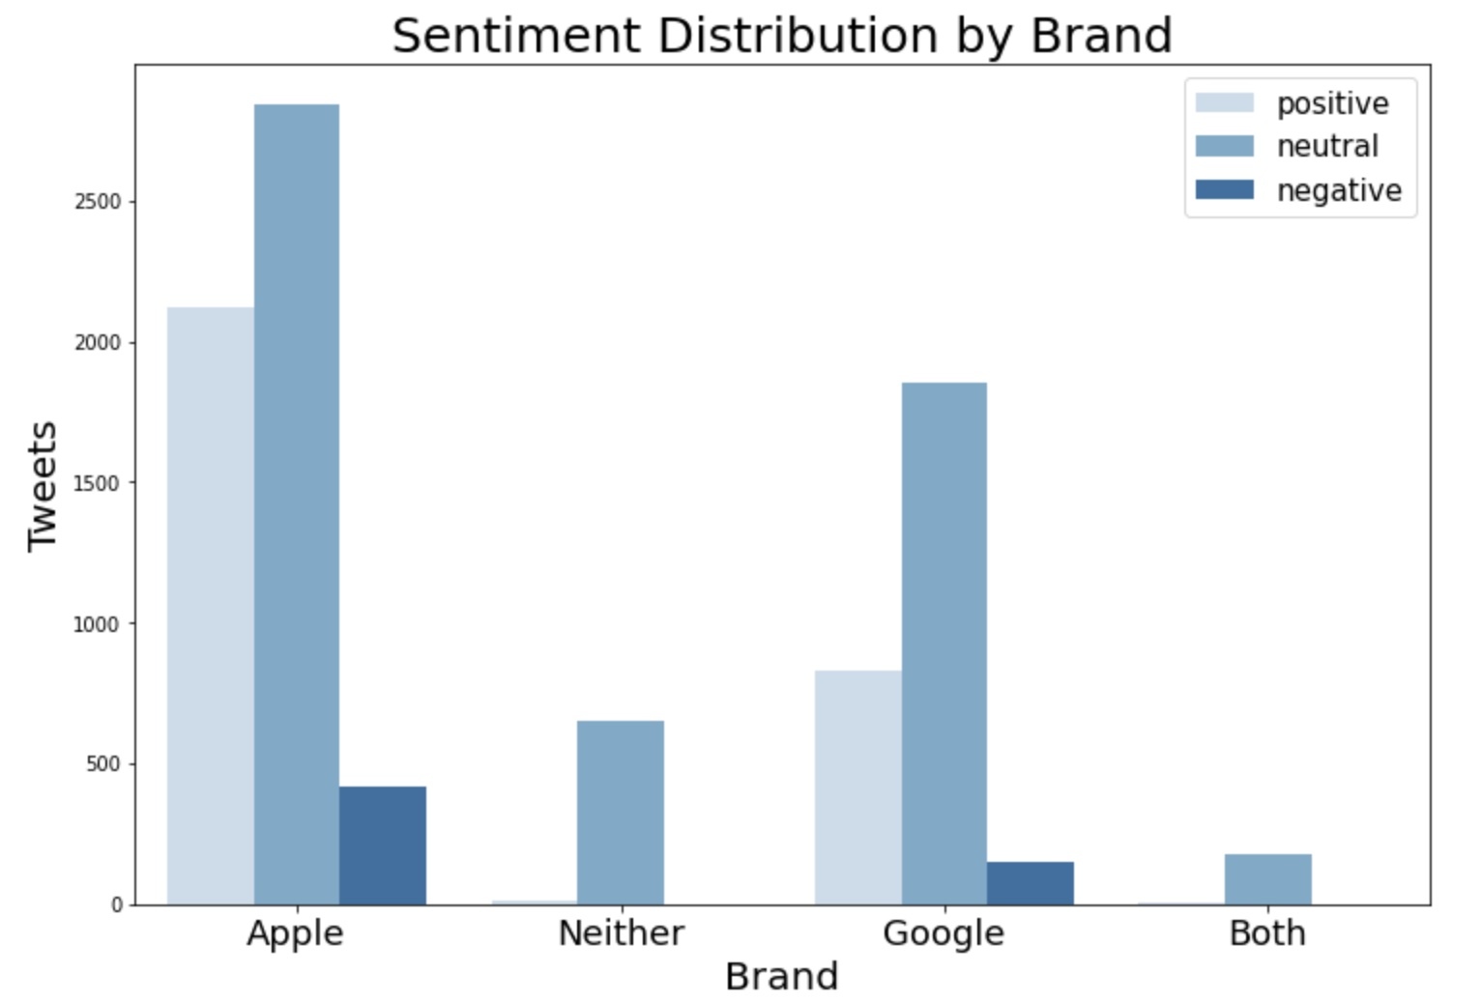
Data
both Apple and Google had (+) : (–) ratio of about 5 : 1

Slide 7
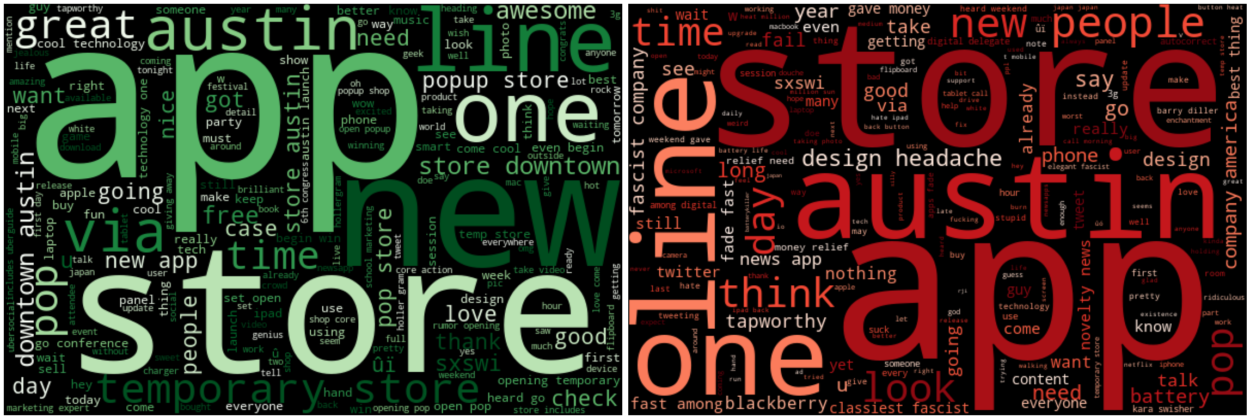
Apple Overview
(+): “temporary store”, “popup store”, “downtown Austin”
(–): “battery”, “design headache”, “fascist company”

Slide 8
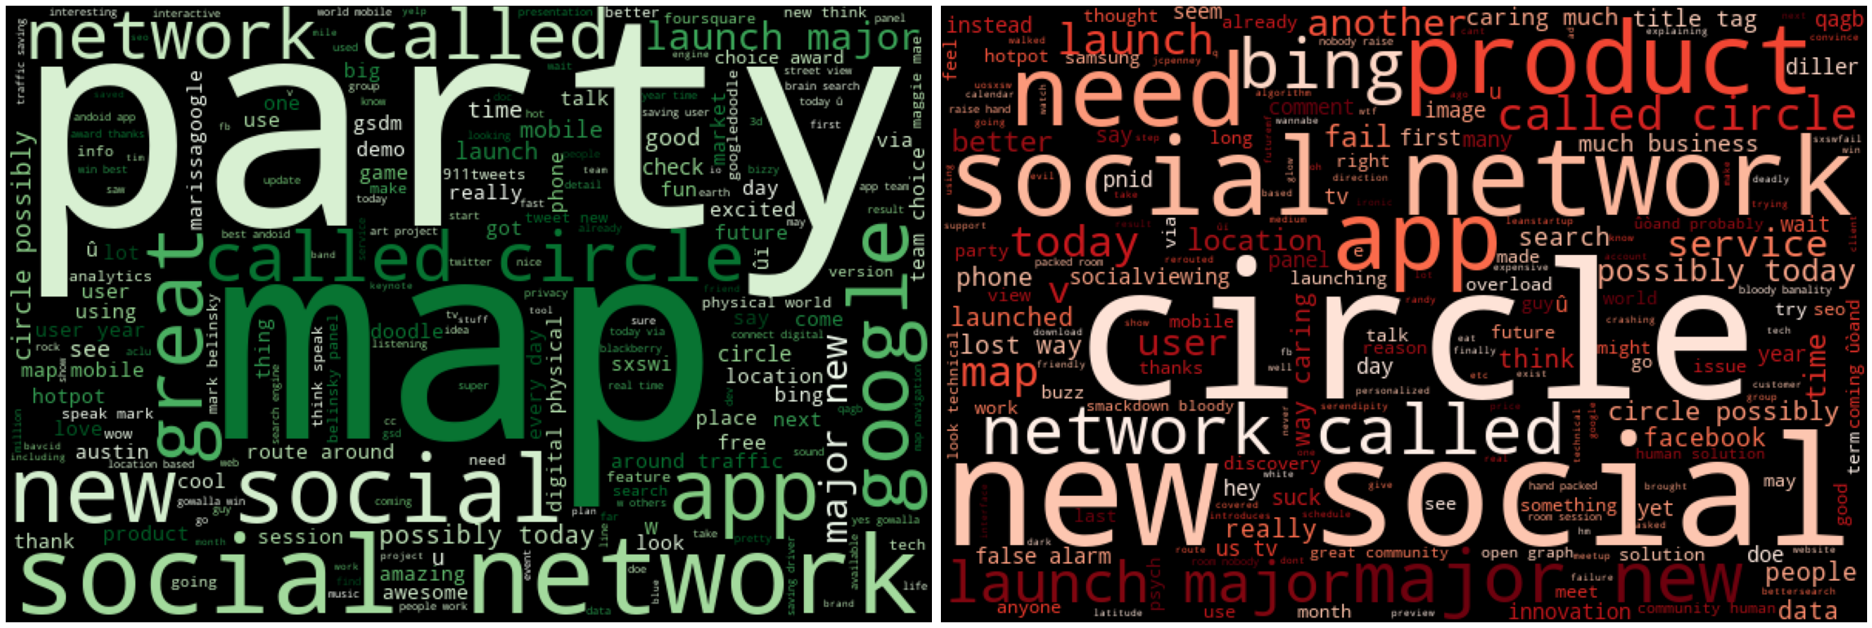
Google Overview
(+): “party”, “maps”
(–): “circles”, “Bing”, “launching”

Slide 9
Methods
tokenize + remove common words + vectorize tweets
binary classification: positive / NON-positive
ML classifiers: Naïve Bayes, Random Forest, Gradient Boost*
* final model
metric: accuracy

Slide 10
Results
model | training score | test score
Naïve Bayes (BASELINE) | 79.4% | 71.5%
… with hyperparameter tuning | 89.0% | 72.2%
… with over sampling | 86.7% | 68.0%
Random Forest | 96.5% | 73.2%
… with hyperparameter tuning | 86.4% | 72.5%
Gradient Boost (FINAL) | 74.9% | 72.3%

Slide 11
Recommendations
pop-up store + event synergy = great idea
throw a party
address battery life and design issues

Slide 12
Further Inquiry
analyze all three sentiments
incorporate more features to the model (e.g. tweet length)
get to the bottom of overfitting issues

Slide 13
Thank you
Aaron Galbraith • 2023
www.linkedin.com/in/aarongalbraith

