Slide 1
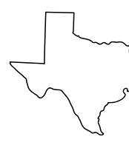

Apple at SXSW 2011
A project to capitalize on a successful product launch
Aaron Galbraith • 2023

Slide 2
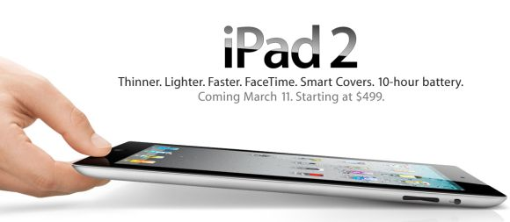

Background

Slide 3
Project Goal
1. to help Apple understand how their presence at SXSW was received
2. to give Apple a tool to interpret public sentiment

Slide 4




Data
#sxsw × 9,000

Slide 5
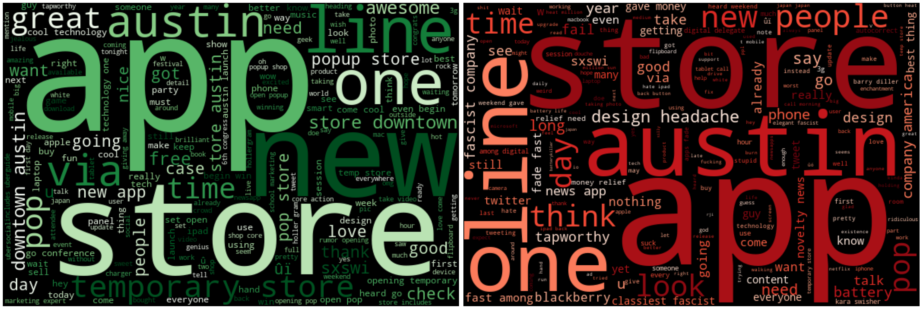
Apple Overview

Slide 6
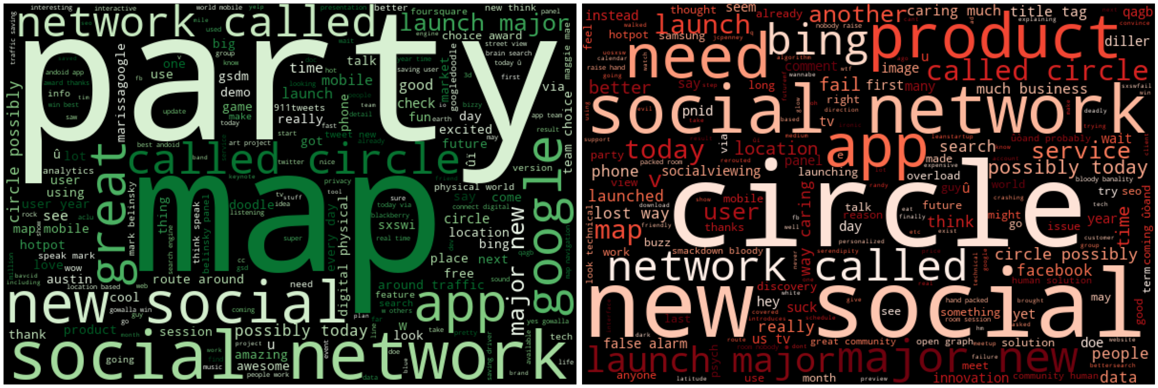
Google Overview

Slide 7
Methods
tokenize + remove common words + vectorize tweets
binary classification: positive / NON-positive
ML classifiers: Naïve Bayes, Random Forest, Gradient Boost
metric: simple accuracy

Slide 8
Results
model | training score | test score
Naïve Bayes (BASELINE) | 79.4% | 71.5%
… with hyperparameter tuning | 89.0% | 72.2%
… with over sampling | 86.7% | 68.0%
Random Forest | 96.5% | 73.2%
… with hyperparameter tuning | 86.4% | 72.5%
Gradient Boost (FINAL) | 74.9% | 72.3%

Slide 9
Recommendations
pop-up store + event synergy = great idea
throw a party
address battery life and design issues

Slide 10
Further Inquiry

Slide 11
Thank you
Aaron Galbraith • 2023
www.linkedin.com/in/aarongalbraith

