Slide 1
Title
Description
Aaron Galbraith • 2023

Slide 2
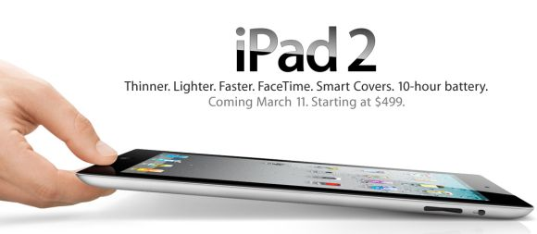

Background

Slide 3
Project Goal
1. to help Apple understand how their presence at SXSW was received
2. to give Apple a tool to interpret public sentiment

Slide 4
Data
review: bar graph of methods
sentiment: bar graph of ratings
brand:

Slide 5
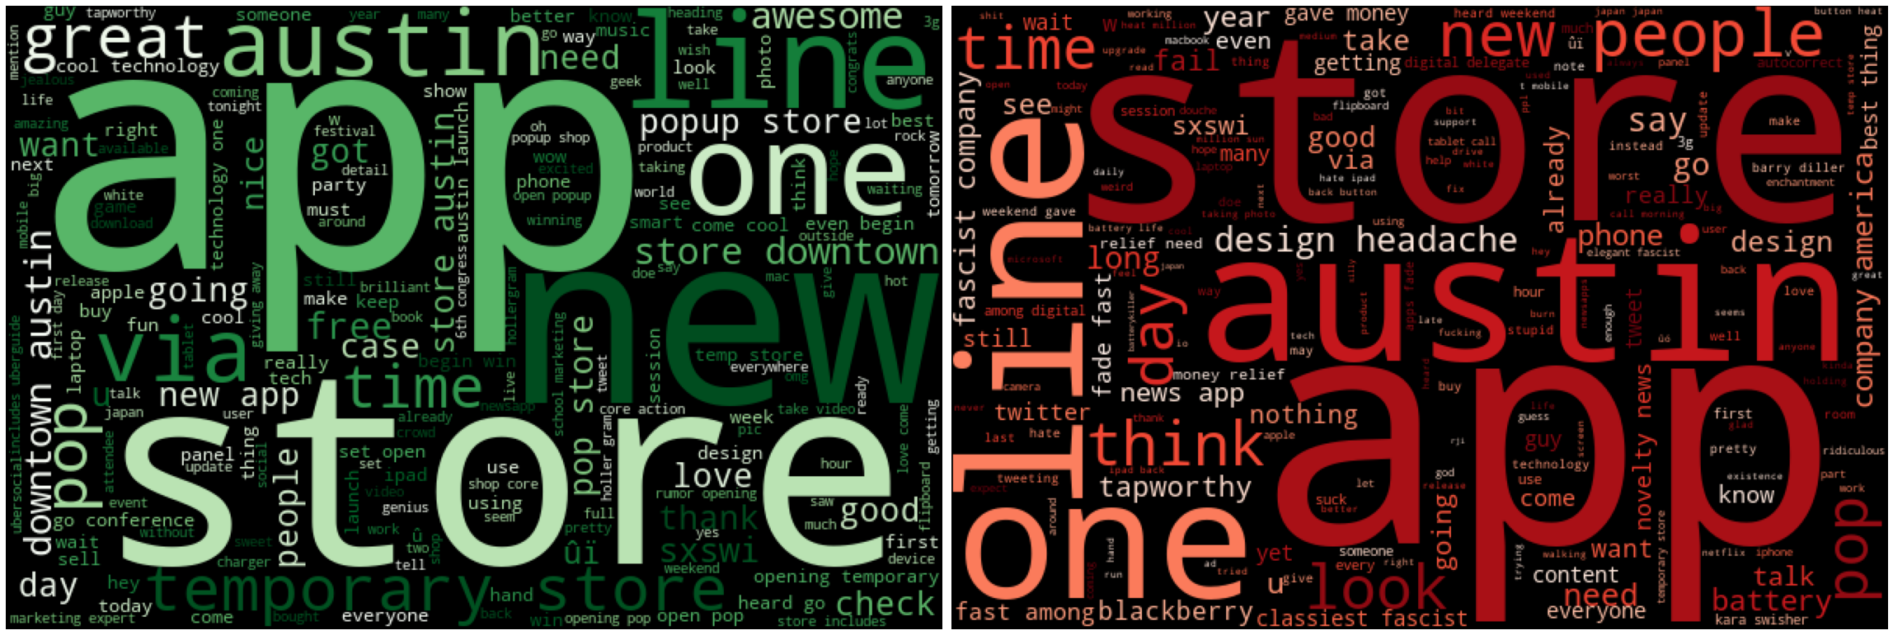
Apple Overview
(+): “temporary store”, “popup store”, “downtown Austin”
(–): “battery”, “design headache”, “fascist company”

Slide 6
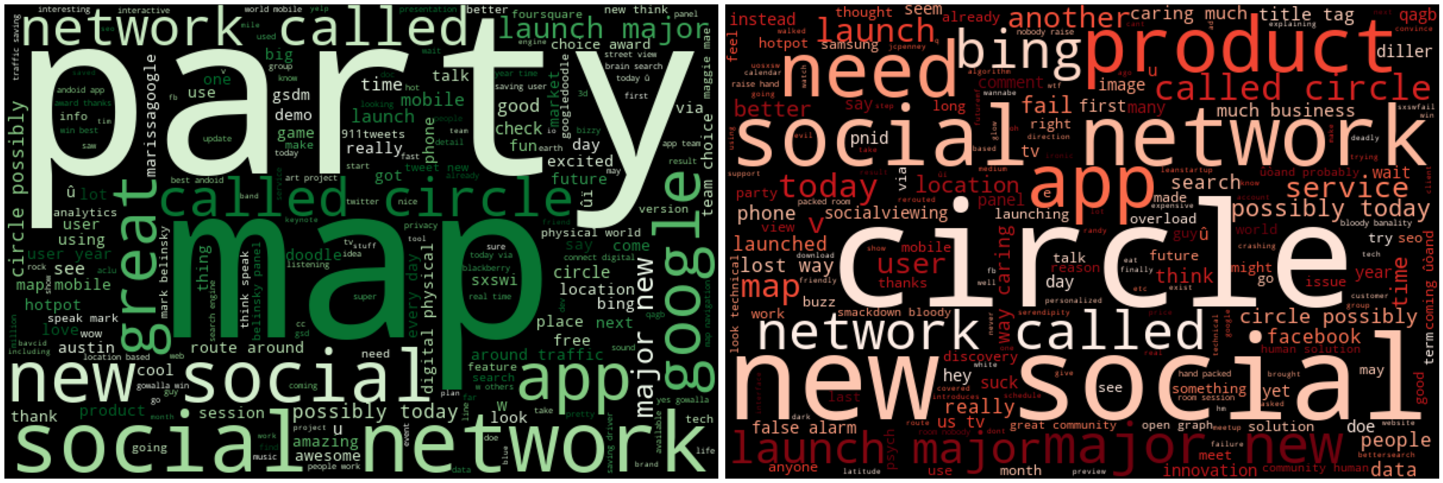
Google Overview
(+): “party”, “maps”
(–): “circles”, “Bing”, “launching”

Slide 7
Methods
ChatGPT3 helped with brand categorization
ML classifiers: Naïve Bayes, Random Forest, Gradient Boost*
* final model
metric: accuracy

Slide 8
Results
model | training score | test score
Naïve Bayes (BASELINE) | 79.4% | 71.5%
… with hyperparameter tuning | 89.0% | 72.2%
… with over sampling | 86.7% | 68.0%
Random Forest | 96.5% | 73.2%
… with hyperparameter tuning | 86.4% | 72.5%
Gradient Boost (FINAL) | 74.9% | 72.3%

Slide 9
Recommendations
pop-up store + event synergy = great idea
throw a party
address battery life and design issues

Slide 10
Further Inquiry
analyze all three sentiments
incorporate more features to the model (e.g. tweet length)
get to the bottom of overfitting issues

Slide 11


Thank you
Aaron Galbraith • 2023
www.linkedin.com/in/aarongalbraith

