Slide 1
Rockbuster Stealth Data Analysis Project
PRESENTATION
Aaron Gilbert

Slide 2
Agenda
Introduction
Business questions and Analysis
Data Overview
Recommendations
Q&A

Slide 3
Introduction
Facing stiff competition from streaming services such as Netflix and Amazon Prime, the Rockbuster Stealth management team is planning to use its existing movie licenses to launch an online video rental service in order to stay competitive.
Under the leadership of Rockbuster Stealth’s business intelligence (BI) department, this analysis has been conducted to support the launch strategy of the new online video service.
To this end, this analysis responds to key questions asked by the management team about e.g., revenue contribution by movies, customer geography, sales by region, etc

Slide 4
Business Questions and Analysis
Questions:
Which movies contributed the most/least to revenue gain?
What was the average rental duration for all videos?
Which countries are Rockbuster customers based in?
Where are customers with a high lifetime value based?
Do sales figures vary between geographic regions?
The Rockbuster Stealth Management Board has asked a series of business questions and they expect data-driven answers that they can use for their 2020 company strategy. Here are the main questions they’d like to answer:

Slide 5
DATA Overview Inventory Stats
Rental Duration
Highest | 7 days
Lowest | 3 days
Average | 5 days
Rental Rate
Highest | $4.99
Lowest | $0.99
Average | $2.98
Film Length
Highest | 185 mins
Lowest | 46 mins
Average | 115 mins
Replacement Cost
Highest | $29.99
Lowest | $9.99
Average | $19.98
Our movie rental service company currently offers a selection of 1000 films, across 17 different categories in 108 countries.

Slide 6
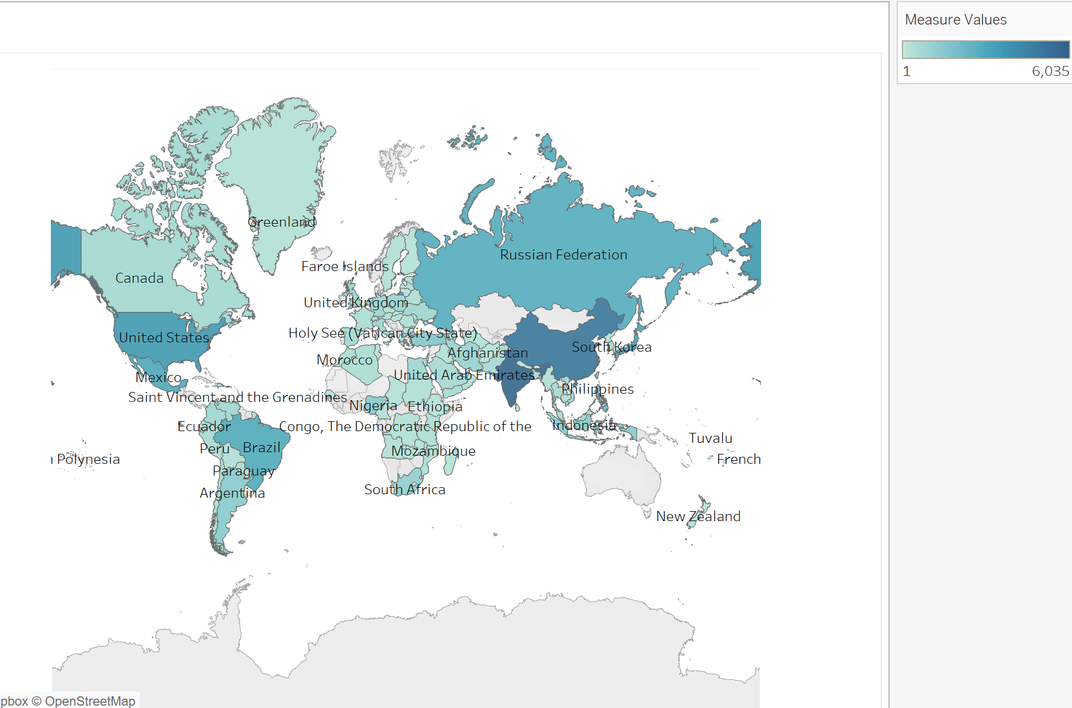
Countries with sales nation wide
Sales show variation across different geographic regions. We currently have sales is 108 countries.
Our highest earning countries are in Asia and America.
Rockbuster Stealth | Tableau Public

Slide 7
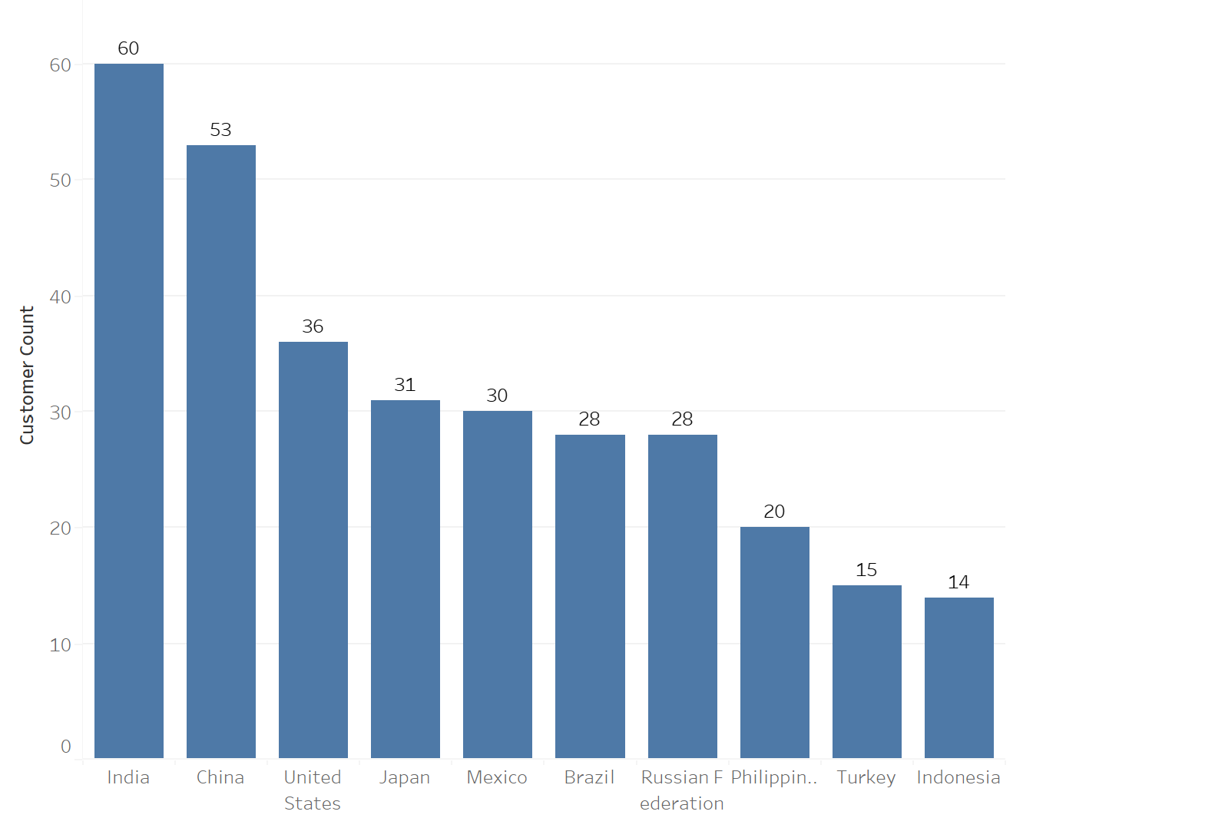
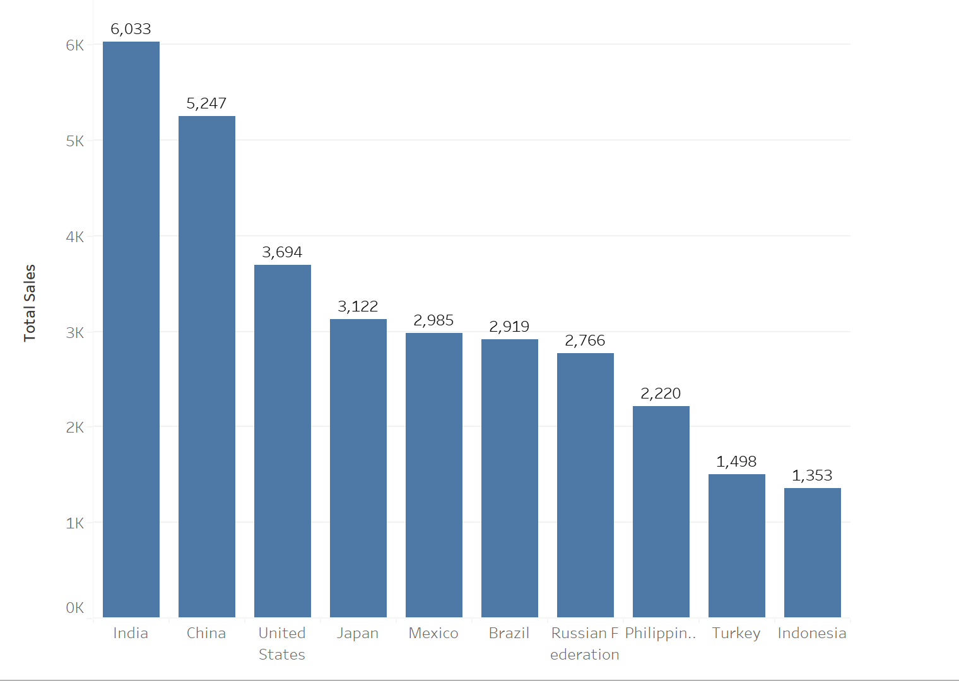
High value countries
Customer count by country
Payment count by country
The current rental service has the highest number of customers in India and China.
India and China customers make up the highest streams of revenue.

Slide 8
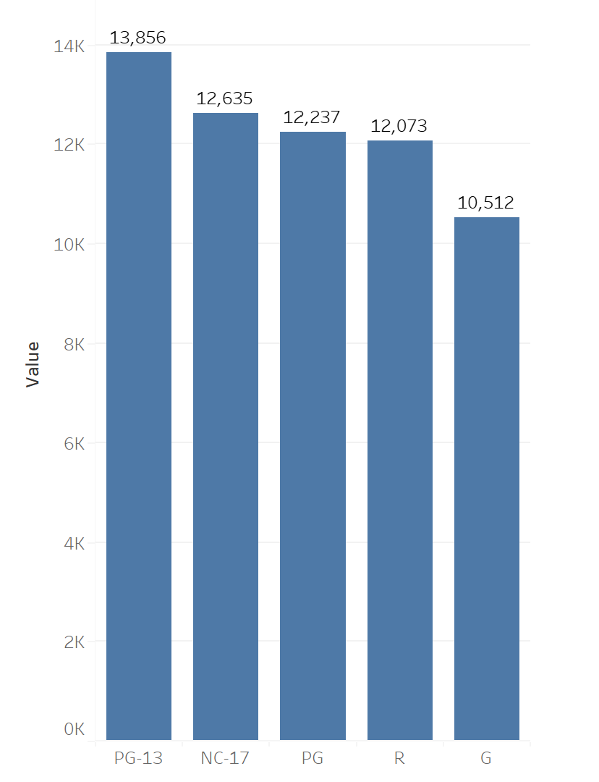
Analysis by film category
PG-13 contributed the most to the revenue.
PG-13 has the most popular film rating.

Slide 9

Recommendations
Market Focus
We recommend the digital platform be first launched in markets where Rockbuster already has an existing customer base, namely India, China and the United States of America.
These results suggest focusing marketing campaigns and resources on the genres, especially the PG-13 with the highest rating, with highest sales.
To reduce costs on movie licenses, consider discontinuing current movies with minimal or no rental history. This approach ensures a more efficient allocation of resources by focusing on movies that have a higher rental demand.

Slide 10
Questions? THANK YOU

