Slide 1

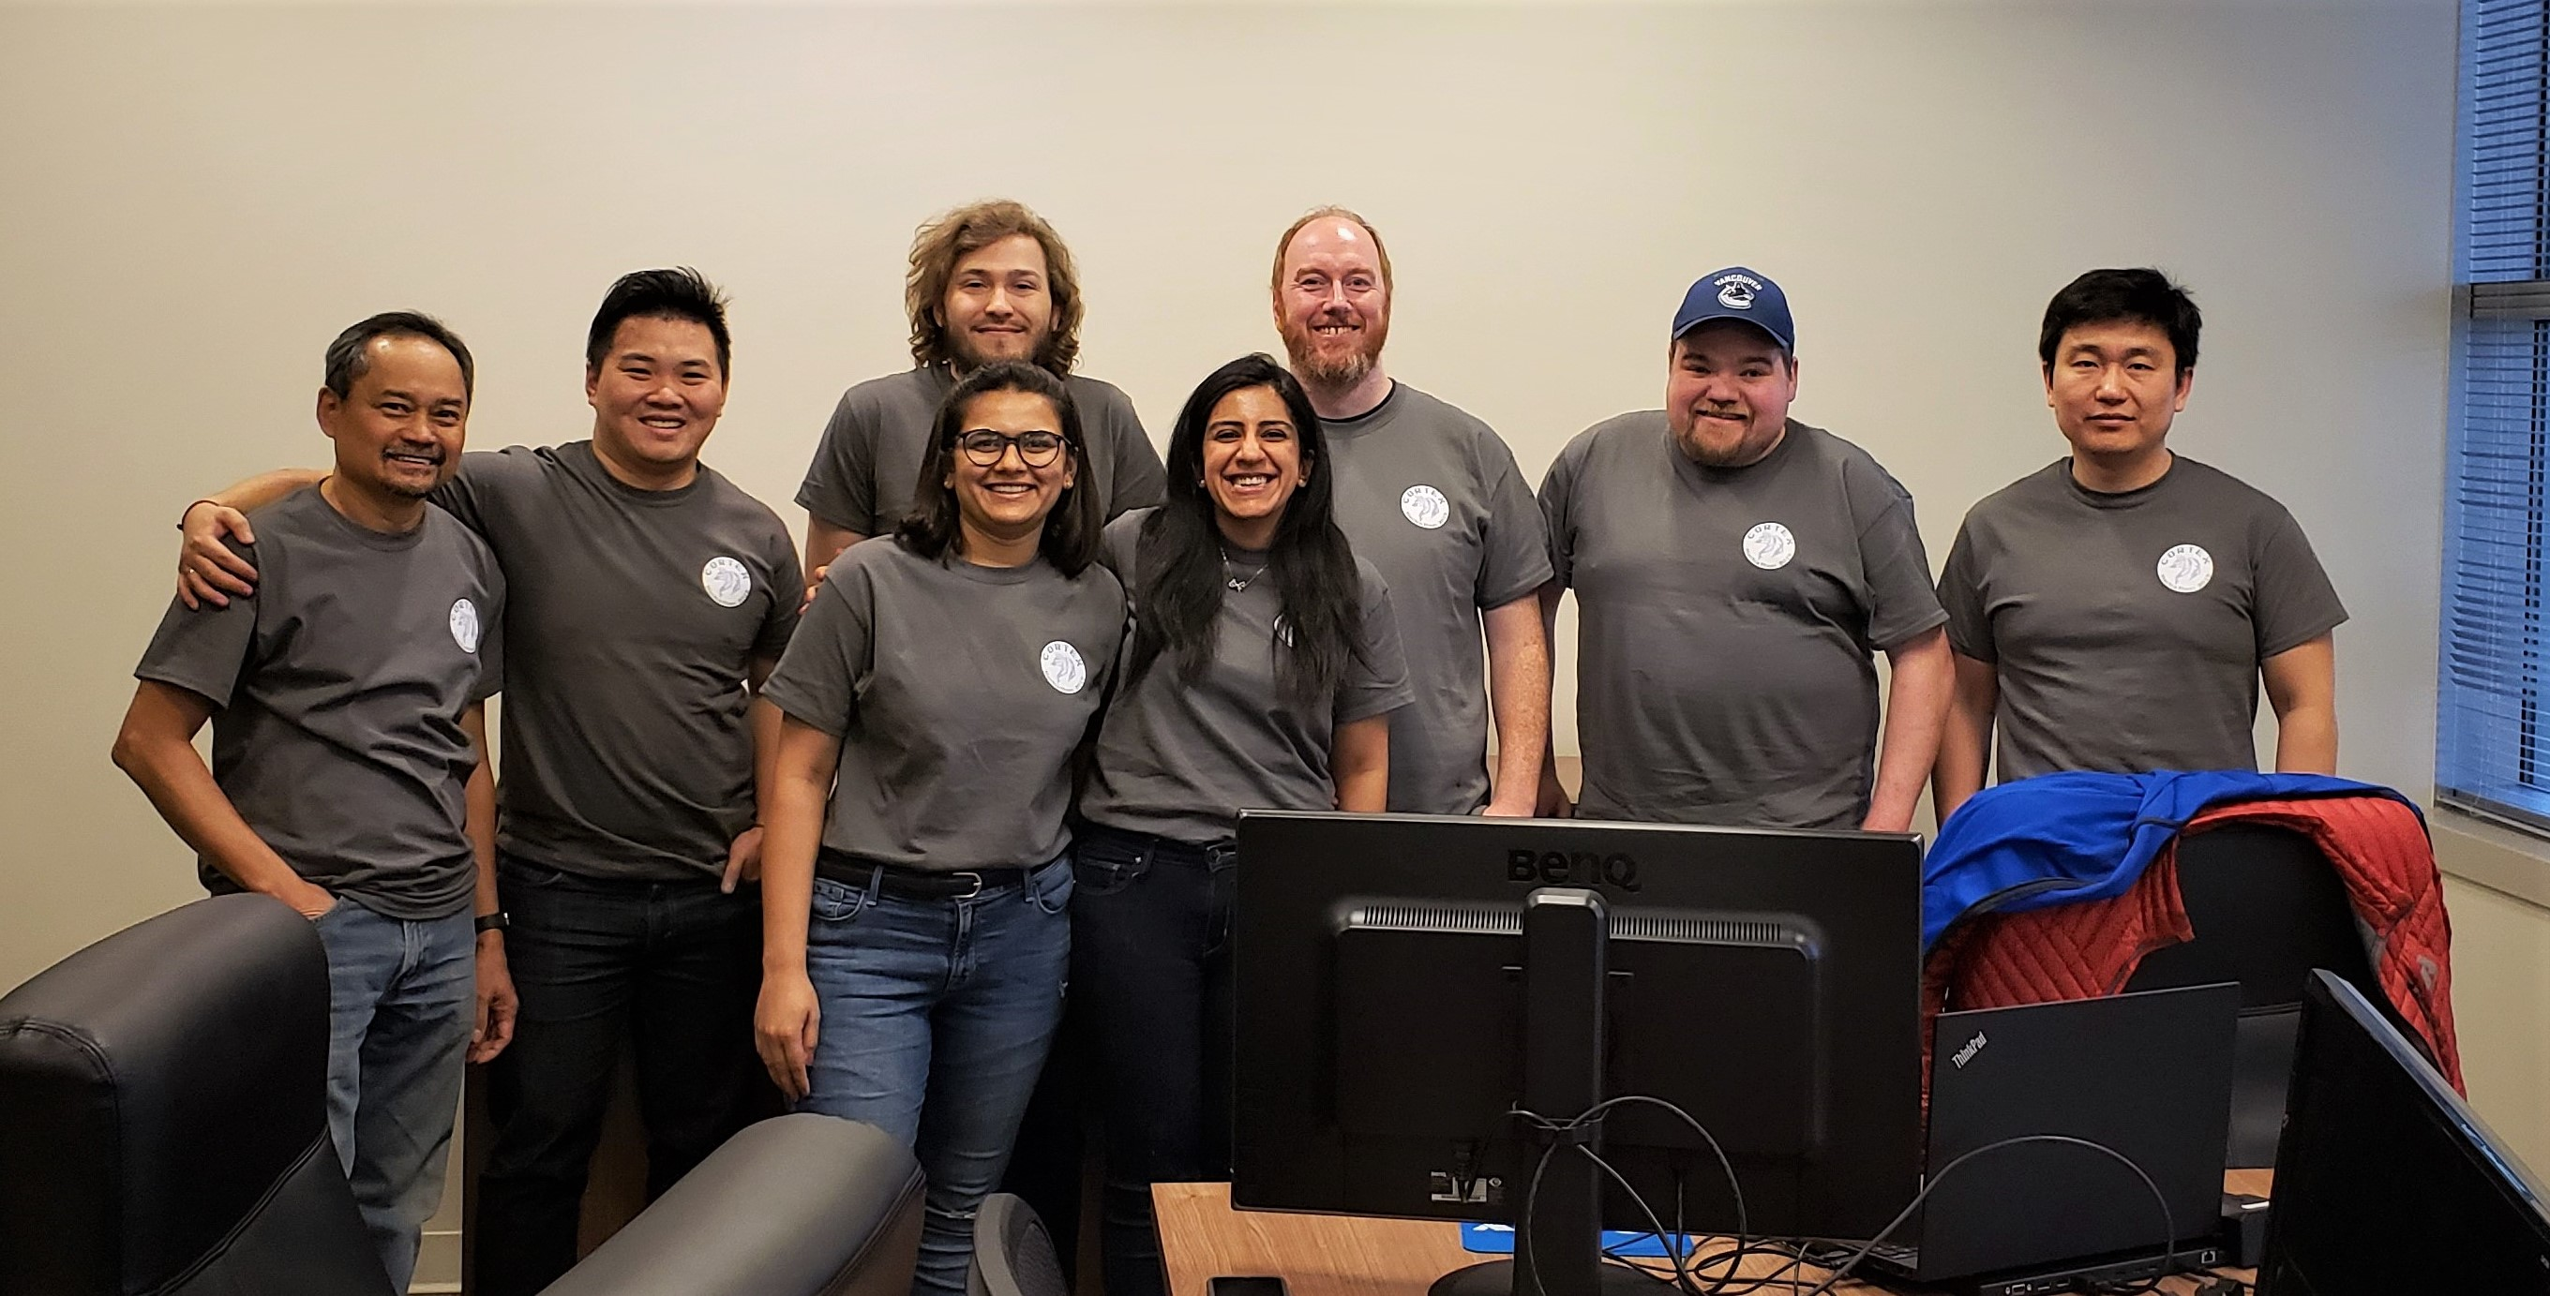
Cortex Hackathon 2019
Aaron GUO | ALEXANDER YONGE | ALLAN CRISOLOGO | CHANG LIU | DOUGLAS DENNIE | nisha fadadu | NISHITA WADHWANI | STEPHEN KANE
Team Skynet

Slide 2
Objective
Utilize Machine Learning and build Artificial Intelligence to predict future expenditures based on historical data for the given relationship
Provide a solution to add value to our existing customer base and increase our current product offerings to maintain a competitive advantage in the O&G industry
Utilize technology to create processes for enabling better and quicker decision-making

Slide 3
assumptions
Product = Commodity per the UNSPSC (United Nations Standard Products and Services Code)
Commodity code is a linked field in Workbench, although currently not mandatory
To encompass predictions for both materials, and a service, products selected with mock data and to demo the prediction:
Drill Pipe – CC 20121508
Drill Pipe Thread Protectors – CC 20121506
Well Monitoring Services – CC 71122800

Slide 4
CHALLENGES
Short-time frame to finish the functionalities which required significantly long hours
No previous experience with the domains, Python and Machine Learning algorithm, therefore new technical skills were required
Generating the mock historical data in the format required
Design and implement dynamic column population
Narrow the scope of prediction to ensure it’s value added for the customer

Slide 5
DEMO

Slide 6
Solution perks
Customers will have the ability to see filtered on a product basis, how their cost from each supplier differs and can compare that to the industry average
Customers will have the ability to see on a monthly, quarterly or annual basis, the summary of their costs on a product basis
Customers can utilize the predictions provided by the AI to better budget future costs, and to assist in making better, faster decisions

Slide 7
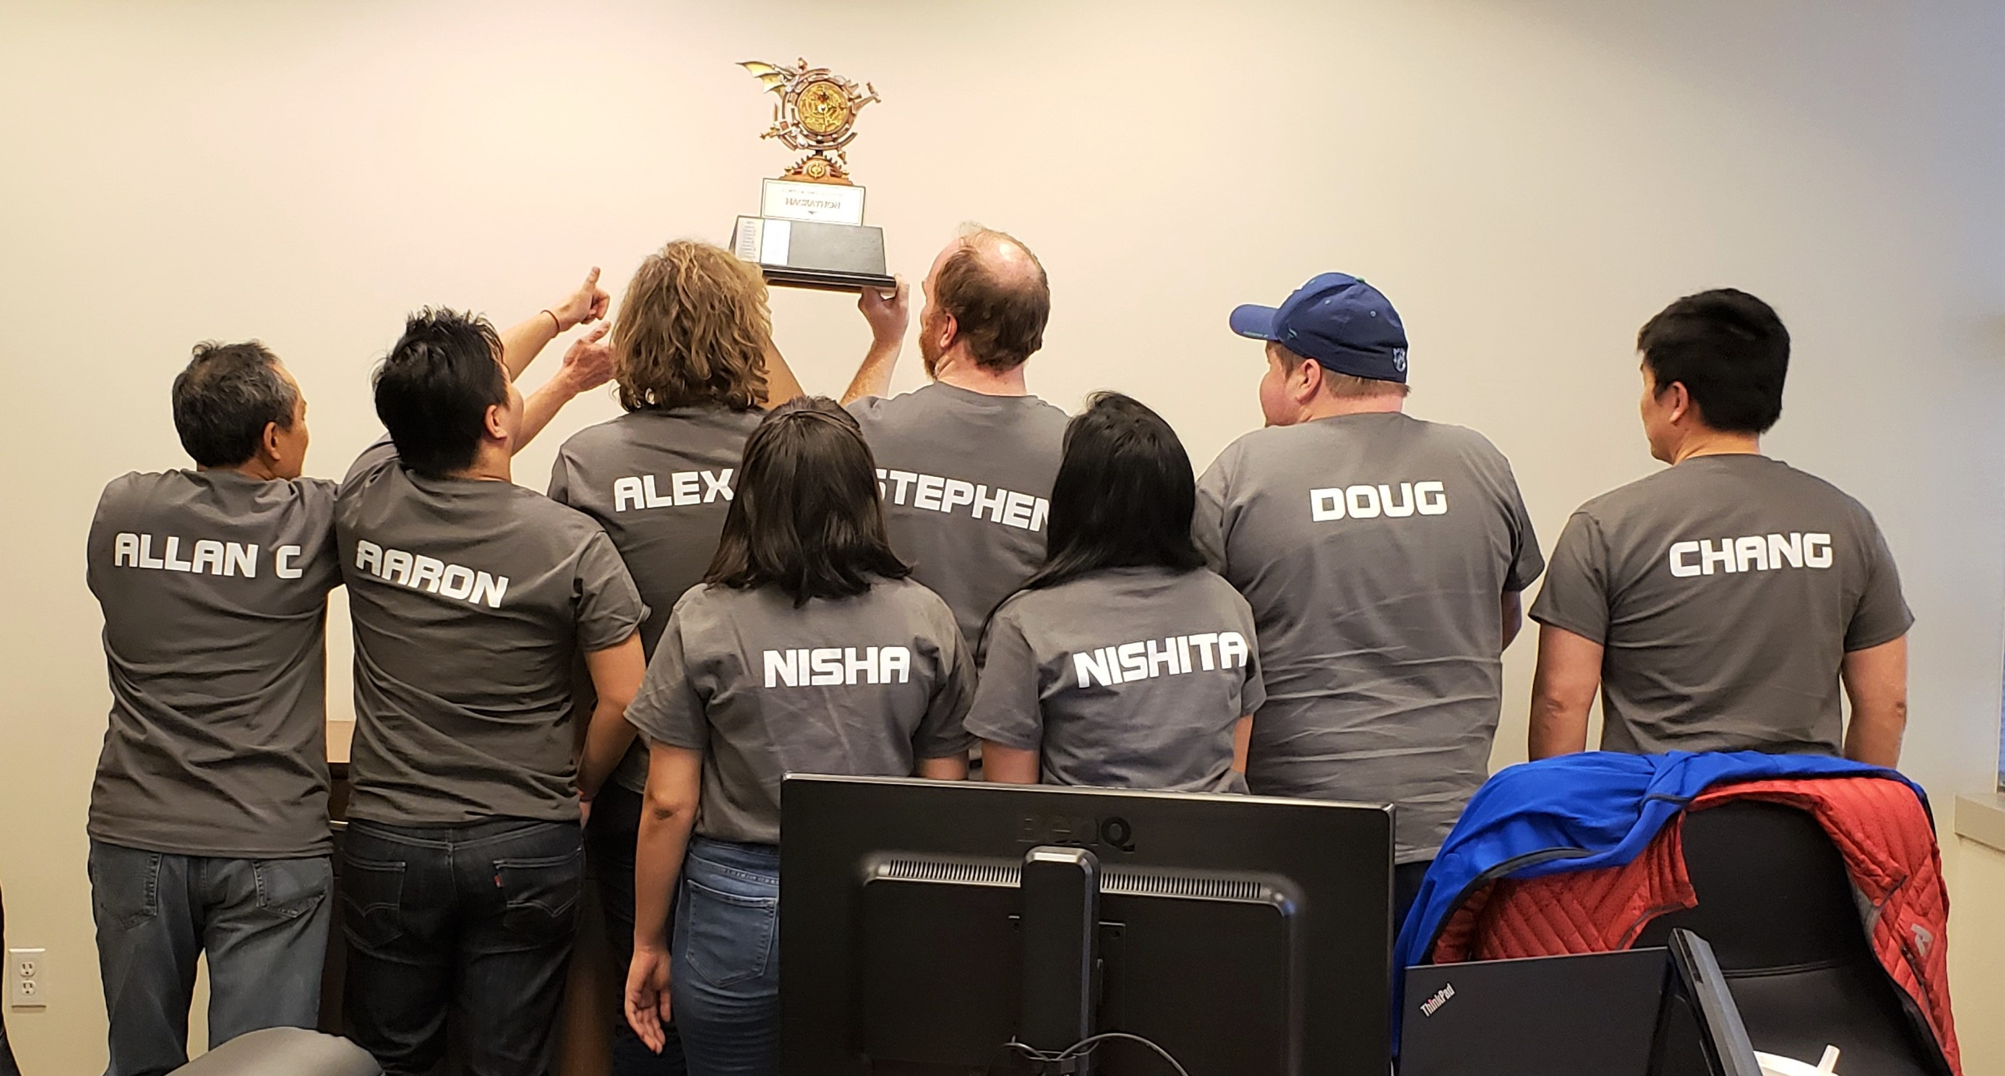
Predicting The Future

