Slide 1
MIDTERM RESEARCH PROPOSAL
Impact of Weather Information Availability on One-Hour-Ahead Bike-Sharing Demand Forecasting: A Cross-Model Study
Predictive Learning
Department of Computer Science and Information Engineering
National Taiwan Normal University
October 27, 2026
Group Members: [Member A] · [Member B] · [Member C] · [Member D]

Slide 2
Research Background and Motivation
Weather is a recognized driver of bike-sharing use, but a forecast can only use weather that is already known.
Demand depends on weather
Seoul hourly data is public
Evaluation must match use
Cold, rain and high humidity are associated with fewer and shorter bikeshare trips (Gebhart & Noland, 2014). Weather and temporal factors recur across the bike-sharing literature (Eren & Uz, 2020).
The Seoul Bike Sharing Demand data pairs hourly rental counts with weather and calendar fields, and has been used for weather-based demand prediction (Sathishkumar & Cho, 2020).
Hourly forecasts are made at a forecast origin and applied to later months. Which weather is available, and how flexible the model is, should be judged out of time.
Scope: system-wide hourly rental counts only; no station, return-flow or inventory data, so no rebalancing claims.
2 / 14

Slide 3
Research Problem and Forecasting Scenario
Which information is available at the forecast origin, and how complex should the model be?
Forecasting scenario
Target: system-wide Rented Bike Count in the target hour (rentals per hour)
Forecast origin: end of the previous hour; only earlier observations may be used
Protocol: rolling one-step forecasts; model parameters stay frozen during testing
P1 Information availability
P2 Model complexity
P3 Attribution and errors
Is previous-hour observed weather useful? How much does target-hour actual weather change the picture?
How do regularization and flexibility affect generalization from winter–spring training to later months?
What do demand history, time, calendar and weather each add, and when do forecasts fail?
3 / 14

Slide 4
Related Work: Bike-Sharing Demand Forecasting
Study | Setting | What it contributes
Eren & Uz (2020) | Review of station-based bike-sharing research | Organizes factors behind demand: weather, built environment, public transport, socio-demographics, temporal and safety factors.
Sathishkumar & Cho (2020) | Seoul hourly rentals with weather data | Weather-based, rule-based model for Seoul bike demand prediction; this line of work uses the Seoul Bike dataset adopted here.
Xin (2026) | Seoul and Washington, DC; one-hour-ahead | Probabilistic forecasting with Transformer-based and other models; reports point error and 80% interval coverage.
Prior work links weather to demand and forecasts Seoul hourly demand with learned models.
Sources: see References (slide 14). Descriptions summarize each work's stated scope.
4 / 14

Slide 5
Related Work: Weather Information and Predictive Models
Weather evidence
Predictive models: Xin (2026), Seoul, one hour ahead
Gebhart & Noland (2014), Washington, DC: cold temperature, rain and high humidity reduce both the likelihood and duration of bikeshare trips.
Eren & Uz (2020): weather is one of several factor groups studied for demand.
Sathishkumar & Cho (2020): weather variables used for Seoul demand prediction.
Model | MAE (rentals/h) | 80% coverage
N-BEATS | 115.07 | 75.42%
Random Forest | 115.86 | 89.26%
TFT | 306.98 | 81.11%
Transformer | 317.72 | 74.01%
Reported by Xin (2026), Table 2 (p. 6). Not our results and not directly comparable to ours.
Lowest point error does not imply the best interval coverage.
Open point: the literature does not specify, field by field, which weather values exist at the forecast origin of a one-hour-ahead forecast.
5 / 14

Slide 6
Research Gap and Proposed Contribution
Insufficiently clarified question | What prior work leaves open | Our contribution
Information timing | Xin (2026) describes target-time covariates; availability of each field at the forecast origin is not fully specified (not an allegation of leakage). | Explicit E1 / E2 / E3 information settings under one protocol
Complexity control | Models from different families are compared; controlled complexity curves are not the focus. | Ridge α, KNN k and tree-depth curves with train vs. validation error (X2, X3)
Information value | Which input group matters, and where errors concentrate, is not isolated. | Group ablation and temporal error slices (X4, X5)
Shared with Xin (2026): date boundaries of the chronological split. Different: five weather variables and three demand lags, a 168-hour warm-up, and the definition of eligible samples.
Not claimed: the first weather study, any leakage in prior work, or superiority over probabilistic methods.
6 / 14

Slide 7
Research Aim and Research Questions
Aim: separate the value of available weather information from retrospective information, and study model complexity under out-of-time evaluation.
 | Research question | Objective | Falsifiable hypothesis | Analyses
RQ1 | Does previous-hour observed weather improve next-hour forecasts, and how does target-hour actual weather differ? | Quantify E1 vs. E2 vs. E3 | E2 may beat E1; E3 may help precipitation hours but is not guaranteed to beat E2. | X1, X4, X5
RQ2 | How do model complexity and regularization affect out-of-time generalization? | Map train vs. validation error | Moderate regularization may help; complex models need not win. | X1, X2, X3
RQ3 | What do demand, time, calendar and weather contribute, and where do models fail? | Attribute value and locate errors | Demand history may add most; peak hours may have larger absolute error. | X4, X5
7 / 14

Slide 8
Dataset, Preprocessing and Chronological Split
8,760
8,297
4,152
720
3,425
hourly observations, 14 columns
eligible samples
training
validation
test
Dec 1–7, 2017: 168-h warm-up
Train
Val
Test
Dec 8, 2017
Jun 1, 2018
Jul 1
Nov 30, 2018
1 Align timestamps
2 Build lags first
3 Select eligible rows
4 Fit on train only
Date + Hour become a unique hourly timestamp (Seoul local time); no gaps, no missing cells.
lag_1, lag_24 and lag_168 are shifted on the full hourly axis; non-functioning hours stay as observed history.
Score only Functioning Day = Yes targets with all lags available: 8,465 operating hours, 8,297 after warm-up.
StandardScaler and encoders are fitted on training rows, then applied to validation and test.
›
›
›
Leakage control: chronological split, past-only lags, no target-hour demand input.
Source: Kaggle, Seoul Bike Sharing Demand Prediction (SeoulBikeData.csv); file checksum identical to the UCI release. Bar length proportional to calendar days.
8 / 14

Slide 9






Feature Engineering and Information Settings (E1–E3)
Target hour
last week
yesterday
last completed hour
predict
E1 · 13 features
time + calendar
No explicit weather
lag_168
lag_24
lag_1
E2 · 18 features
time + calendar
Previous-hour observed weather
lag_168
lag_24
lag_1
E3 · 18 features
Target-hour weather (oracle)
lag_168
lag_24
lag_1
time + calendar
Forecast origin
not yet observed
Group | Columns | Encoding | Dim.
H Historical demand | lag_1, lag_24, lag_168 | StandardScaler | 3
T Time | Hour and Weekday of the target hour | sin / cos pairs | 4
C Calendar | Season (4 levels), Holiday (2 levels) | One-hot | 6
W Weather | Temperature, Humidity, Wind speed, Rainfall, Snowfall | StandardScaler | 5
E1 = H + T + C. E2 adds the previous-hour weather; E3 replaces it with target-hour weather. E3 is a retrospective oracle, is not deployable, and need not beat E2. Target-hour demand is never an input.
9 / 14

Slide 10
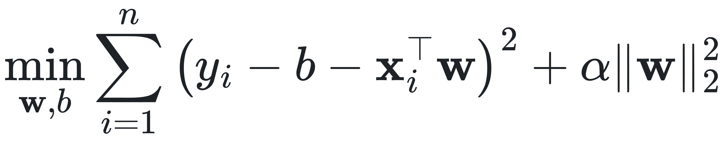
Experimental Design: X1–X3
X1–X5 are analyses; E1–E3 are information settings. They are crossed, not eight separate experiments.
Analysis | Models | E1 | E2 | E3 | Varied or controlled
X1 Model comparison | Ridge, KNN, Random Forest, 3 naive | ● | ● | ● | Model × information setting
X2 Ridge regularization | Ridge | ○ | ● | ○ | Penalty α
X3 Complexity control | KNN, Decision Tree | – | ● | – | k; max_depth
X4 Weather and ablation | Ridge, Random Forest | ● | ● | ● | Setting; removed group (E2)
X5 Temporal error analysis | Best E2 model by validation | ○ | ● | ○ | Hour, month, day type, rain
● main analysis ○ supplementary comparison – not used
X1 · Model comparison
X2 · Ridge regularization
X3 · Complexity control
Does the model ranking change with the information setting?
Ridge, KNN, Random Forest × E1, E2, E3, plus 3 naive baselines
How does L2 strength change out-of-time error?
E2 fixed; 10 log-spaced α; train vs. validation RMSE
Does added flexibility only lower training error?
E2 fixed; KNN k = 1–97; tree max_depth = 2–16, None
X2 Ridge objective
10 / 14

Slide 11
Experimental Design: X4–X5
X4 · Weather information and feature ablation
X5 · Temporal error analysis
4a E1 vs. E2 vs. E3. Ridge and Random Forest on identical samples.
Pre-specified slices of the test period, for the best E2 model by validation MAE:
Slice | Definition
Hour | MAE for each target hour 0–23; night 00–05, peaks 07–09 and 17–19
Month | July to November 2018
Day type | Weekday vs. weekend; holiday flag
Precipitation | Rainfall > 0 or Snowfall > 0 vs. none (scoring label only)
Curve | Actual vs. predicted, 2018-07-01 to 2018-07-07 (fixed in advance)
4b Group ablation on E2. Hyperparameters fixed from Full E2; same samples.
Variant | Removed columns
Full E2 | none (reference)
− H | lag_1, lag_24, lag_168
− T | hour and weekday sin / cos
− C | season and holiday
− W | 5 weather columns (= E1)
Each slice reports n, mean rentals, MAE, RMSE and signed error.
Ablation is not a causal intervention.
11 / 14

Slide 12
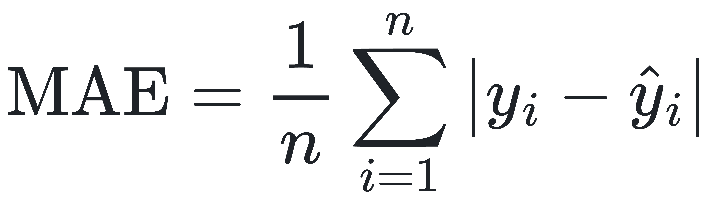
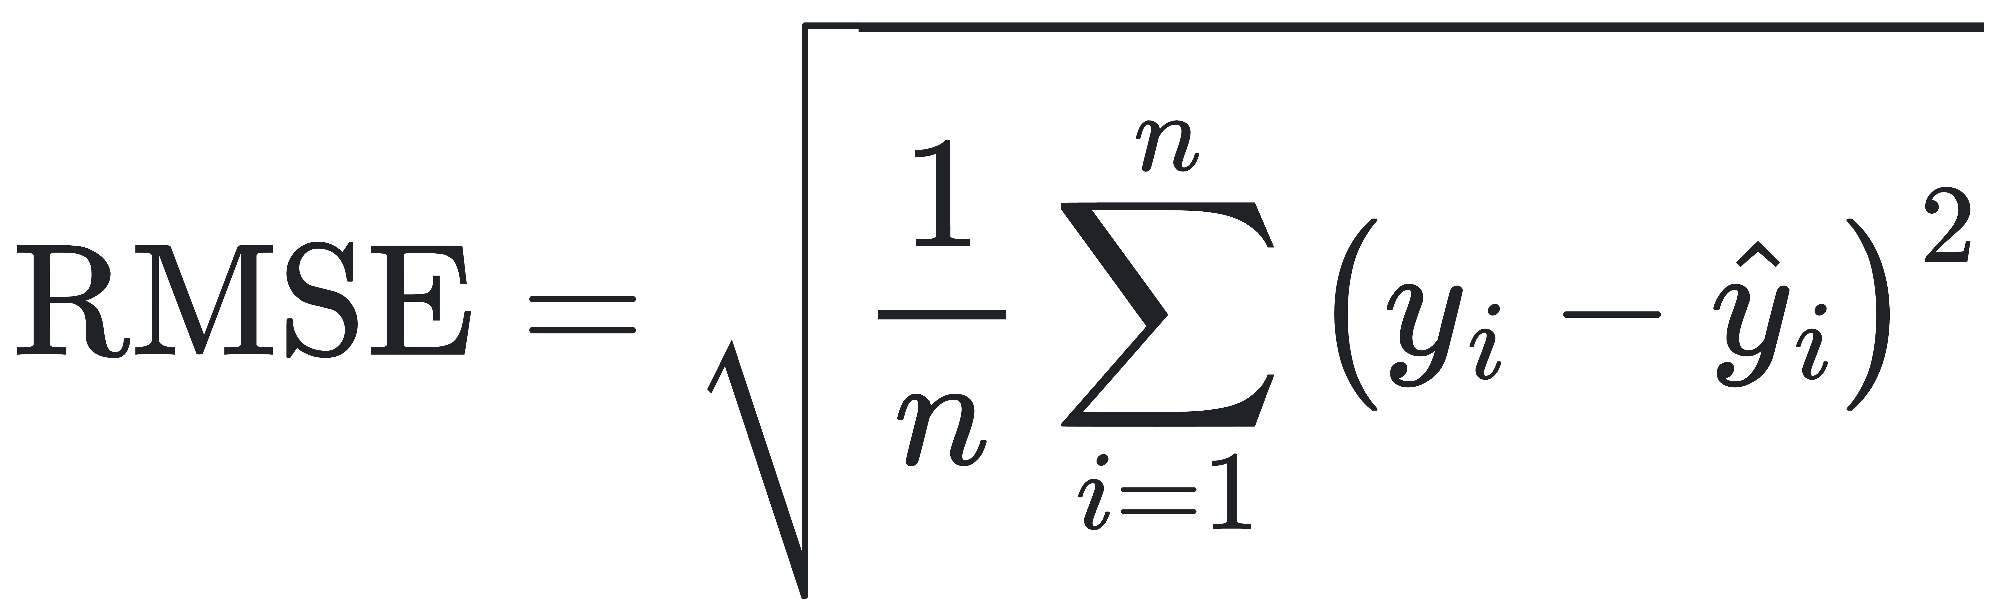
Evaluation Protocol, Resources and Project Timeline
Evaluation metrics
Model selection and leakage control
Validation MAE selects hyperparameters
Test evaluated once on a pre-registered list
Scalers fitted on training rows only; no shuffled K-fold
Unit: rentals per hour; predictions clipped at 0
No MAPE (zero counts); rolling one-step forecasts
Project timeline
Oct 26
Oct 27
Week 1
Week 2
Week 3
Week 4
Week 5
Moodle upload by 23:59
Presentation (backup Nov 3)
Shared pipeline, baselines, Ridge
X1–X3 on train / validation; freeze settings
X4 setup; LSTM extension
Freeze list; run test and X5 once
Reproducibility check, final report
Resources and budget
Collaboration
Ethics and confidentiality
Python, pandas, scikit-learn (Pedregosa et al., 2011), matplotlib on laptop CPUs. No additional budget.
A: data and pipeline. B: Ridge, KNN (X2, X3). C: Random Forest (X1, X4). D: X5, integration, LSTM extension.
Public aggregated hourly data; no human subjects, personal data or animal experiments. No ethics review is claimed.
12 / 14

Slide 13
Proposed Outcomes and Research Limitations
Planned analyses and deliverables
Research limitations
Model × information-setting table of MAE and RMSE, with naive baselines
Quantified Gain and Gap between E1, E2 and E3
Ridge α curve; KNN k and tree-depth curves
Group-ablation chart of MAE change (H, T, C, W)
Hourly, monthly, weekday and precipitation error analysis
Reproducible, time-ordered, leakage-checked pipeline
One city and one year; no multi-year or cross-city claim
Season and time are confounded in the split
Aggregate rentals are not station demand or unmet demand
E2 assumes the previous hour is already published
E3 is oracle information, not a weather forecast
Point forecasts only; no interval calibration
Figures shown in the final report will come from executed experiments; none are claimed here.
Contribution: a reproducible protocol separating available from retrospective weather information, with complexity and error analysis.
13 / 14

Slide 14
References
Eren, E., & Uz, V. E. (2020). A review on bike-sharing: The factors affecting bike-sharing demand. Sustainable Cities and Society, 54, 101882. https://doi.org/10.1016/j.scs.2019.101882
Gebhart, K., & Noland, R. B. (2014). The impact of weather conditions on bikeshare trips in Washington, DC. Transportation, 41(6), 1205–1225. https://doi.org/10.1007/s11116-014-9540-7
Pedregosa, F., et al. (2011). Scikit-learn: Machine learning in Python. Journal of Machine Learning Research, 12, 2825–2830.
Sathishkumar, V. E., & Cho, Y. (2020). A rule-based model for Seoul Bike sharing demand prediction using weather data. European Journal of Remote Sensing, 53(sup1), 166–183. https://doi.org/10.1080/22797254.2020.1725789
Xin, Q. (2026). Probabilistic bike-sharing demand forecasting under changing weather and seasonal regimes with Transformer-based models. Findings. https://doi.org/10.32866/001c.157499
Seoul Bike Sharing Demand [Data set]. UCI Machine Learning Repository. https://doi.org/10.24432/C5F62R
Seoul Bike Sharing Demand Prediction [Data set]. Kaggle. https://www.kaggle.com/datasets/saurabhshahane/seoul-bike-sharing-demand-prediction
14 / 14

