Slide 1
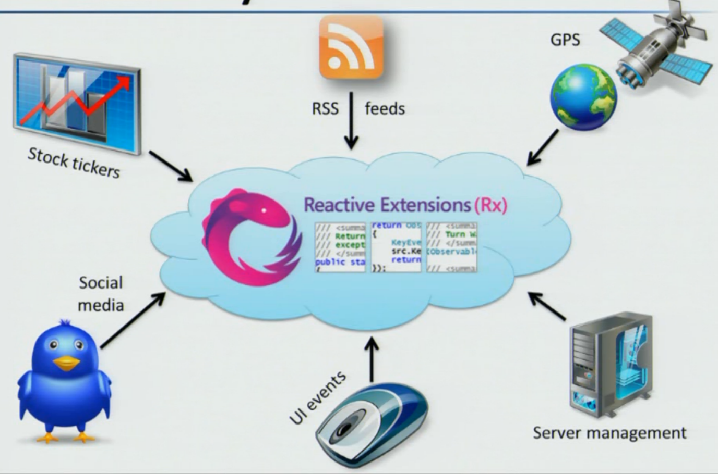
Reactive Extensions (Rx) For .NET and JavaScript
Aaron D. Hoffman
Hoffman.Aaron.D@gmail.com
@aaron_hoffman

Slide 2
Overview
Reactive Extensions (Rx)
About Me
Consultant at StoneFinch
Agile Development, Data Analytics
Lean Startup (intrepreneur)
Human-Centered Design
Big Data
Data Visualization
Organizations
Iowa .NET User Group Leader
1 Million Cups Organizer

Slide 3
Overview
Reactive Extensions (Rx)
About You
ASP.NET ?
WPF ?
Winforms ?
HTML5 + JavaScript ?
WinRT / Windows 8 ?
MVVM ?
NuGet ?
Rx ?

Slide 4
Overview
Reactive Extensions (Rx)
Agenda
Rx Overview
Basics
User Input
Service Calls
JavaScript Examples
Testing

Slide 5
Rx Overview
Reactive Extensions (Rx)
Wikipedia describes Reactive Programming as…
…a programming paradigm oriented around data flows and the propagation of change…the underlying execution model will automatically propagate changes through the data flow.
Um, what?

Slide 6
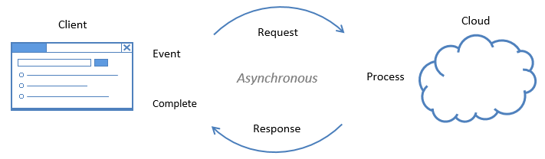
Rx Overview
Reactive Extensions (Rx)
Reactive Programming
Problem Domain: asynchronous, event-based
Essentially every application. Think event-based programming or line-of-business applications.

Slide 7
Rx Overview
Reactive Extensions (Rx)
Pain Points in Domain
Events
Event Listeners (not very MVVM)
Filtering within event listener is clumsy (logic gets lost)
Asynchronous
Passing object state from Begin to Complete
Cancel Operation, Exception happens
Two concurrent requests, race condition
Chaining async calls….
Creates a lot of repeated boiler code
Composition is difficult (chaining functionality)
Industry is moving to “Async everything” async/await
Unit Testing Events

Slide 8
Rx Overview
Reactive Extensions (Rx)
Rx makes you think about Reactive Programs in a new way…
“Asynchronous Data Streams”
Let’s take the Button Click event as an example
Can this….
0 - - 1 - - - 2 - - - 3 - - - - - - - - 4 - 5 - - - - - - - - 0
Be represented like this?
[ 1, 2, 3, 4, 5 ]

Slide 9
Rx Overview
Reactive Extensions (Rx)
Reactive Extensions (Rx) is a library for composing asynchronous and event-based programs using
observable sequences and LINQ-style query operators.
Represent asynchronous data streams with Observables.
Query asynchronous data streams using LINQ operators.
Parameterize the concurrency of the asynchronous data streams using Schedulers.
Rx = Observables + LINQ + Schedulers

Slide 10
Rx Overview
Reactive Extensions (Rx)
Backbone of Rx is Observable
Not “ObservableCollection”
Async Data Stream = “Future Collection”
Almost all data can be expressed in this way
Understanding Observable is essential to Rx
Data Source Observable Action
Rx
?
Standardize the “glue” (similar to LINQ)

Slide 11
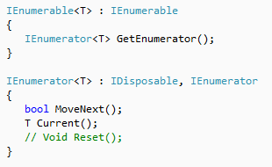
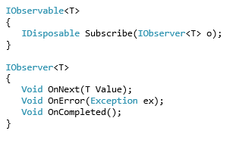
Rx Overview
Reactive Extensions (Rx)
Enumerable - Pull Observable - Push
“The world has moved to push; users are waiting for us to catch up.”
Lee Campbell, http://www.introtorx.com

Slide 12
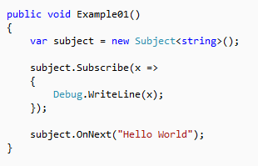
Rx Overview
Reactive Extensions (Rx)
System.Reactive namespace
Designed with Portability in mind
NuGet Package (“Reactive Extensions - Main Library”)
Contains many extension methods, similar to LINQ

Slide 13
Rx Overview
Reactive Extensions (Rx)
Release History
Version 1.0 November 2009
Version 1.1 June 2011
Version 2.0 August 2012
Open Sourced November 2012
Version 2.1 February 2013

Slide 14
Rx Overview
Reactive Extensions (Rx)
Examples
Questions? Just speak up

Slide 15
Conclusion
Reactive Extensions (Rx)
Links for More Info:
Reactive Extensions Home: http://msdn.microsoft.com/en-us/data/gg577609
MSDN: http://msdn.microsoft.com/en-us/library/hh242985(v=VS.103).aspx
Source Code: https://rx.codeplex.com/
NuGet: http://nuget.org/profiles/rxteam
Intro to Rx http://www.introtorx.com/
Reactive Extensions in 15 Minutes: http://channel9.msdn.com/blogs/charles/erik-meijer-rx-in-15-minutes
Reactive Extensions Theory, Background and Fundamentals: http://channel9.msdn.com/Blogs/codefest/DC2010T0100-Keynote-Rx-curing-your-asynchronous-programming-blues
Channel 9: http://channel9.msdn.com/search?term=reactive&type=All

