Slide 1
Confident JavaScript
An Intro to the Deno Runtime

Slide 2
Deno – An Alternative to Node
Relatively new (May 13, 2018)
Created by Ryan Dahl – the creator of Node
A different approach – Align with the WEB

Slide 3

How do you solve a problem like security?
Don’t trust any code
Require explicit permissions
Mark unsafe runtime routines as unstable

Slide 4

Provide a standard library
Seperate the standard library from the runtime
Smaller overall footprint
Build-in only what requires wholly non-JavaScript

Slide 5
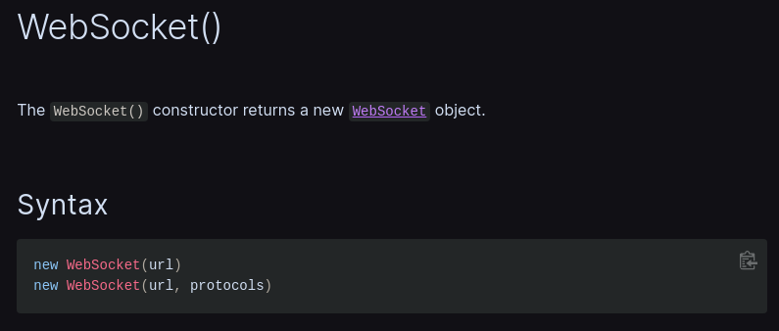
Make programming simple
If you know the web, you know Deno
If you learn Deno, it crosses over to the Web
Example: WebSocket API just works

Slide 6
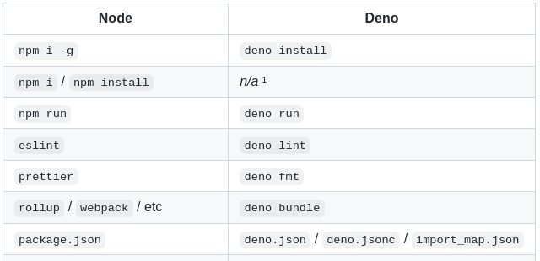
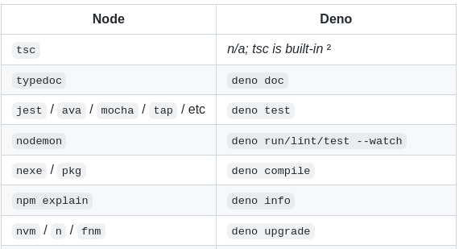
Make programming easy
Built-in tooling! Less set up compared to Node

Slide 7
Resources
This talk @ Github
aaronhuggins/cvdg_talk_confident_javascript
https://deno.land
Github
denoland/deno

