Slide 1

INDIAN INSTITUTE OF TECHNOLOGY ROORKEE
Deep Learning-Based Glacial Lake
Segmentation Using Multi-Architecture Models
Deep Learning
Aaron Jacob (25572001) | Aditi Gulati (25572002) | Rudra Pratap Masram (25572007)
Department of Applied Mathematics and Scientific Computing | IIT Roorkee
April 2026

Slide 2
INDIAN INSTITUTE OF TECHNOLOGY ROORKEE
Table of Contents
01
Introduction & Problem Statement
05
Training Configuration
02
Dataset — GLID
06
Evaluation Metrics
INDIAN INSTITUTE OF TECHNOLOGY ROORKEE
03
Methodology & Pipeline
07
Results & Comparison
04
Model Architectures
08
Conclusion & Future Work
IIT ROORKEE
2 / 22

Slide 3
INDIAN INSTITUTE OF TECHNOLOGY ROORKEE
Introduction & Problem Statement
🏔
📡
🤖
The Challenge
Traditional Limitations
Deep Learning Solution
Glaciers retreating globally due to rising temperatures. Himalayan region severely impacted, creating glacial lakes that pose GLOF risk.
Manual satellite imagery interpretation is time-consuming, labor-intensive, and error-prone. Spectral indices need auxiliary data.
Semantic segmentation models perform pixel-level classification for precise lake extraction — scalable and automated.
Objective: Implement and compare U-Net, DeepLabV3, and Swin Transformer for automated glacial lake segmentation.
IIT ROORKEE
3 / 22

Slide 4
INDIAN INSTITUTE OF TECHNOLOGY ROORKEE
Dataset — GLID (Glacial Lake Inventory Dataset)
Lake Categories
18,367
512×512
Supraglacial Lakes
Total Samples
Image Resolution (px)
Form on glacier surface; rapid drainage risk
Proglacial Lakes
At glacier terminus; major GLOF source
4
80/10/10%
Ice-Marginal Lakes
Lake Categories
Train / Val / Test Split
Along glacier edges; dammed by ice
Unconnected Glacial Lakes
Isolated from active glacier systems
Masks: Lake pixels = 255 | Background = 0 | Includes shapefiles & metadata
IIT ROORKEE
4 / 22

Slide 5
INDIAN INSTITUTE OF TECHNOLOGY ROORKEE
Methodology & Pipeline
Satellite
Images
Pre-
processing
Model
Training
Segmentation
Mask
Evaluation
▶
▶
▶
▶
GLID Dataset
512×512 px
Resize 224×224
Normalize
U-Net / DeepLabV3
Swin Transformer
Predicted lake
pixel maps
IoU, Dice,
Accuracy
Data Preprocessing Details
Images resized from 512×512 to 224×224 pixels to reduce computational load
Pixel values normalized to a consistent range for stable convergence
Dataset split: 80% training, 10% validation, 10% testing
Batch size: 8 | Epochs: 50 | Loss: Binary Cross-Entropy + Dice
IIT ROORKEE
5 / 22

Slide 6
INDIAN INSTITUTE OF TECHNOLOGY ROORKEE
Model Architectures
U-Net
DeepLab V3+
Swin Transformer
CNN — Encoder-Decoder
CNN + Atrous Convolutions
Vision Transformer
Key Components
Key Components
Key Components
Symmetric encoder–decoder structure
ResNet backbone for feature maps
Input image split into patches/tokens
Skip connections preserve spatial info
Atrous (dilated) convolutions
Hierarchical multi-scale structure
Transposed convolutions for upsampling
ASPP: multi-scale feature extraction
Shifted Window Self-Attention (SWSA)
Max-pooling for feature extraction
Expanded receptive field without resolution loss
Long-range dependency modelling
✔ Fine detail & boundary detection
✔ Best multi-scale representation
✔ Global contextual understanding
✘ Limited global context
✘ Higher computational cost
✘ Needs more data & compute
IIT ROORKEE
6 / 22

Slide 7
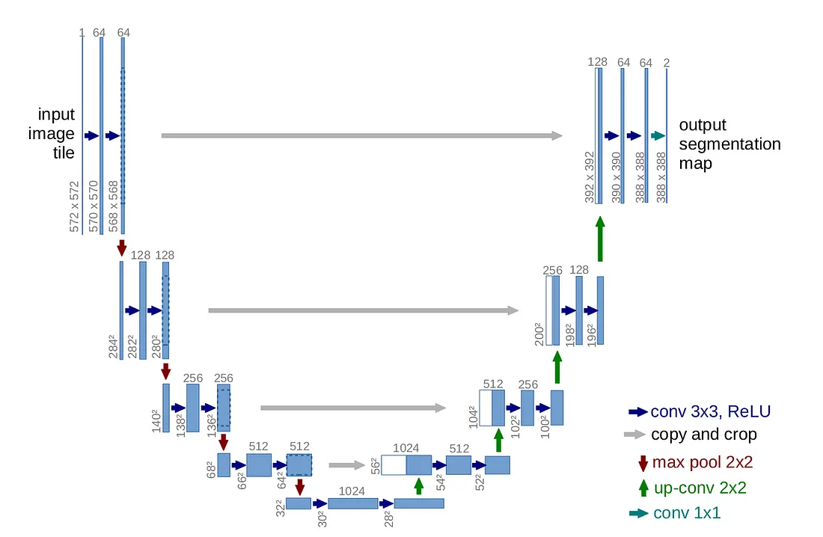
INDIAN INSTITUTE OF TECHNOLOGY ROORKEE
U-Net Architecture
CNN — Symmetric Encoder-Decoder for Precise Segmentation
U-Net features a symmetric encoder-decoder design. The contracting path applies repeated 3x3 convolutions + ReLU and 2x2 max pooling, progressively doubling channels (64 → 128 → 256 → 512 → 1024) while halving spatial resolution.
The bottleneck captures the deepest feature representation. The expansive path uses up-convolutions (2x2 transposed convolutions) to restore resolution, while skip connections directly concatenate encoder feature maps to preserve fine spatial detail.
This symmetric structure with skip connections enables precise boundary detection and is especially powerful for segmentation tasks with limited labelled data, as seen in glacial lake mapping.
7 / 22

Slide 8
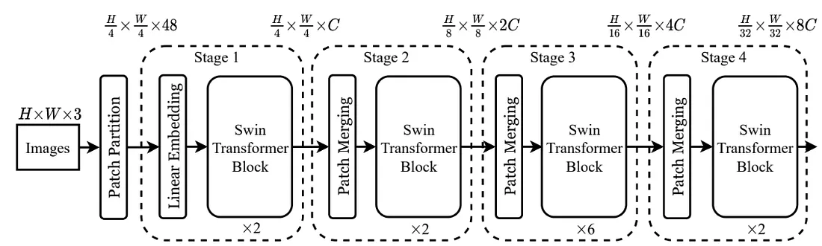
INDIAN INSTITUTE OF TECHNOLOGY ROORKEE
Swin Transformer Architecture
Vision Transformer — Hierarchical Shifted Window Self-Attention
Input images (H x W x 3) are split into non-overlapping 4x4 patches, producing H/4 x W/4 tokens. A linear embedding projects these into dimension C. Stage 1 applies 2 Swin Transformer Blocks with local window attention and cyclic shifted windows (SW-MSA) for cross-window connectivity.
Patch Merging layers between stages halve the spatial resolution and double the channel count (C → 2C → 4C → 8C), creating a 4-level feature hierarchy. Stages 2 and 4 use 2 blocks each; Stage 3 uses 6 blocks for deeper representation.
Shifted Window Self-Attention (SWSA) enables efficient long-range dependency modelling within a hierarchical structure — giving the model global contextual understanding critical for complex lake boundary delineation.
9 / 22

Slide 9
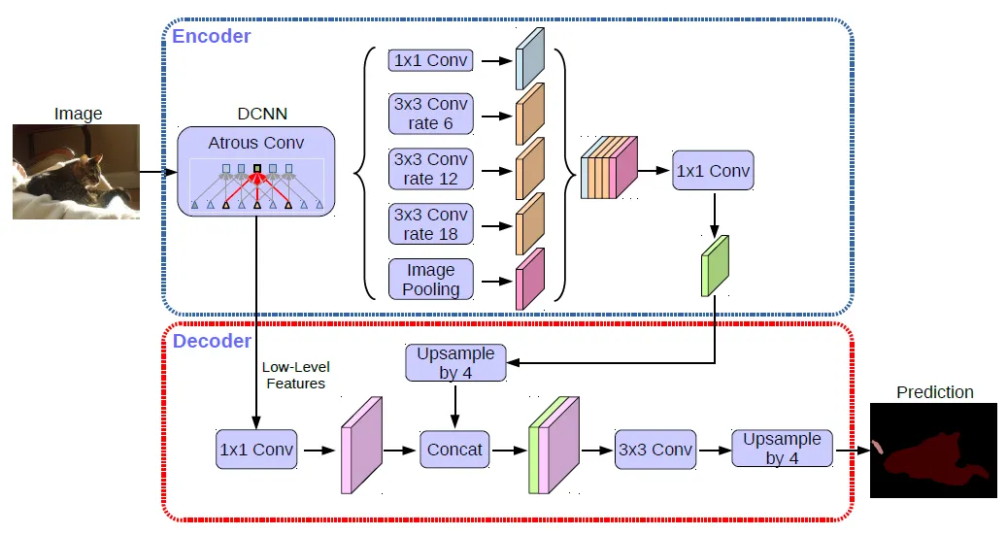
INDIAN INSTITUTE OF TECHNOLOGY ROORKEE
DeepLabV3+ Architecture
CNN + Atrous Spatial Pyramid Pooling — Multi-Scale Semantic Segmentation
The encoder uses a DCNN backbone (ResNet50) with atrous (dilated) convolutions that expand the receptive field without loss of resolution. The ASPP module applies parallel dilated convolutions at rates 6, 12, and 18 alongside image-level pooling to capture multi-scale context.
ASPP outputs are concatenated and reduced via a 1x1 convolution, then upsampled 4x. The decoder concatenates this with low-level features from the backbone, refines via a 3x3 convolution, and applies a final 4x upsample to produce the pixel-level prediction.
This architecture excels at capturing both fine boundaries and broad semantic context — key advantages for segmenting small and irregular glacial lake regions.
8 / 22

Slide 10
INDIAN INSTITUTE OF TECHNOLOGY ROORKEE
Training Configuration
Parameter
Value
Why These Choices?
Input Image Size
224 × 224 px
Adam Optimizer
Batch Size
8
Adaptive LR for complex architectures; faster & stable convergence
Epochs
50
BCE Loss
Ideal for binary masks; penalizes pixel-wise errors precisely
Optimizer
Adam
Loss Function
Binary Cross-Entropy (BCE) + Dice
Triple LR Study
Compares fast convergence (0.001) vs stable training (0.0001) vs slow convergence (0.00001)
Learning Rates
0.001 & 0.0001 & 0.00001
50 Epochs
Train / Val / Test
80% / 10% / 10%
Sufficient for convergence monitoring across all models
IIT ROORKEE
10 / 22

Slide 11
INDIAN INSTITUTE OF TECHNOLOGY ROORKEE
Evaluation Metrics
★ PRIMARY
SECONDARY
SUPPLEMENTARY
IoU (Jaccard Index)
Dice Coefficient
Pixel Accuracy
TP / (TP + FP + FN)
2TP / (2TP + FP + FN)
(TP + TN) / (TP+TN+FP+FN)
Measures overlap between predicted and ground truth masks. Primary metric — not biased by class imbalance.
Closely related to IoU. Gives more weight to correctly predicted lake pixels. Sensitive to boundary precision.
Proportion of correctly classified pixels. High but potentially misleading on imbalanced datasets.
0 → 1 (higher is better)
0 → 1 (higher is better)
0 → 1 (not sole metric)
IoU is used as the primary metric as it directly measures prediction quality without being skewed by background pixel count.
IIT ROORKEE
11 / 22

Slide 12
INDIAN INSTITUTE OF TECHNOLOGY ROORKEE
Quantitative Results — Model Comparison
LR = 1e-3
Model | Train Loss | Val Loss | Train Acc | Val Acc | Train IoU | Val IoU
Swin Transformer | 0.6491 | 0.6961 | 0.9663 | 0.9665 | 0.2595 | 0.2593
U-Net | 0.5349 | 0.5439 | 0.9726 | 0.9743 | 0.3372 | 0.4107
DeepLabV3+ | 0.4152 | 0.4368 | 0.9795 | 0.9802 | 0.4569 | 0.5189
LR = 1e-4
Model | Train Loss | Val Loss | Train Acc | Val Acc | Train IoU | Val IoU
Swin Transformer | 0.5701 | 0.7028 | 0.9755 | 0.9679 | 0.3538 | 0.3153
U-Net | 0.4153 | 0.4909 | 0.9806 | 0.9789 | 0.4603 | 0.4799
DeepLabV3+ ★ | 0.1234 | 0.2760 | 0.9923 | 0.9864 | 0.8127 | 0.6911
LR = 1e-5
Model | Train Loss | Val Loss | Train Acc | Val Acc | Train IoU | Val IoU
Swin Transformer | 0.5857 | 0.7618 | 0.9757 | 0.9674 | 0.3557 | 0.2268
U-Net | 0.6034 | 0.6188 | 0.9677 | 0.9713 | 0.3989 | 0.4355
DeepLabV3+ | 0.2787 | 0.4446 | 0.9865 | 0.9789 | 0.6404 | 0.4790
★ DeepLabV3+ (LR = 1e-4) achieves the best Val IoU (0.6911) across all configurations.
High accuracy (~98%) reflects severe class imbalance (background ≫ lake pixels) — IoU and Dice are the reliable indicators of true segmentation quality.
IIT ROORKEE
12 / 22

Slide 13
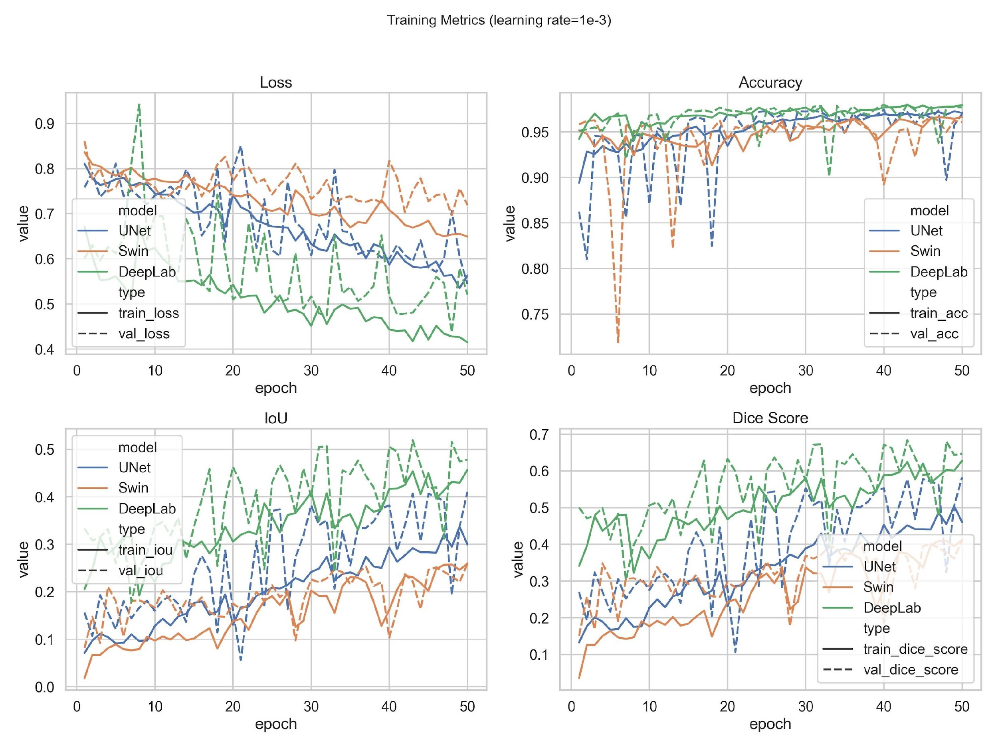
INDIAN INSTITUTE OF TECHNOLOGY ROORKEE
Model Comparison — LR = 1e-3
Learning Rate: 1e-3
LR=1e-3 causes high variance in IoU (wide boxes) — models overfit quickly and diverge, especially Swin Transformer. Tight boxes indicate stable convergence; outliers suggest instability.
IIT ROORKEE
13 / 22

Slide 14
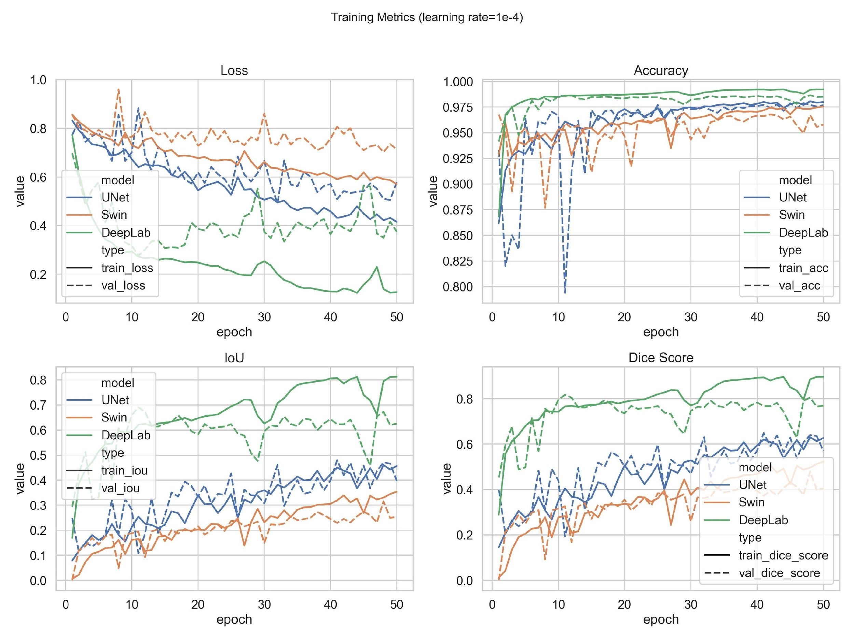
INDIAN INSTITUTE OF TECHNOLOGY ROORKEE
Model Comparison — LR = 1e-4
Learning Rate: 1e-4
LR=1e-4 is the sweet spot — DeepLab V3+ shows the narrowest IoU box with high median, confirming robust and stable training. U-Net and Swin shave acceptable spread.
IIT ROORKEE
14 / 22

Slide 15
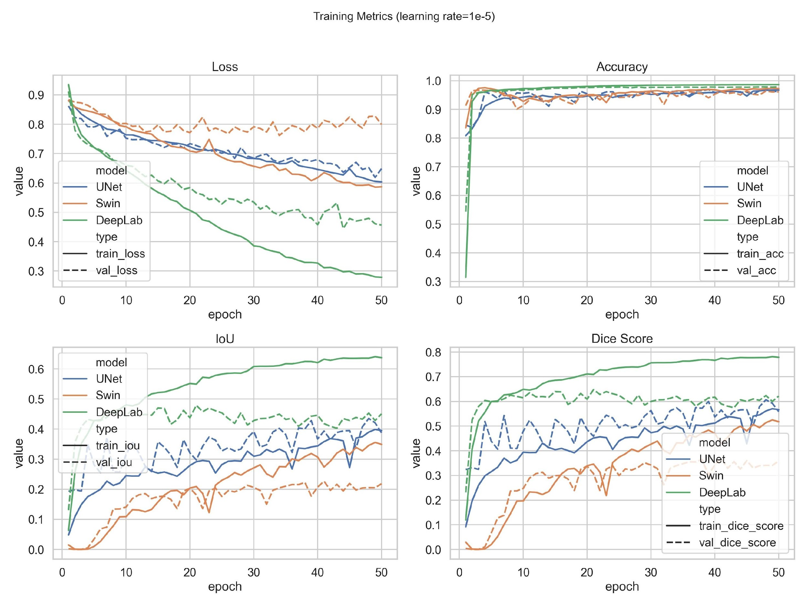
INDIAN INSTITUTE OF TECHNOLOGY ROORKEE
Model Comparison — LR = 1e-5
Learning Rate: 1e-5
LR=1e-5 leads to underfitting — all models shave lower IoU median with tight but low boxes, indicating too-slow convergence within 50 epochs. More epochs or LR warmup may help.
IIT ROORKEE
15 / 22

Slide 16
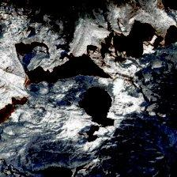
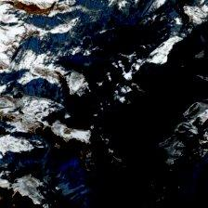
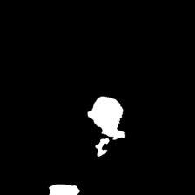
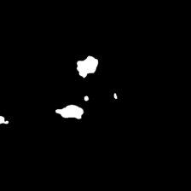
INDIAN INSTITUTE OF TECHNOLOGY ROORKEE
Original Images & True Labels
Original Satellite Images
True Segmentation Labels
Sample ID: 16
Sample ID: 17
Sample 16 contains a large, compact proglacial lake; Sample 17 shows fragmented ice-marginal lakes — testing the model’s ability to handle both dense and scattered lake geometries.
IIT ROORKEE
16 / 22

Slide 17

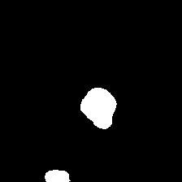
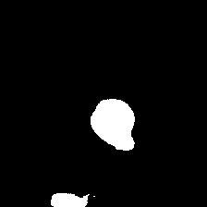
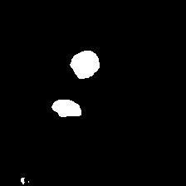
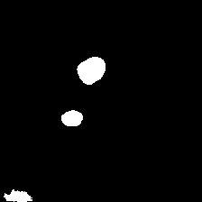
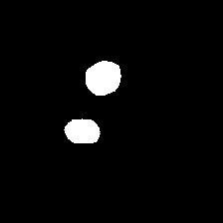
INDIAN INSTITUTE OF TECHNOLOGY ROORKEE
Segmentation Results — U-Net
LR = 1e-3
LR = 1e-4
LR = 1e-5
Label 16
Label 17
IIT ROORKEE
17 / 22

Slide 18
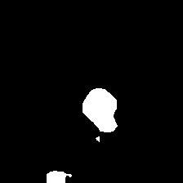
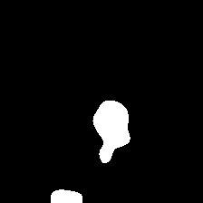

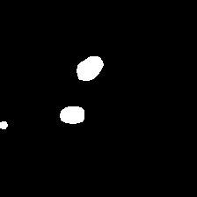
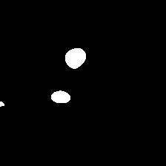
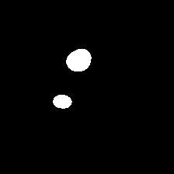
INDIAN INSTITUTE OF TECHNOLOGY ROORKEE
Segmentation Results — DeepLabV3+
LR = 1e-3
LR = 1e-4
LR = 1e-5
Label 16
Label 17
IIT ROORKEE
18 / 22

Slide 19
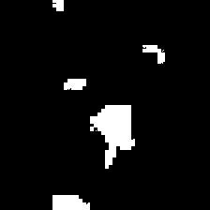
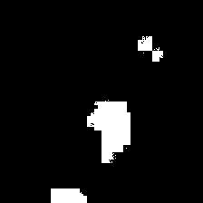
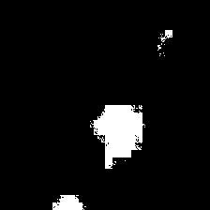
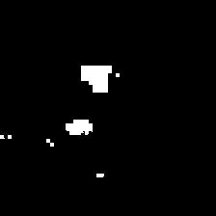
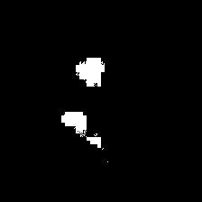
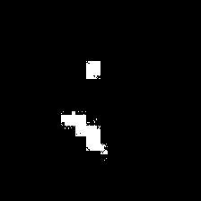
INDIAN INSTITUTE OF TECHNOLOGY ROORKEE
Segmentation Results — Swin Transformer
LR = 1e-3
LR = 1e-4
LR = 1e-5
Label 16
Label 17
IIT ROORKEE
19 / 22

Slide 20
INDIAN INSTITUTE OF TECHNOLOGY ROORKEE
Model Comparison Summary
U-Net
DeepLab V3+
Swin Transformer
Rank: 2nd
Rank: 1st ★
Rank: 3rd
STRENGTHS
STRENGTHS
STRENGTHS
Simple & stable architecture
Lowest training & validation loss
Captures long-range dependencies
Good boundary detection
Highest IoU score
Powerful global context
Effective with small datasets
Strong multi-scale feature extraction
Effective for complex scenes
Strong training baseline
Better boundary refinement
LIMITATIONS
LIMITATIONS
LIMITATIONS
Lower IoU under current setup
Limited global context capture
Higher computational complexity
Needs more data & compute
Slight boundary inaccuracies
Requires tuning for small datasets
: IoU provides the most meaningful comparison — DeepLabV3+ clearly outperforms on generalization despite similar accuracy.
IIT ROORKEE
20 / 22

Slide 21
INDIAN INSTITUTE OF TECHNOLOGY ROORKEE
Conclusion
✅
Automated Segmentation Achieved
All three deep learning models successfully detect glacial lakes from satellite imagery with strong agreement to ground truth.
🏆
DeepLabV3+ Best Performer
Achieved lowest loss and highest IoU. Multi-scale ASPP with dilated convolutions enables superior boundary refinement.
📊
U-Net — Reliable Baseline
Stable training, competitive metrics. Effective for general lake structure detection with smaller datasets.
🔍
Swin Transformer — Promising Direction
Lower current performance, but holds potential with more data and hyperparameter tuning for complex scenes.
🌍
Scalable & Automated Mapping
Reduces reliance on manual methods. Establishes a strong foundation for scalable glacial lake monitoring globally.
IIT ROORKEE
21 / 22

Slide 22
INDIAN INSTITUTE OF TECHNOLOGY ROORKEE
Future Work & References
Future Directions
References
1
Hyperparameter optimization (LR schedulers, augmentation strategies)
[1] Ma et al. (2025). Efficient glacial lake mapping via deep transfer learning. J. Hydrology, 657.
2
Incorporate diverse geographic datasets for better generalization
[2] Ronneberger et al. (2015). U-Net for biomedical image segmentation. MICCAI.
3
Explore ensemble models combining CNN + Transformer strengths
[3] Chen et al. (2017). Rethinking atrous convolution for semantic segmentation. arXiv:1706.05587.
4
Extend to Glacial Lake Outburst Flood (GLOF) risk prediction
[4] Liu et al. (2021). Swin Transformer: Hierarchical vision transformer. ICCV.
5
[5] Goodfellow, Bengio & Courville (2016). Deep Learning. MIT Press.
Deploy as a real-time monitoring system using multi-temporal imagery
[6] Zhang et al. (2021). Glacial lake mapping via remote sensing & ML. Remote Sensing J.
IIT ROORKEE
22 / 22

