Slide 1

TripSync
BIDA 2026 · TECHNOLOGY CATEGORY
Board smart,
travel smarter.
A governed boarding journey for passengers, operators, and frontline staff.
TRIPSYNC
University of Mindanao
Aaron Jalapon · John Benedict J. Bongcac
Hazel Mae B. Fuerzas · Ana Mae M. Viduya
Plan
Seat
Guide
Board
Notes:
Timing: 0:20. Aaron opens. Welcome the judges, name TripSync, and land the promise: board smart, travel smarter. Keep this opening concise, then introduce the team.

Slide 2
HAZEL
Global public-transport impact
One credible number. One clear implication.
OWNER INPUT REQUIRED
[ XX% ]
Hazel to provide
One global comparison visual with labeled units
A plain-language interpretation of the number
Headline percentage
Authoritative source and publication date
State exactly what the percentage measures and the population or geography it covers.
One sentence the judges should remember
Source · publication date · page or URL
Owner-input shell · No statistic inserted without Hazel’s verified source
Notes:
Timing: 0:35. Hazel owns this slide. Replace every bracketed prompt before presenting. State the metric, define its scope, show the comparison, and end with the direct implication for public transport. Handoff to Ben.

Slide 3
BEN
The Philippine transportation problem
Make the local operating problem visible before introducing the product.
Three local pain points
OWNER INPUT REQUIRED
[ PAIN POINT 01 ]
Ben to provide
1
Describe the passenger or operator consequence.
One contextual Philippine visual
Three concise, non-overlapping pain points
2
[ PAIN POINT 02 ]
Authoritative Philippine sources
Describe the passenger or operator consequence.
A bridge from the problem to Ana’s experience
3
[ PAIN POINT 03 ]
Describe the passenger or operator consequence.
Suggested source types
DOTr / LTFRB
PSA
Peer-reviewed
Owner-input shell · Keep units, geography, and publication dates visible
Notes:
Timing: 0:40. Ben owns this slide. Use three sourced Philippine pain points and one contextual visual. Avoid stacking multiple statistics in one sentence. Handoff: invite Ana to connect the system problem to lived experience and the team’s survey.

Slide 4
ANA
Personal experience and survey
Turn lived experience into a transparent evidence story.
PERSONAL OPENING
OWNER INPUT REQUIRED
Ana to provide
“[ One short, specific experience that explains why this problem matters. ]”
Survey method and collection dates
Sample size and respondent profile
Two or three selected findings with exact wording
Source location for the complete survey output
One careful takeaway—no overgeneralization
Keep the story concrete: route, moment, consequence.
Owner-input shell · Survey percentages intentionally omitted pending Ana’s approved selection
Notes:
Timing: 0:45. Ana owns this slide. Open with a specific lived experience, then explain how the survey was conducted before showing any result. Include sample size and respondent profile. Handoff to Aaron: ‘That is the journey TripSync is designed to govern.’

Slide 5
AARON
TripSync connects boarding into one governed journey
The system supports staff decisions from demand planning to verified boarding.
CURRENT STATE · PROTOTYPE
Demand planning
Accessible seating
Passenger guidance
Verified boarding
01
02
03
04
Plan
Seat
Guide
Board
Seven-day demand context for operator review.
Explainable recommendations with accessibility first.
Clear passenger steps across the booking journey.
Signed QR passes designed for offline verification.
Staff remain in control: accept, modify, or reject system recommendations.
Source: TripSync business plan · Current prototype uses demo or synthetic operational evidence
Notes:
Timing: 0:55. Say: ‘TripSync connects boarding into one governed journey.’ Walk left to right: demand planning, accessibility-first seating, passenger guidance, and verified boarding. Emphasize governance—not automation for its own sake. Staff remain responsible for operational decisions and can accept, modify, or reject recommendations. Be explicit that the current system is a working prototype using demo or synthetic operational evidence; no field pilot has been completed. Handoff to Ben for the passenger view.

Slide 6

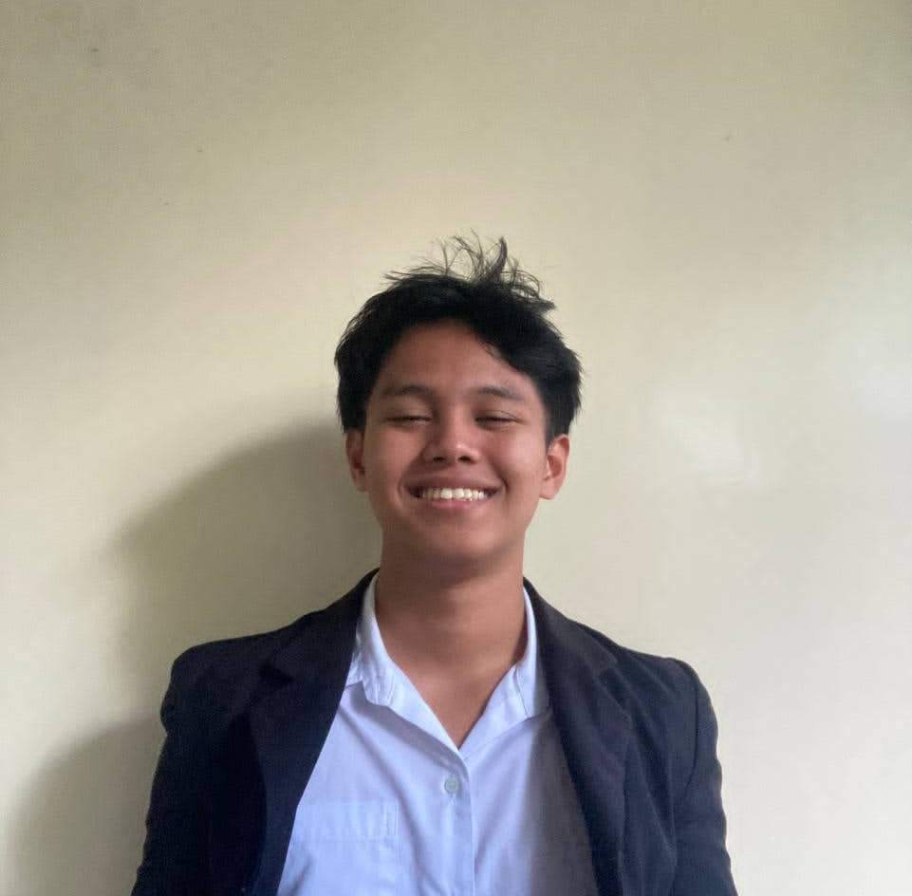
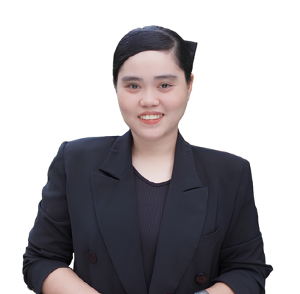

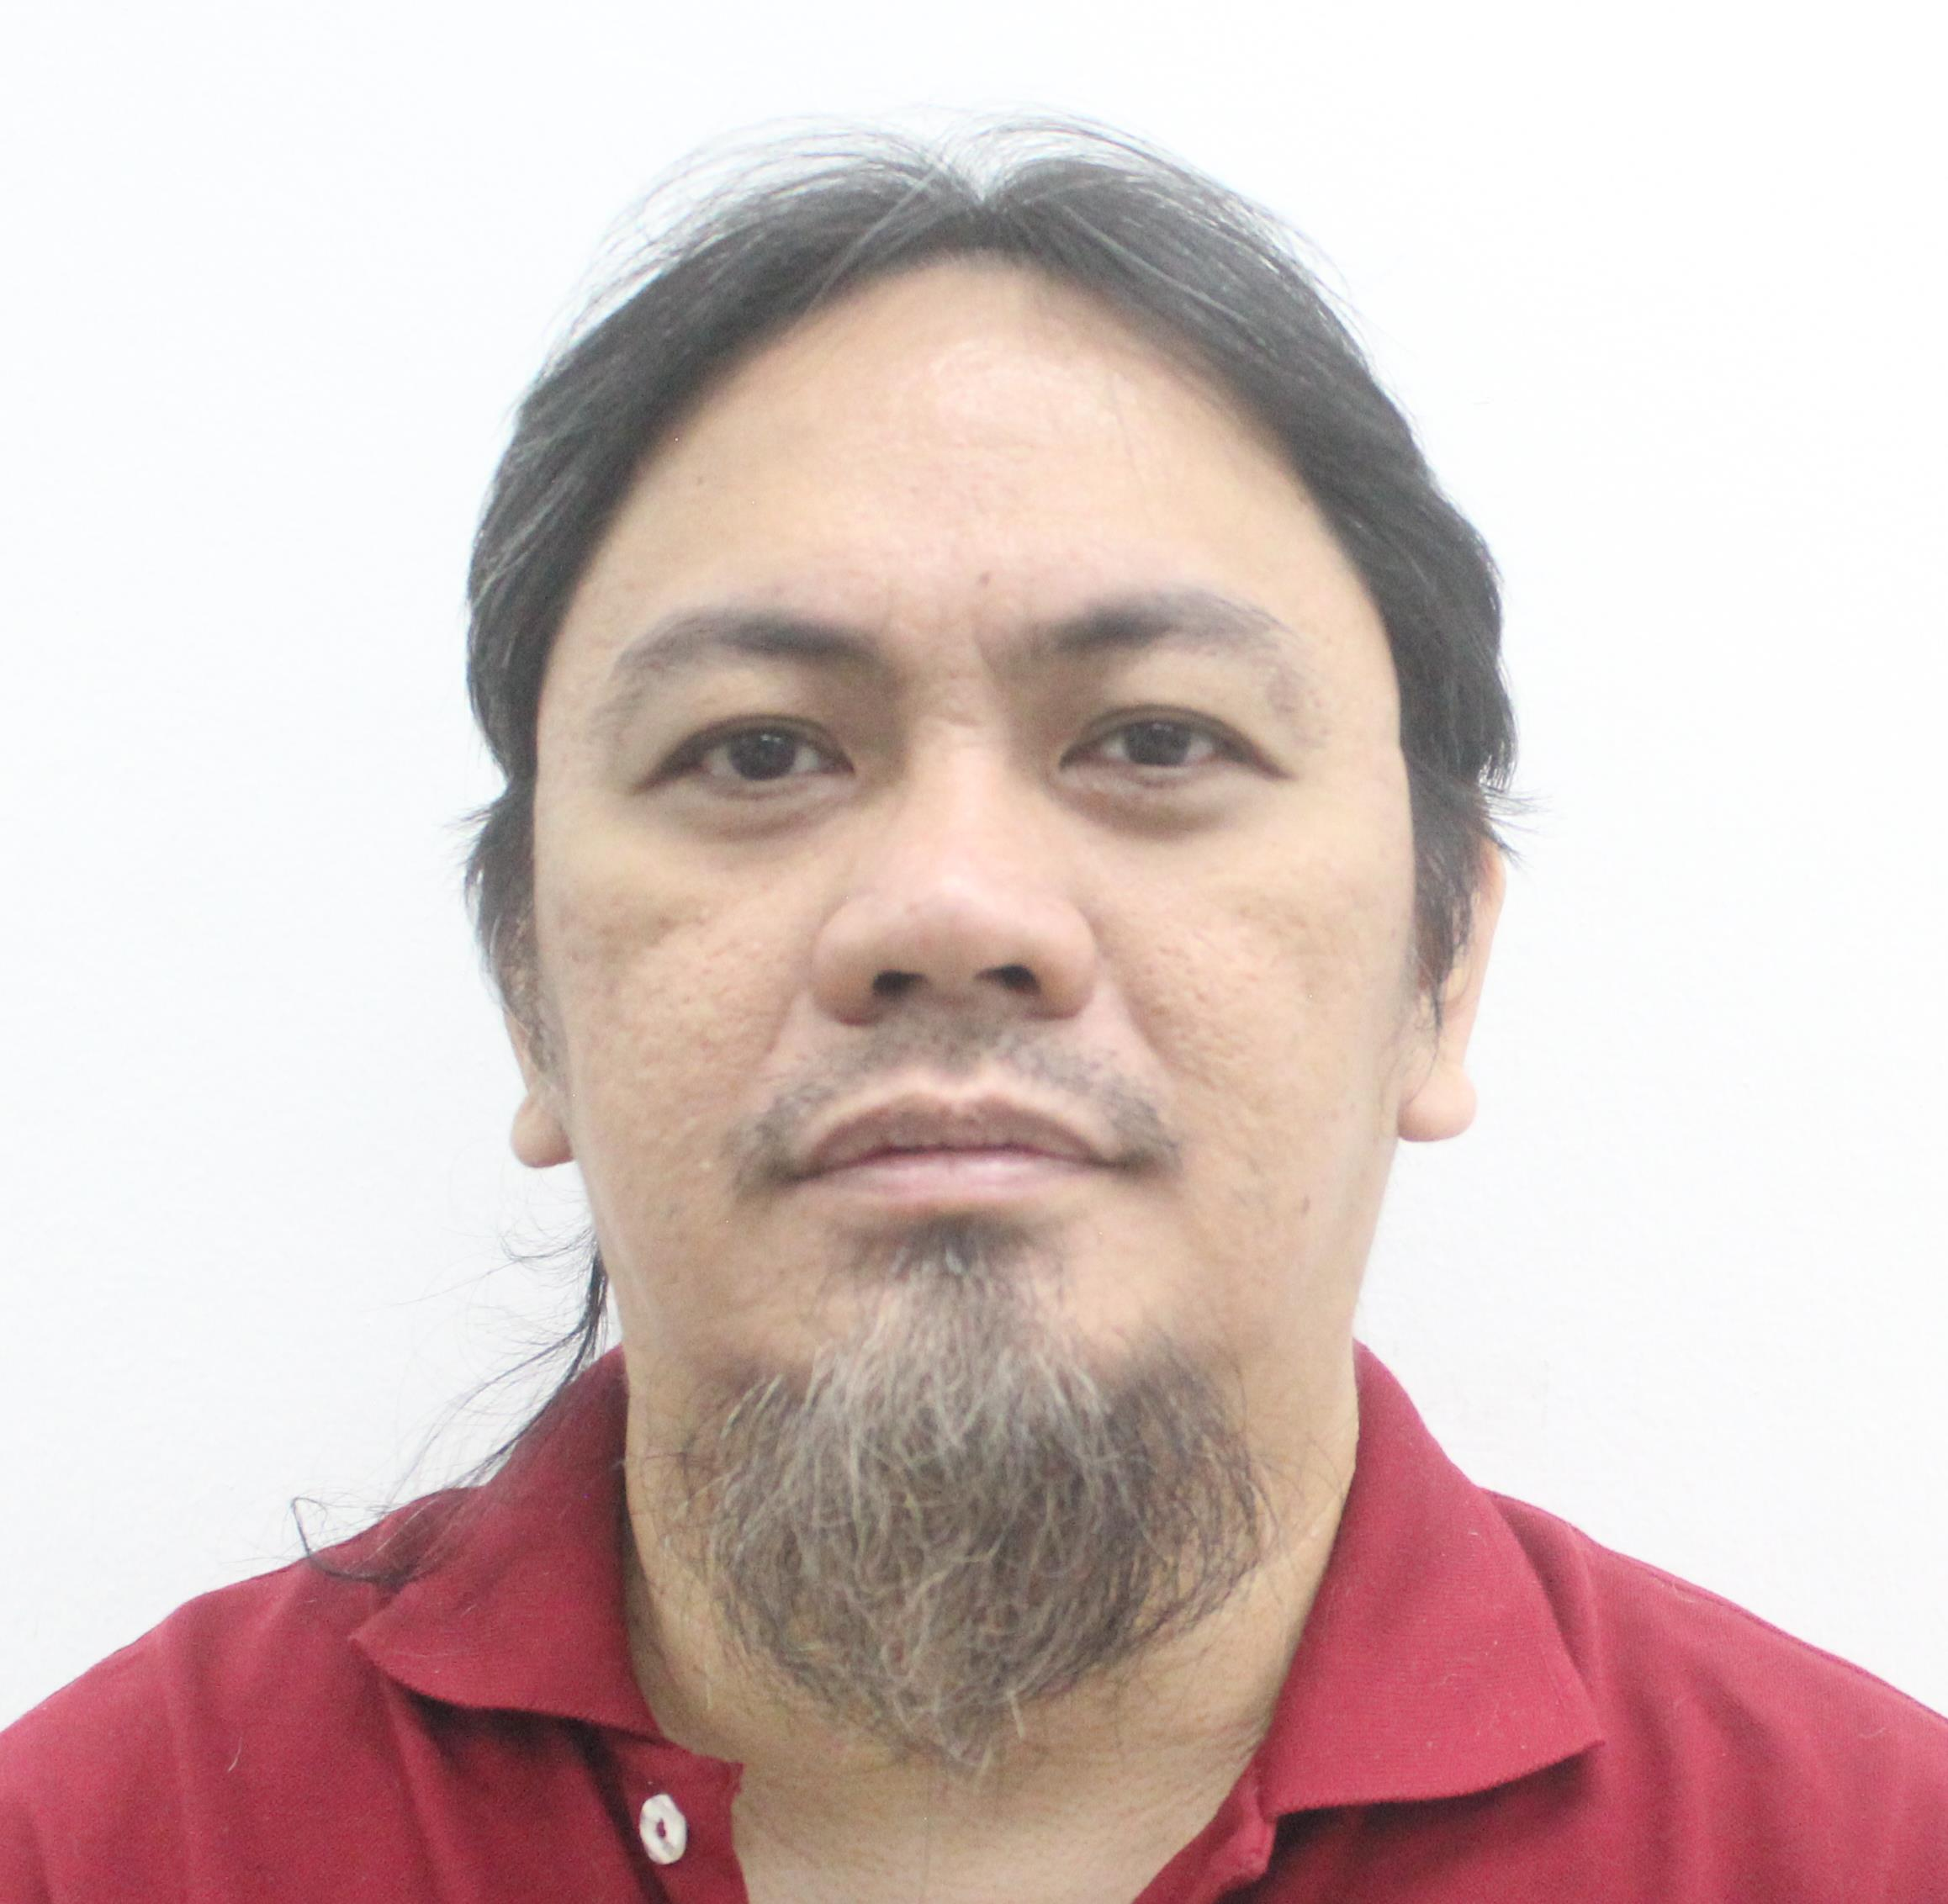
TEAM
Meet the people building TripSync
Four founders, one governed passenger-and-operator journey.
Aaron Jalapon
John Benedict J. Bongcac
Hazel Mae B. Fuerzas
Ana Mae M. Viduya
Chief Executive Officer
Chief Technology Officer
Chief Marketing Officer
Chief Financial Officer
Clyde Abner Valdez
ADVISER · OUTSIDE MANAGEMENT
External Faculty Adviser
Notes:
Timing: 0:30. Aaron introduces the four founders by role, then acknowledges Clyde as external faculty adviser. Handoff: ‘Hazel will frame why better public transport matters.’

Slide 7
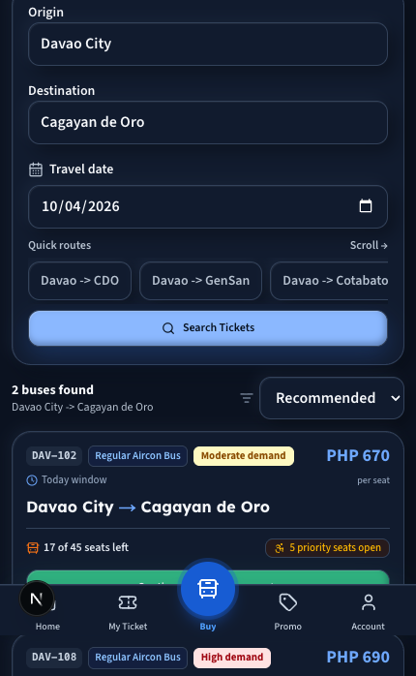
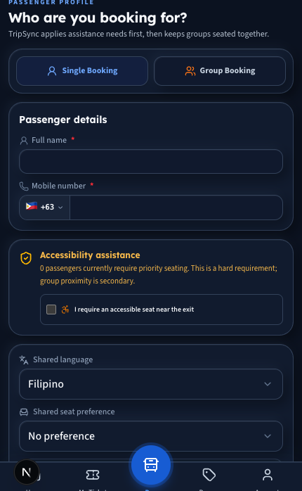
BEN
Passenger walkthrough: search and preferences
Fresh prototype views · Demo data · Owner-controlled callouts
BEN · ADD BEFORE PRESENTING
01
[ What the passenger is trying to do ]
02
[ Why the preference choice matters ]
03
[ One accessibility or clarity callout ]
04
[ The passenger benefit in plain language ]
1 · SEARCH
2 · PREFERENCES
Source: current TripSync repository build · Captured 19 Sep 2026 · Prototype / demo data
Notes:
Timing: 0:40. Ben owns the narrative and callouts. Demonstrate the passenger’s first two steps: search for a route, then state preferences. Keep the walkthrough focused on decisions, not every control. Handoff: continue to seat selection and the boarding pass.

Slide 8
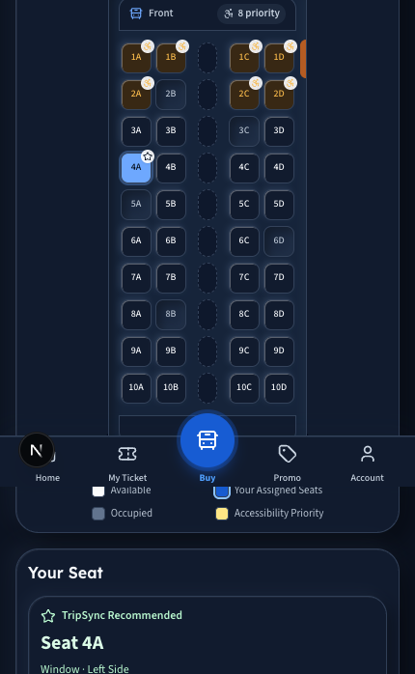
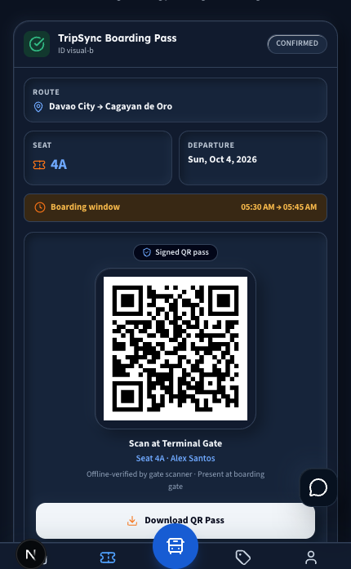
BEN
Passenger walkthrough: seat and boarding pass
Fresh prototype views · Demo data · Owner-controlled callouts
BEN · ADD BEFORE PRESENTING
A
[ Accessibility handling ]
B
[ Why this seat is recommended ]
C
[ What the signed QR pass verifies ]
D
[ The passenger benefit ]
3 · SEAT
4 · BOARDING PASS
Source: current TripSync repository build · Captured 19 Sep 2026 · Prototype / demo data
Notes:
Timing: 0:40. Ben owns this walkthrough. Explain the accessibility handling and the reason shown for a recommendation. Then show the signed QR boarding pass. Do not imply production deployment or field-pilot results. Handoff to Aaron for the operator view.

Slide 9
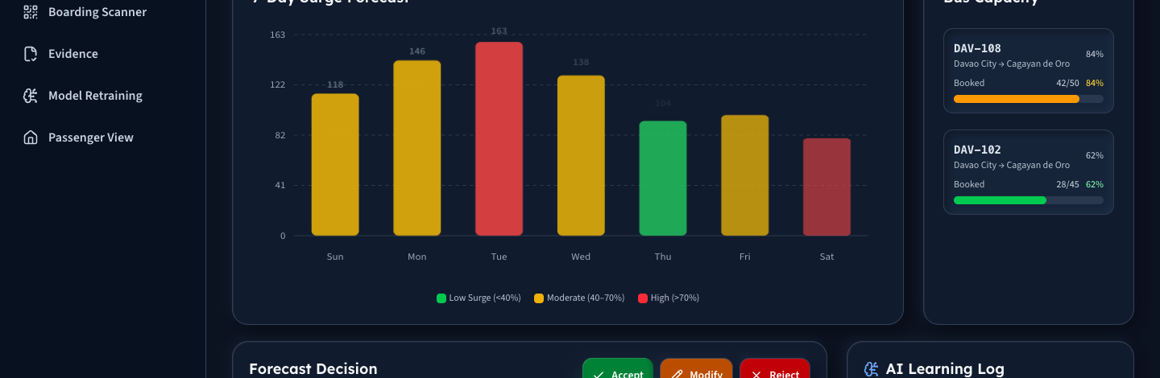
AARON
Operator walkthrough: see and decide
The primary operator moment
Forecasts inform staff. Staff decide.
7-DAY VIEW
FLEET CONTEXT
ACCEPT · MODIFY · REJECT
Source: current TripSync repository build · Demo model / synthetic operational evidence · No completed field pilot
Notes:
Timing: 0:55. This is the presentation’s main visual moment. Pause after the headline: ‘Forecasts inform staff. Staff decide.’ Point to the seven-day view, then fleet context, then the accept/modify/reject controls. The purpose is operational judgment with traceability—not an automated dispatch decision. The displayed dashboard is prototype evidence generated from demo or synthetic operational data. Do not state accuracy, savings, or field performance. Transition: the decision is only useful if the system records what happened next.

Slide 10
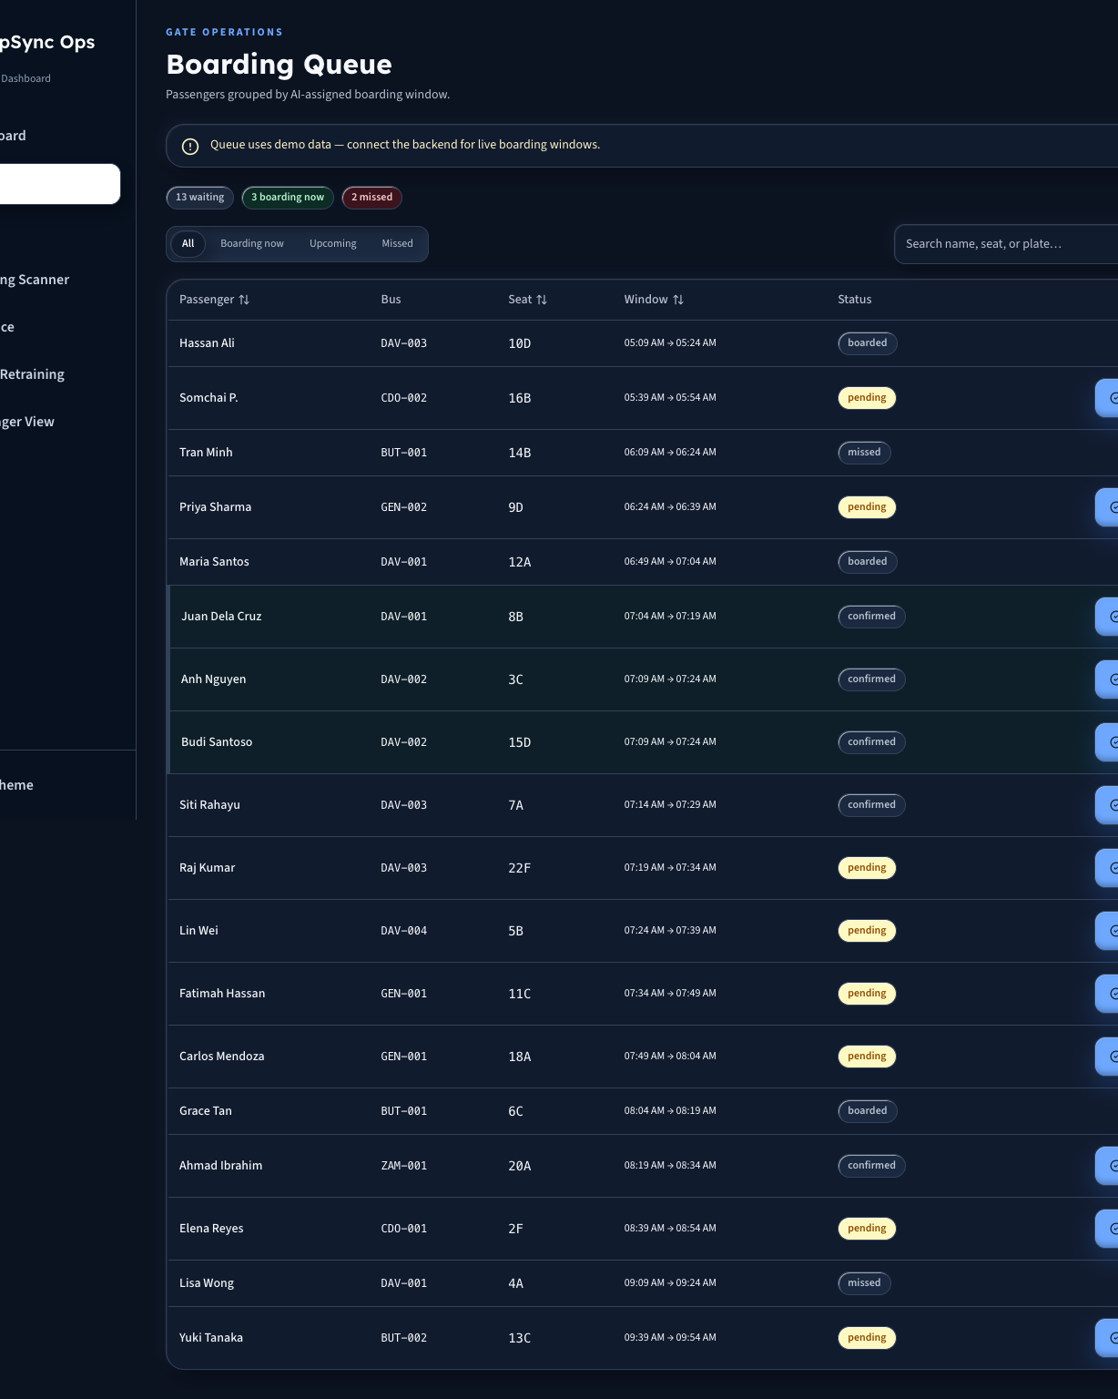
AARON
Operator walkthrough: learn from outcomes
An editable evidence loop—without unsupported performance claims
01
02
03
04
Forecast snapshot
Human action
Operational outcome
Evidence gate
What the system showed
Accept, modify, or reject
What actually happened
Review before retraining
Evidence is captured first. Model changes remain gated.
QUEUE / EVIDENCE VIEW
Source: TripSync business plan and current prototype · Planned evidence loop · No performance claim
Notes:
Timing: 0:50. Describe the governance loop in four steps. First, preserve the forecast snapshot. Second, record the staff decision. Third, capture the actual operational outcome. Fourth, review the accumulated evidence before any retraining or model change. The queue crop is prototype support, not proof of field performance. Avoid saying the system improves accuracy or operations today; this slide explains the intended control loop. Handoff to Ana for the cost-and-benefit case.

Slide 11
ANA
Cost and benefit
A concise decision view—not a dense financial table.
IMPLEMENTATION COST
OPERATOR VALUE
₱ [ INSERT ]
[ ONE VERIFIED BENEFIT ]
Financial period: [ INSERT ]
Define the unit, time period, and comparison baseline.
Key assumptions: [ INSERT ]
Source: [ INSERT ]
ANA · OWNER CHECK
Approved figures · assumptions · period · source
Owner-input shell · Use only the approved business-plan model and Ana’s approved explanation
Notes:
Timing: 0:40. Ana owns this slide. Replace all prompts with approved figures from the selected financial model. Define the period and assumptions. Frame the operator benefit without inventing savings or pilot results. Handoff to Hazel for the defensible capability and urgency.

Slide 12
HAZEL
Core competency and urgency
Why TripSync can matter—and why the timing matters now.
DEFENSIBLE CAPABILITY
WHY NOW
[ Name the capability ]
[ One time-sensitive reason ]
[ Explain why operators or passengers cannot get the same value from a disconnected process. ]
[ Add one comparison or market signal with a source and date. ]
Judge-facing conclusion: [ INSERT ]
Evidence: [ INSERT ]
Owner-input shell · Capability, comparison evidence, source, and conclusion remain Hazel-controlled
Notes:
Timing: 0:40. Hazel owns this slide. Name one defensible capability, one reason the timing matters, and one sourced comparison. End with a single judge-facing conclusion. Handoff: Aaron will show how the business and product mature together.

Slide 13
AARON
TripSync roadmap: today to Year 5
Business-model and product milestones move together through explicit evidence gates.
TODAY
YEAR 1
YEAR 2
YEAR 3
YEAR 4
YEAR 5
BUSINESS MODEL
Pre-pilot
B2B proposition
Incorporate · 5 wins
≥1 paid pilot
Standard onboarding
15 customers · +2 roles
Conditional growth to 40
Ticketing scope gate
Passenger premium only
after WTP validation
Philippines expansion
then evidence-gated ASEAN
PRODUCT
Working prototype
Demo / synthetic evidence
Production hardening
Operator data · pilot QA
Multi-tenant tools
Repeatable integrations
Integrate with operator
payment / ticketing systems
Profiles · alerts · rebooking
History · priority support
Localization · integrations
Language · compliance
EVIDENCE GATES
PROTOTYPE
PAID PILOT
SCALE
B2B2C VALIDATION
PREMIUM
GEOGRAPHY
Passenger-premium pricing remains unspecified until willingness-to-pay validation.
Source: TripSync business plan · Years 1–3 preserved; Years 4–5 are evidence-gated extensions approved for this deck
Notes:
Timing: 1:15. Read the roadmap in two lanes. Today, TripSync is a pre-pilot B2B proposition and a working prototype using demo or synthetic evidence. Year 1: incorporation and privacy readiness, five customer wins, at least one paid pilot, production hardening, operator-data integration, and pilot QA. Year 2: standardized onboarding, fifteen customers, two added delivery roles, multi-tenant tools, repeatable integrations, stronger offline and support operations. Year 3: growth to forty customers only if service quality, cash, and team capacity support it; integrate with operator payment and ticketing systems without replacing them, and prepare B2B2C validation. Year 4: launch an optional passenger premium tier only after willingness-to-pay validation—pricing remains unspecified. Product candidates include saved profiles, proactive alerts, flexible rebooking, trip history, and priority support. Year 5: broader Philippine expansion, then evidence-gated ASEAN bus-market entry with localization, operator integrations, language expansion, and market-specific compliance. The gates matter: prototype, paid pilot, scale, premium, and geography are separate decisions.

Slide 14
ANA
14
Promise and call to action
Close with one promise and one decision request.
“[ Insert one owner-approved promise. ]”
PILOT INVITATION
DECISION REQUEST
[ Who should pilot—and what should the pilot test? ]
[ What do you want the judges to decide or enable? ]
Owner-input shell · Final promise and ask remain Ana-controlled
Notes:
Timing: 0:35. Ana owns the closing promise and the formal ask. Keep the promise specific and credible. Name the pilot audience, what the pilot will test, and the exact decision or support requested from the judges. Then invite Aaron and Ben to open the volunteer test.

Slide 15
BEN + AARON
Try the TripSync prototype
Help us test the passenger journey and signed boarding-pass flow.
Volunteer flow
1
Scan
Open the beta link.
2
Try
Search, set preferences, select a seat.
3
Board
Show the signed QR boarding pass.
Tell us
Share what was clear—or confusing.
INSERT BETA URL
4
QR placeholder only
Board smart. Travel smarter.
Prototype test invitation · Replace the QR placeholder only after a verified beta URL is approved
Notes:
Timing: 0:40. Aaron says: ‘We are inviting volunteers to test the passenger journey and the signed boarding-pass flow.’ Explain that the QR area is a placeholder until a verified beta URL is approved; never present it as a live code. Invite volunteers to scan, try the core flow, and give concise usability feedback. Handoff to Ben to manage the live test or demo queue, then thank the judges.

Slide 16
LIBRARY
16
Civic Clay reusable components
Hidden slide · Copy and adapt these editable modules.
Raised card
Product panel
OWNER INPUT REQUIRED
Warm Canvas + white surface
Civic Navy + cool border
OWNER to provide
Prompt item
Evidence slot
Stat
Evidence
XX%
Source · date · unit
PHONE
FRAME
DASHBOARD
FRAME
INSERT
BETA URL
PROTOTYPE
PILOT
VALIDATED
CITATION · DATE
Step
Station
Gate
Next
Notes:
Hidden component library. Copy these editable Civic Clay modules into future TripSync slides.

