Slide 1

Project :
Bank of CLI
Presented by Aaron James
9/25/2026

Slide 2

Overview
A Java CLI application simulating real banking operations against a live PostgreSQL database.
Core flows : Register → Login → Deposit / Withdraw / Transfer → View History → Logout
Built to behave like a real financial system : no negative balances, no partial transfers, every money movement is logged.

Slide 3
Project Requirements
Authentication : PIN-based registration and login for security.
Persistence : Balances and transaction history stored in PostgreSQL.
Transactions : Deposit, withdraw and cross-account transfer.
Atomicity : A transfer either fully succeeds or fully rolls back.
Auditability : Every balance change writes a permanent transaction record.
Multi-layered : Strict separation between CLI, business logic and data access.

Slide 4
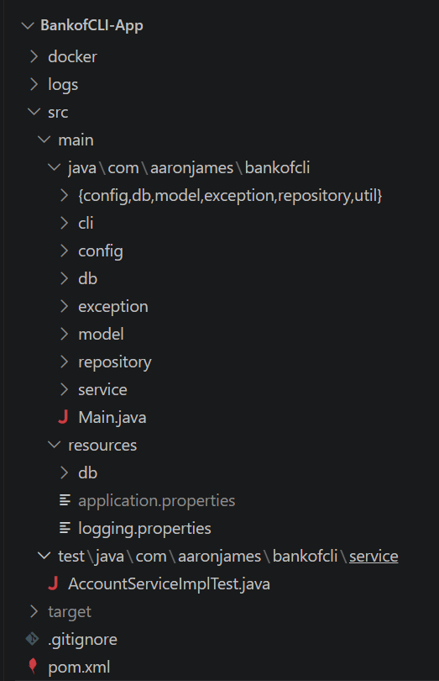
Layered- Architecture

Slide 5




Technology Stack
Java 17 / Maven : Application logic and build/dependency management.
JDBC : Communication with the database.
PostgreSQL 18 (Dockerized) : Stores accounts and transaction records.
Docker Compose : Reproducible local database environment, no manual Postgres install.

Slide 6
SOLID Principles
S — Single Responsibility: Repositories only do SQL, services only enforce business rules and the CLI only handles I/O.
O — Open/Closed: New ConnectionProvider or AccountRepository implementations can be added without changing service code
L — Liskov Substitution: any AccountRepository implementation can stand in for another — the service layer doesn't know or care
I — Interface Segregation: small, focused contracts (ConnectionProvider, TransactionManager, UnitOfWork) instead of one bloated interface
D — Dependency Inversion: Main.java is the only class that references concrete classes; everything else depends on interfaces.

Slide 7
Key Engineering Decisions
Atomic transfers: A transfer runs as one database transaction debit, credit and two audit rows all commit together or all roll back, so money is never deducted from one account without appearing in the other.
Separated exception hierarchy: Business errors (InsufficientFundsException, InvalidPinException) show the user a specific message, technical errors (DataAccessException) show a generic message and log the real detail so that the user never sees a raw stack trace.
Two-row transfer audit model: A transfer writes two linked records (TRANSFER_OUT on the sender, TRANSFER_IN on the recipient) via a shared related_account_id, instead of one ambiguous TRANSFER row, so any single row tells you debit or credit without needing to cross-reference its pair.

Slide 8

Live Demo

Slide 9

Q&A

