Slide 1
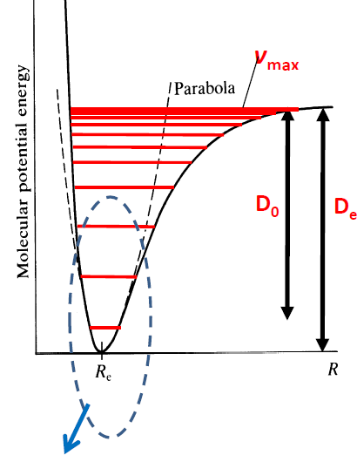
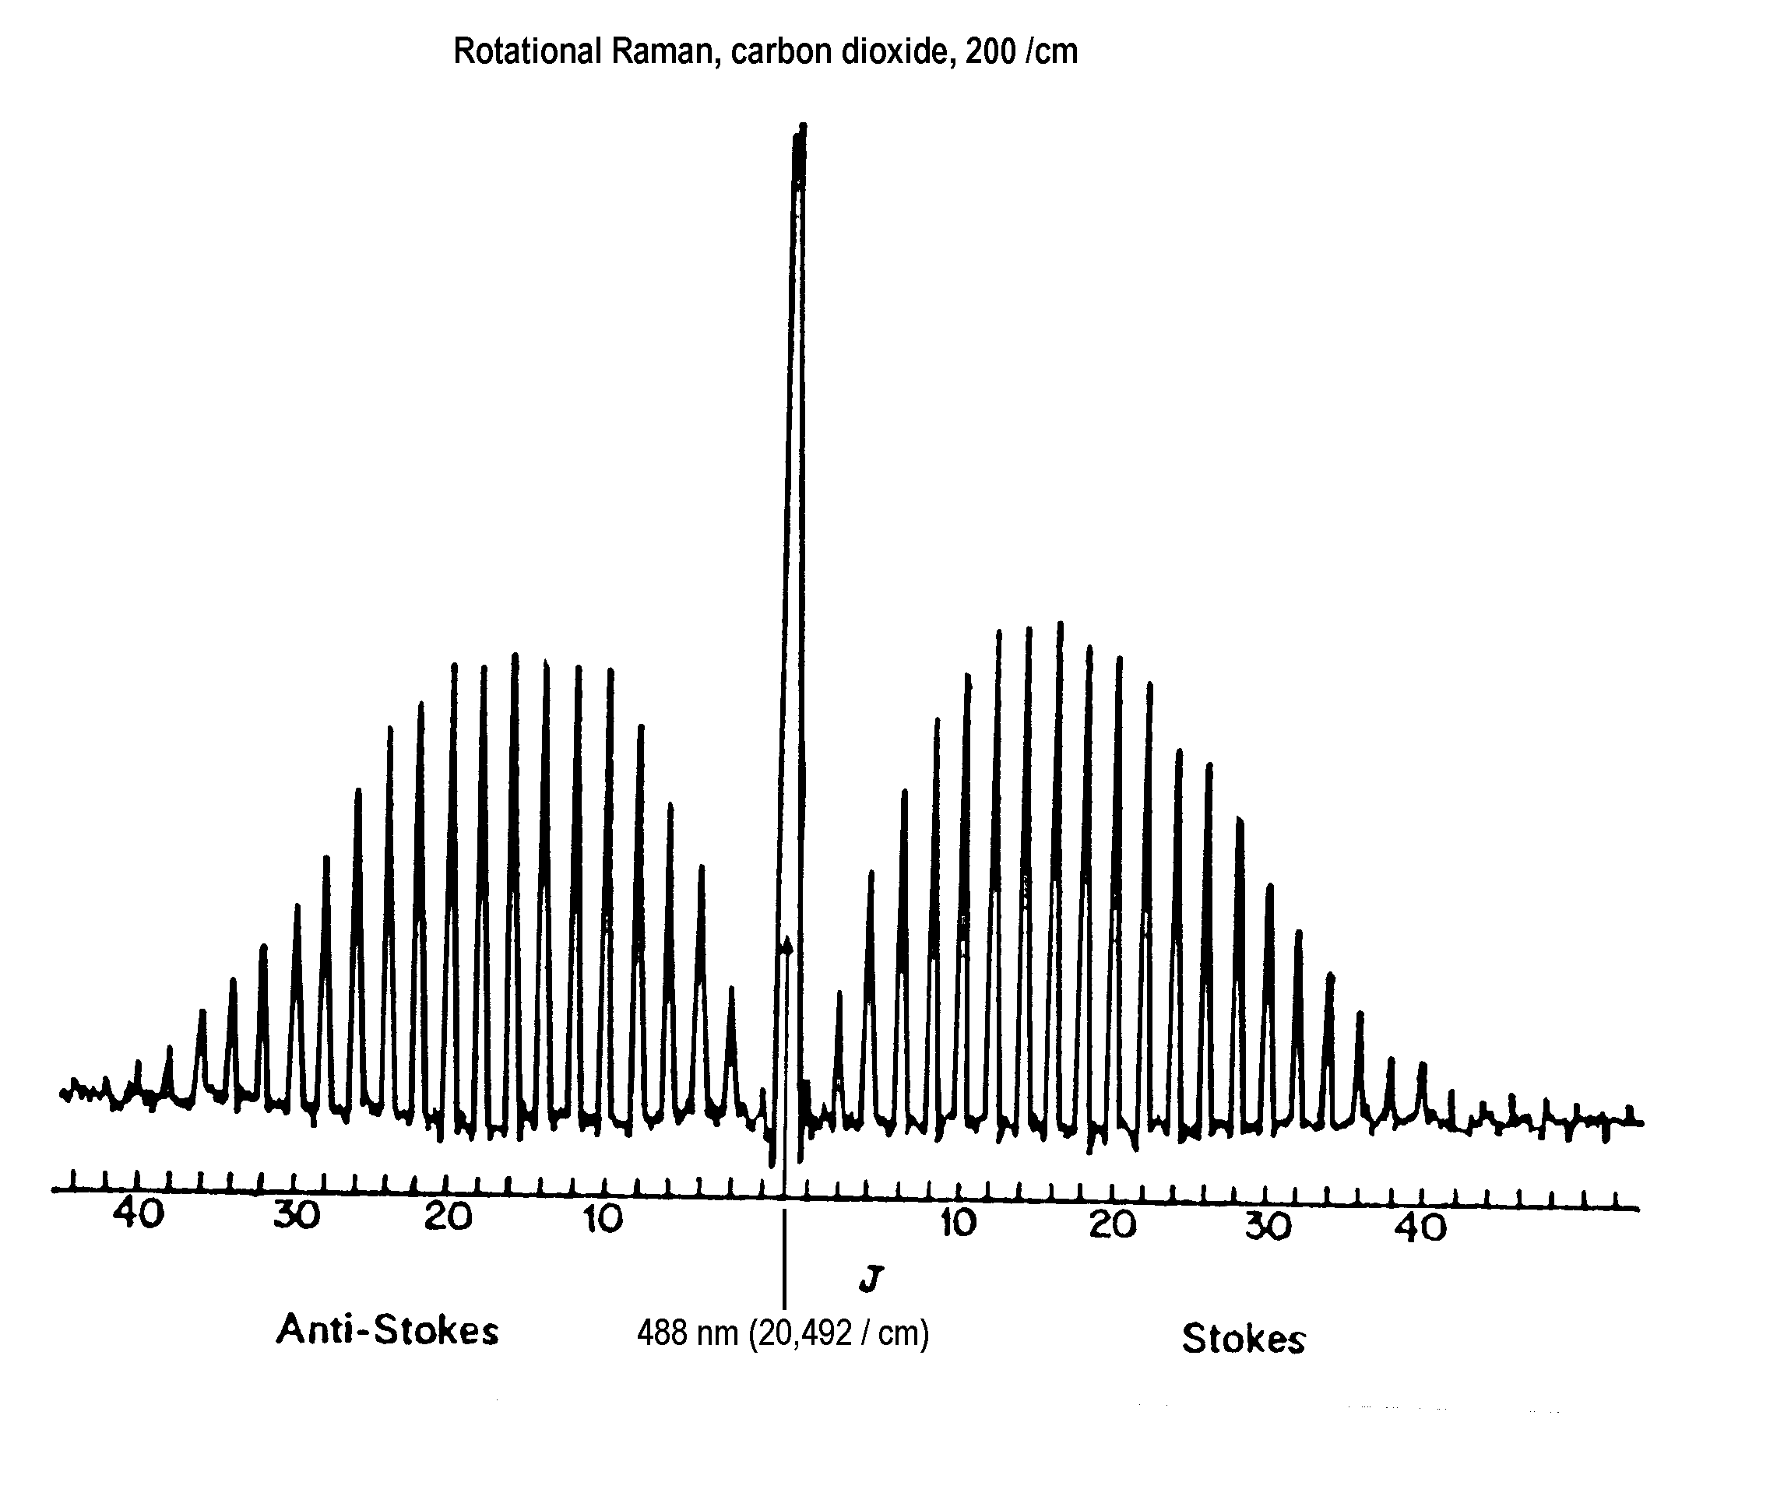
Lecture 14: Anharmonic Oscillator and Raman Effect
Notes:
Please mention about selection rule

Slide 2
Transition Moment Integral
Can be evaluated analytically
Often simplified by symmetry
Gives rise to selection rules if recursion formulae exist
Notes:
Please mention about selection rule

Slide 3
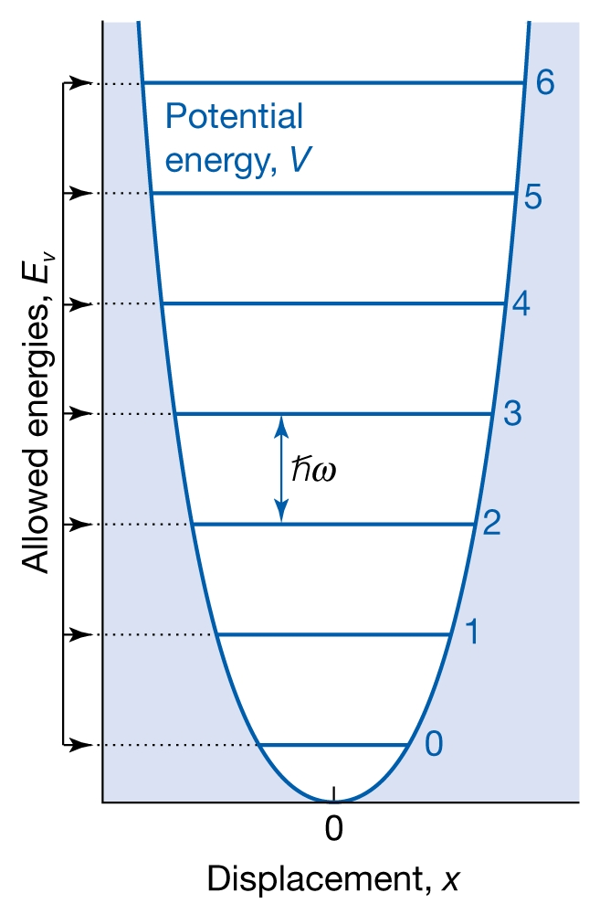
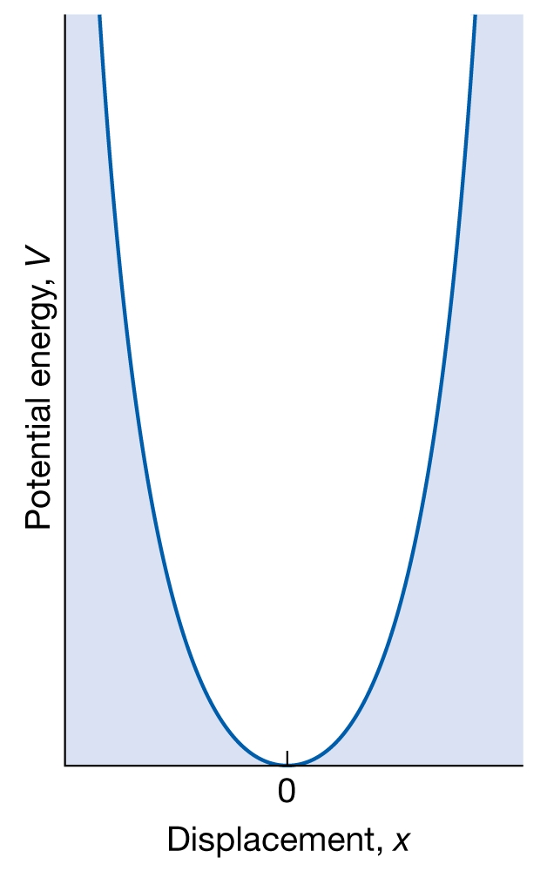
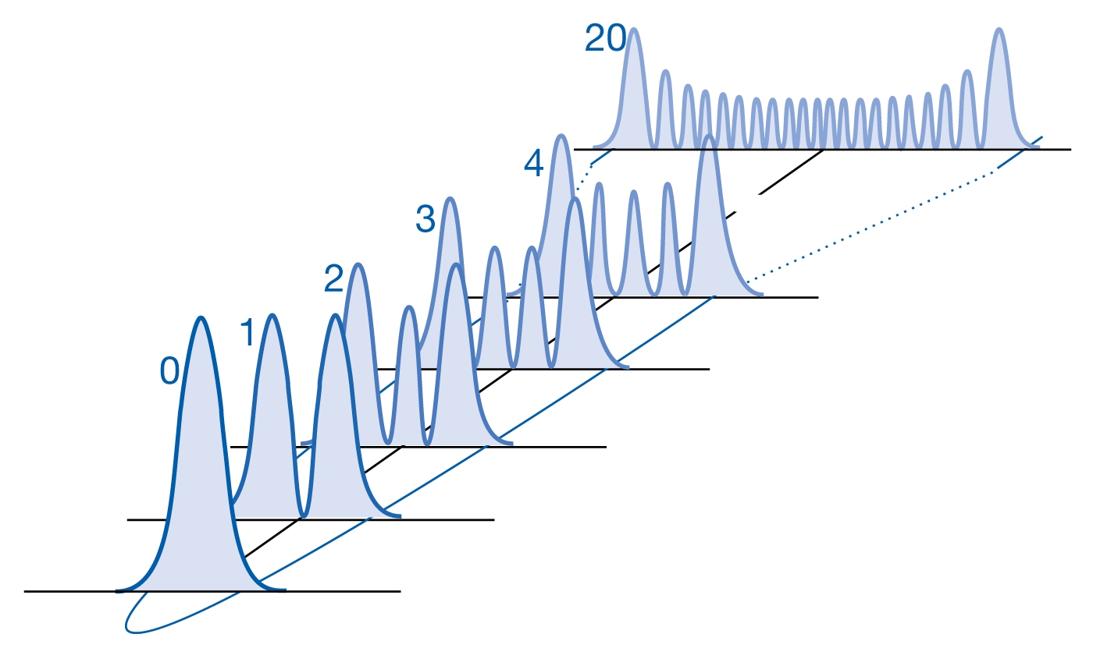
The chemical bond as a simple harmonic oscillator
Parabolic potential:
Schrödinger equation:
Boundary condition:
ψ = 0 at x = + ∞
E_{v} = (v + ½)ħω
SHO: a good approximation
for small displacements
Notes:
Please mention about selection rule

Slide 4
The chemical bond as a simple harmonic oscillator
v = Vibrational quantum number
= 0, 1, 2, 3, …
Force constant
Reduced mass
E_{v+1} – E_{v} =
ħω
= hω/2π
= hν
E_{v=0} = ½ħω
Zero point energy
Notes:
Please mention about selection rule

Slide 5
Spectrum of a harmonic oscillator
v = Vibrational quantum number
= 0, 1, 2, 3, …
Δv=1
Force constant
Intensity
Reduced mass
E_{v+1} – E_{v} =
ħω
0
1000
2000
3000
= hω/2π
= hν
Energy of transition
IR Spectrum:
Bond strength
Polyatomic molecule: Different Bond strengths
➔ Functional groups
Notes:
Please mention about selection rule

Slide 6
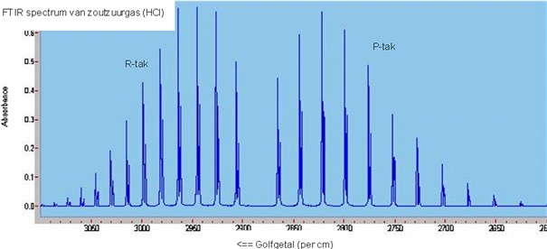
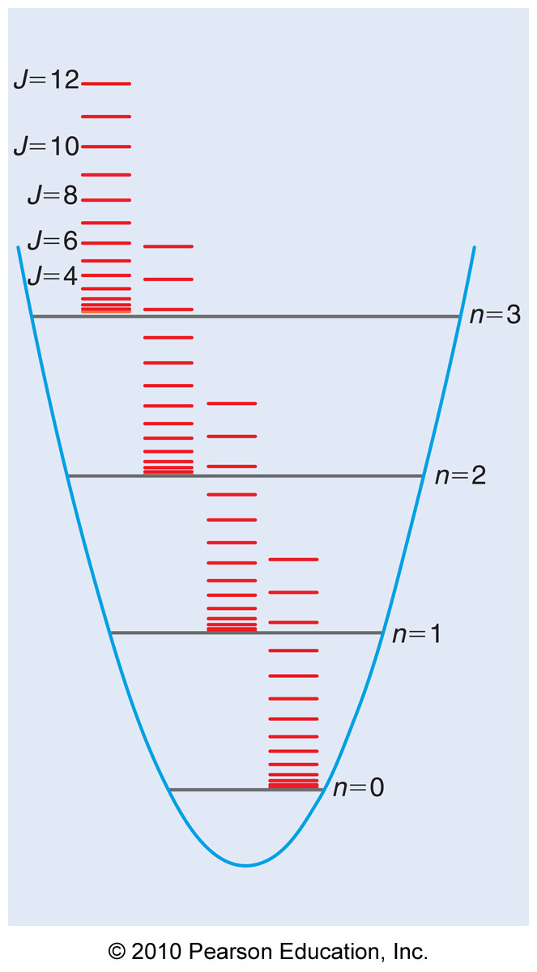
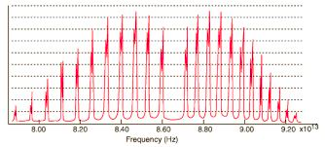
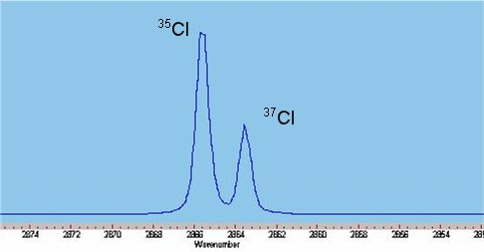
High resolution IR spectrum of HCl
Rotational fine structure
Δv=1, ΔJ=+1
Isotope effect

Slide 7
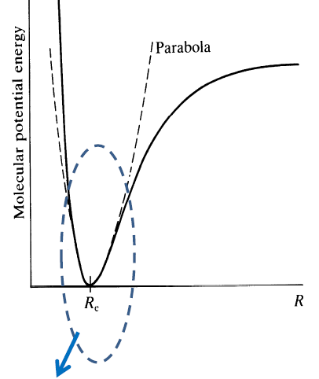
Anharmonic oscillator
The bond breaks at large displacements
Bond dissociation energy
Morse potential
SHO: a good approximation
only for small displacements
Notes:
Please mention about selection rule

Slide 8
Anharmonic oscillator
The bond breaks at large displacements
Bond dissociation energy
Energy levels come closer for higher values of v
Fundamental and overtones in IR spectra
Morse potential
SHO: a good approximation
only for small displacements
Notes:
Draw a relative picture of anharmonic pic

Slide 9
Anharmonic oscillator: Energies
The bond breaks at large displacements
Bond dissociation energy
Energy levels come closer for higher values of v
Fundamental and overtones in IR spectra
Morse potential
ε_{v} = (v + ½)ν
− (v + ½)²x_{e}ν
x_{e} = ν/4D_{e}
Δv=+1, +2, +3,….
SHO: a good approximation
only for small displacements
Notes:
Draw a relative picture of anharmonic pic

Slide 10
Anharmonic oscillator: “Selection” rules
The bond breaks at large displacements
Bond dissociation energy
Energy levels come closer for higher values of v
Fundamental and overtones in IR spectra
Morse potential
ε_{v} = (v + ½)ν
− (v + ½)²x_{e}ν
x_{e} = ν/4D_{e}
Δv=+1, +2, +3,….
Fundamental
1st Overtone
2nd Overtone
Notes:
Draw a relative picture of anharmonic pic

Slide 11
Anharmonic oscillator: Position of spectral lines
ε_{v} = (v + ½)ν
− (v + ½)²x_{e}ν
x_{e} = ν/4D_{e}
Δv=+1, +2, +3,….
Fundamental
1st Overtone
2nd Overtone
Notes:
Draw a relative picture of anharmonic pic

Slide 12
Anharmonic oscillator: Position of spectral lines
x_{e} = ν/4D_{e}
Δv=+1, +2, +3,….
Fundamental
1st Overtone
2nd Overtone
Notes:
Draw a relative picture of anharmonic pic

Slide 13
Anharmonic oscillator: Position of spectral lines
Intensity
Wavenumber
x_{e} = ν/4D_{e}
Fundamental
Δv=+1, +2, +3,….
1st Overtone
2nd Overtone
Notes:
Draw a relative picture of anharmonic pic

Slide 14
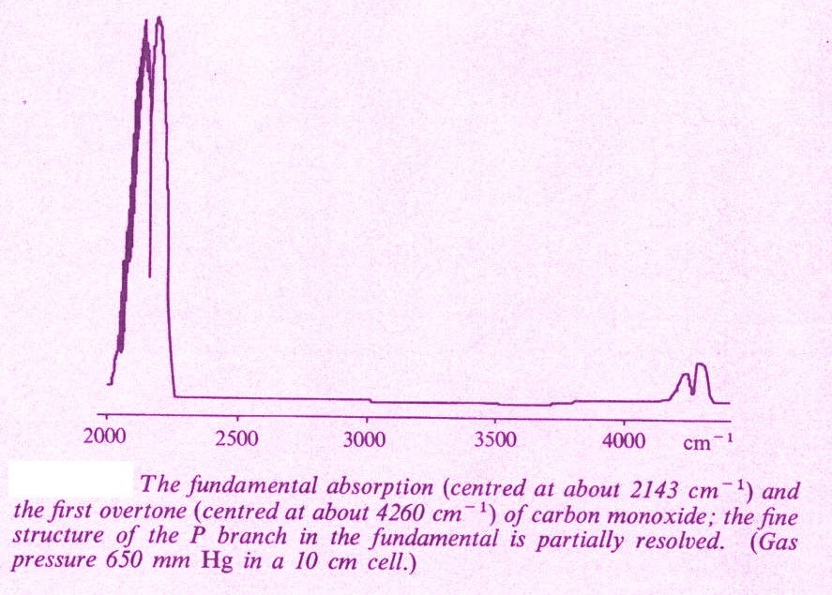
IR Spectrum of Carbon Monoxide
Fundamental Peak
2143 cm⁻¹
First Overtone
4260 cm⁻¹

Slide 15
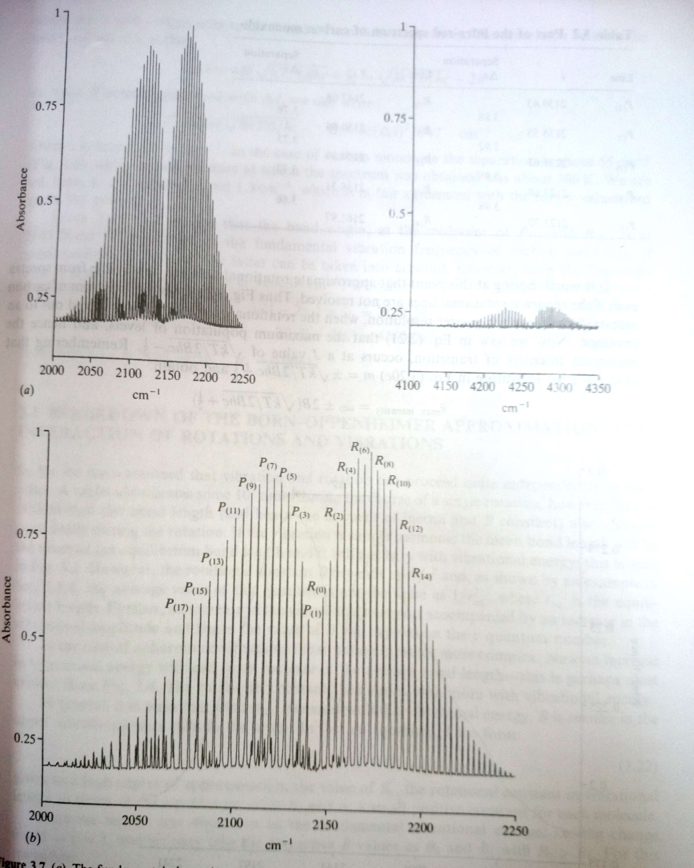
IR Spectrum of Carbon Monoxide: High resolution
Fundamental Peak
2143 cm⁻¹
First Overtone
4260 cm⁻¹

Slide 16
Population of states and hot band
Morse potential
Boltzmann distribution:
Typical energy gap:
100s and 1000s of cm⁻¹
Hot band
for energy gap of 1000 cm⁻¹
High temperature: v =1 to v = 2 ….. are possible
Intensity of hot band: Population of v =1 at that temperature

Slide 17
How to find out bond length of H₂ ?
Diatomic molecule, NO permanent dipole moment
Polarizability: Induced dipole moment.
Molecular rotation or vibration: Oscillating induced dipole
Raman Spectroscopy
Scattering of (usually) visible monochromatic light by molecules of a gas, liquid or solid
Two kinds of scattering :
Rayleigh (1 in every 10,000) : No change in frequency
Raman (1 in every 10,000,000): Change in frequency

Slide 18
Raman Spectroscopy
Virtual level
ν_{ex}
ν
Anti-Stokes
shift
Stokes
shift
0
Δν (= ν – ν_{ex}) ➔
Rayleigh scattering:
no change in energy of light
Δν : energy gaps in molecule
Δν : No dpendence on ν_{ex}
Raman scattering:
different from original
Stokes strong, anti-Stokes weak for vibrational levels

Slide 19
Rotational Raman Spectroscopy: CO₂
Selection Rule:

