Slide 1
EE 207: BJTs
S. Lodha
From: R. Pierret, Semiconductor Device Fundamentals

Slide 2
NPN and PNP BJTs
Only two independent voltages and currents

Slide 3
Device Cross-section
Double-diffused discrete pnp BJT

Slide 4
Device Cross-section
BJT in an integrated circuit
Device isolation is critical
All contacts at the top

Slide 5
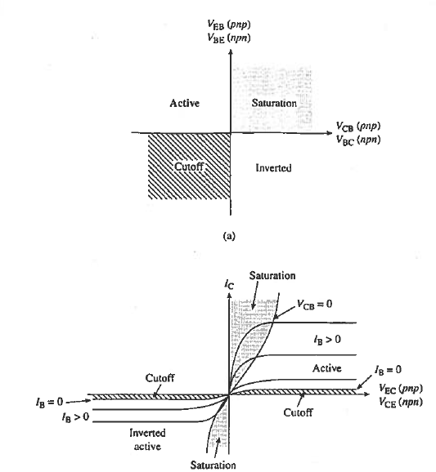
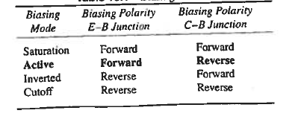
Biasing Modes
Amplifier in active mode
Switch in cut-off and saturation regimes

Slide 6
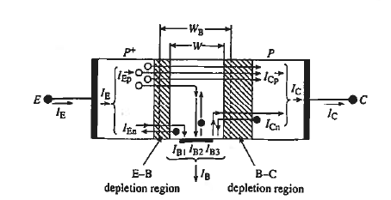
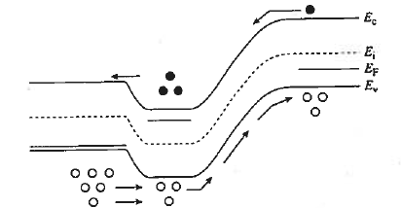
Operation of BJT
Active mode biasing

Slide 7
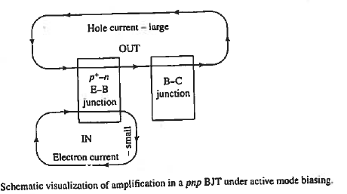
Amplification
Common emitter mode
Small base electron current controls the large hole collector current

Slide 8
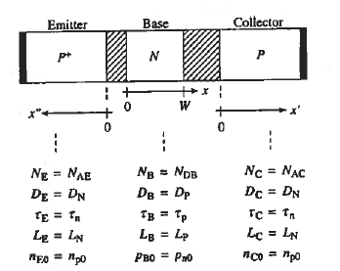
Ideal BJT solution
Similar to the ideal diode case, solve MCDE in three quasi-neutral regions

Slide 9






Strategy
Emitter:
Base:
Collector:
Solve MCDE in each QN region with appropriate boundary conditions

Slide 10
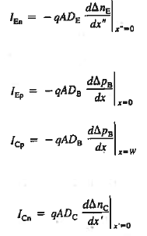
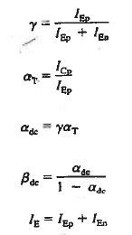

Strategy (contd.)

Slide 11






Solution
Base:
Emitter:
Collector:
The solution in the base region is similar to narrow-width diode

Slide 12
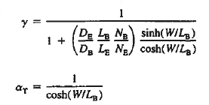
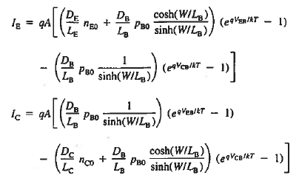


Solution (contd.)

Slide 13
W<<L_{B}
No recombination → Linear dependence

Slide 14
BJT parameters
Higher emitter doping improves ϒ
Smaller W improves β_{dc}

Slide 15
Ebers-Moll DC circuit
DC equivalent circuit

Slide 16
Ebers-Moll DC circuit
Used in circuit simulation software
Show that α_{F}= α_{DC}

Slide 17
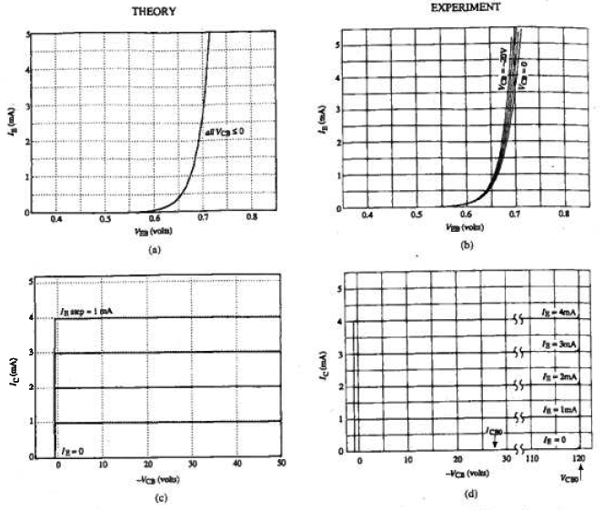
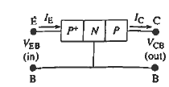
Theory vs Experiment
V_{CB} dependence of I_{E}
I_{C} increase for large V_{CB}

Slide 18
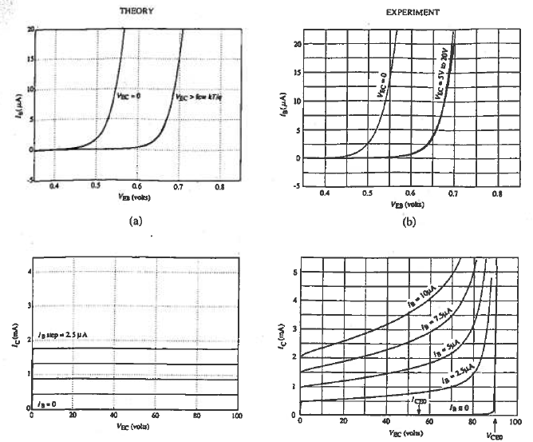
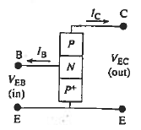
Theory vs experiment
Increase in I_{C} with V_{EC}
Breakdown at V_{CE0} < V_{CB0}

Slide 19
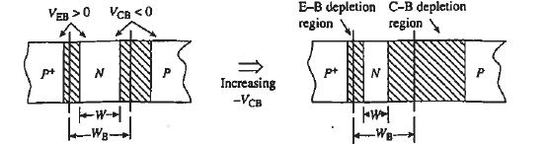
Base-width modulation
Quasi-neutral base width is a function of applied biases
Also known as “Early effect” after J. Early

Slide 20
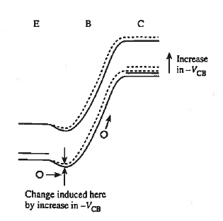
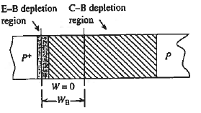
Punchthrough
Extreme case of BWM, W →0
Small increase in –V_{CB} leads to exponential increase in carriers injected over the ‘hill”

Slide 21
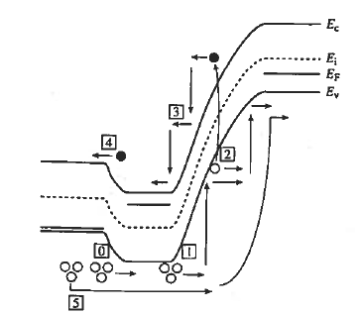
Avalanche breakdown
Common emitter breakdown voltage (V_{EB0}) < Common base breakdown voltage (V_{CB0})

Slide 22
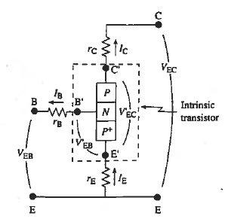
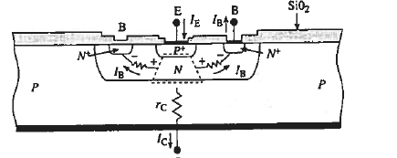
Series Resistances
r_{B} is the most significant since it causes V_{EB} to decrease
V_{EB}’=V_{EB}-I_{B}r_{B}

Slide 23
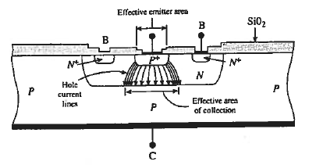
Emitter current crowding
Injection current highest at the emitter edges
Can cause local heating at high current levels

Slide 24
Graded Base
Graded doping in base leads to an electric field
Aids minority carrier transport in the base

Slide 25
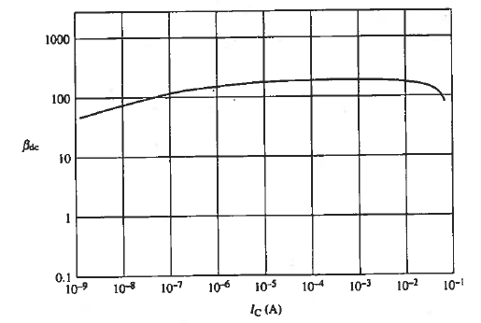
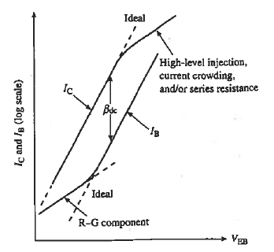
Gummel plot
Ratio of I_{C}/I_{B} gives β_{dc}

Slide 26
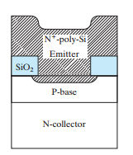
Poly emitter BJT
Lower mobility in poly-emitter reduces electron injection current and increases ϒ

Slide 27
Heterojunction Bipolar Transistors
Abrupt
Graded
Typical heterojunction emitter-base combinations

Slide 28
HBT Advantage
Wide emitter allows N_{E} << N_{B}
Higher base doping lowers r_{B}, current crowding and base-width modulation

Slide 29
Examples

Slide 30
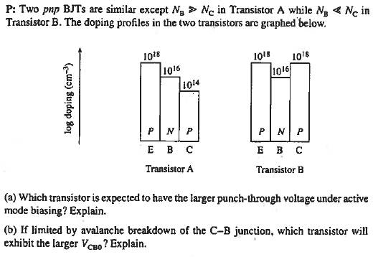
Problem 1

Slide 31
Problem 2

Slide 32


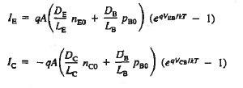
Solution Problem 2
Two back-to-back diodes

Slide 33
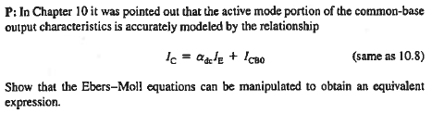

Problem 3

Slide 34
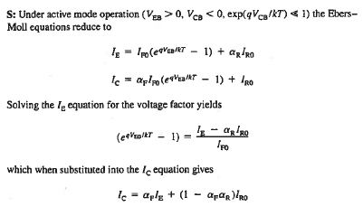

Solution 3

Slide 35
Problem 4
For a narrow base p+ n p BJT:
Using the carrier profile picture show the impact of W reduction on Υ, α_{T}, α_{dc}, β_{dc}
Show the impact of reduction in L_{E} on Υ, α_{T}, α_{dc}, β_{dc}

Slide 36
Problem 5
Assuming a narrow base P+/n/P- BJT, draw the minority carrier distribution in the E, B, and C regions if V_{CE}=0 and I_{B}>0. Comment on relative magnitudes of I_{C} and I_{E}.
Using the Ebers Moll model, express I_{C} in terms of EB parameters and the E-B voltage, V_{CE}=0
Noting the relative magnitudes of the EB parameters (assuming a P+ n p- structure) discuss how I_{C} depends on I_{B} at V_{CE}=0. Do the curves pass through the origin?

