Slide 1
EE 207: MOS Fundamentals
S. Lodha
From: R. Pierret, Semiconductor Device Fundamentals

Slide 2
MOS Capacitor
Ideal capacitor

Slide 3
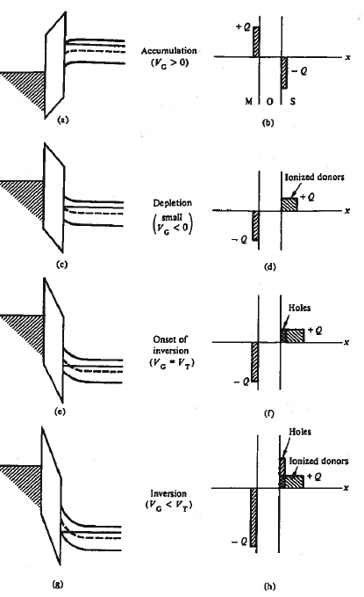
N-type MIS
Block charge diagrams

Slide 4
Definitions of potentials
ɸ_{F}>0 for p-type semiconductor
ɸ_{F}<0 for n-type semiconductor

Slide 5
Variation in ɸ_{s}>0 for p-type semiconductor
The variation for n-type will be the negative of the variation for p-type

Slide 6
Actual Solution
Accumulation and Depletion in p-type Si

Slide 7
Actual solution
At and beyond inversion in p-type Si

Slide 8
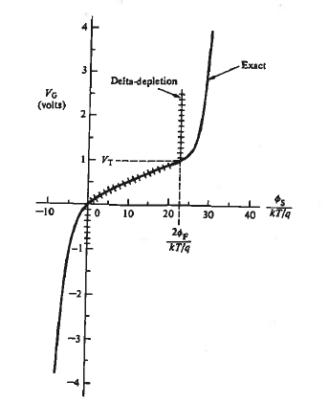
Vg vs φ_{s}
Delta depletion vs exact
Little modulation of φ_{s} in accumulation / inversion with increase in Vg
All voltage drop across oxide

Slide 9
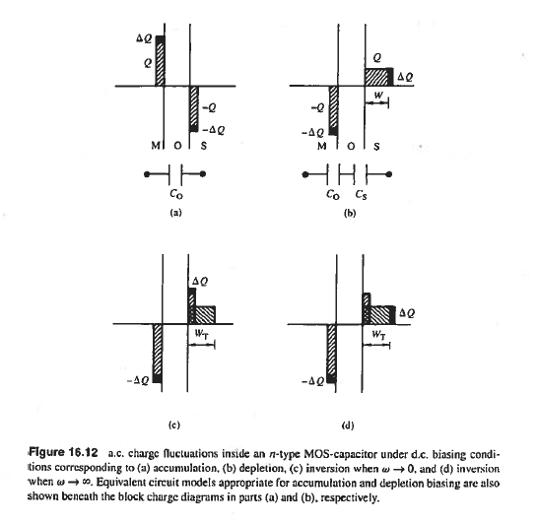
MOS C-V Charge Analysis

Slide 10
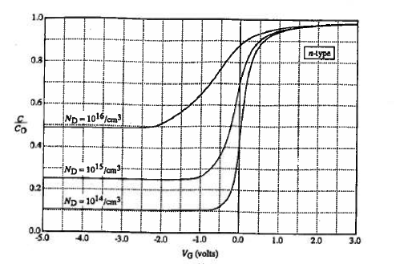
Effect of doping variation
Increased Cmin and wider depletion region in the C-V
Flat for heavily doped (semiconductor is like metal plate)

Slide 11
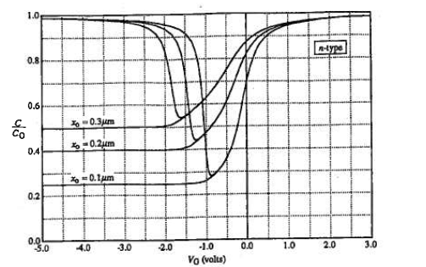
Effect of oxide thickness
Increasing Cmin, wider depletion region of C-V
Increase in voltage drop across the oxide with thicker oxides

Slide 12
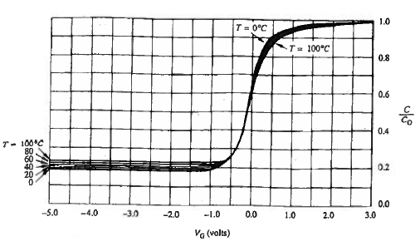
Effect of temperature

Slide 13
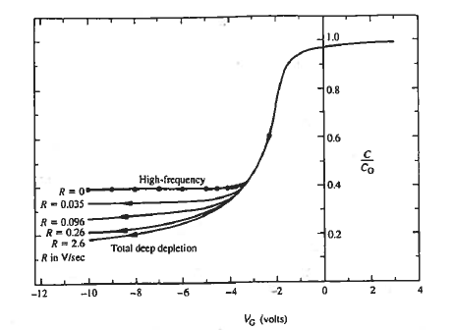
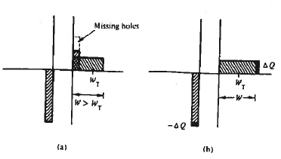
Deep depletion
Faster ramp rates do not allow enough time for minority charge to appear
Depletion region widens to uncover positive charge

Slide 14
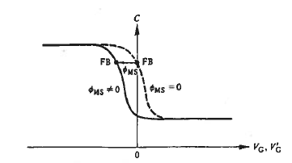
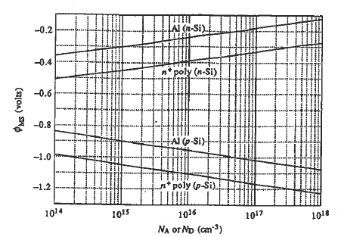
Non ideality: φ_{ms}≠0
Flat band voltage shift

Slide 15
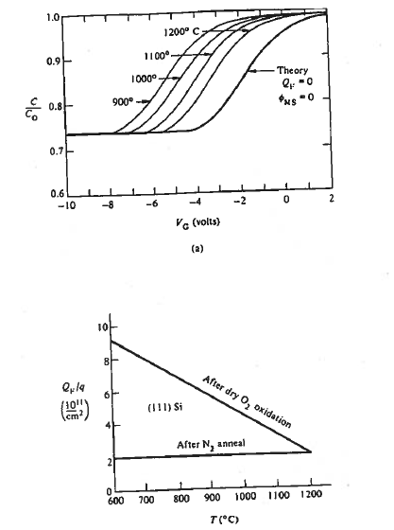

Non-ideality: Fixed charge
Oxidation condition dependent
Post N2 anneal helps
Adds to flat-band voltage shift

Slide 16
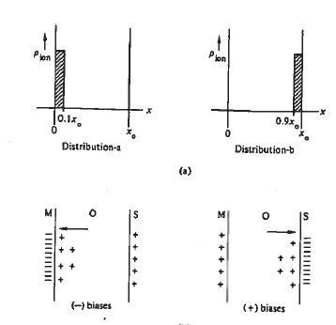
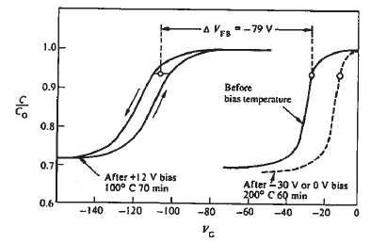

Non-ideality: Mobile ions
Alkali ions that move with applied bias and temperature

Slide 17
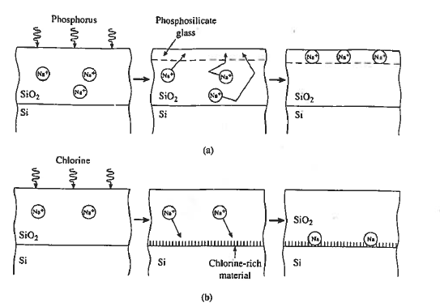
Non-ideality: Mobile ions
Gettering or charge neutralization

Slide 18
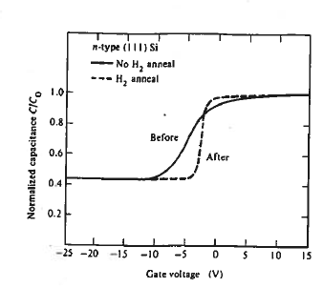
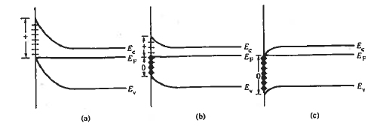

Non-ideality: Interface states
C-V stretch out
Acceptor-like traps in upper half of band-gap
Donor-like traps in lower half of band-gap

Slide 19
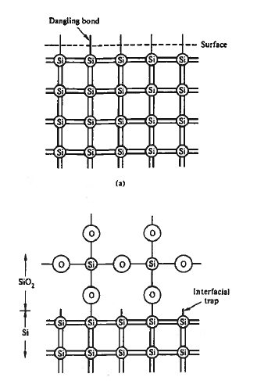
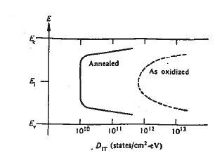
Interface traps
H2 anneal passivates dangling bonds
Midgap Dit ~ 10¹⁰ states/cm² eV

Slide 20
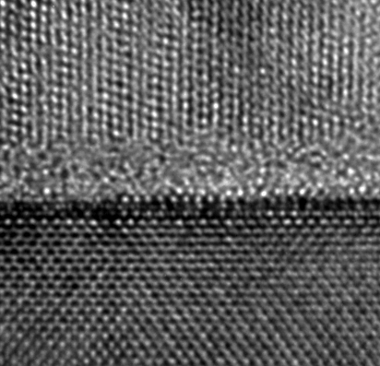
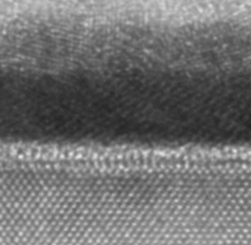
State of the art gate stack
Gate
Gate
1.2nm SiO₂
3.0nm High-k
Silicon substrate
Silicon substrate

