Slide 1
EE-222
Electric Machines
&
Power Electronics
Lecture - 10
Prof. Kishore Chatterjee
Department of Electrical Engineering,
IIT Bombay

Slide 2
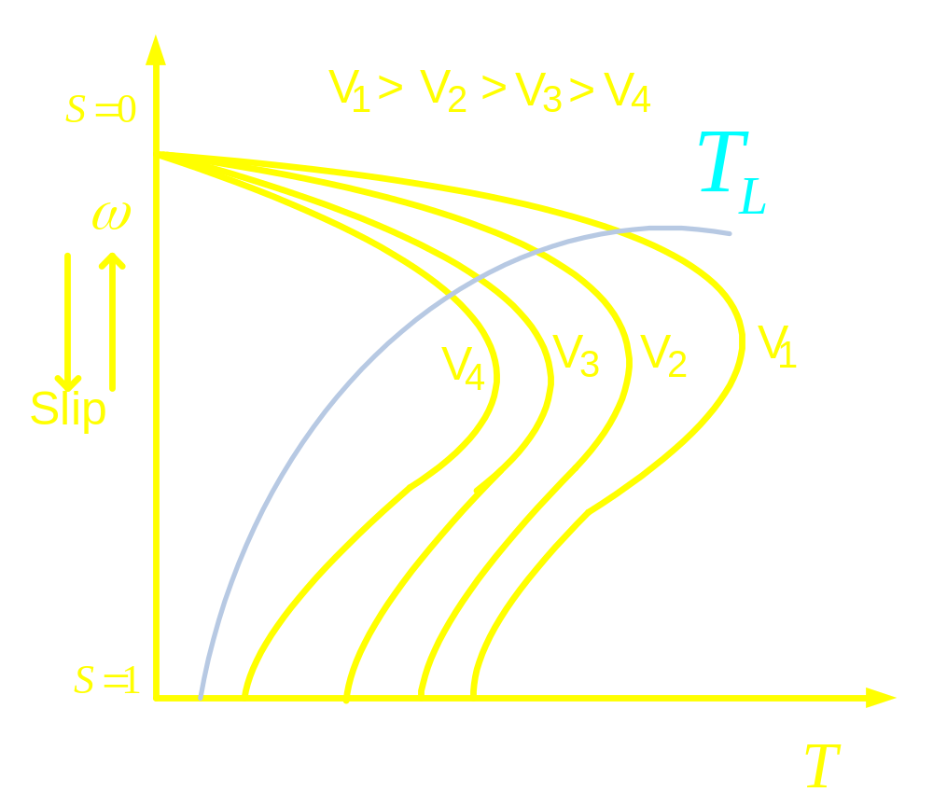

Slide 3
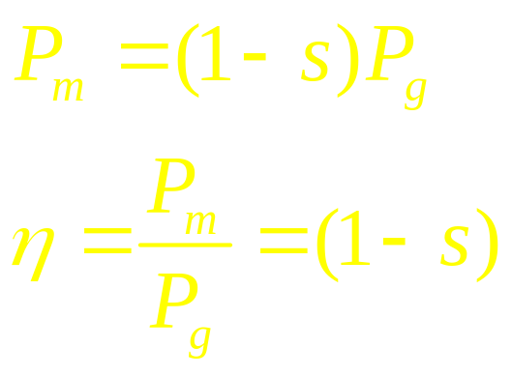
Variable terminal voltage control
Allows speed control below base speed
T/I ratio falls as speed is reduced : Suitable
for loads whose torque requirement
also falls with speed.
Poor efficiency
Neglecting stator losses and rotational losses:

Slide 4
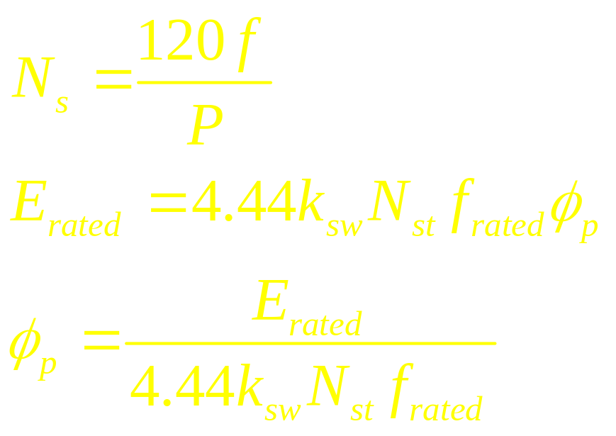

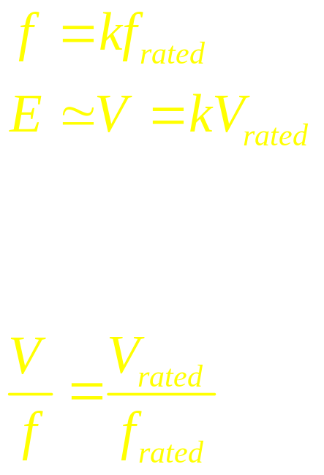
Variable frequency Control
In order to maintain air gap
flux at its rated value:
Assuming,
Therefore,
V / f Controlled induction motor drive

Slide 5
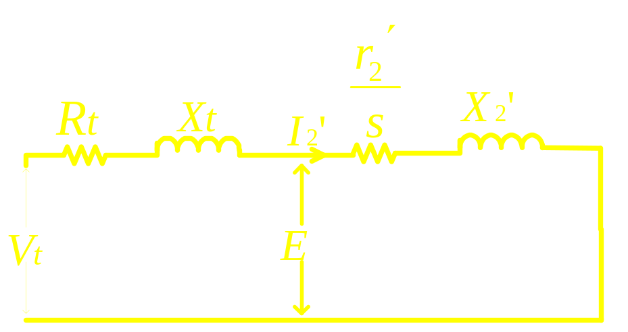
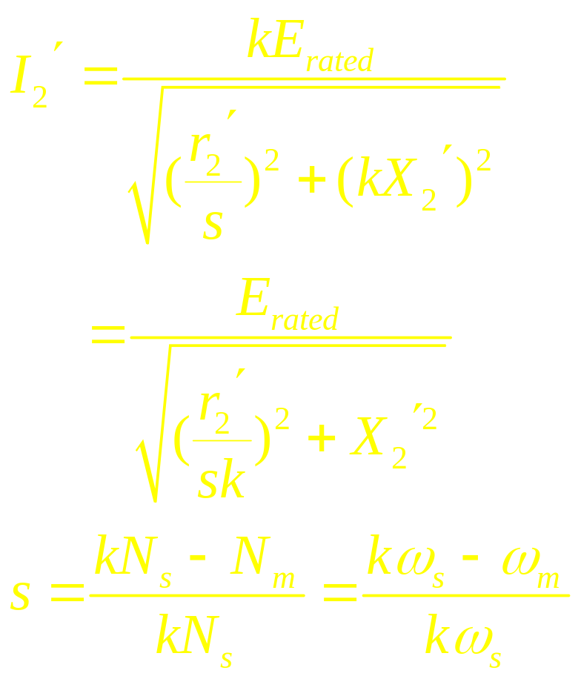
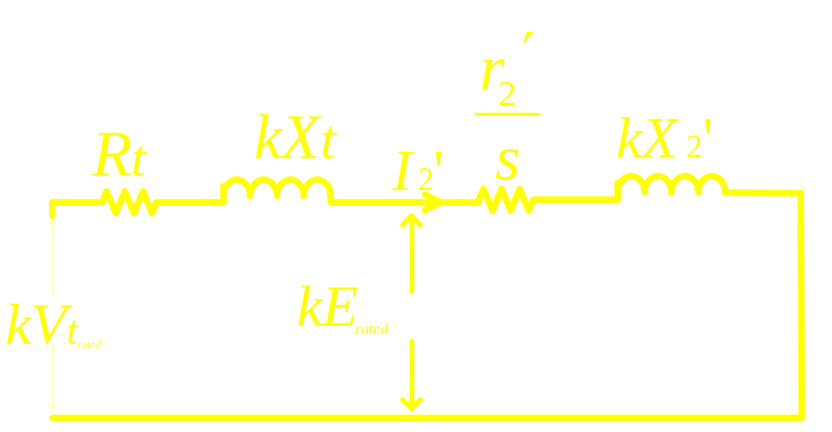
Characteristic of E / f controlled drive

Slide 6
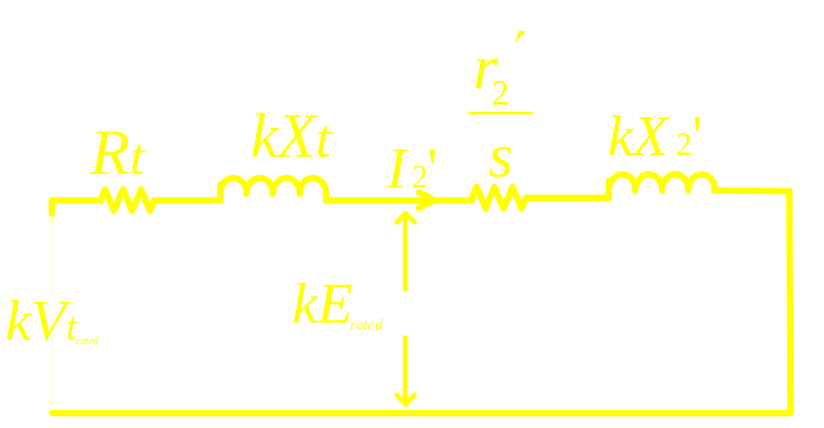
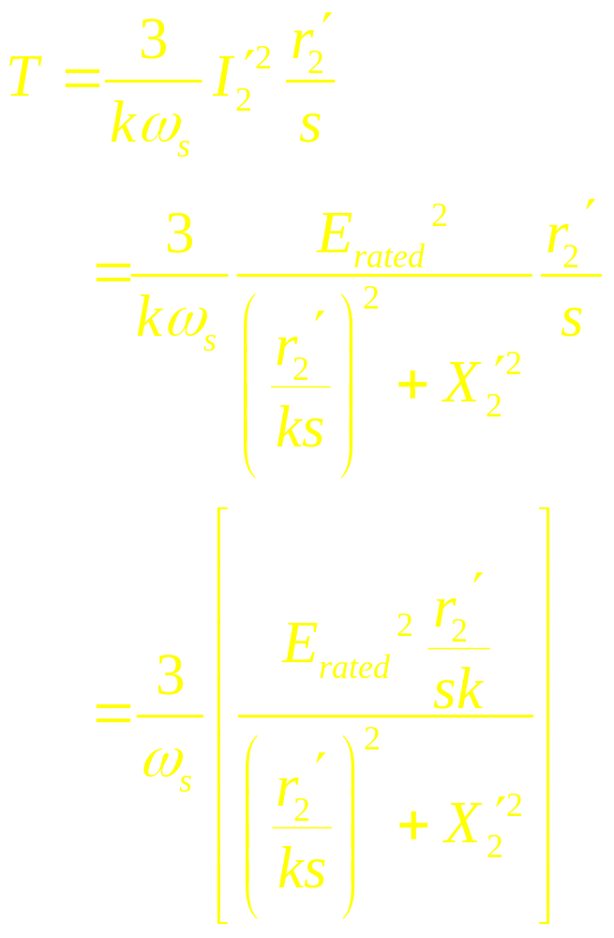
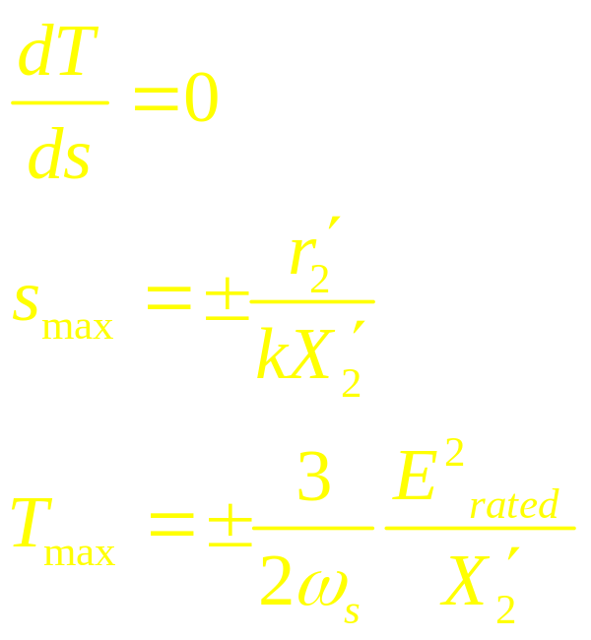

Slide 7
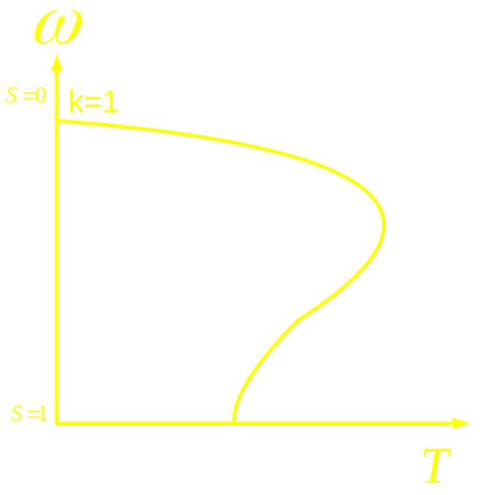
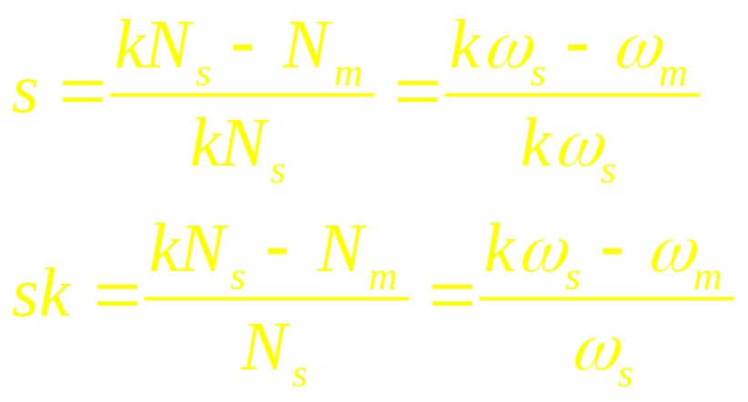
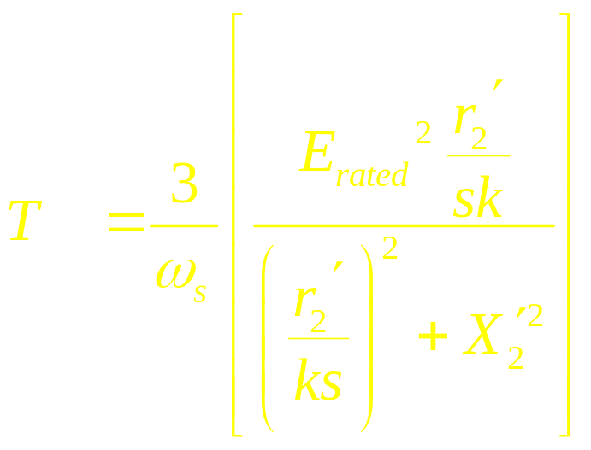
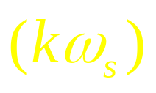
For any value of T, the
drop in motor speed
from no load speed
is same for all values of
k (or frequency)

