Slide 1
EE-222
Electric Machines
&
Power Electronics
Lecture - 11
Prof. Kishore Chatterjee
Department of Electrical Engineering,
IIT Bombay

Slide 2
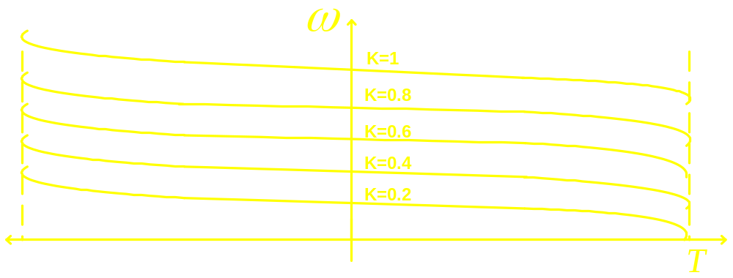

Characteristic of E / f controlled drive
T- lines are parallel to each other
T_{MAX} is independent of k
Starting torque is high

Slide 3
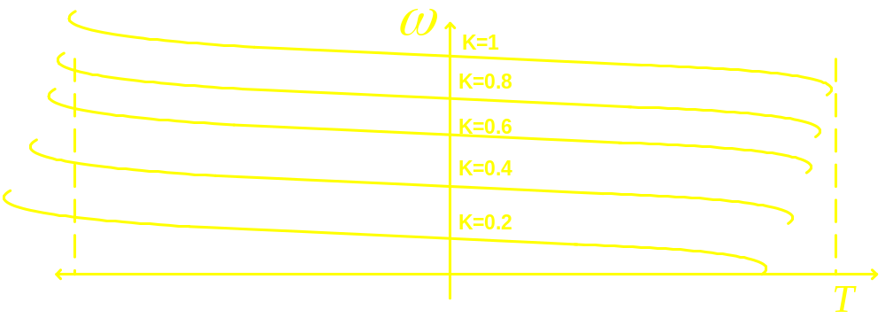
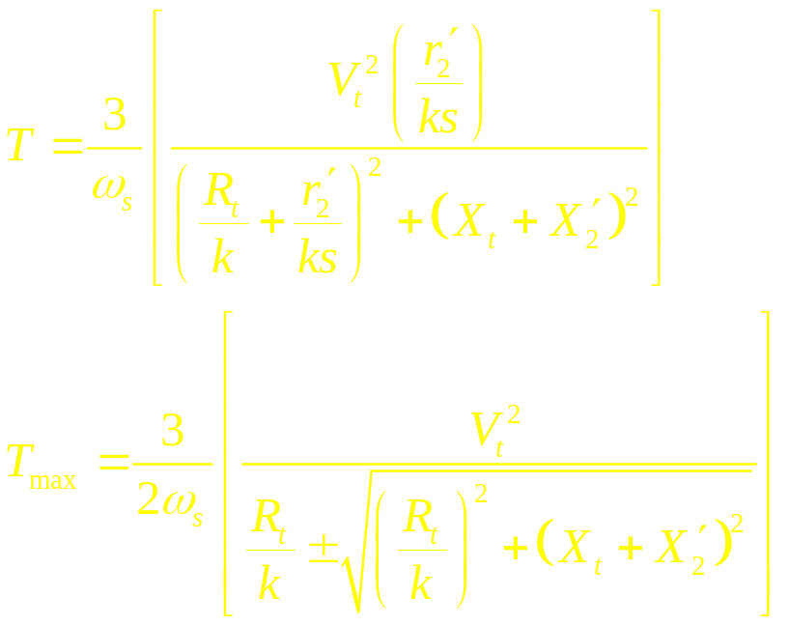
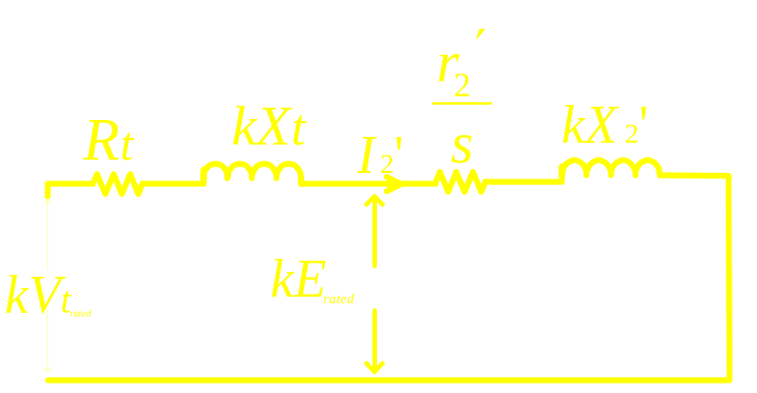
Characteristic of V / f controlled drive

Slide 4

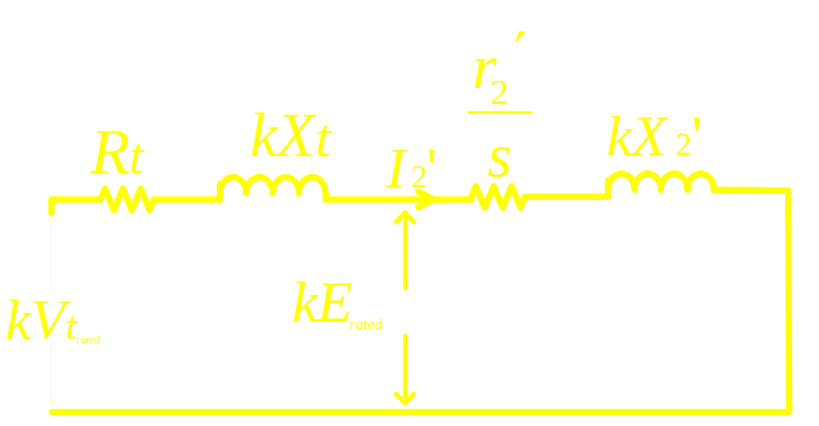
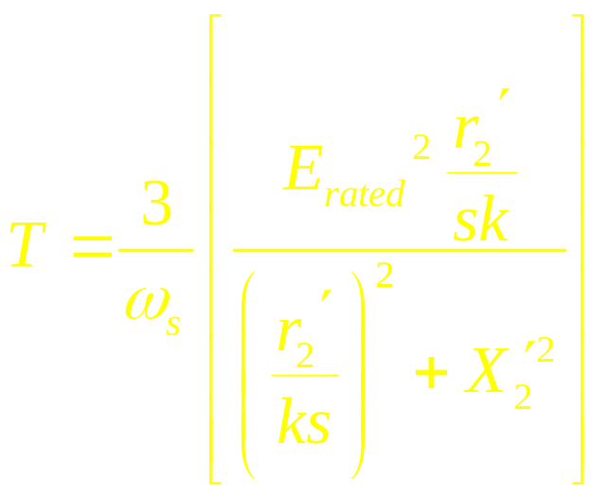
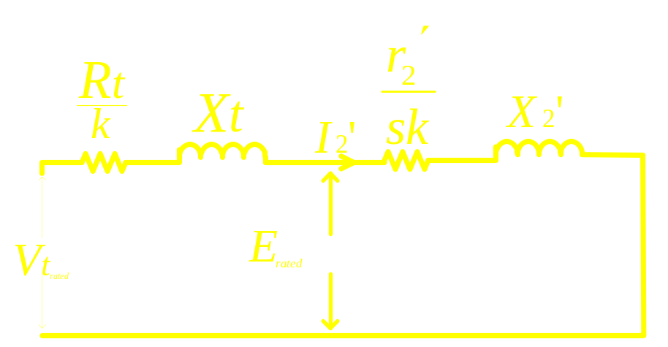
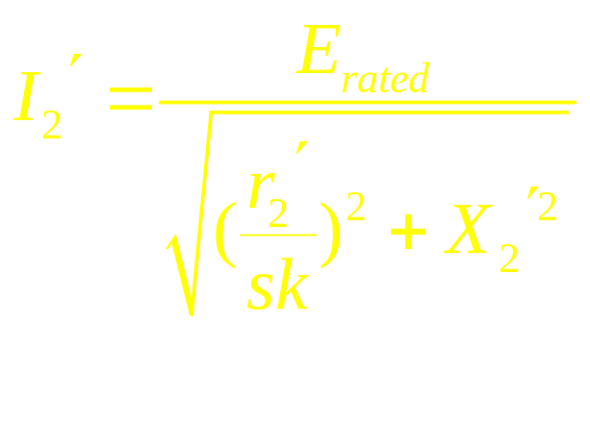
Approximate of V / f controlled Drive

