Slide 1
EE-222
Electric Machines
&
Power Electronics
Lecture - 12
Prof. Kishore Chatterjee
Department of Electrical Engineering,
IIT Bombay

Slide 2

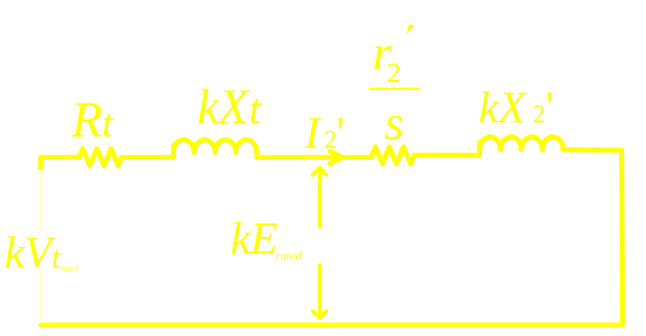
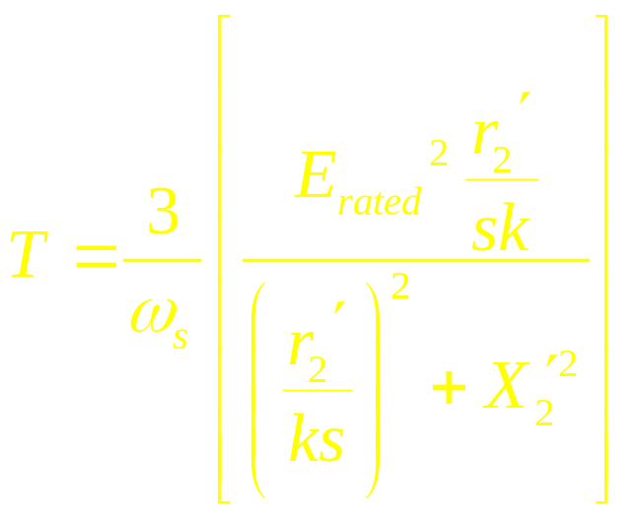
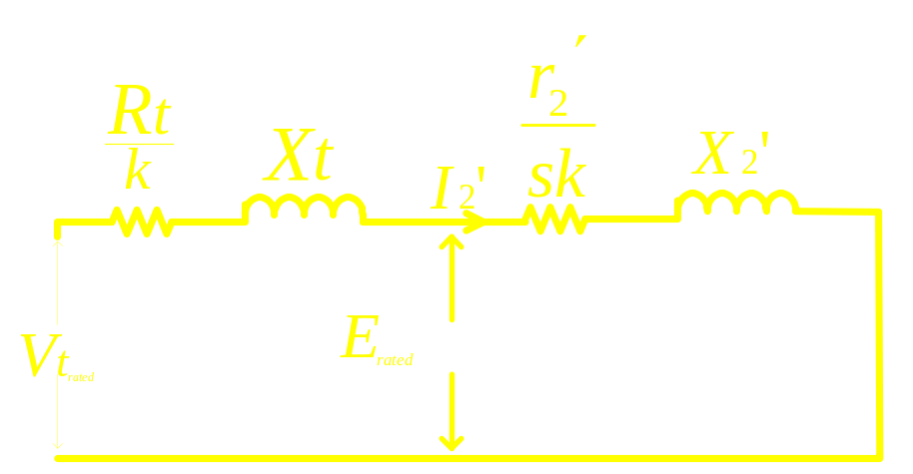
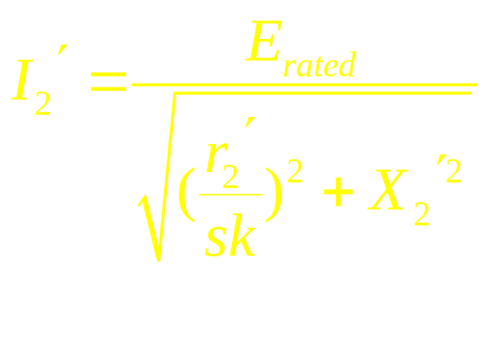
Approximate of V / f controlled Drive

Slide 3
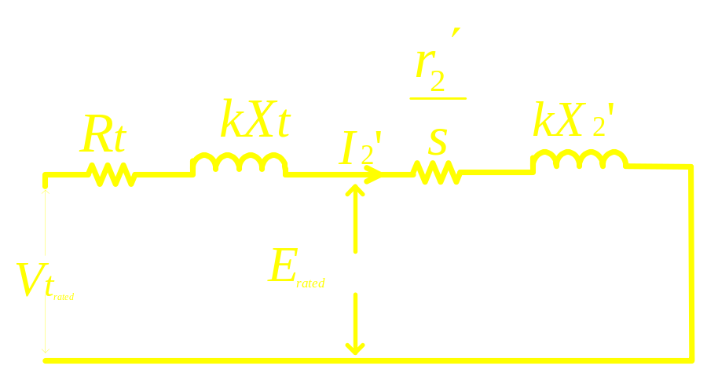
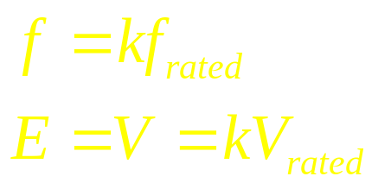

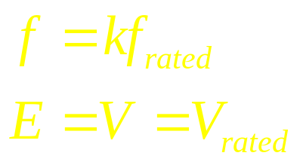

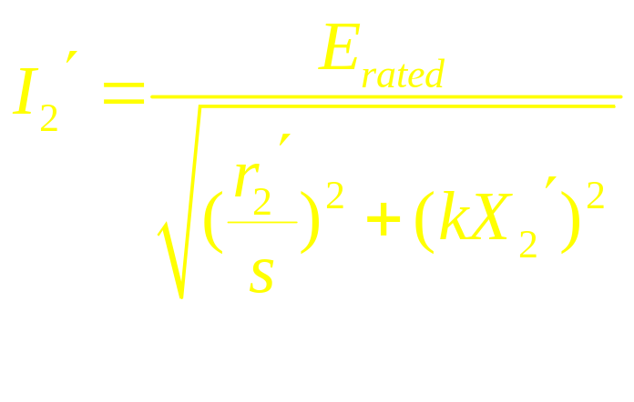
Characteristic of E / f controlled drive
above rated frequency
for
for

Slide 4
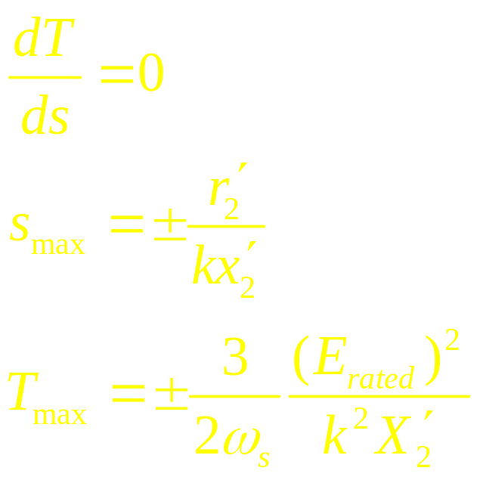
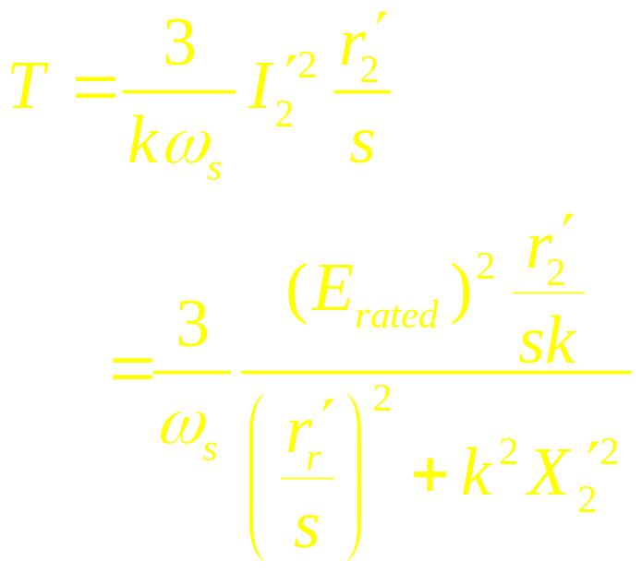
Characteristic of E / f controlled drive
above rated frequency

Slide 5
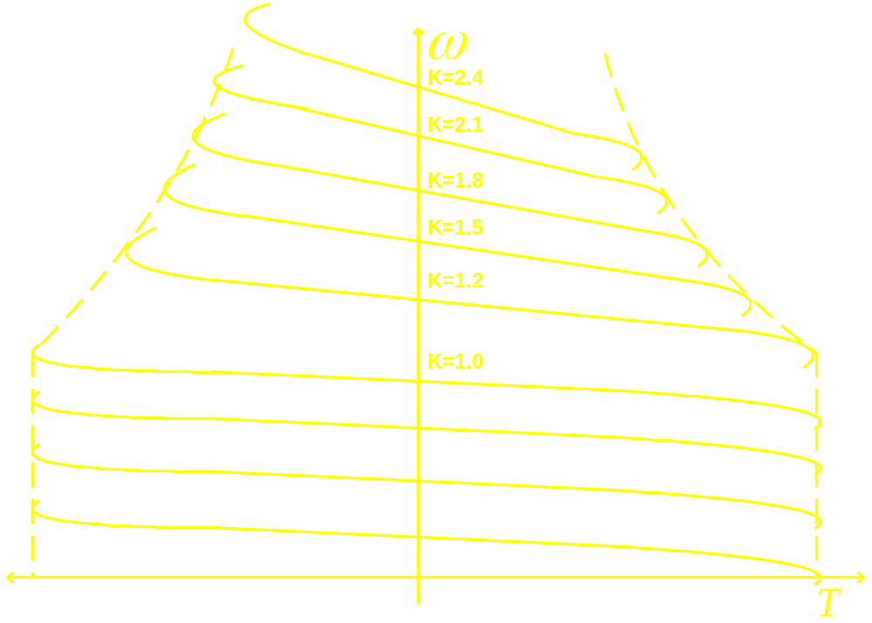
Characteristic of E / f controlled drive
above rated frequency

Slide 6
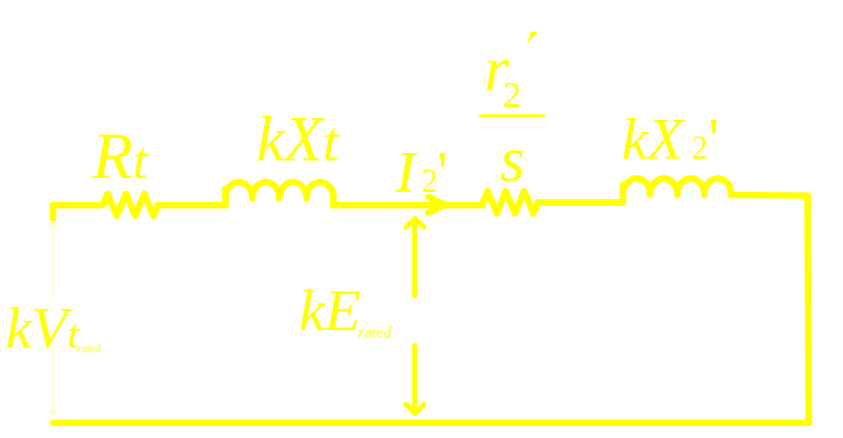
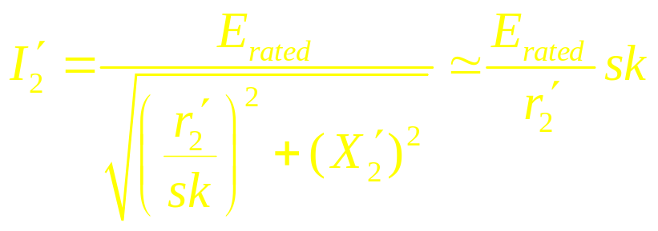
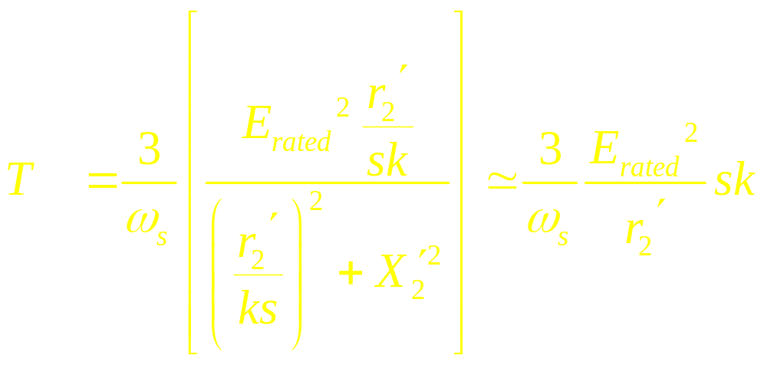
Torque and Power Capabilities: k<1
For rated current, slip
speed is constant and independent of k
For rated current, torque
is constant and independent of k

Slide 7
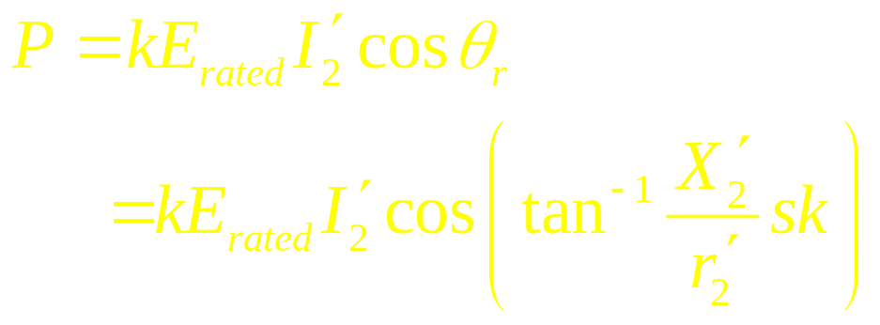
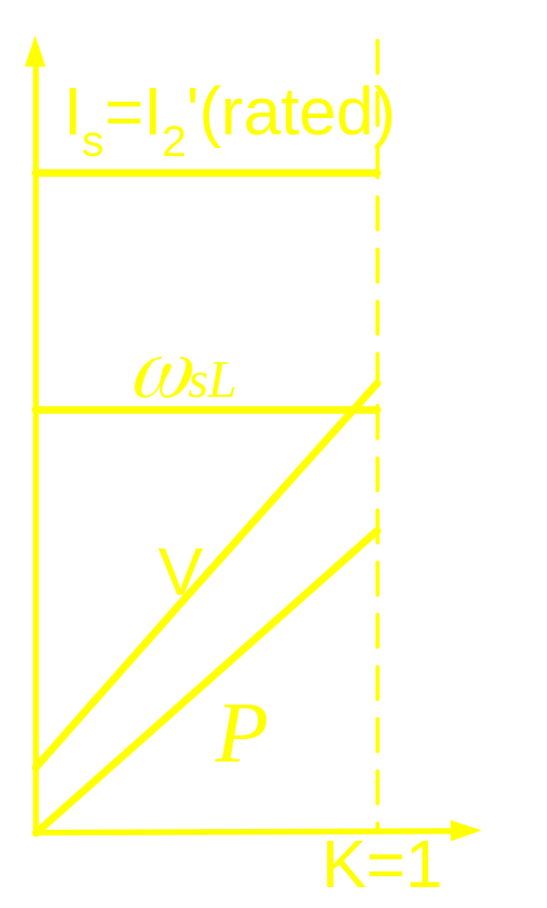
Torque and Power Capabilities: k<1
For rated current,
power is directly
proportional to k

Slide 8
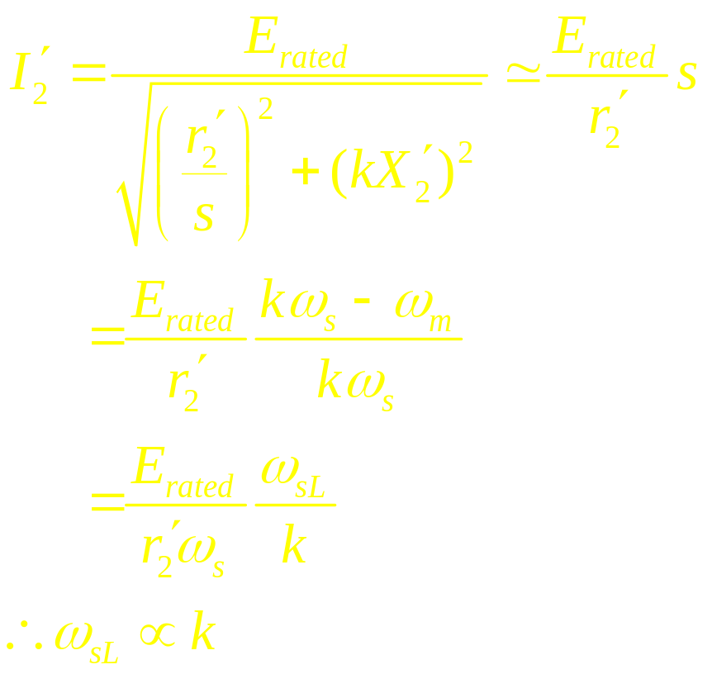
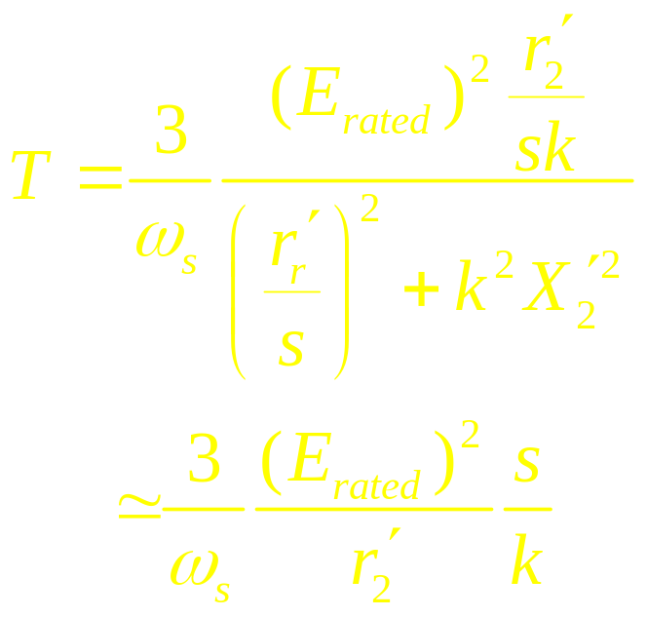
Torque and Power Capabilities: k>1

Slide 9
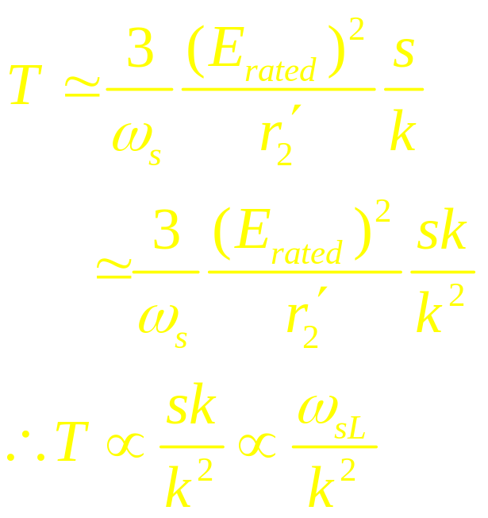
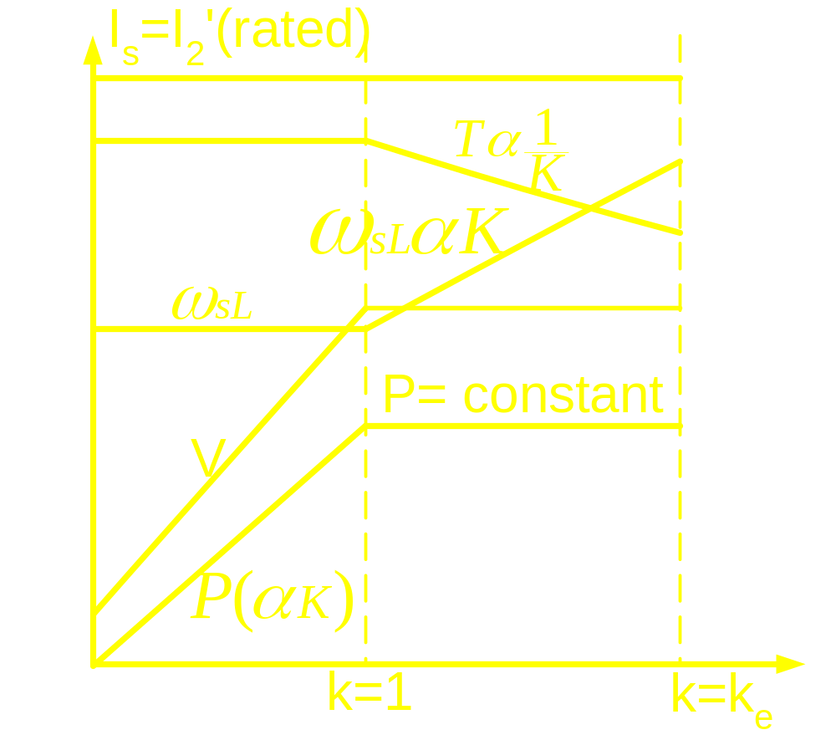

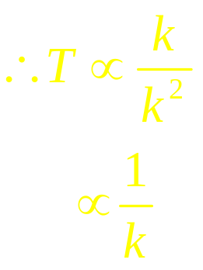
Torque and Power Capabilities: k>1
but

Slide 10
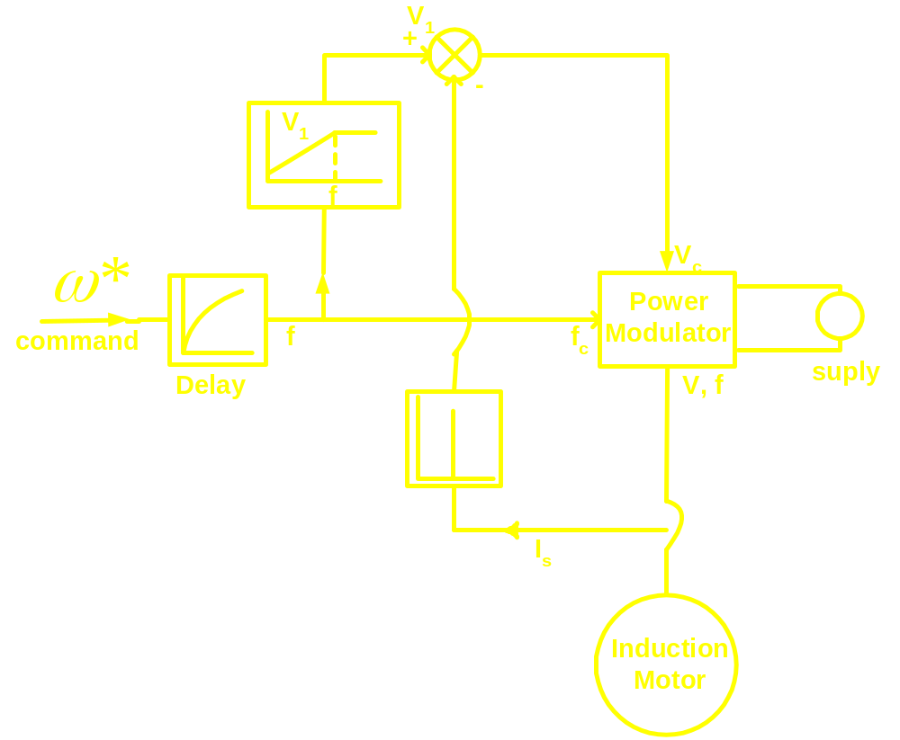
Control of V / f controlled Drive
Open loop Control

