Slide 1
EE-222
Electric Machines
&
Power Electronics
Lecture - 13
Prof. Kishore Chatterjee
Department of Electrical Engineering,
IIT Bombay

Slide 2
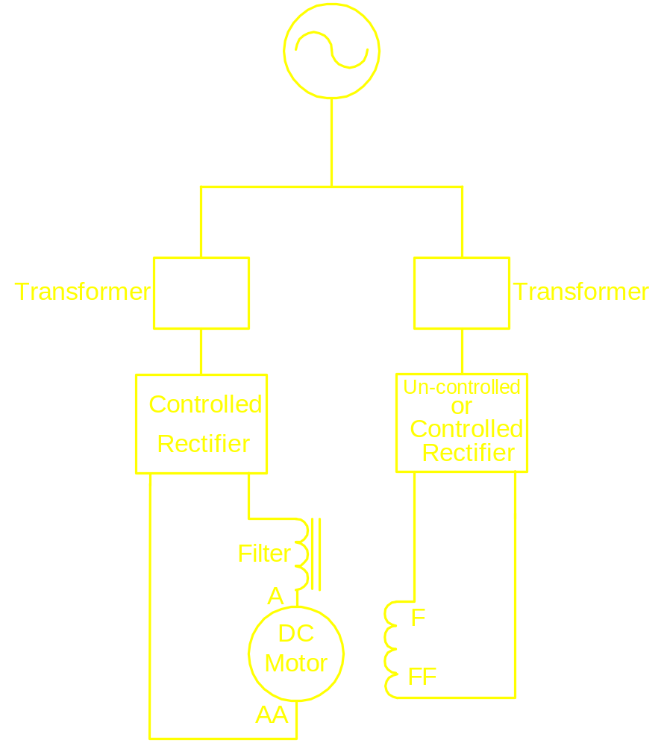
Static Ward-Leonard Scheme
Single Phase
Three Phase

Slide 3
Controlled Rectifiers
Single phase fully controlled
Single phase half controlled
Three phase fully controlled
Three phase half controlled

Slide 4
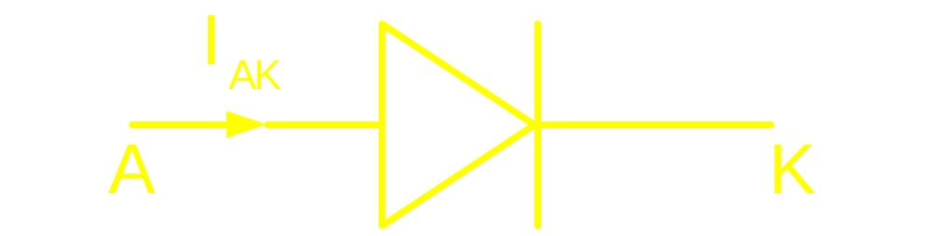
Characteristic of an ideal Diode
To turn on : V should be made +ve
To turn off: V should be made –ve
and as a fall out
I becomes zero
AK
AK
AK

Slide 5
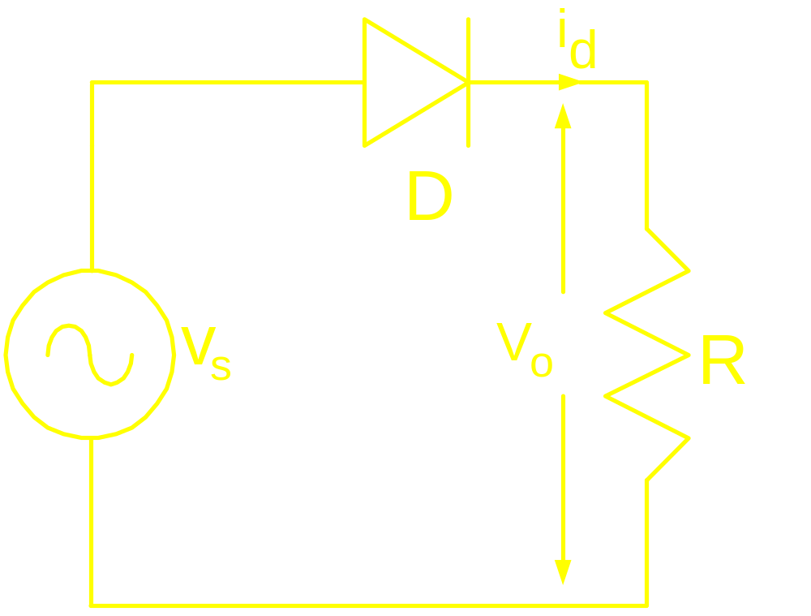
Half wave rectifier feeding R Load

Slide 6
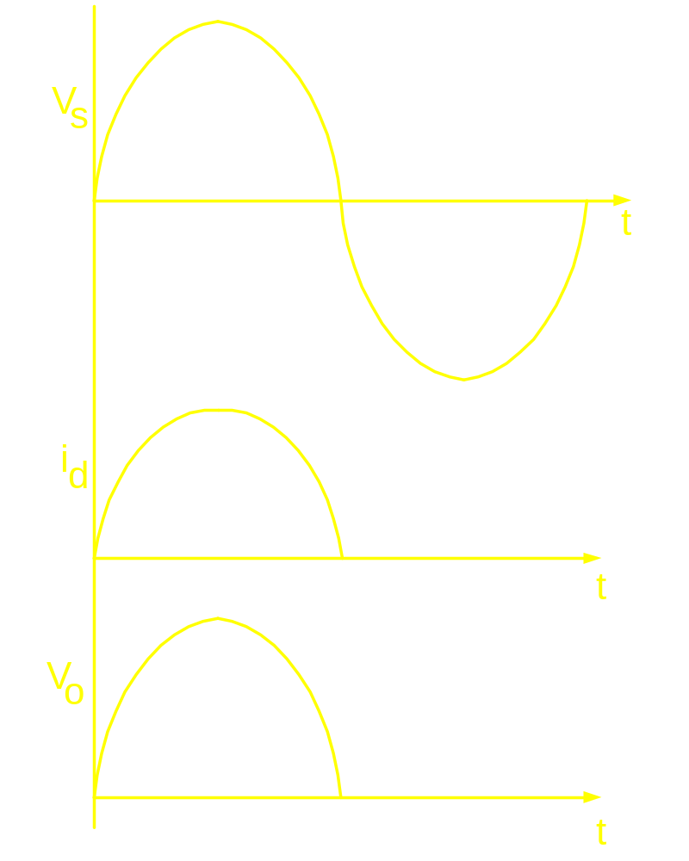

Slide 7
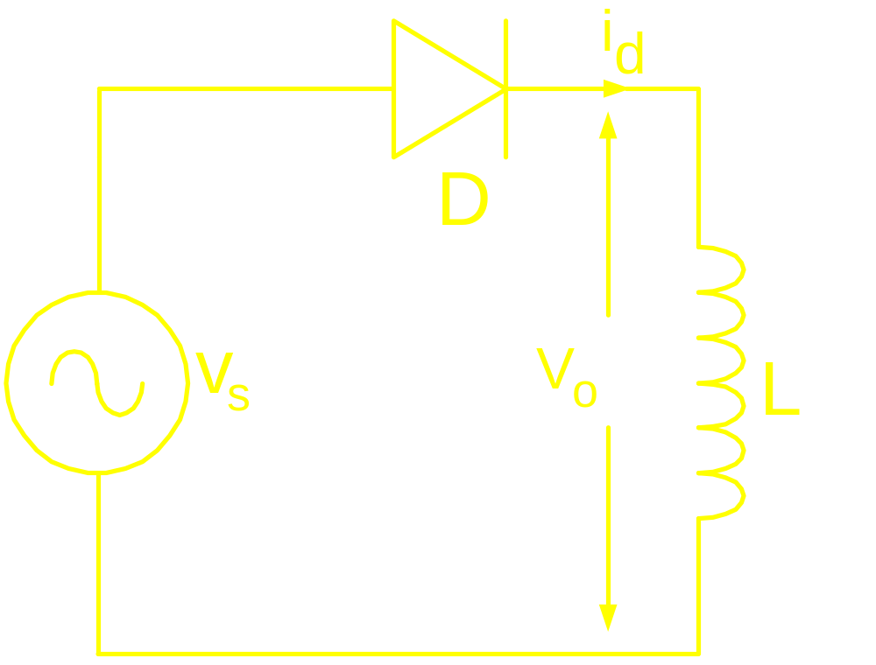
Half wave rectifier feeding L Load

Slide 8
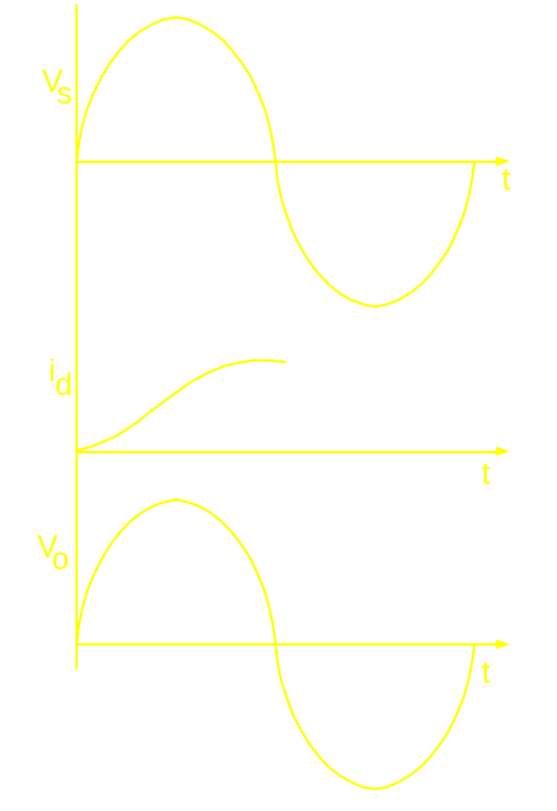

Slide 9
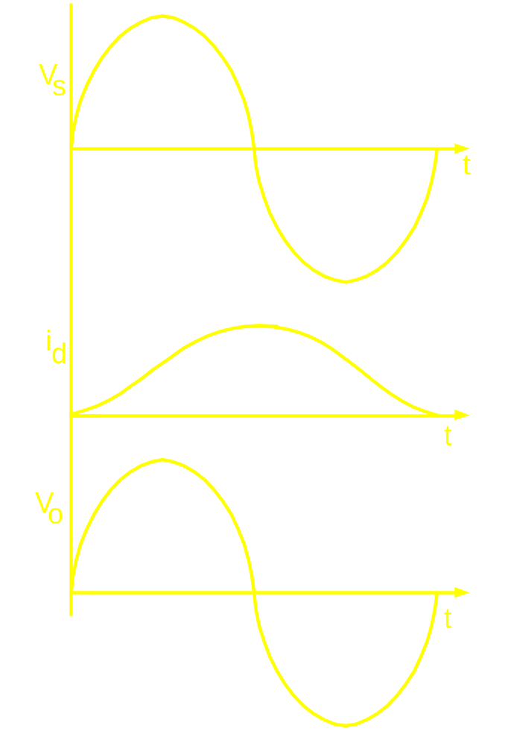

Slide 10
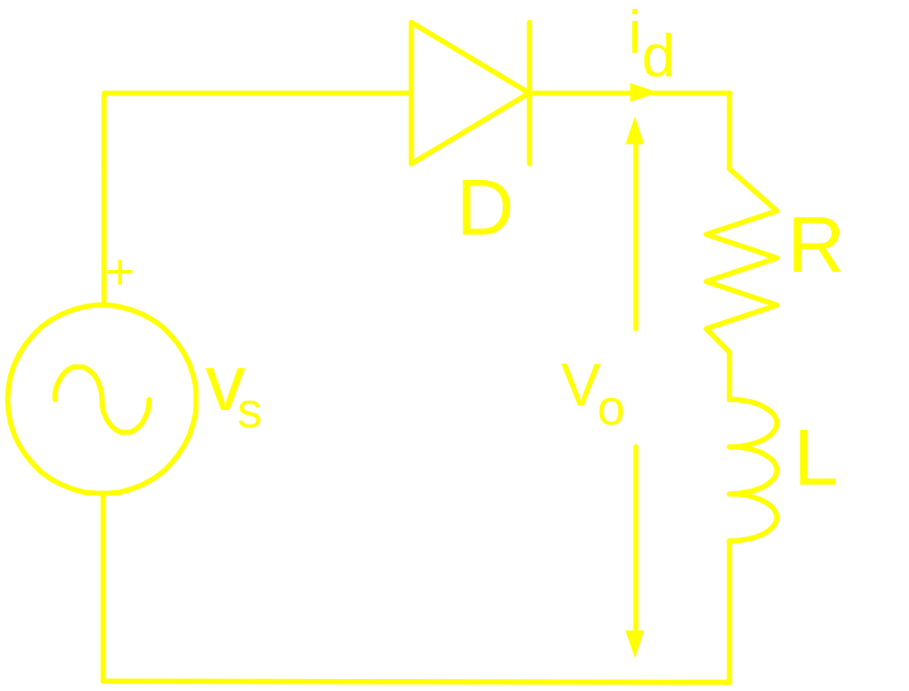
Half wave rectifier feeding R-L Load

Slide 11
