Slide 1
EE-222
Electric Machines
&
Power Electronics
Lecture - 14
Prof. Kishore Chatterjee
Department of Electrical Engineering,
IIT Bombay

Slide 2
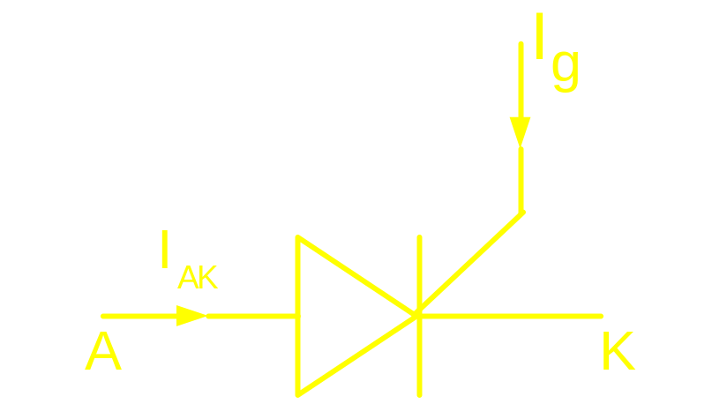
Characteristic of an ideal Thyistor
To turn on : V should be made +ve
and
I should be +ve
AK
g

Slide 3
Characteristic of an ideal Thyistor
To turn off: V should be made –ve
and as a fall out when
I becomes zero
AK
AK

Slide 4
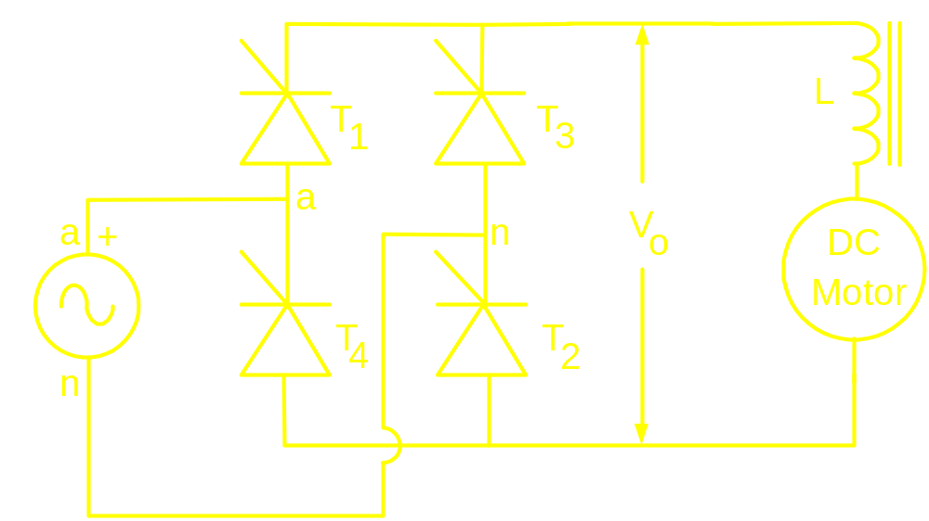
FULL CONTROLLED BRIDGE (Two Quadrant Converter)

Slide 5
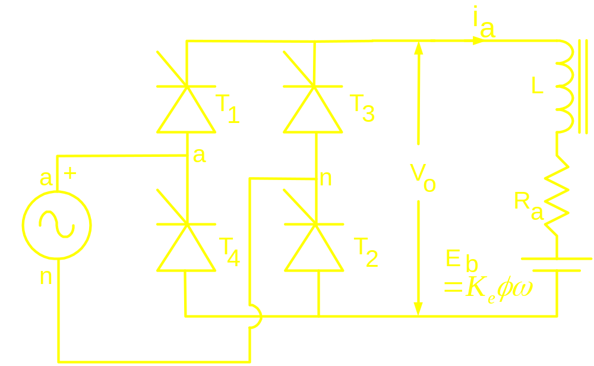
FULLY CONTROLLED BRIDGE (Two Quadrant Converter)

Slide 6
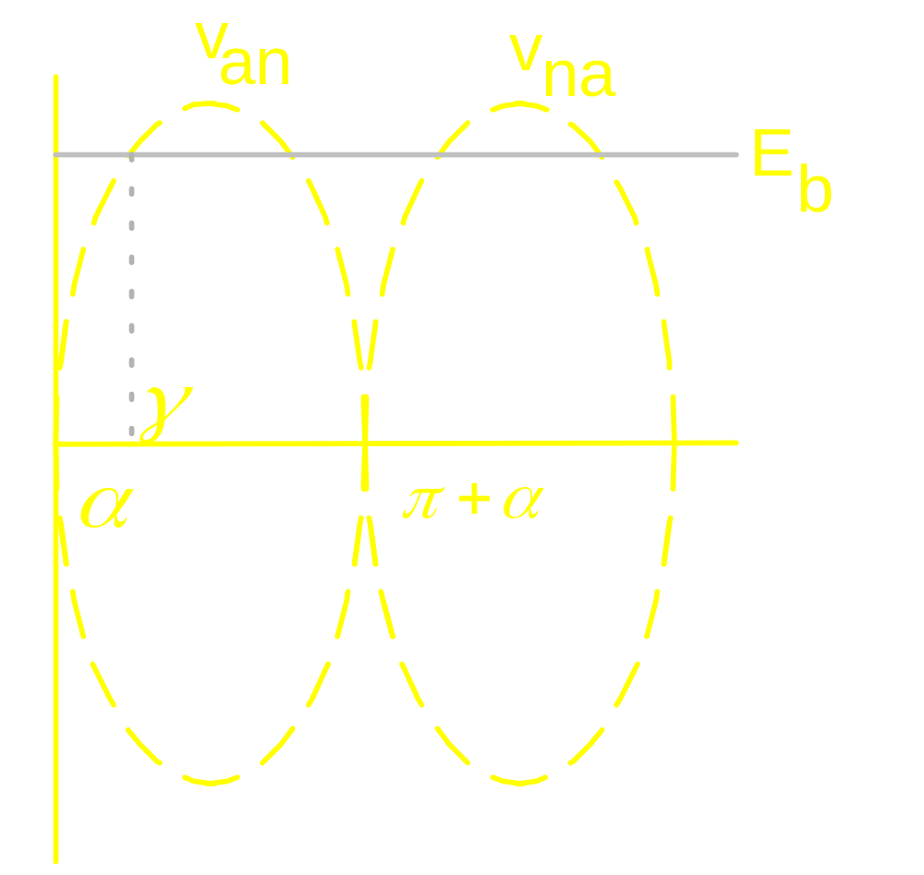
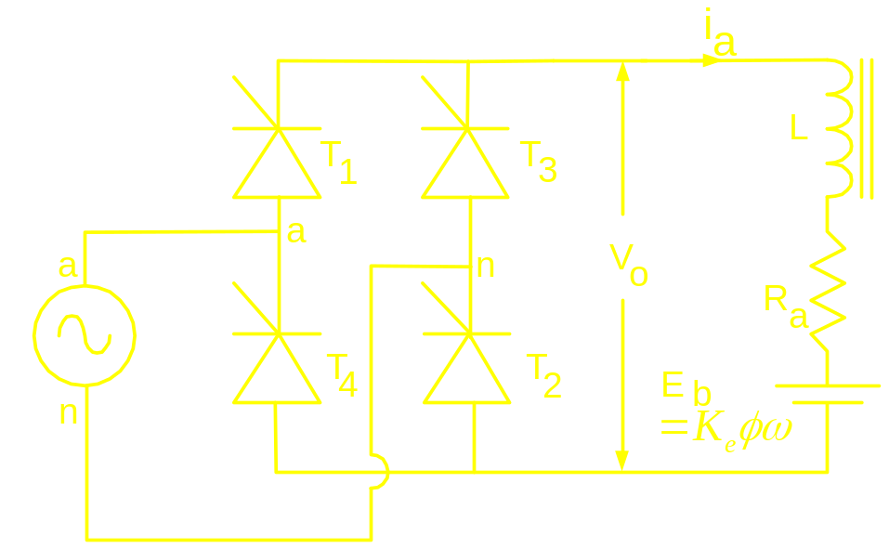

Slide 7
