Slide 1
EE-222
Electric Machines
&
Power Electronics
Lecture - 15
Prof. Kishore Chatterjee
Department of Electrical Engineering,
IIT Bombay

Slide 2
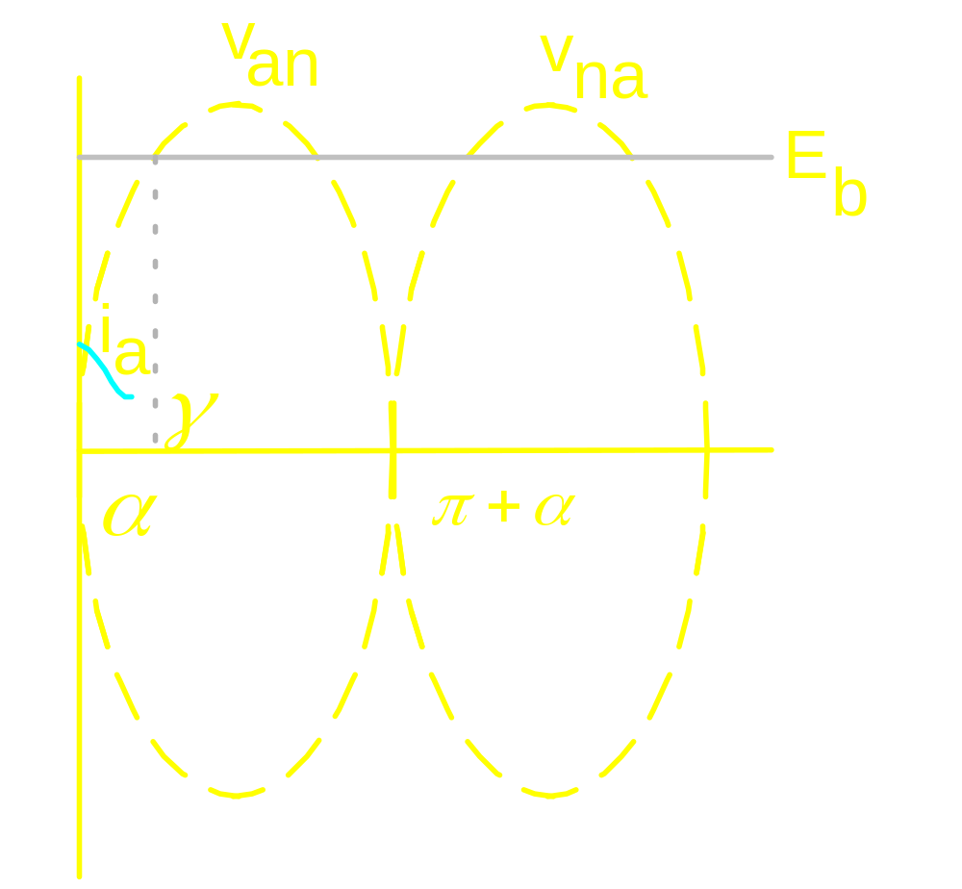
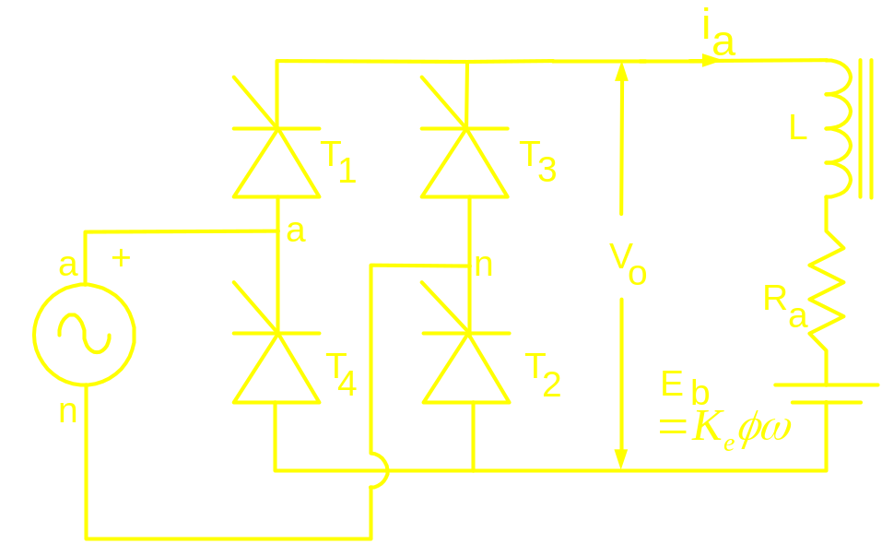
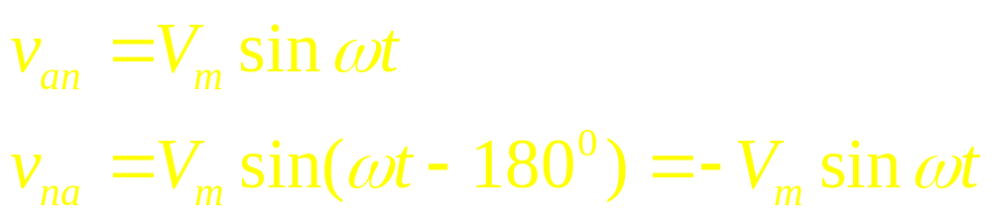

Slide 3
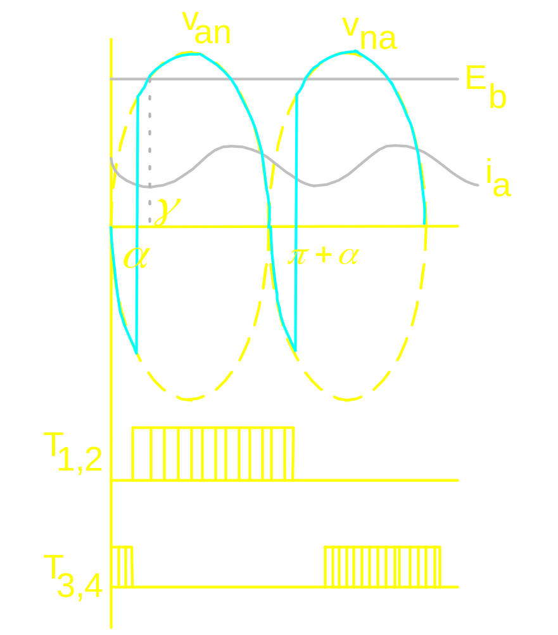

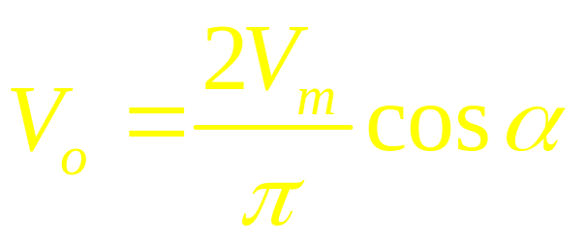

Slide 4
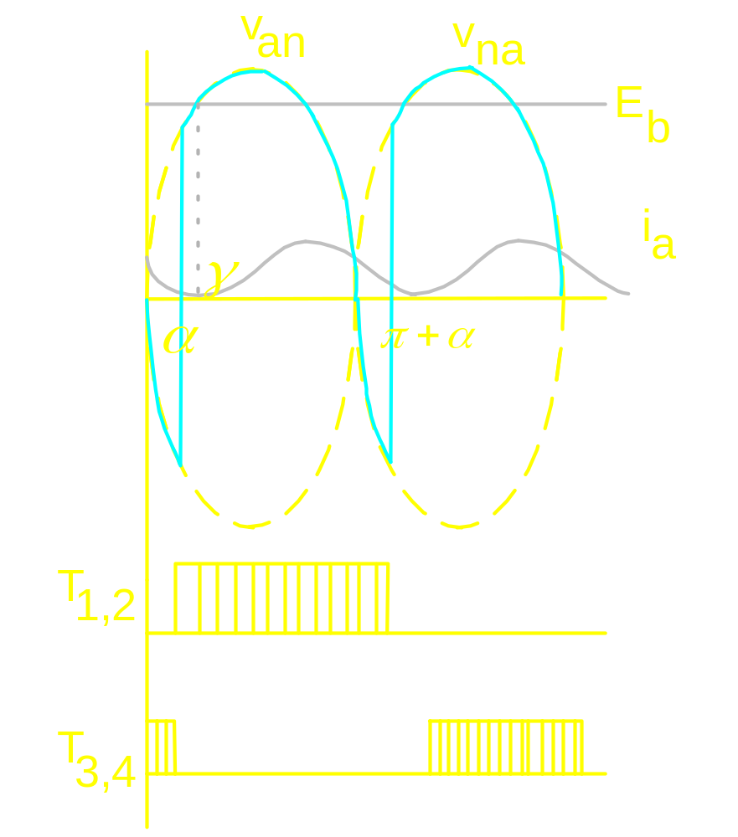

Current Source behaviour

Slide 5
Discontinuous Mode of conduction
firing angle becomes large
speed becomes high
load torque becomes low

Slide 6
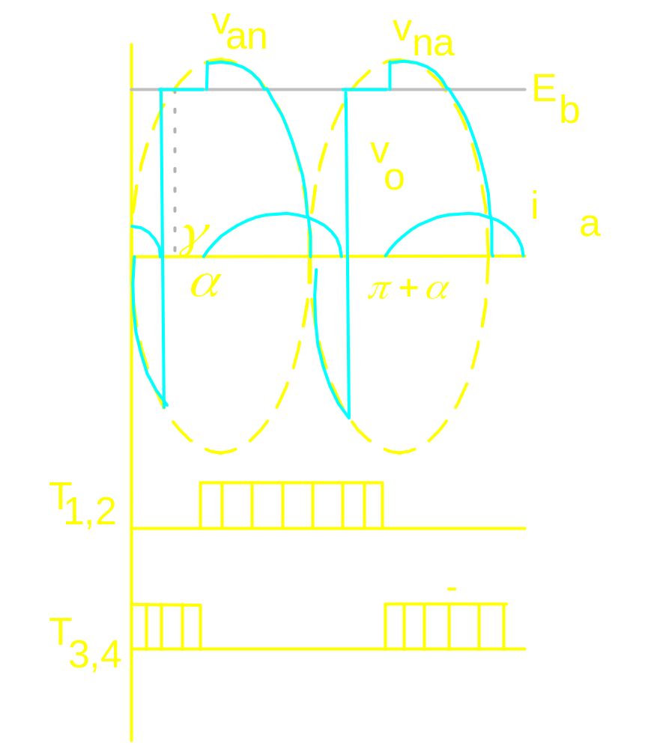


Slide 7
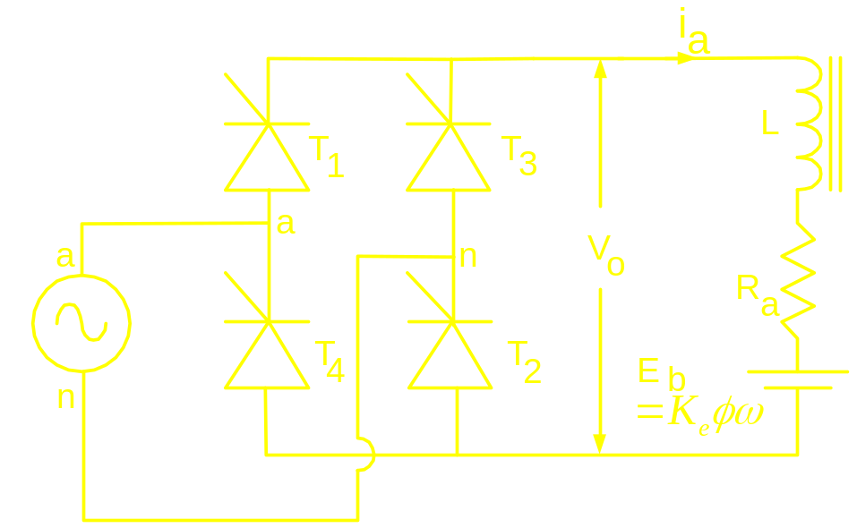
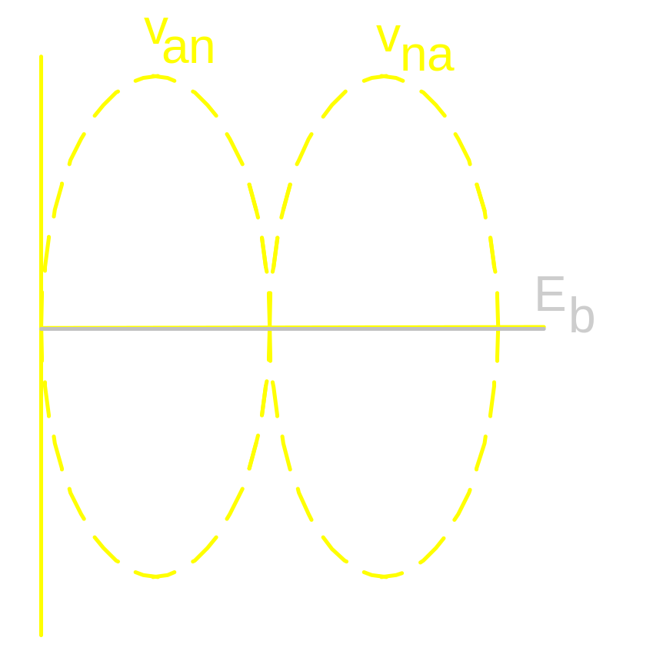

Starting of a converter fed dc motor
is set almost at 180⁰
and then progressively
decreased

