Slide 1
EE-222
Electric Machines
&
Power Electronics
Lecture - 16
Prof. Kishore Chatterjee
Department of Electrical Engineering,
IIT Bombay

Slide 2
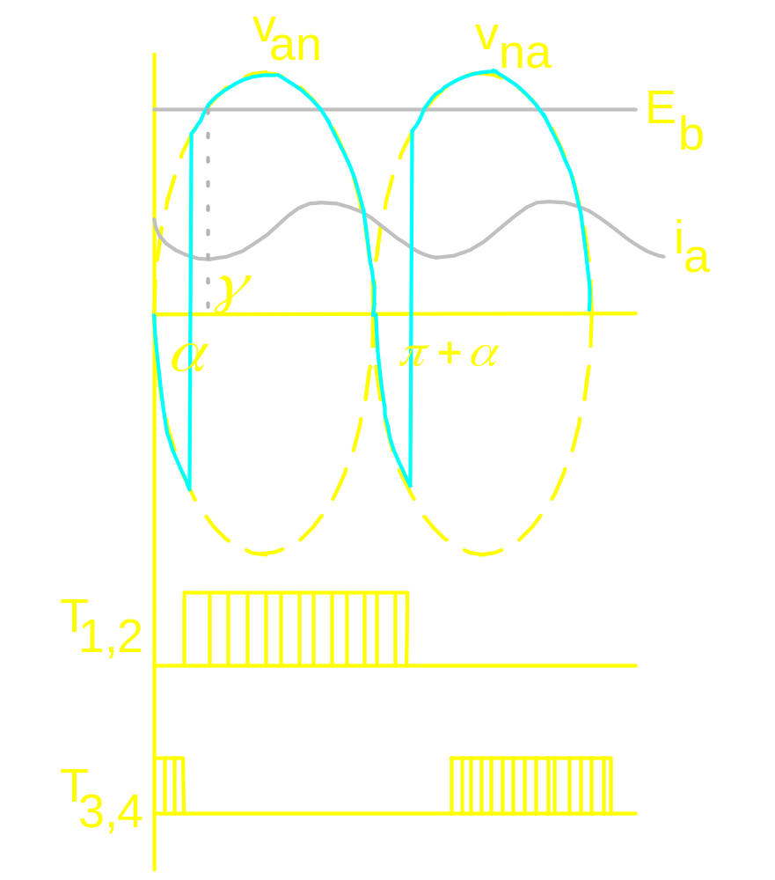
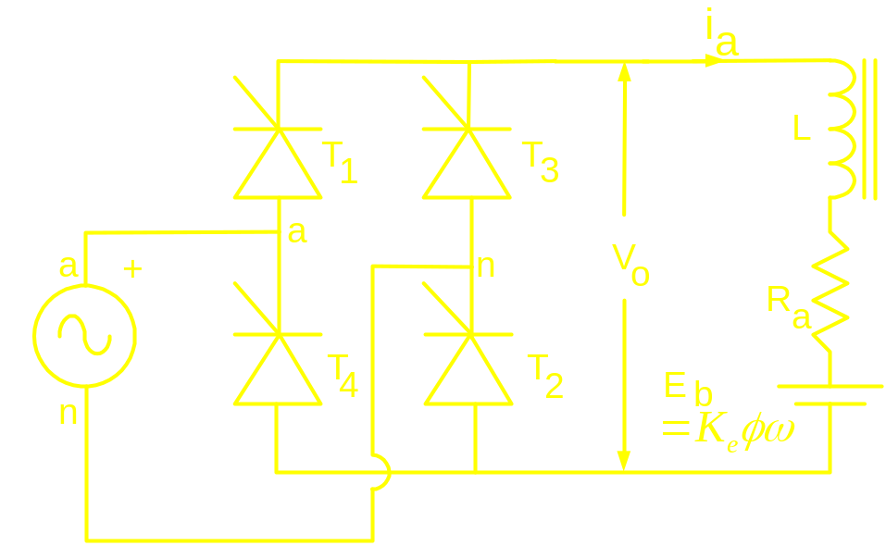
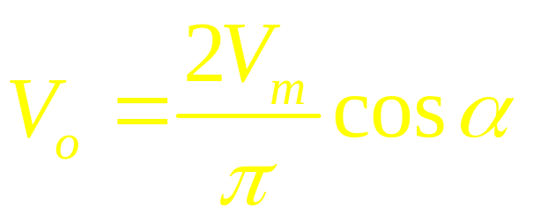
Current Source behaviour

Slide 3
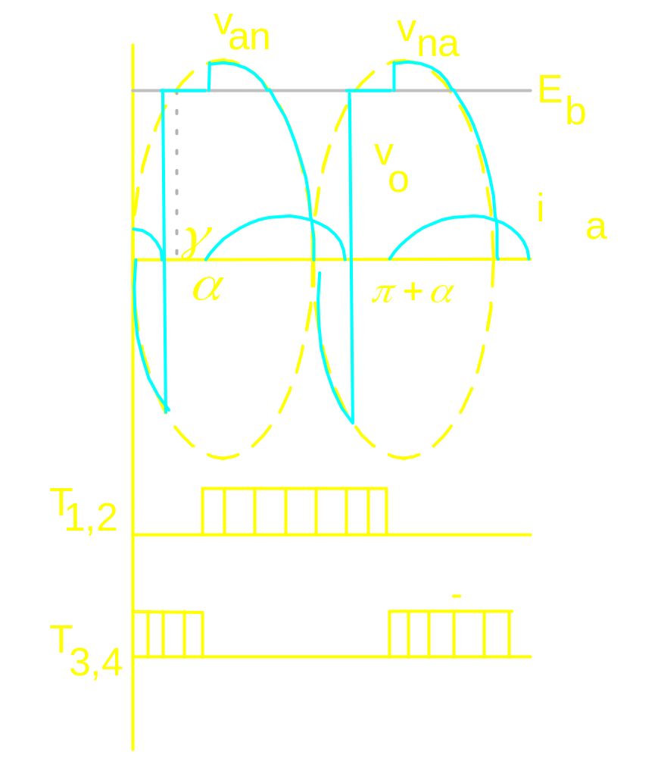


Slide 4
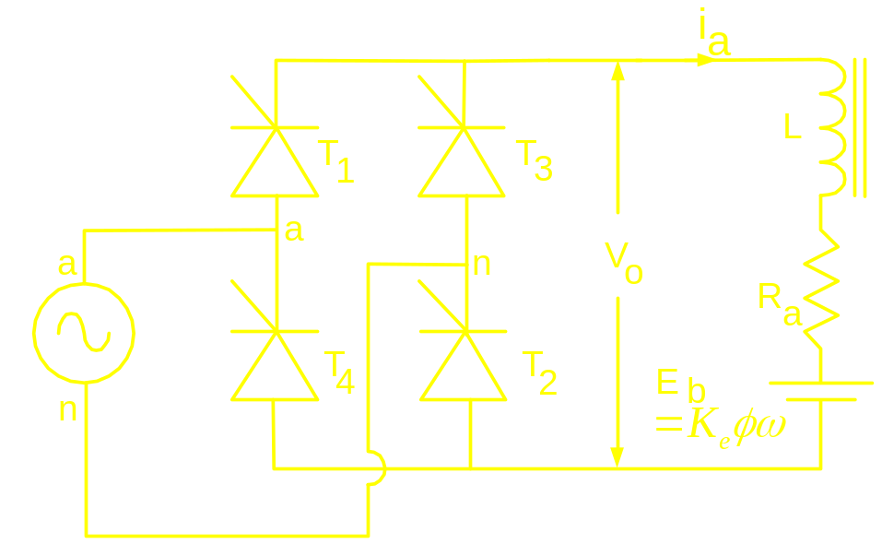
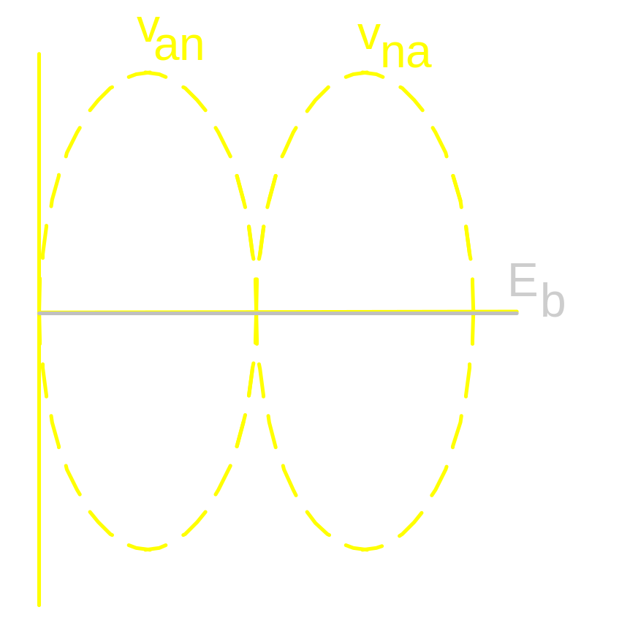

Starting of a converter fed dc motor
is set almost at 180⁰
and then progressively
decreased

Slide 5
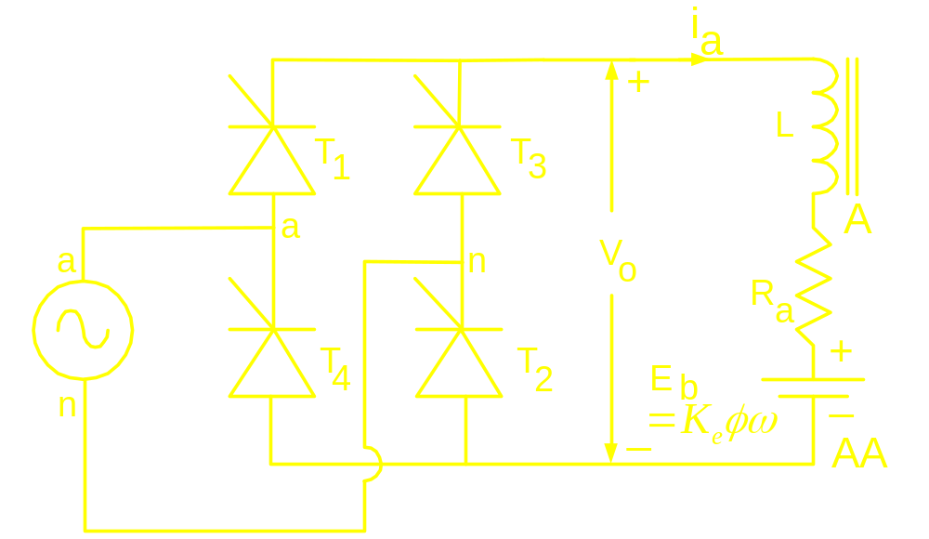
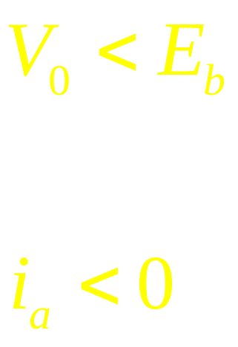
Regenerative braking of a converter
fed dc motor drive
In Motoring Mode
But i_{a} cannot flow
in reverse direction through the thyristors.
Then?

Slide 6

In Motoring Mode
In Regenerative
Braking Mode

Slide 7
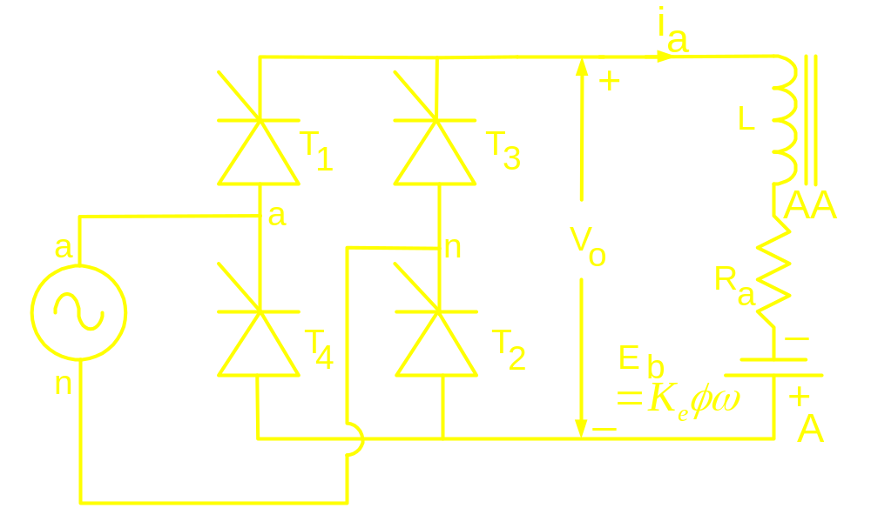
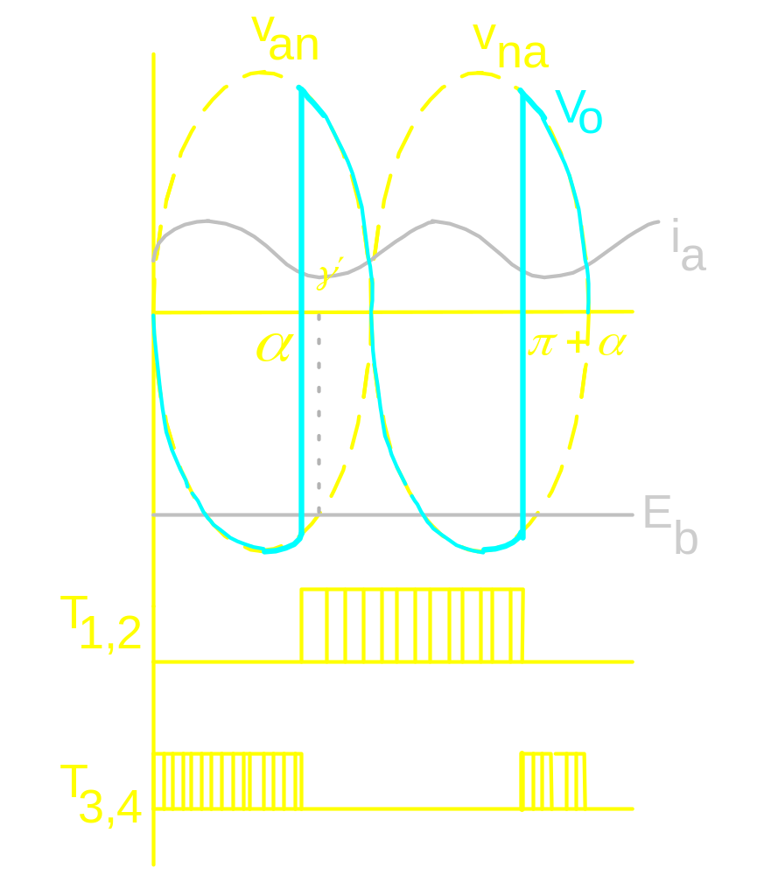
Inverting Mode of Operation
Continuous mode of
operation

Slide 8

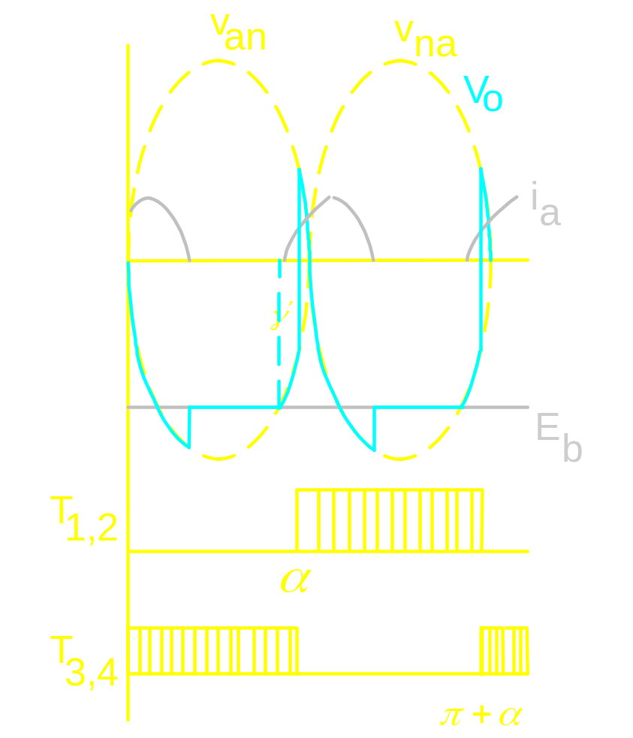
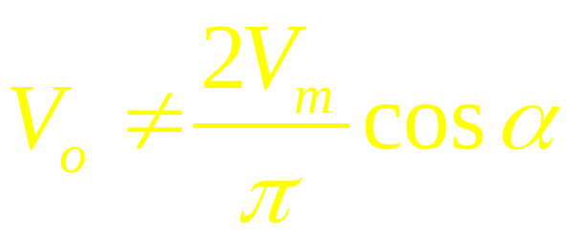
Inverting Mode of Operation
Discontinuous mode of
operation

Slide 9
In Motoring Mode
In Regenerative
Braking Mode

Slide 10
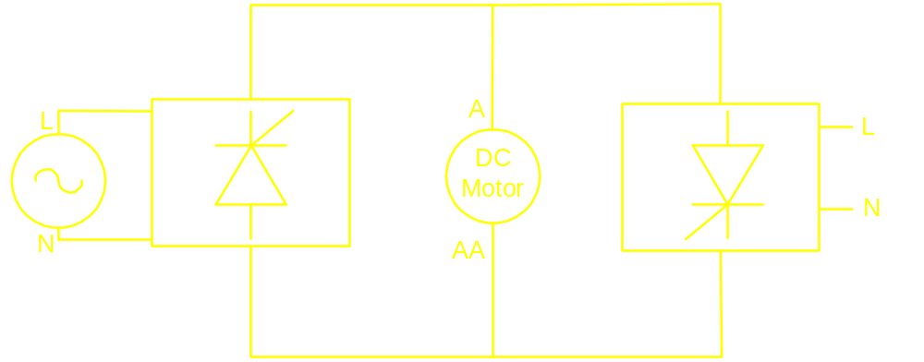
Dual Converter: Non-simultaneous mode

Slide 11
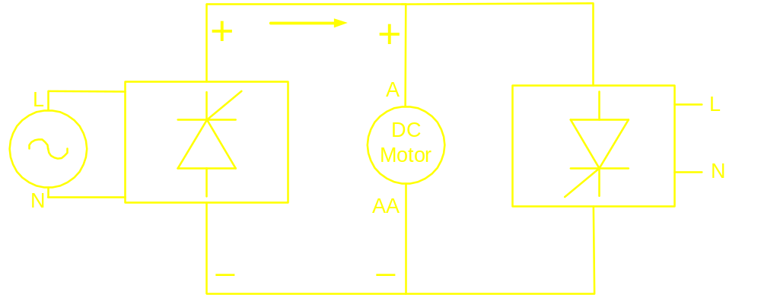
Dual Converter: Non-simultaneous mode

Slide 12
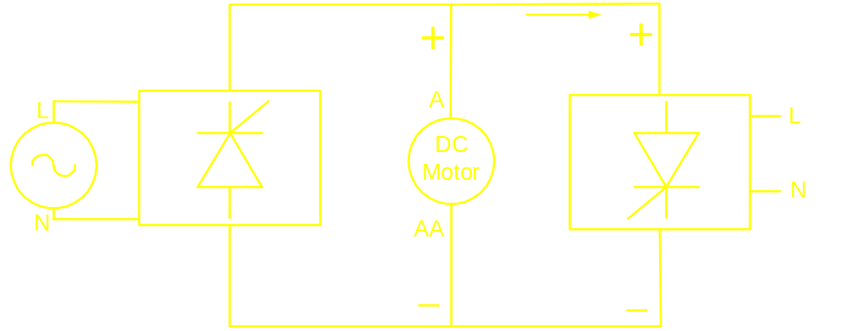
Dual Converter: Non-simultaneous mode

