Slide 1
EE-222
Electric Machines
&
Power Electronics
Lecture - 17
Prof. Kishore Chatterjee
Department of Electrical Engineering,
IIT Bombay

Slide 2
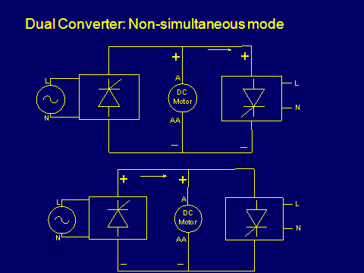

Slide 3
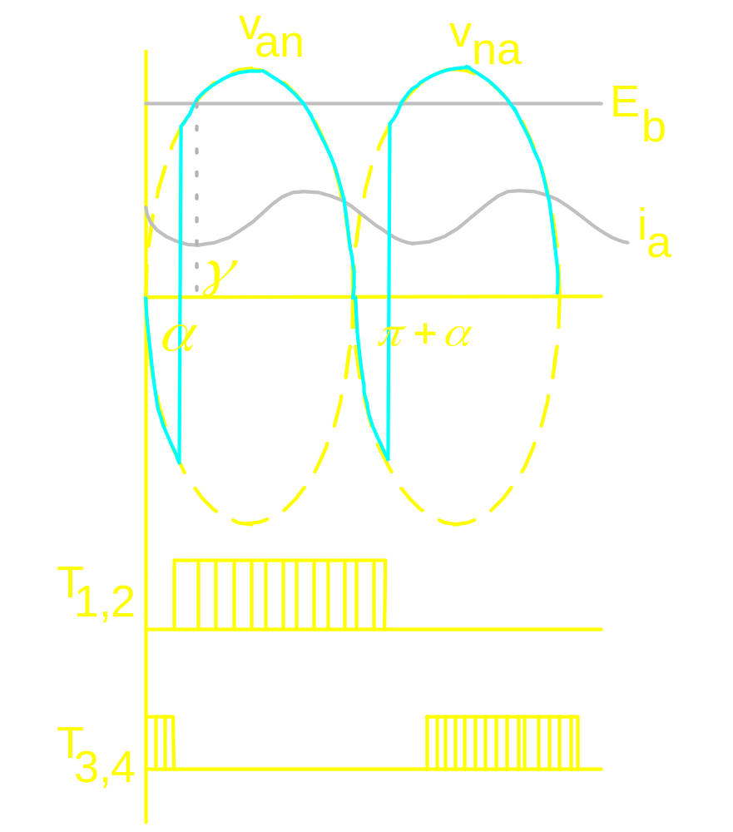
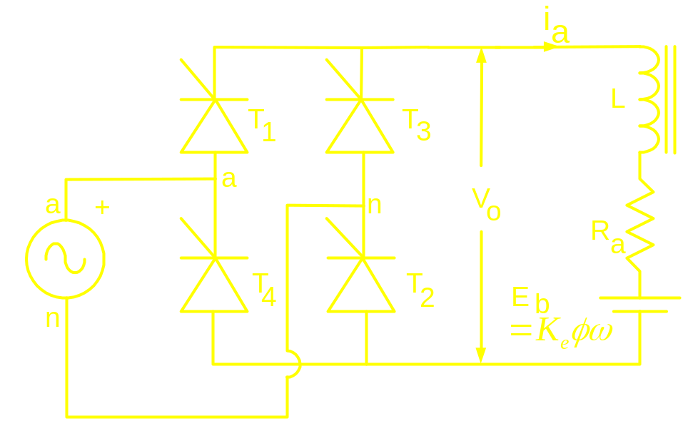
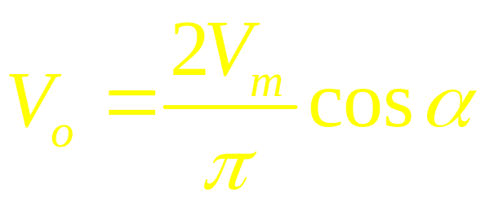
Current Source behaviour

Slide 4
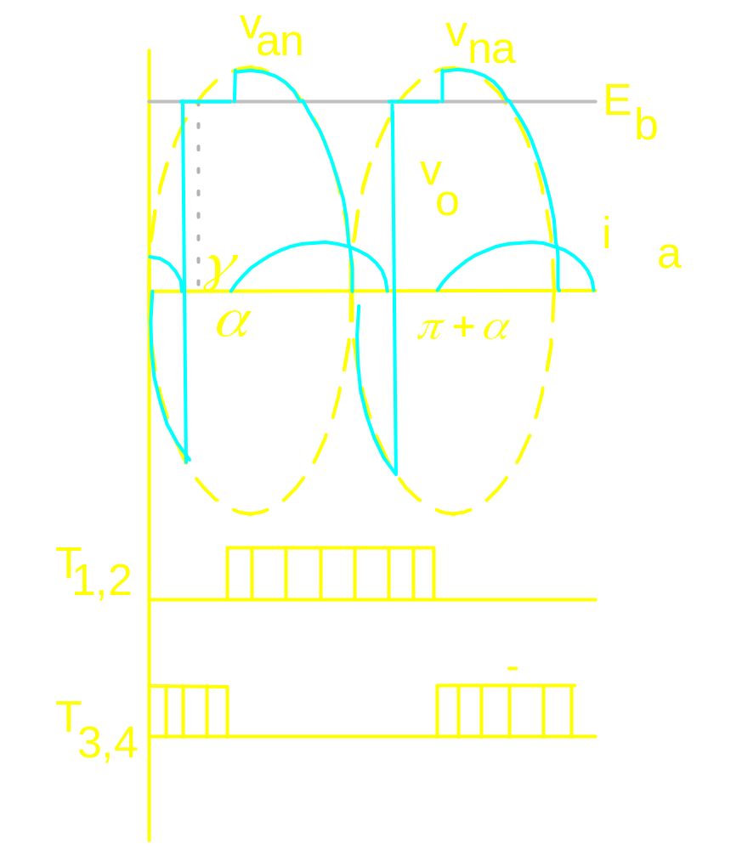


Slide 6

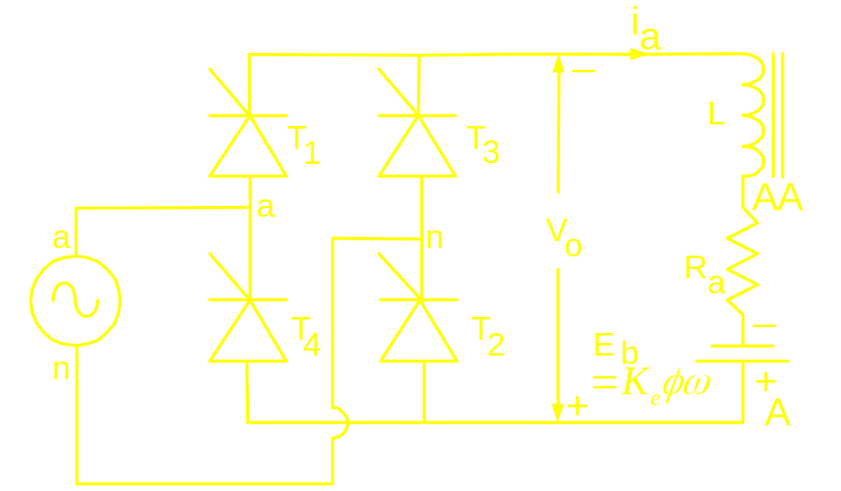
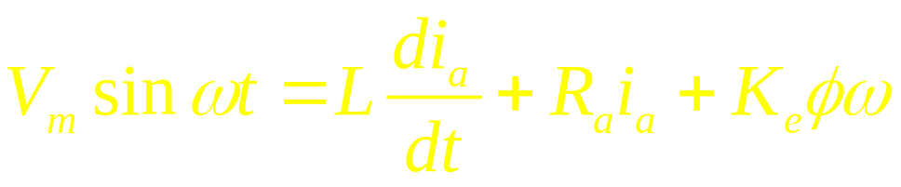
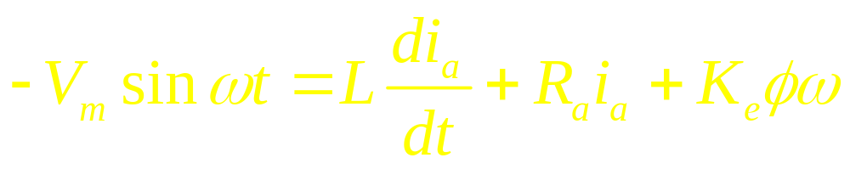
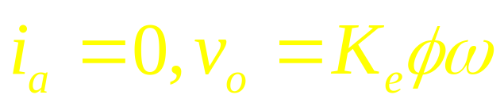
T- Characteristic of a converter fed DC
Motor
When T₁ and T₂ conduct:
When T₃ and T₄ conduct:
When none of the thyristors conduct:

Slide 7
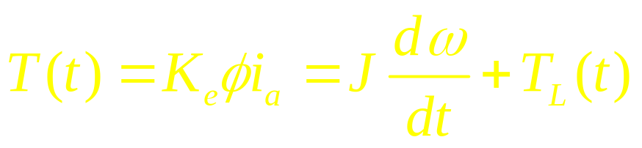
T- Characteristic of a converter fed DC
Motor

Slide 8
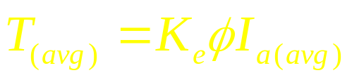
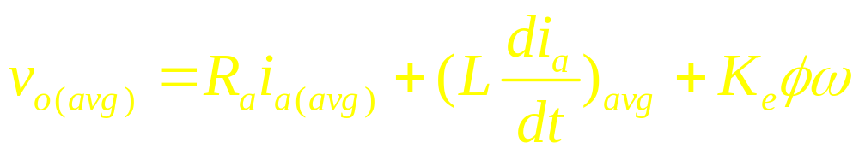
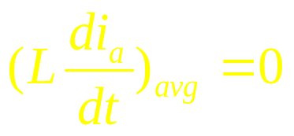
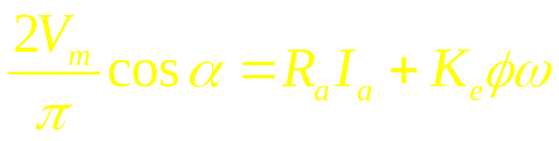
Steady state T- Characteristic of a
converter fed DC Motor in continuous
Mode of conduction
At steady state:
Therefore,

Slide 9
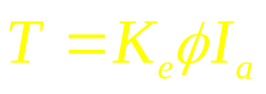
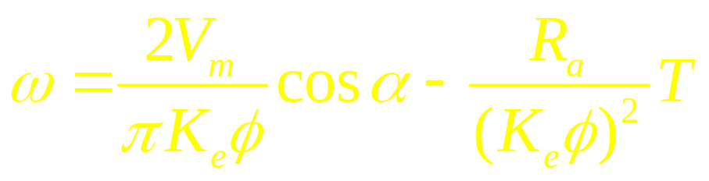
Steady state T- Characteristic of a
converter fed DC Motor in continuous
Mode of conduction

Slide 10
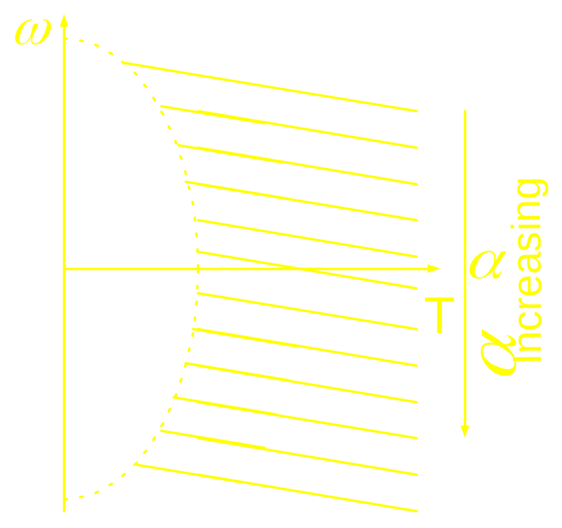
Steady state T- Characteristic of a
converter fed DC Motor in continuous
Mode of conduction

Slide 11
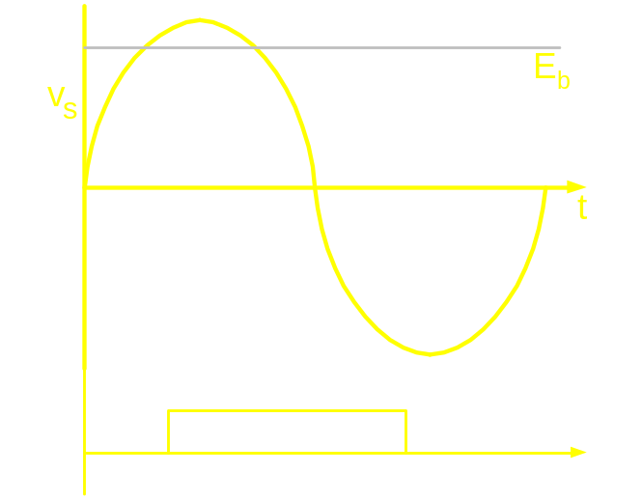
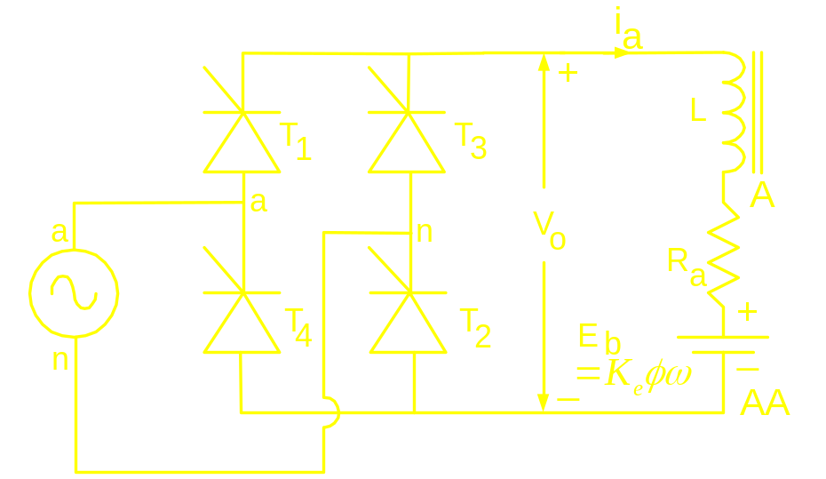
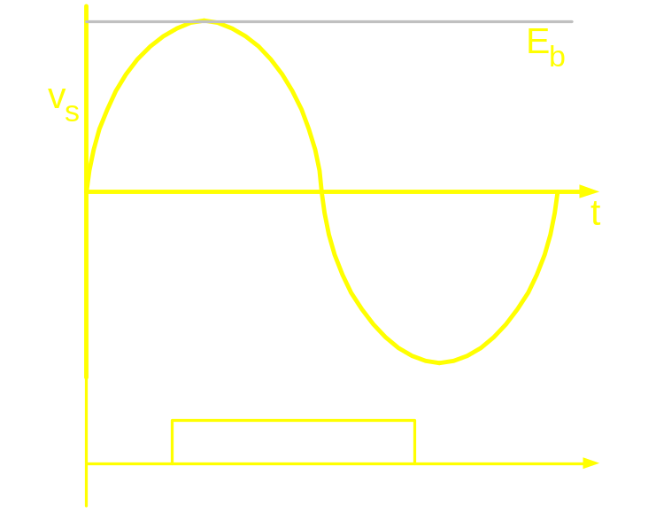
Steady state T- Characteristic of a
converter fed DC Motor in continuous
Mode of conduction

Slide 12
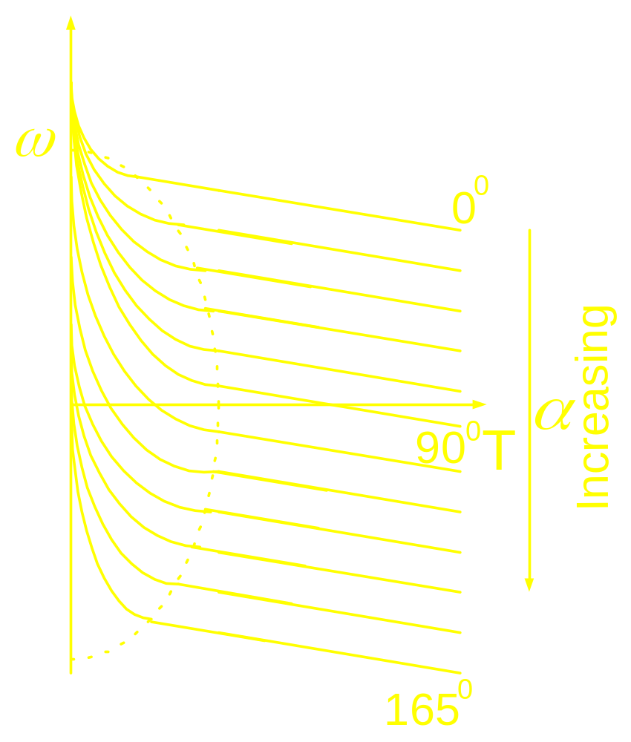
Complete torque-speed characteristic

Slide 13
Discontinuous Mode of operation
Speed regulation is poor
T-w characteristic is non linear
Difficulty in designing a closed loop
controller
Increment in current ripple and hence
torque ripple

Slide 14
Enhancement in the zone of continuous
Mode of conduction
By providing proper value of filter
Inductance:
Leads to slow response

