Slide 1
EE-222
Electric Machines
&
Power Electronics
Lecture - 2
Prof. Kishore Chatterjee
Department of Electrical Engineering,
IIT Bombay

Slide 2
Definition of Drive :

Slide 3
Definition of Drive :
Systems employed for imparting
motion.

Slide 4
Evolution of Drive :
Came into being with the invention of
wheel in the proto historic period of
3500 BC.
Till 18th – 19th century : Not much
conscious effort in the control of
motion

Slide 5
Evolution of Drive (contd.) :
Conscious effort to control motion :
advent of steam governors
Advent of electric motors in 19th century
led to the development of electric drive
Conscious automatic control of drive
became more wide spread.

Slide 6
Present definition of Drive :
Systems employed for motion control
Electric Drive :
Drive employing electric
actuator (motor) as the prime mover

Slide 7
Advantages of Electric Drive :
All the advantages of electrical energy
over other forms of energy are available
Flexibility in control
Longer life, lower noise, lower
maintenance, cleaner operation
Effective non-destructive braking is
possible – regenerative braking is possible

Slide 8
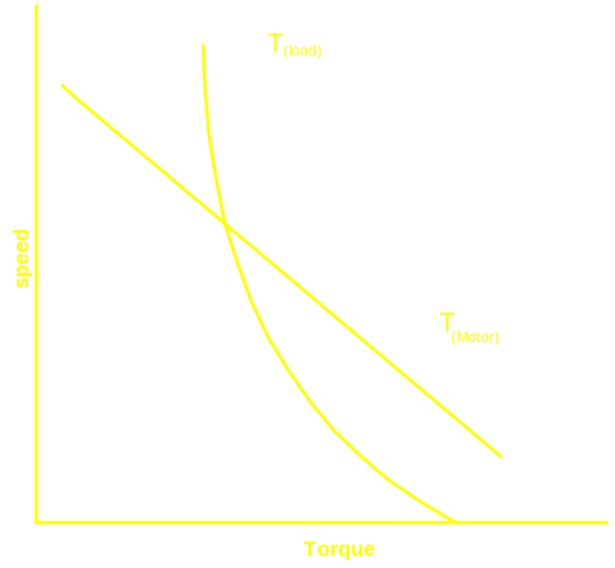
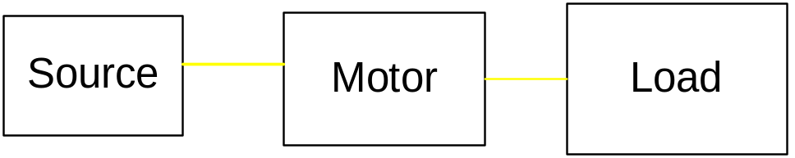
Structure of Electric Drive
Simplest Drive : Natural Characteristic
Conscious control characteristic cannot be
imparted.
How to vary speed ?

Slide 9
To vary speed:
Change source characteristic
Change machine characteristic

Slide 10
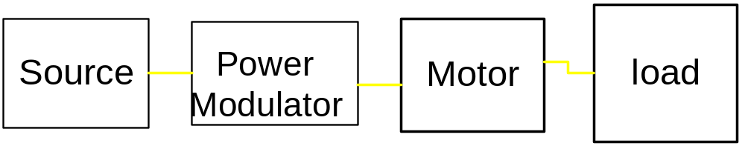
Power Modulator: Device interposed
between the source and the motor which
which will change the input
characteristic for the motor

Slide 11
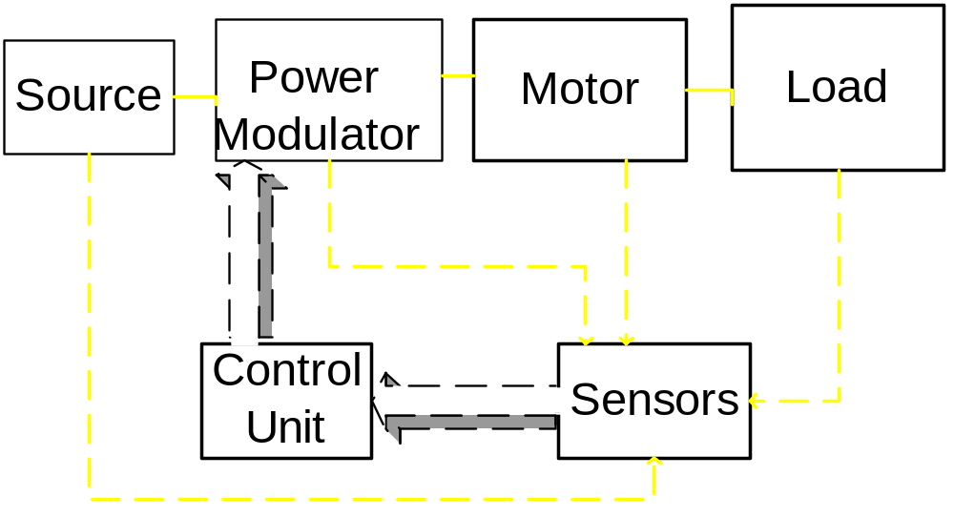
Control Unit : Imparts control law
High performance drive: Closed loop control –
sensing unit
Sensing is also required for providing protection

Slide 12
Important Considerations:
Isolation of the control circuit from the
power circuit
Drive components not to be viewed
as isolated members
Honoring regulations imposed by
power supply authority

Slide 13
Motor Load Interaction

Slide 14
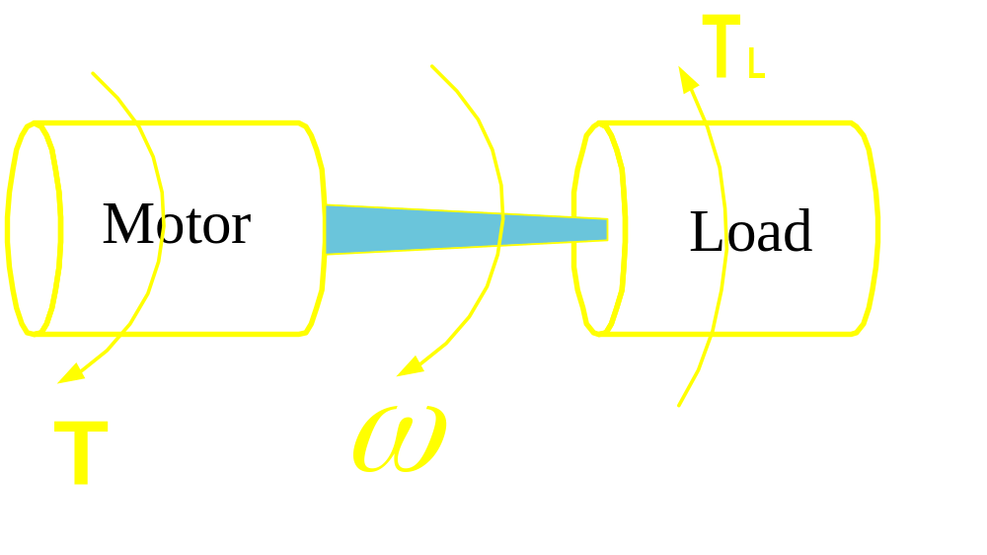
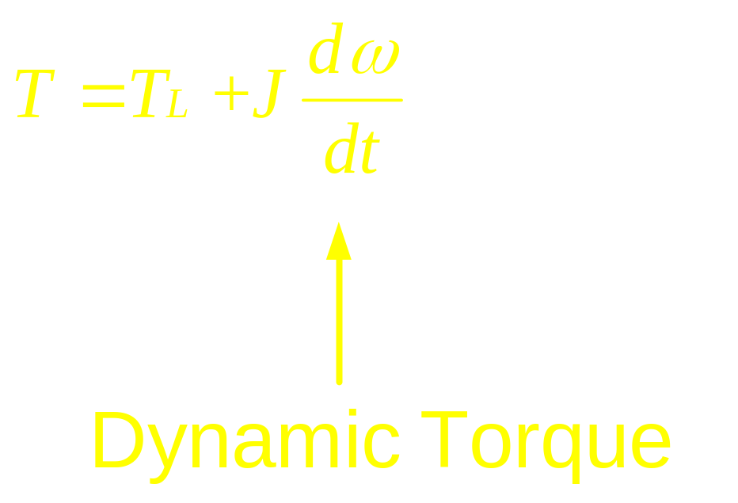

Slide 15
J : Polar moment of Inertia
Effect of J:
Response time
Size of the Motor
In certain applications it can reduce
the size of the motor
Solution of the torque equation

Slide 16
Basic type of Loads:
Passive Load
Active Load

Slide 17
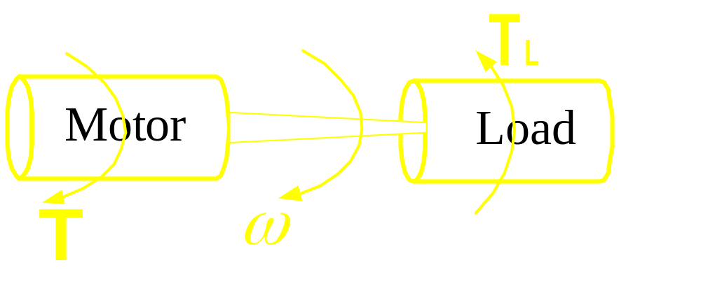
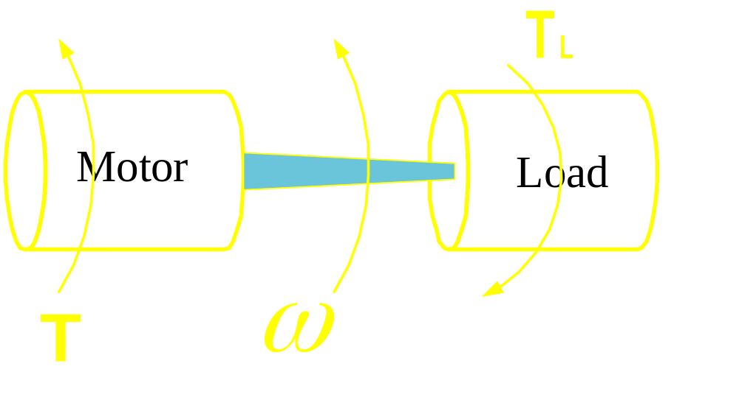
Passive Load

Slide 18
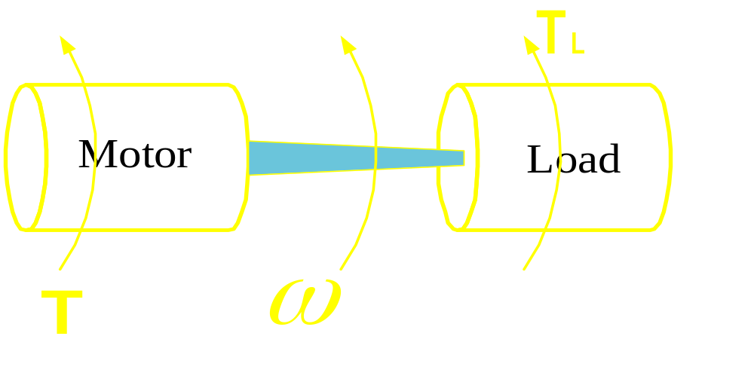
Active Load

Slide 19
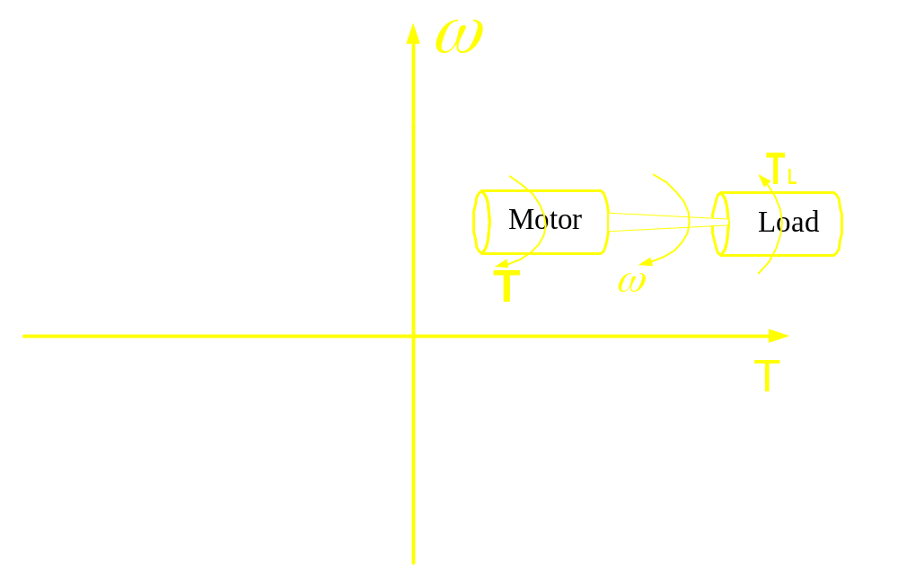
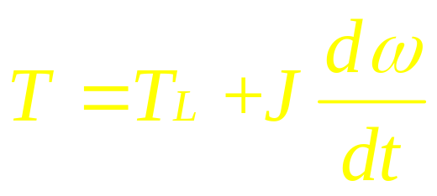
Modes of Operation
II
I
III
IV

Slide 20
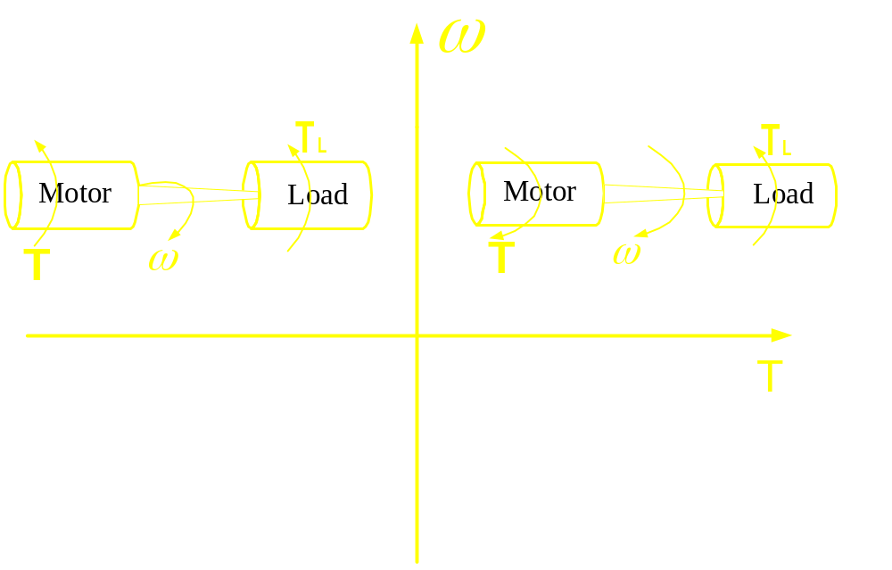
Modes of Operation
II
I
III
IV

Slide 21
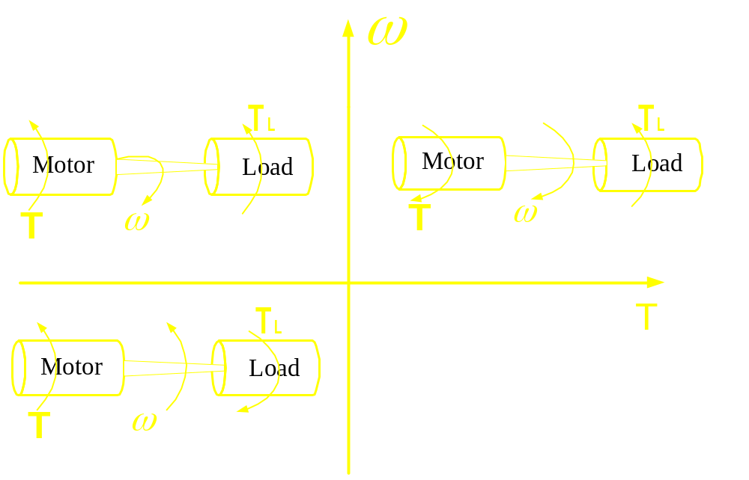
Modes of Operation
II
I
III
IV

Slide 22
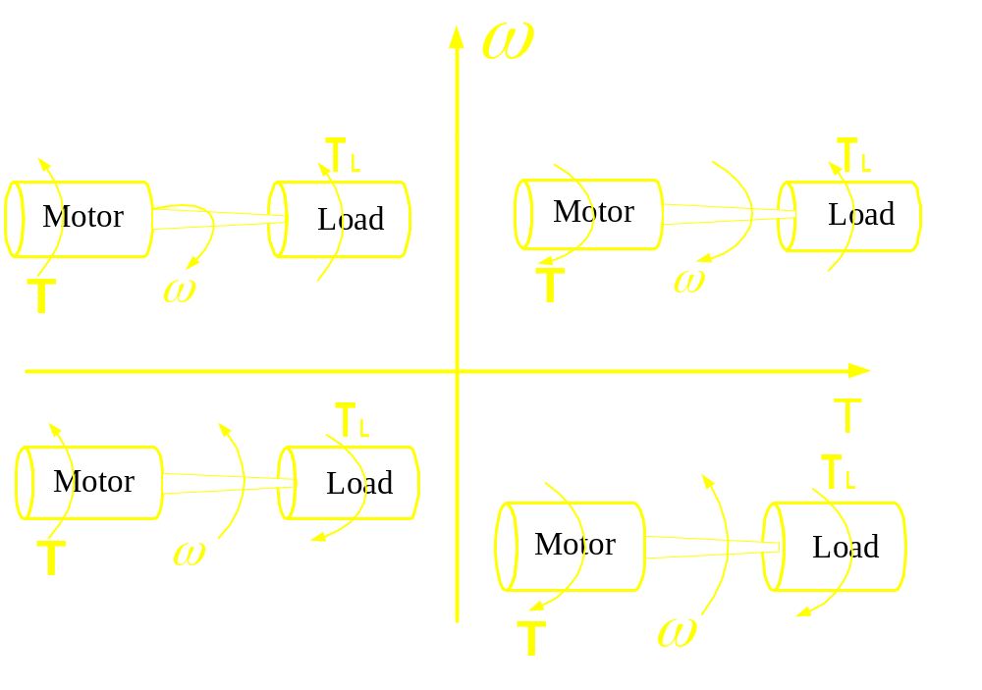
Modes of Operation
II
I
III
IV

