Slide 1
EE-222
Electric Machines
&
Power Electronics
Lecture - 3
Prof. Kishore Chatterjee
Department of Electrical Engineering,
IIT Bombay

Slide 2
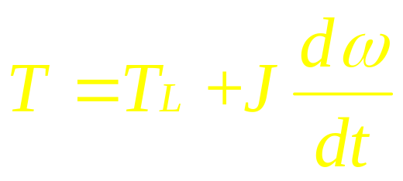
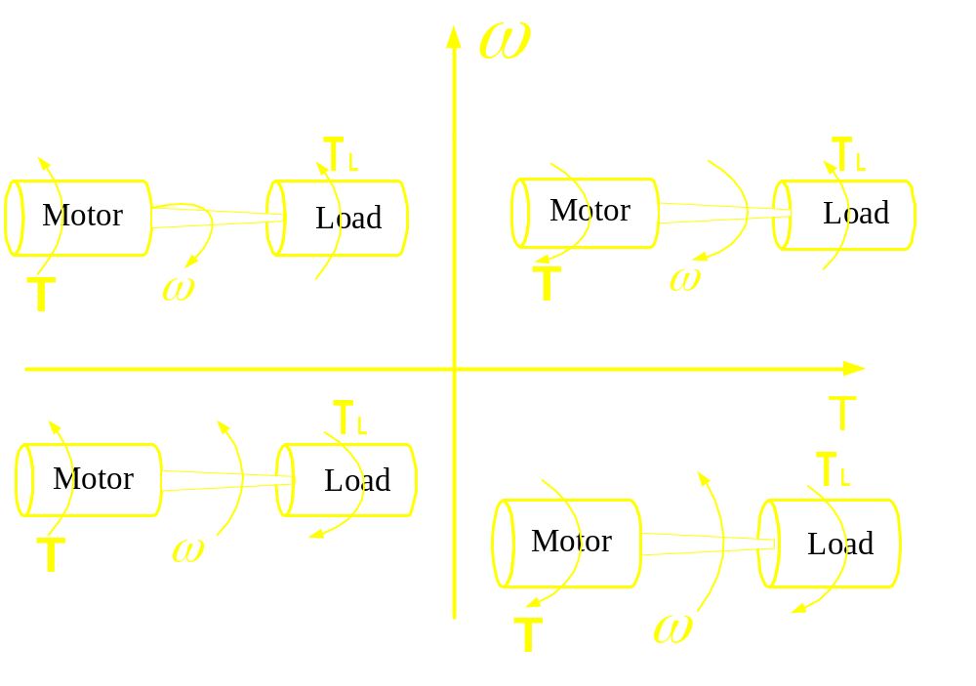
Modes of Operation
II
I
III
IV

Slide 3
Requirement of Braking
Applications requiring frequent and
accurate stops
For emergency stop
While negotiating active loads

Slide 4
Advantages of Electric Braking
No wear and tear of mechanical parts
Smooth and controlled braking is
possible
If regenerative braking is possible,
overall efficiency of the drive is
increased.

Slide 5
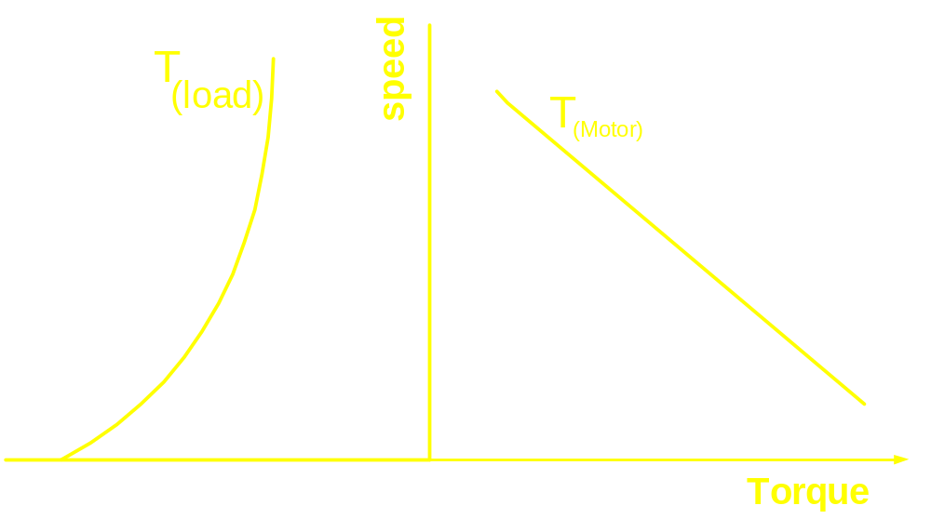
Equilibrium point

Slide 6
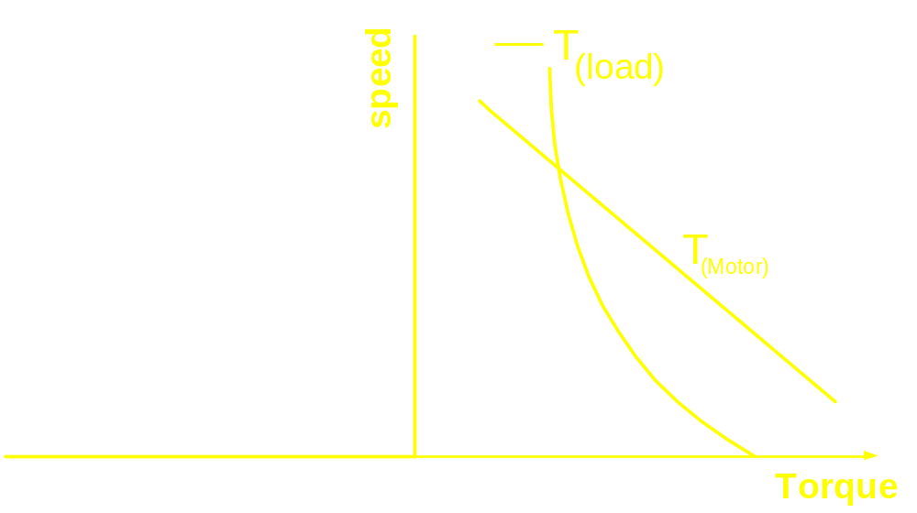
Equilibrium point

Slide 7
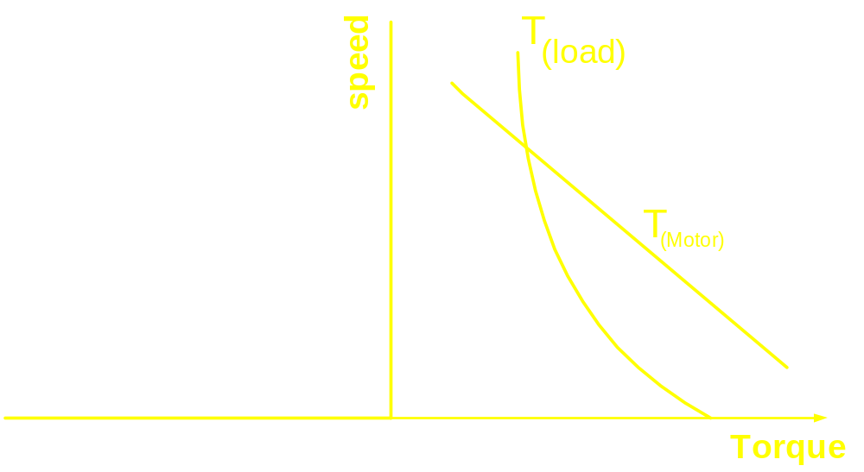
Equilibrium point

Slide 8
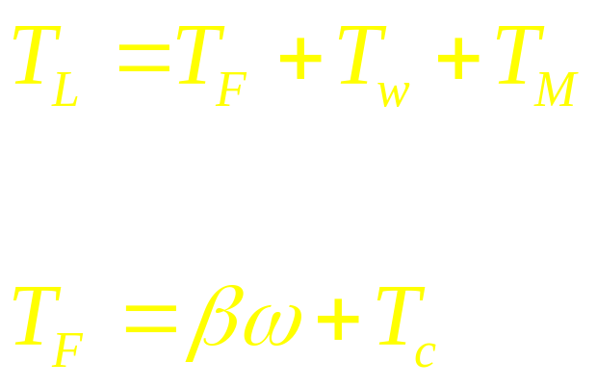
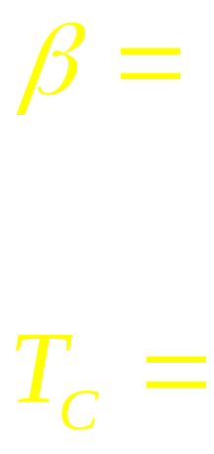
Components of Load torque
Coefficient of viscous friction
Coefficient of coulomb friction

Slide 9
Characteristics of some typical Loads

Slide 10
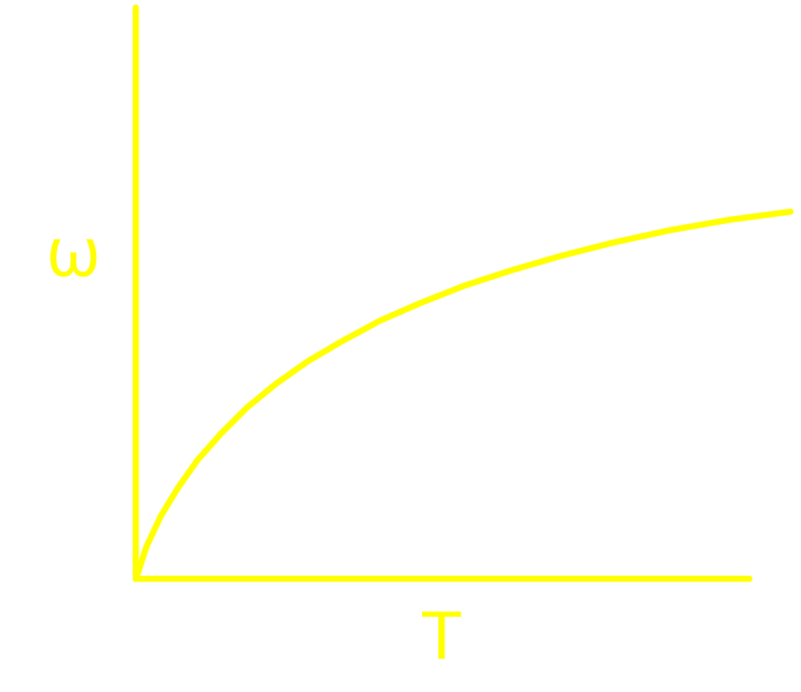
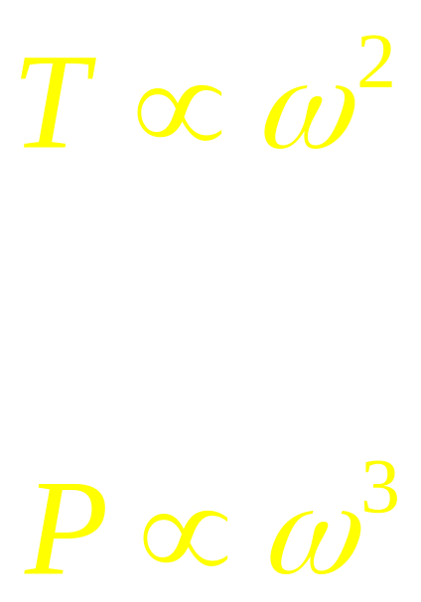
Pump and Blower Load

Slide 11
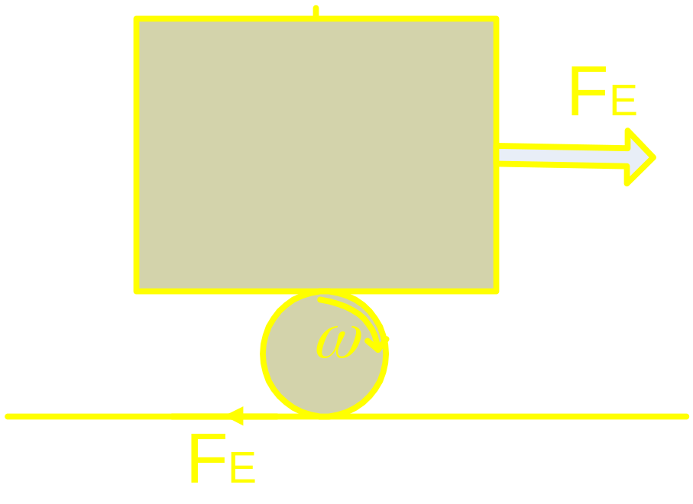
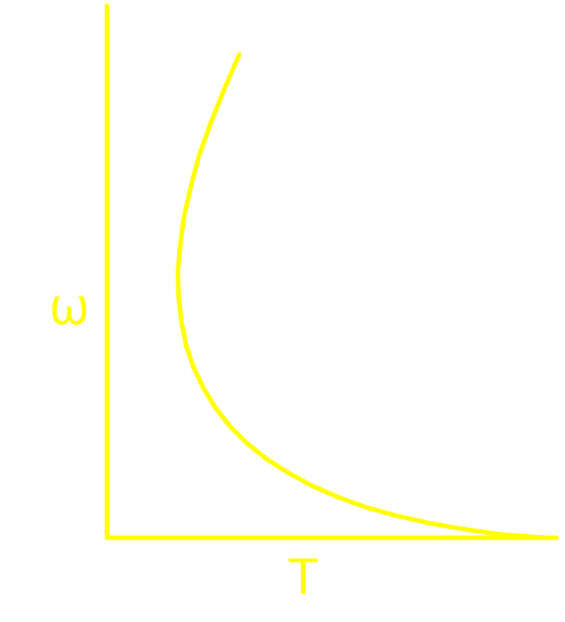
Railway Traction load
F_{E} = Tractive Effort
F_{F} = Force due to Friction

Slide 12
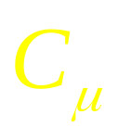
Condition for linear motion of the car
F_{E} < F_{F(max)}
Otherwise wheel starts slipping
F_{F(max)} = N
Max F_{E} that can be applied without
wheel slipping
______________________________
=
Total weight coming on the driving
wheels

Slide 13
Fall out of
Main line traction
Suburban traction

Slide 14
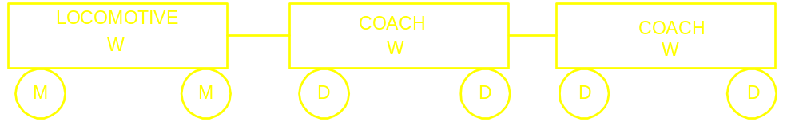
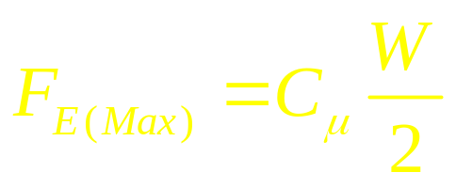
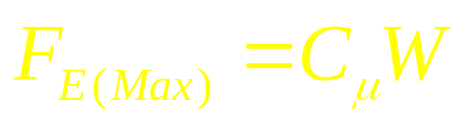
Main Line Traction
For each wheel
For the locomotive

Slide 15
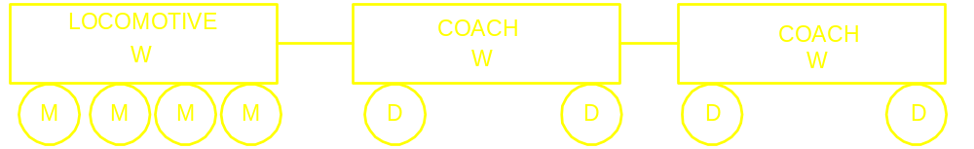
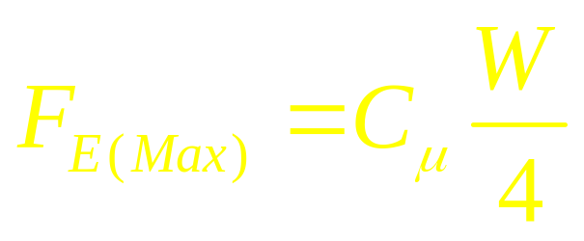
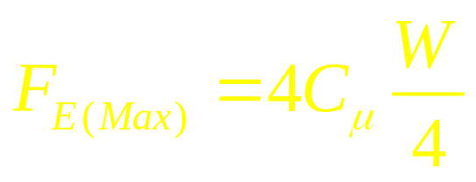
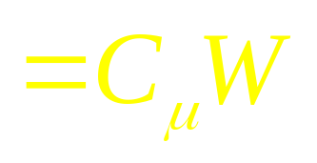
Effort to increase F_{e}
For each wheel
For the locomotive

Slide 16
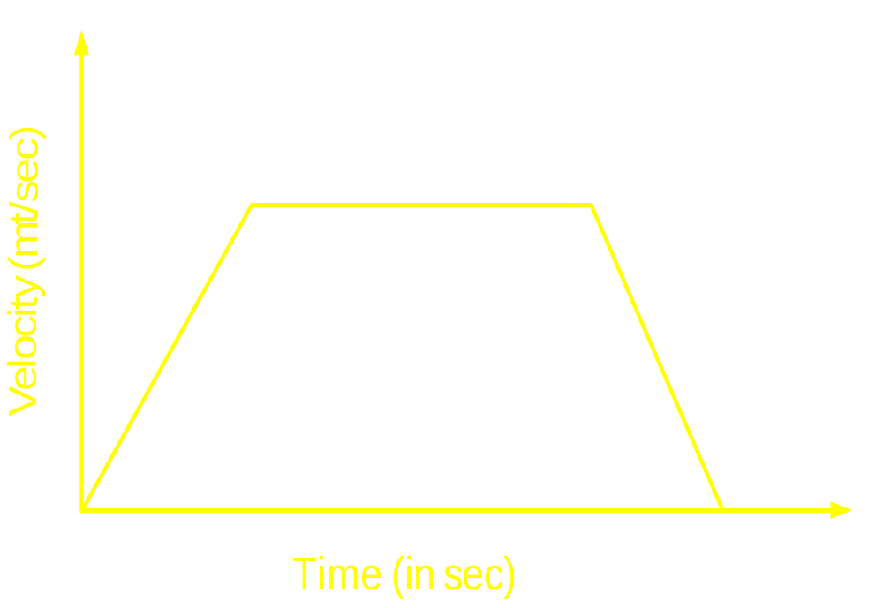
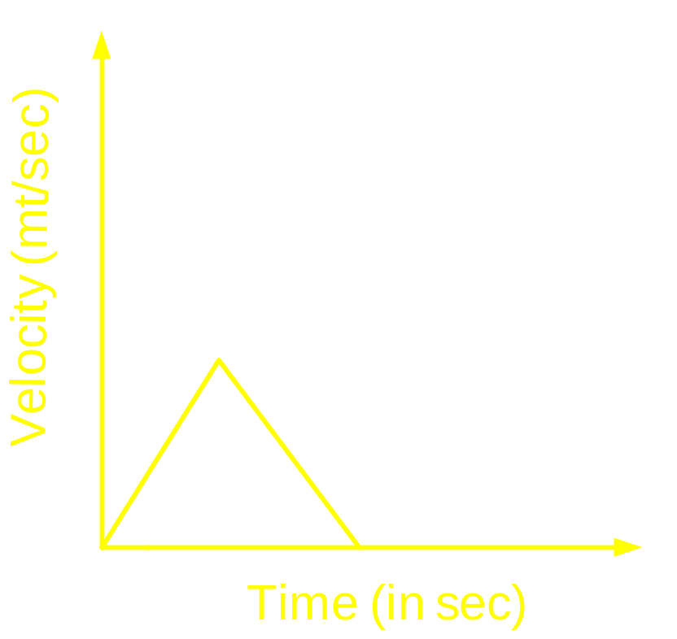
When the distance
between the stops
are large
When the distance
between the stops
are small

Slide 17
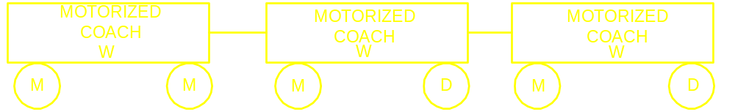
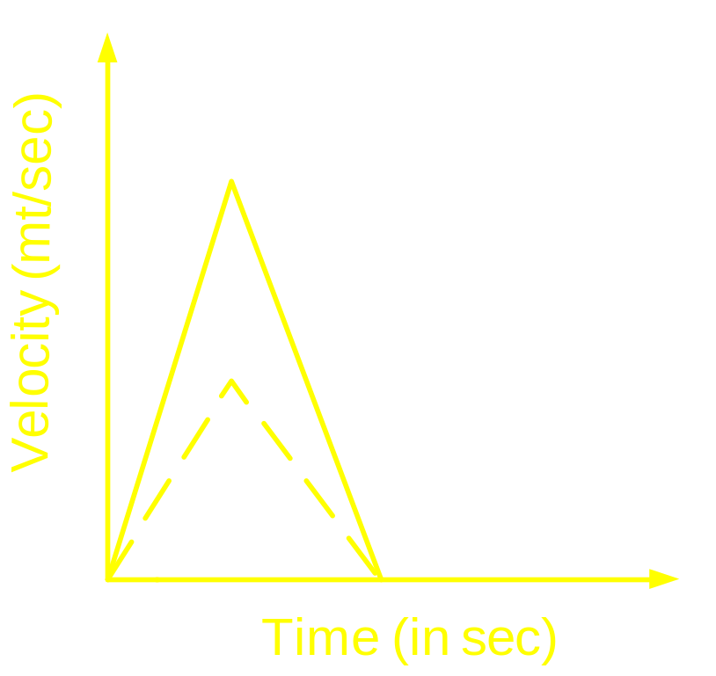
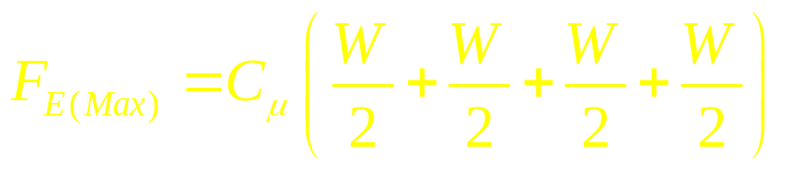
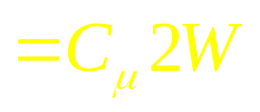
Sub-urban railway: EMU Coaches

Slide 18
Electric Traction:
High initial cost and
low running cost
Diesel Electric Traction:
Low initial cost and
high running cost

Slide 19
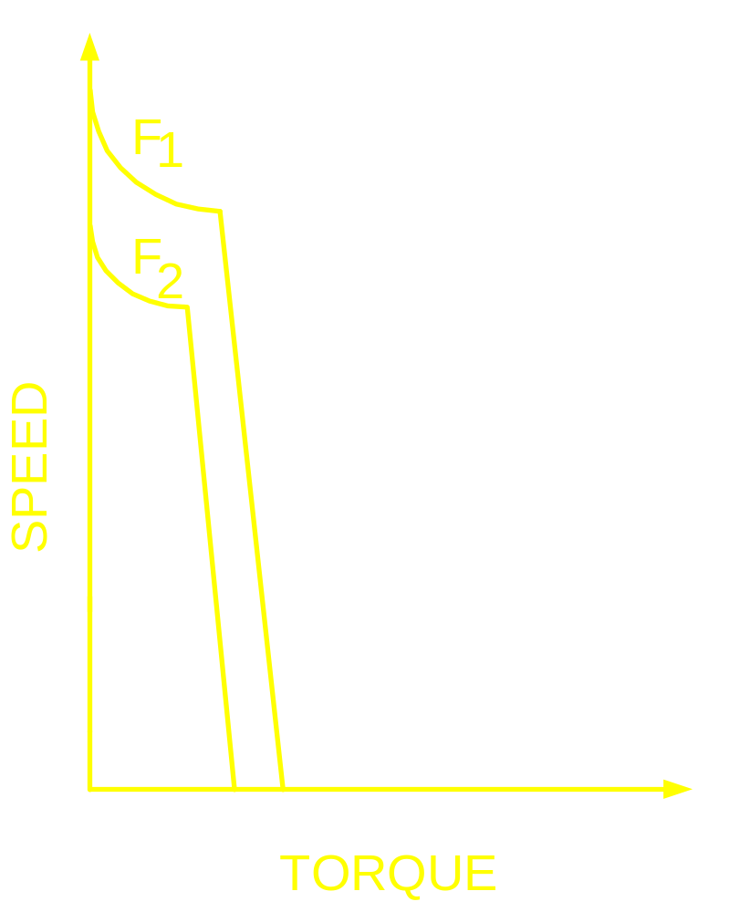
Approx. Characteristic of Diesel Engine
F₁ , F₂ = Rate of Fuel
injection

Slide 20
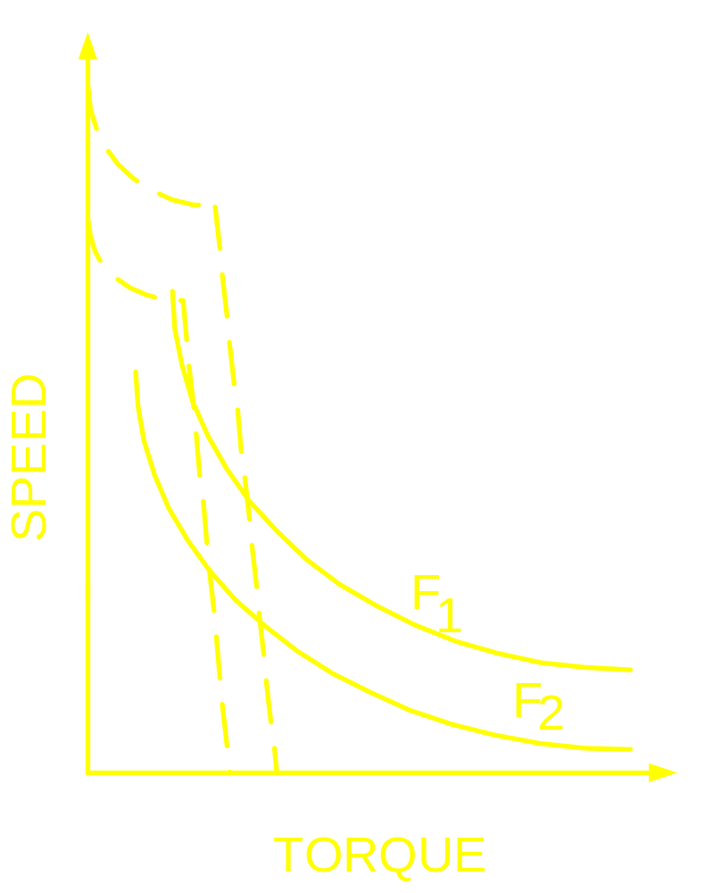
Matching of Characteristic with that of
Load

Slide 21
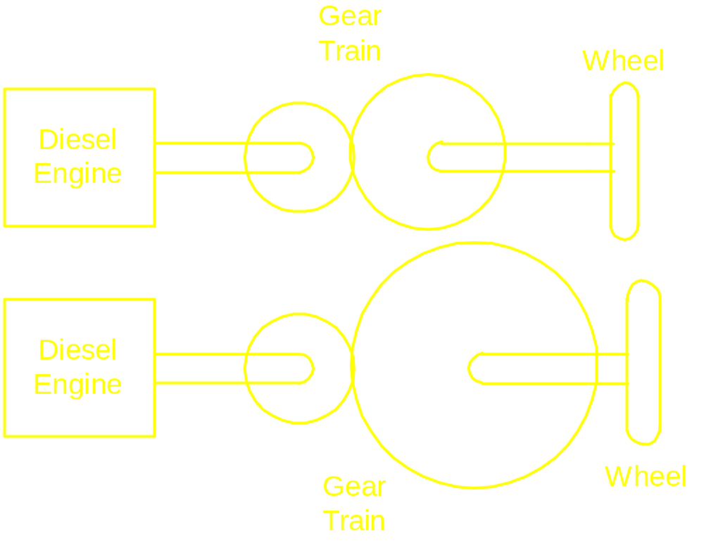
Matching of Characteristic with that of
Load

Slide 22
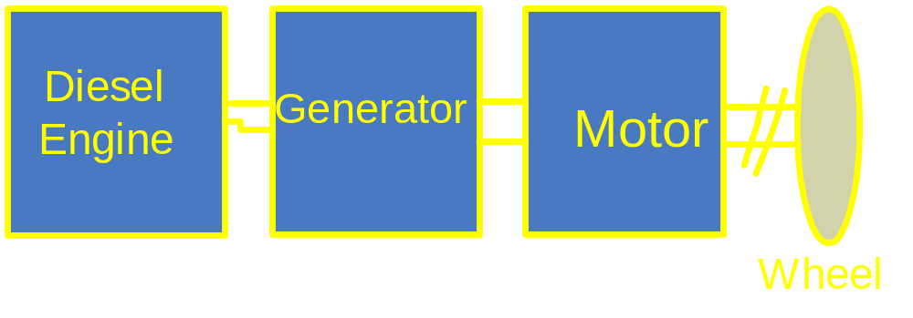
Diesel Electric Locomotive

Slide 23
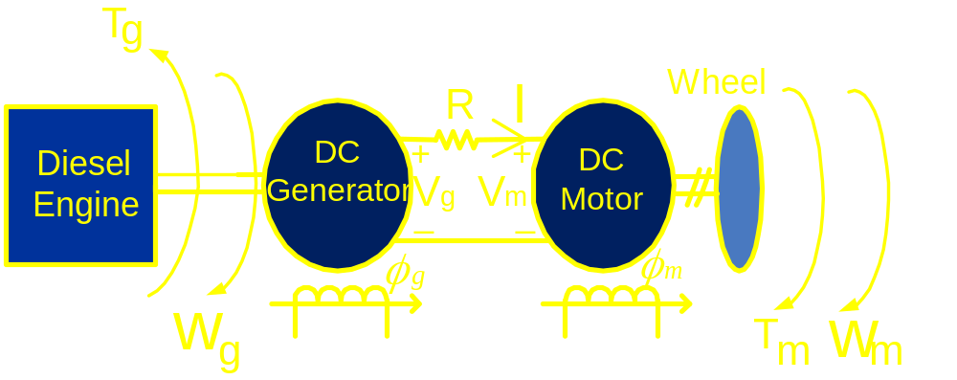
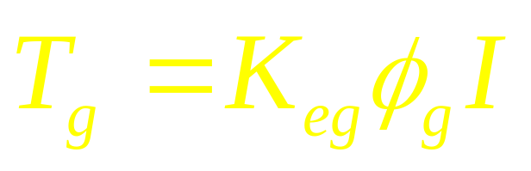
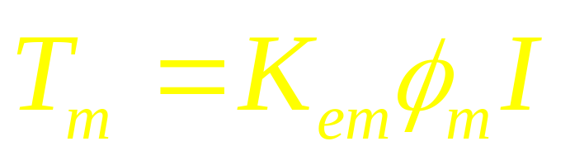
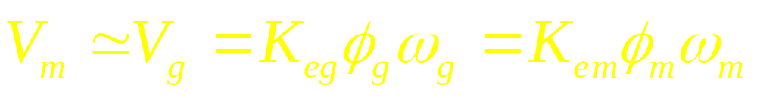
Diesel Electric Locomotive

Slide 24
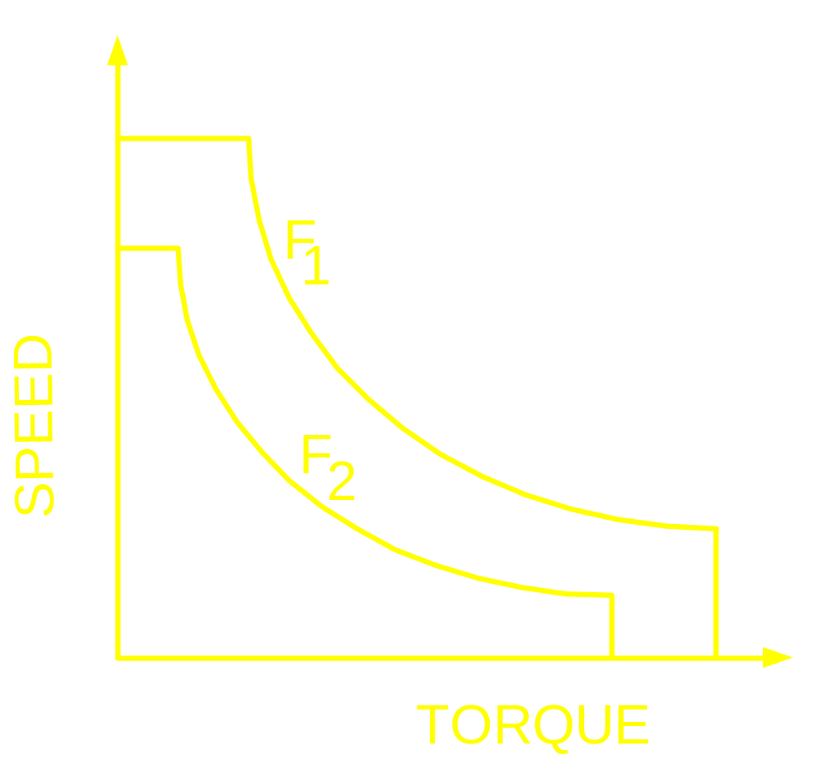
Torque-Speed Characteristic of
Diesel Electric Locomotive

Slide 25
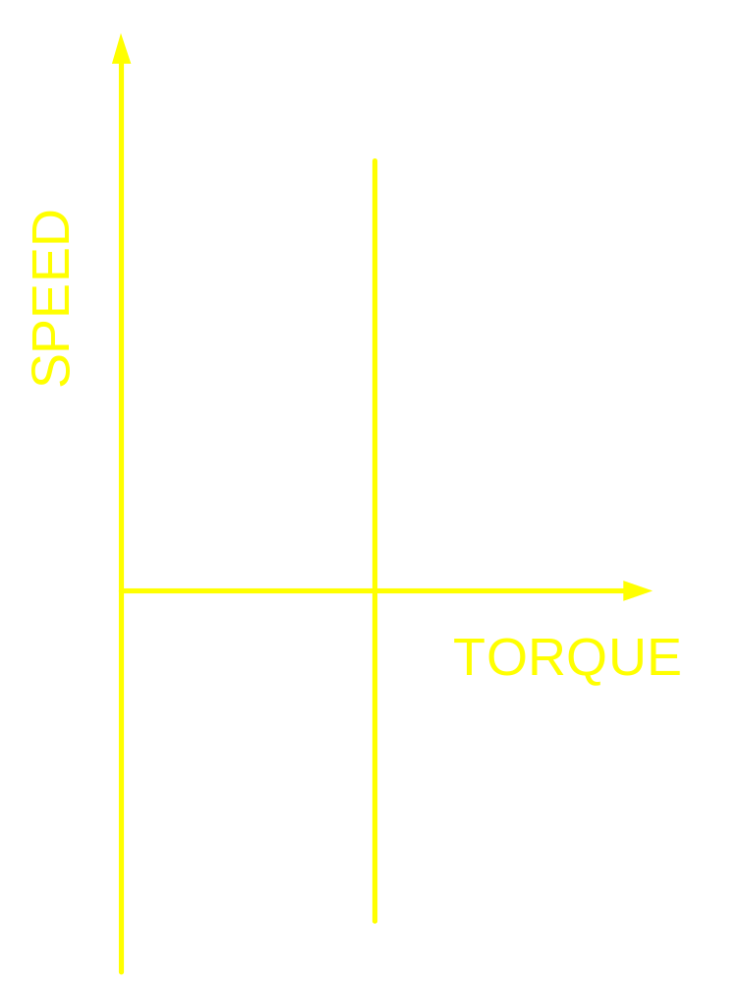
Torque speed Characteristic of Hoist

Slide 26
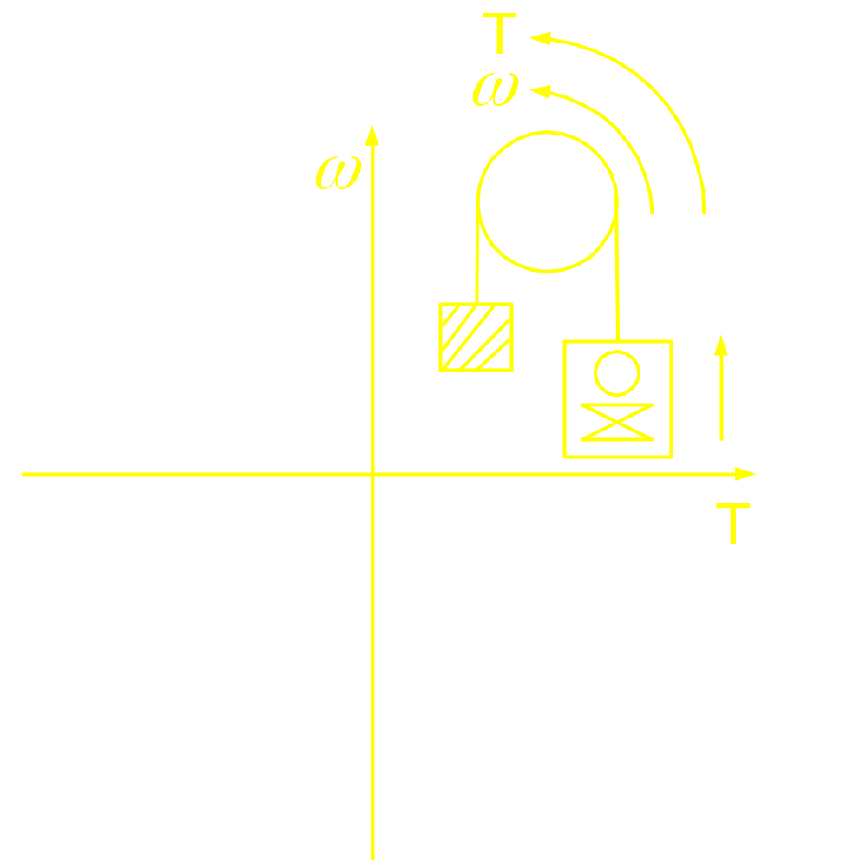
Torque speed Characteristic of Hoist

