Slide 1
EE-222
Electric Machines
&
Power Electronics
Lecture - 4
Prof. Kishore Chatterjee
Department of Electrical Engineering,
IIT Bombay

Slide 2
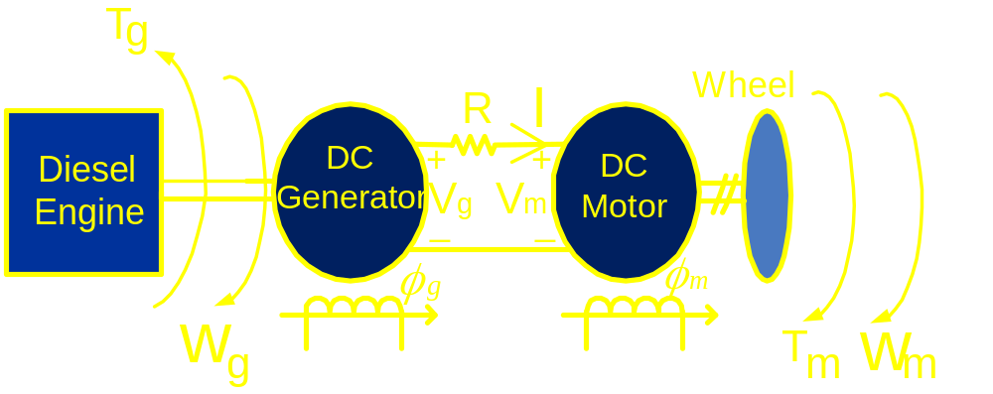
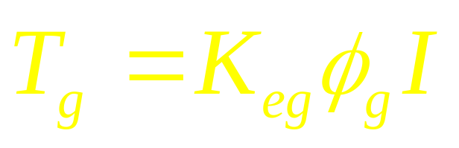
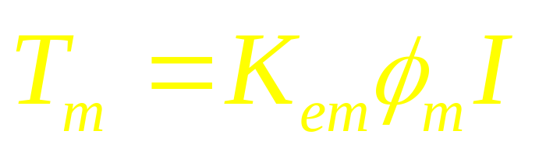
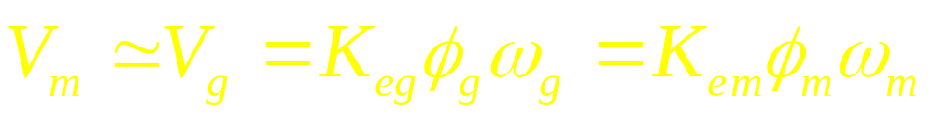
Diesel Electric Locomotive

Slide 3
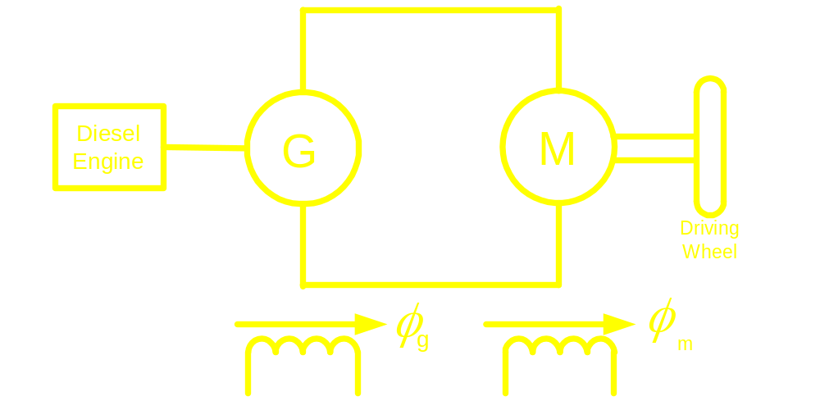
Schematic diagram of a diesel-electric locomotive is shown in the Figure. For a
Particular rate of fuel injection, the diesel engine is developing a constant power
of 1 MW at a speed of 6000 rpm. The rating of both the dc generator and the dc
motor is 1000 V, 6000 rpm, 1500 A and each one is having armature resistance
of 0.02 Ω. Rated flux is maintained for the dc the motor driving the wheel.
Determine φ_{g} as a percentage of its rated value so that the locomotive can
develop a torque of 2000 Nm. Find also the speed at which the driving motor will
run. Neglect rotational losses of the system. Treat the dc machines as dc motors
while determining the machine constant i.e. K_{e}φ.

Slide 4
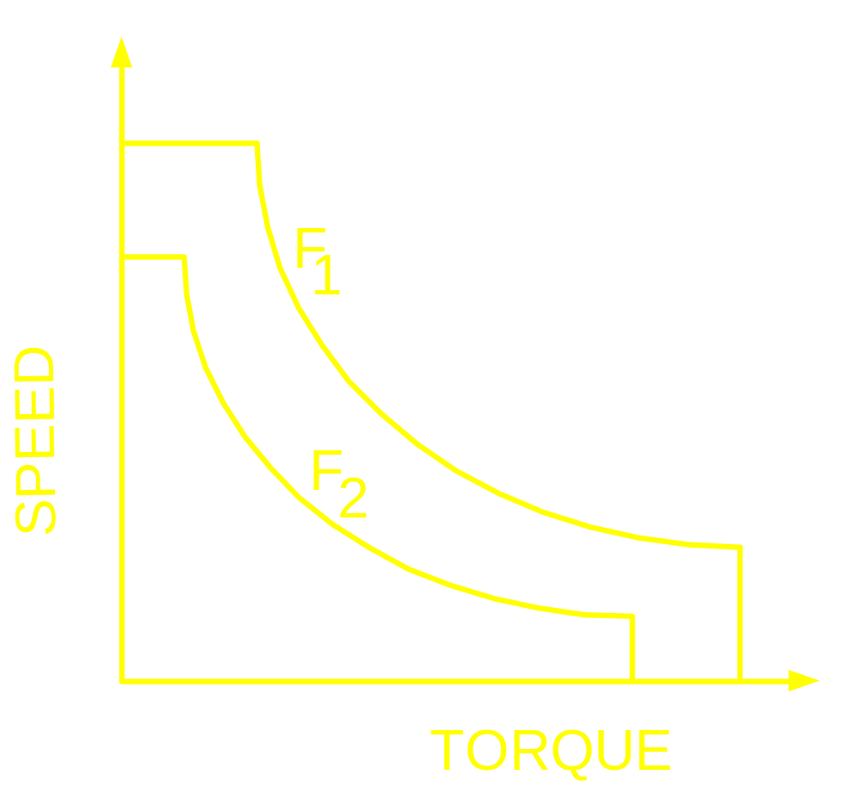
Torque-Speed Characteristic of
Diesel Electric Locomotive

Slide 5
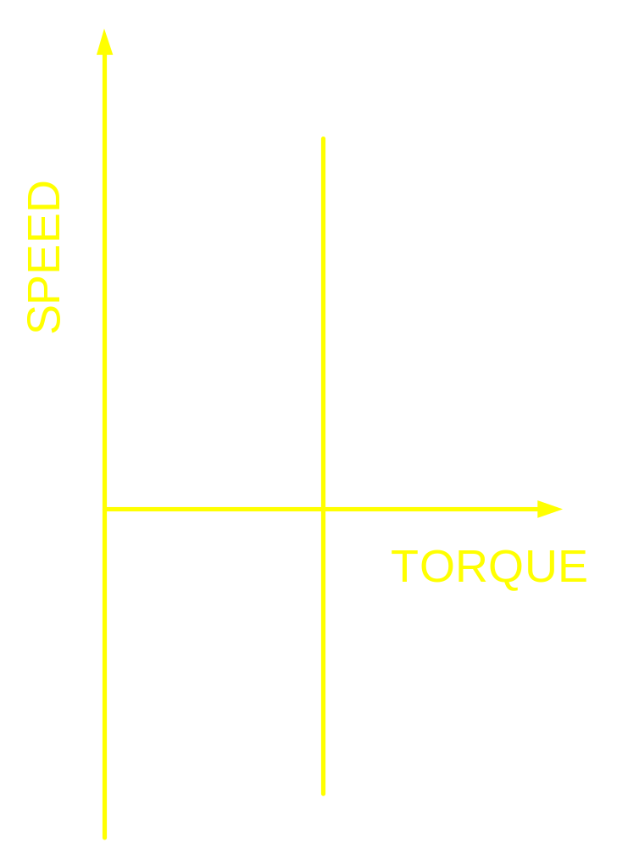
Torque speed Characteristic of Hoist

Slide 6
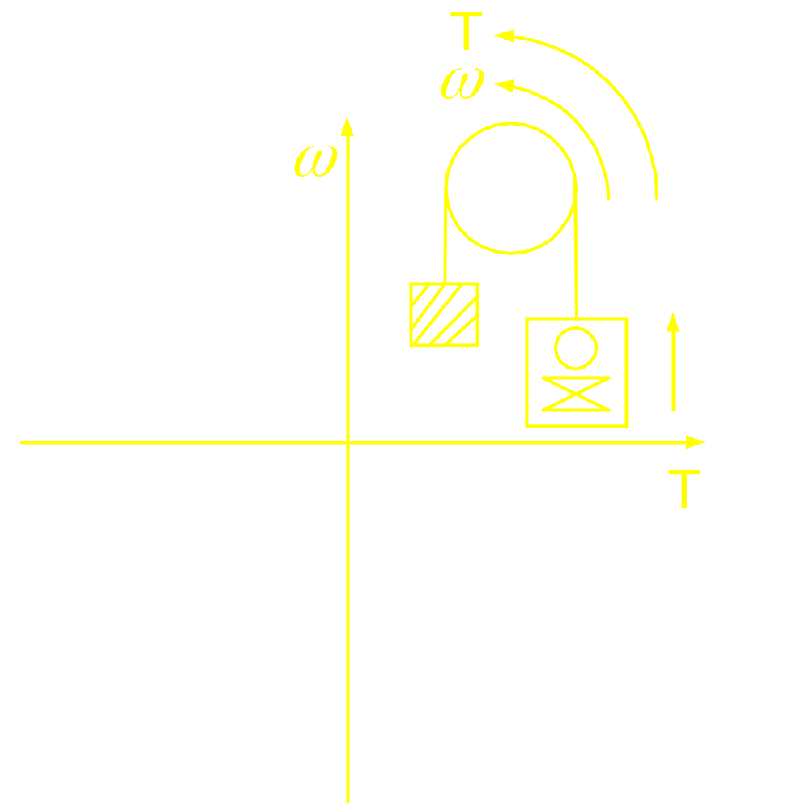
Torque speed Characteristic of Hoist

Slide 7
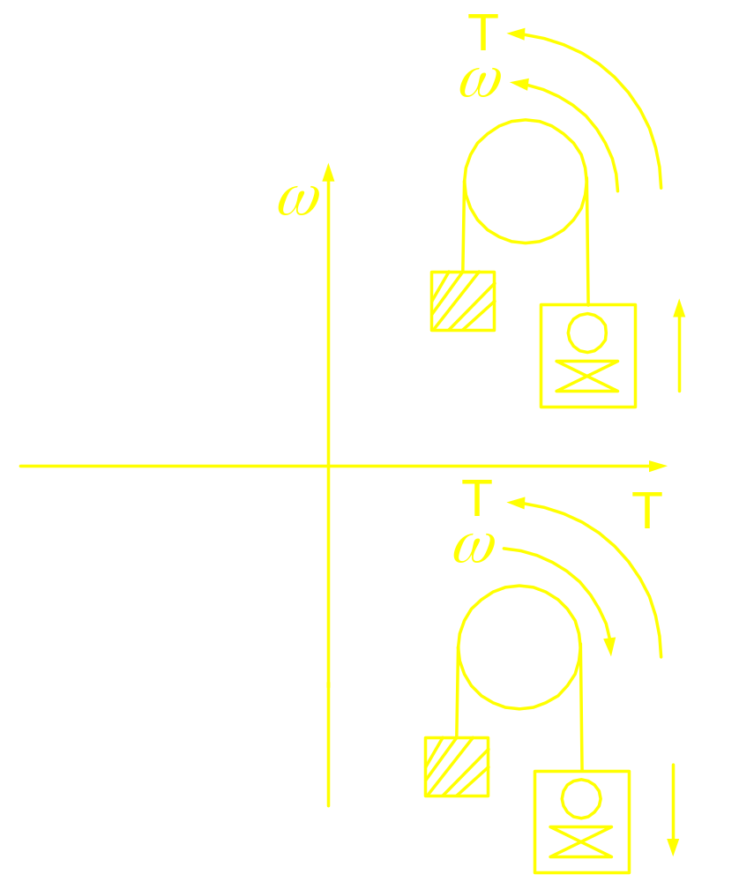
Torque speed Characteristic of Hoist

Slide 8
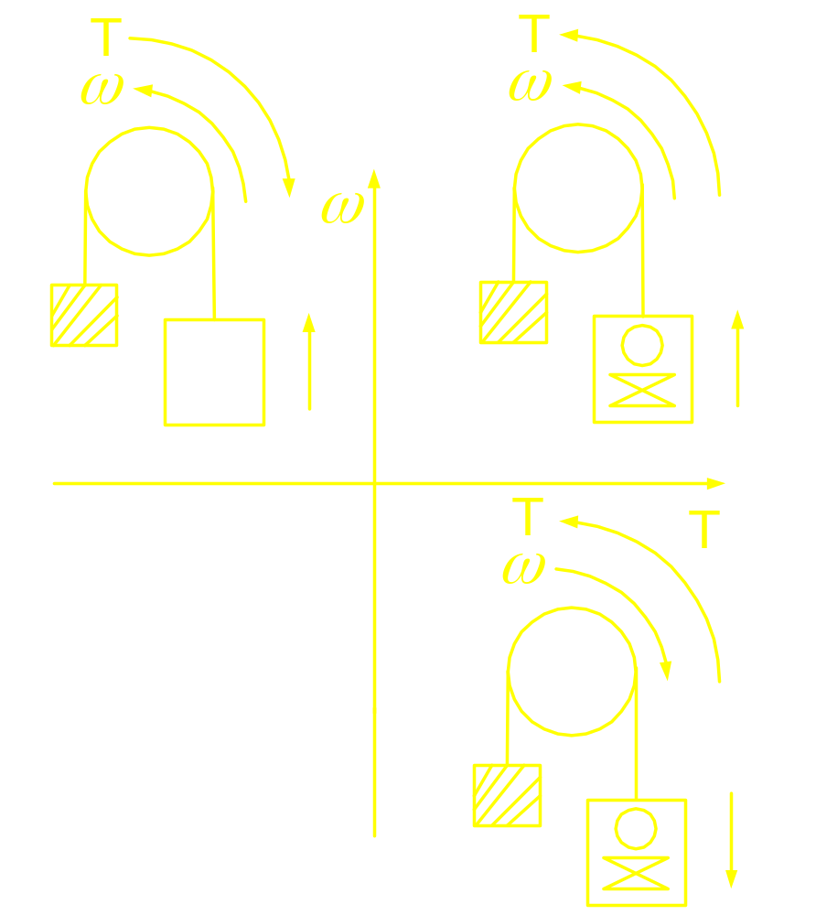
Torque speed Characteristic of Hoist

Slide 9
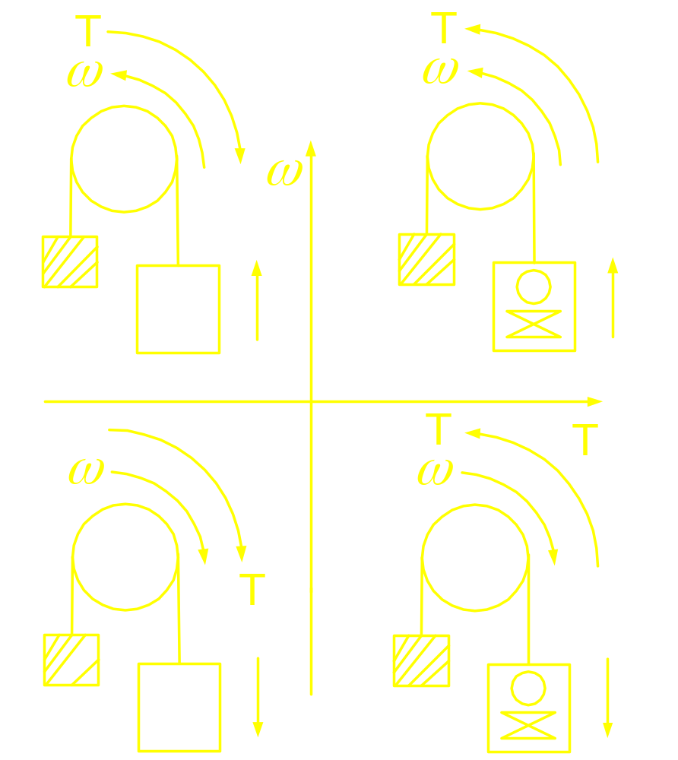
Torque speed Characteristic of Hoist

Slide 10
DC Motor Drive

Slide 11
Advantages:
Simple Control
Flux and Current are decoupled => Fast response (Electrical)
Generally involves single stage of power conversion

Slide 12
Disadvantages:
Fragile Commutator and Brush
Frequent maintenance
Inability to operate at high speed, dusty and contaminated atmosphere
Higher weight, volume and hence slow mechanical response
Higher cost of the machine

Slide 13
Speed-Torque Characteristics:
Compensated DC Machine

Slide 14
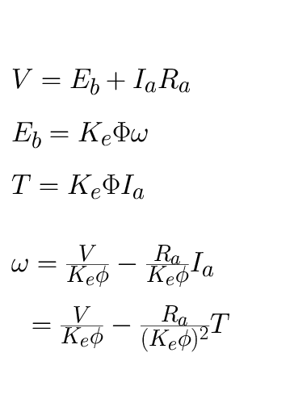
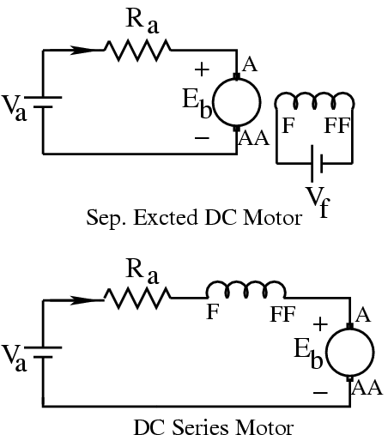
Speed-Torque Characteristics
_
+
I
a
a
_
+
I
a

Slide 15
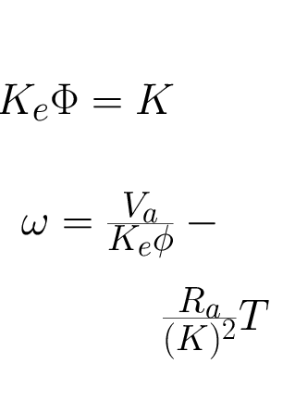
For Sep. Excited Motor:
a

Slide 16
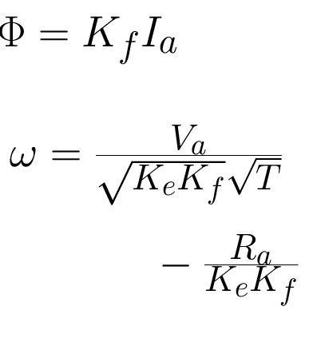
For Series Motor:
a

Slide 17
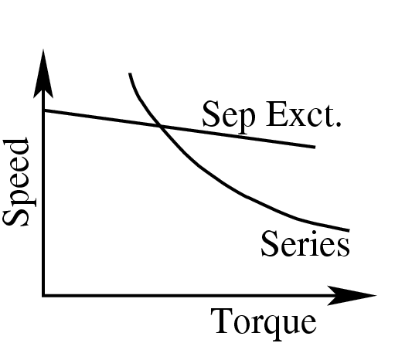
Speed – Torque Characteristic

Slide 18
Speed Control of Separately
excited dc motor

Slide 19

Armature Resistance Control

Slide 20
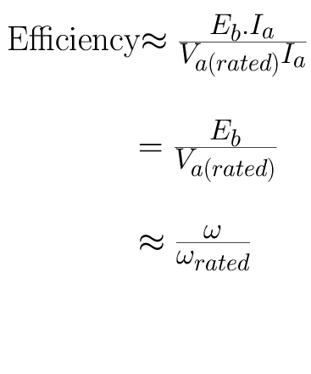
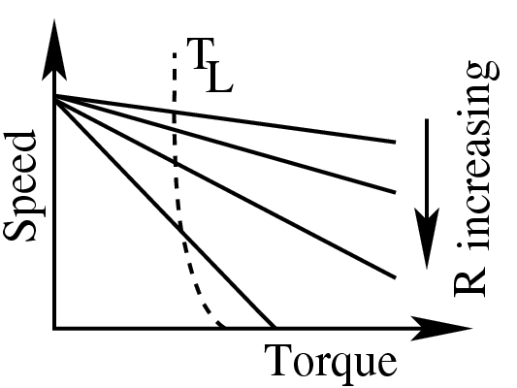
Armature Resistance Control

Slide 21
Armature Voltage Control

