Slide 1
EE-222
Electric Machines
&
Power Electronics
Lecture - 6
Prof. Kishore Chatterjee
Department of Electrical Engineering,
IIT Bombay

Slide 2
Armature Voltage Control of
Separately excited dc Motor

Slide 3
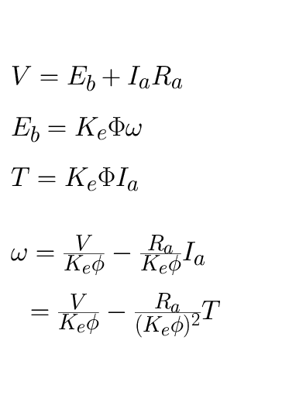
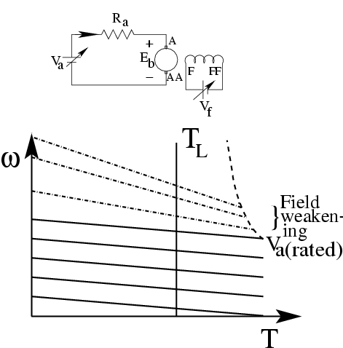
Combined Armature Voltage & Field Control

Slide 4
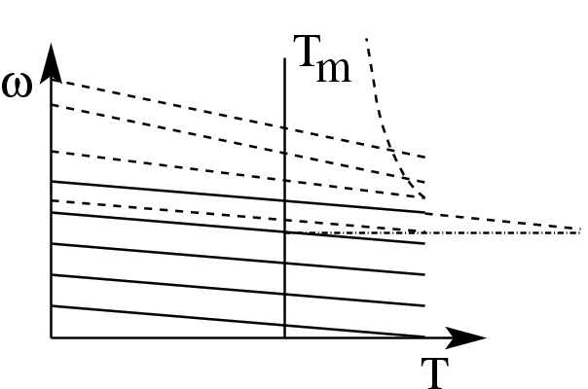
Armature Voltage & Field Control
Dynamics Involved:

Slide 5
Combined Armature Voltage &
Field Control
Control Philosophy:
For obtaining speeds lower than the
base speed: Vary armature voltage
For obtaining speeds higher than the
base speed: Vary field flux (field-
voltage)

Slide 6
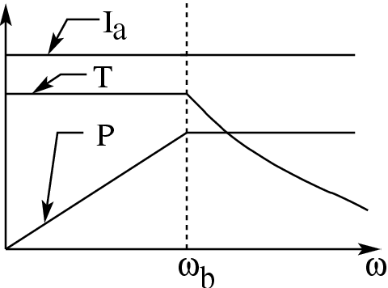
Constant torque
mode
Constant power
mode

Slide 7
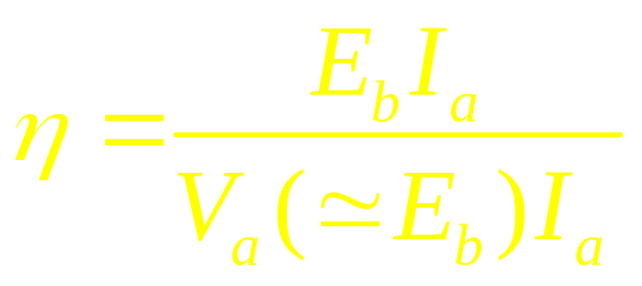
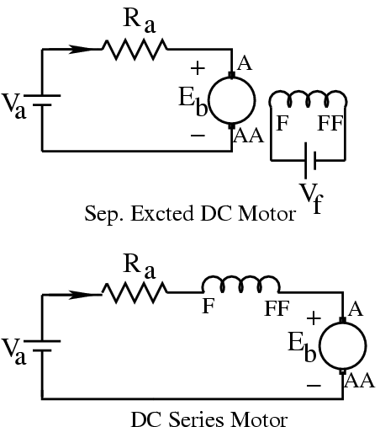
Efficiency of Combined Armature Voltage
& Field Control method
I_{a}

Slide 8
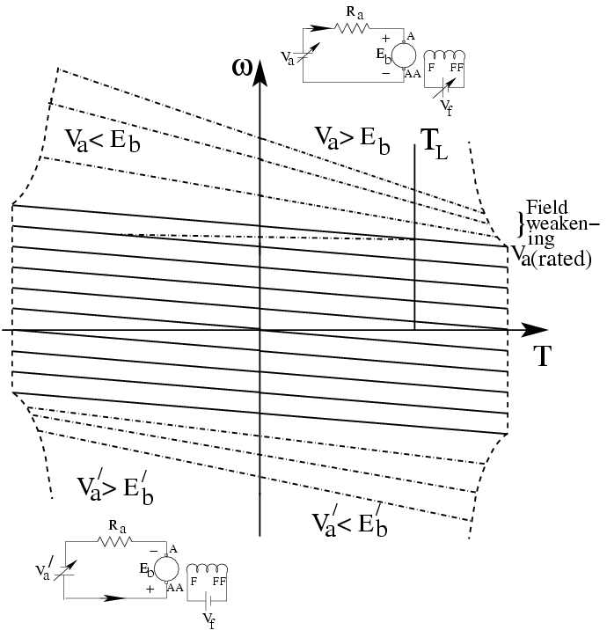
Four Quadrant Drive

Slide 9
Braking
Regenerative Braking
Dynamic Braking
Plugging

Slide 10
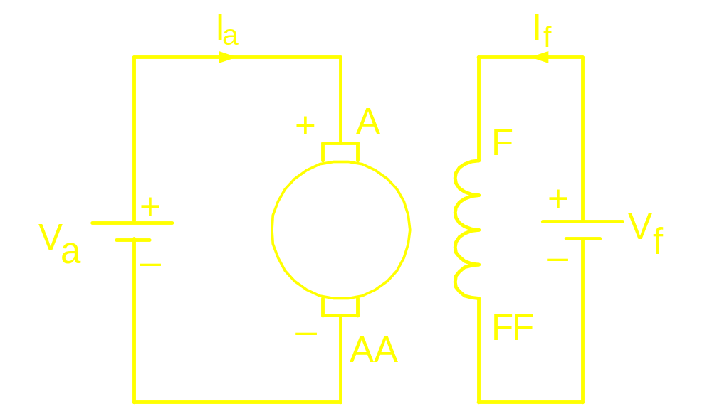
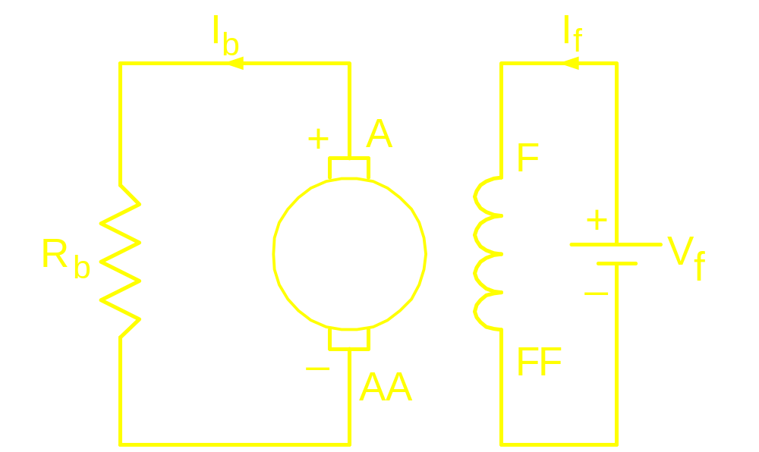
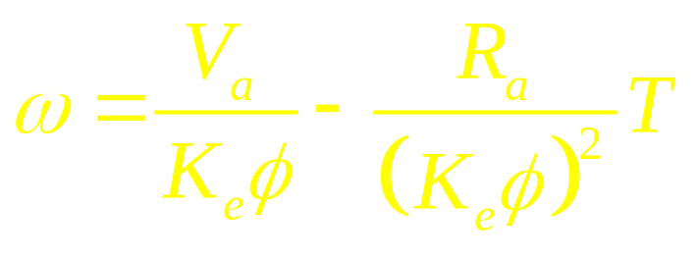
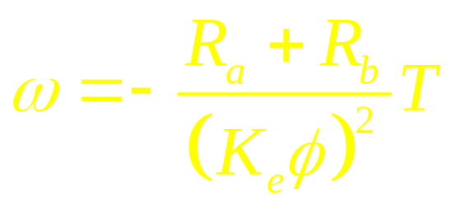
Dynamic Braking

Slide 11
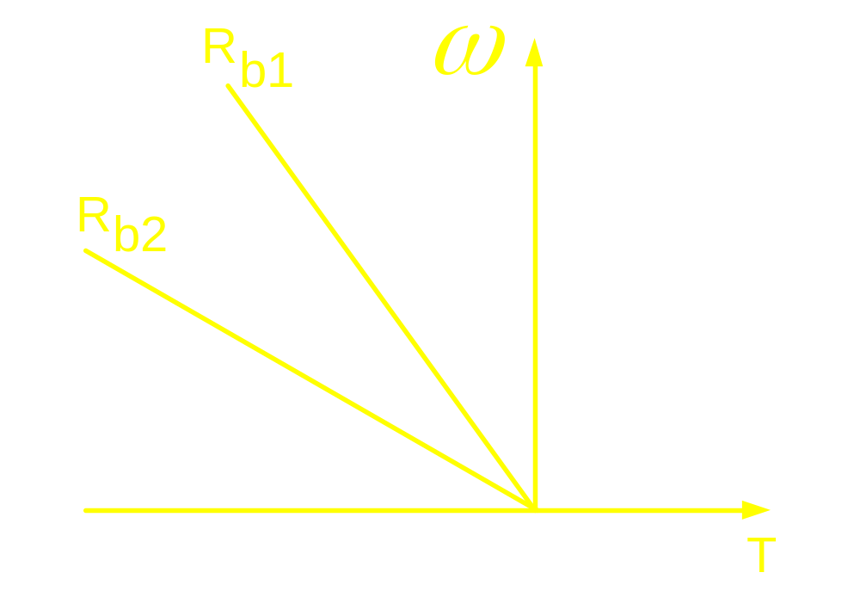
Dynamic Braking

Slide 12

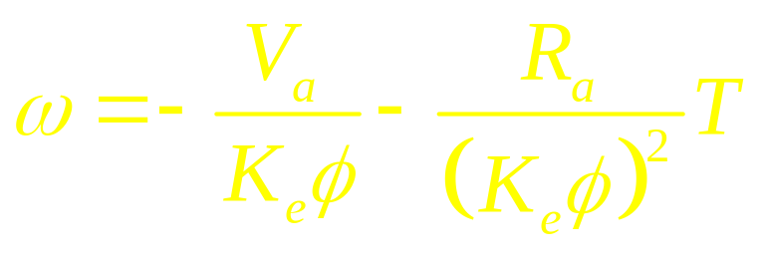
Plugging

Slide 13
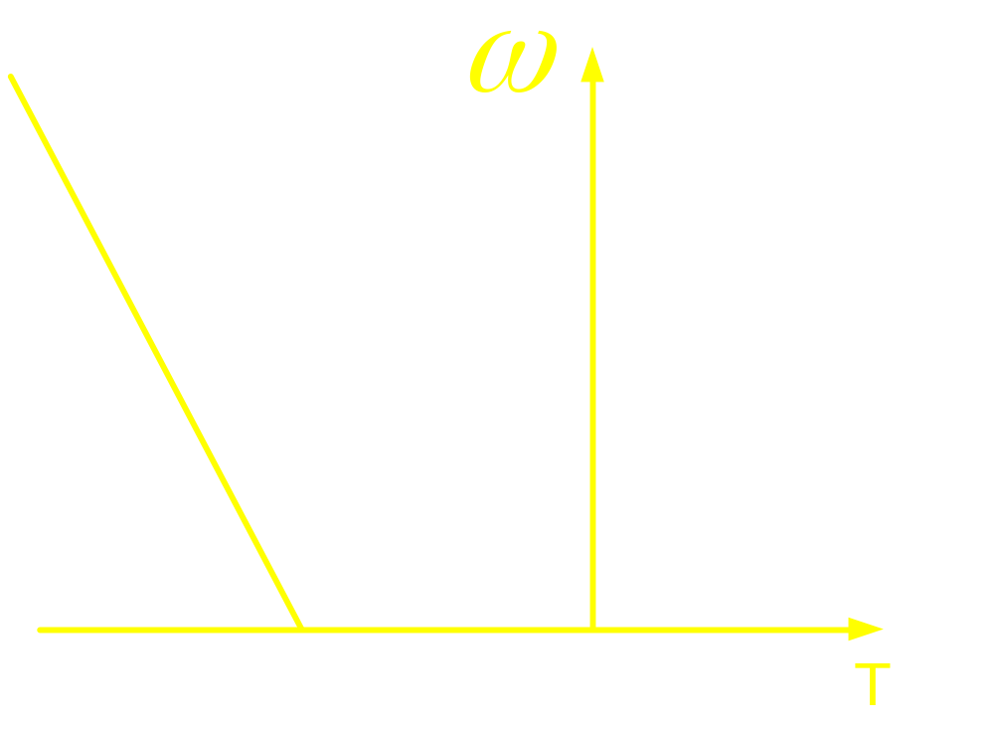
Plugging

Slide 14
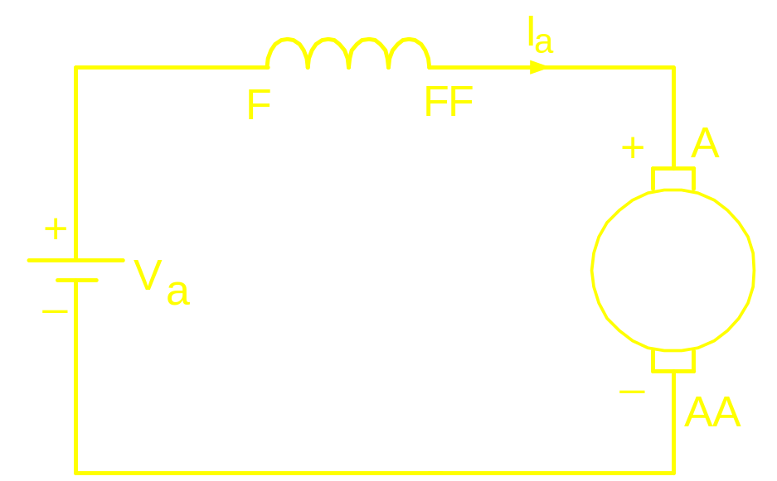
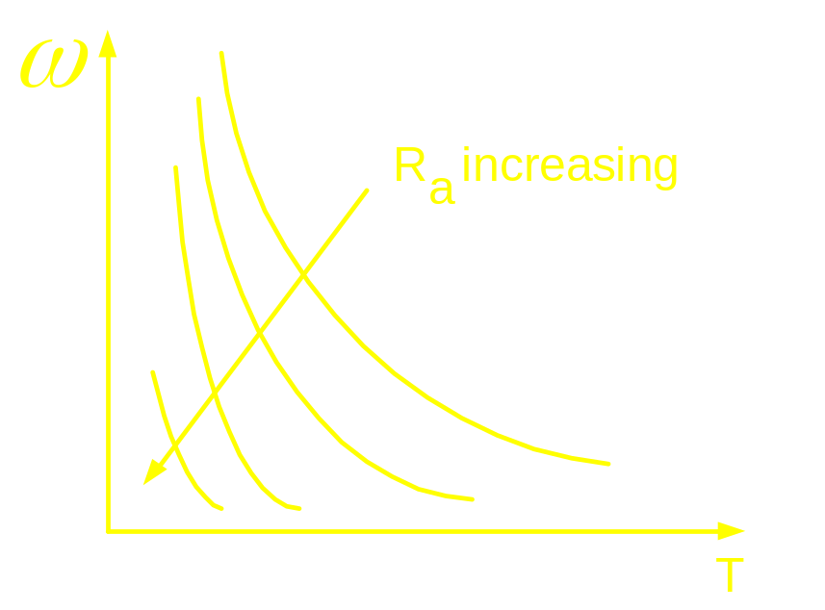
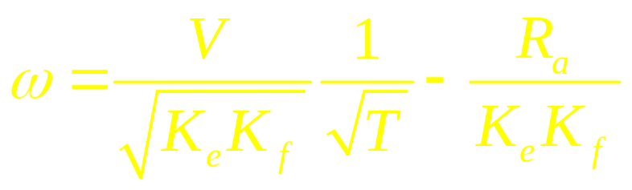
Speed Control of DC Series Motor
Armature Resistance Control

