Slide 1
EE-222
Electric Machines
&
Power Electronics
Lecture - 7
Prof. Kishore Chatterjee
Department of Electrical Engineering,
IIT Bombay

Slide 2
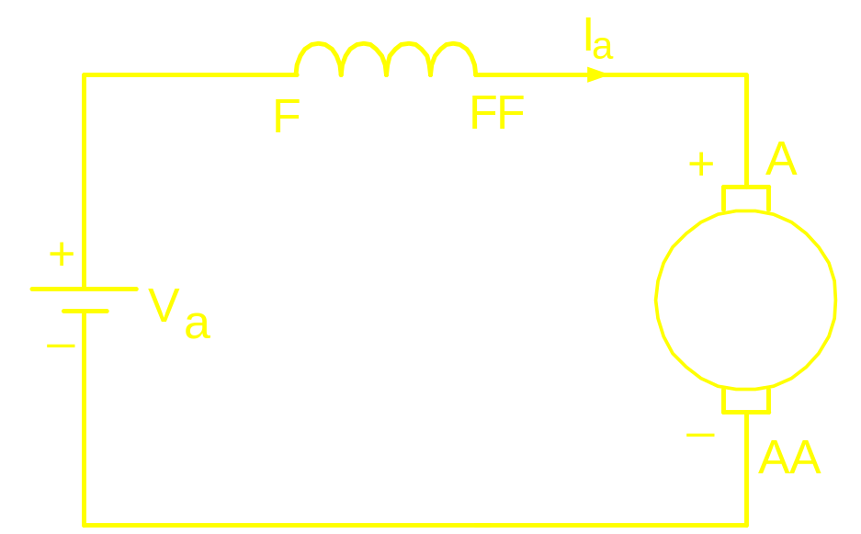
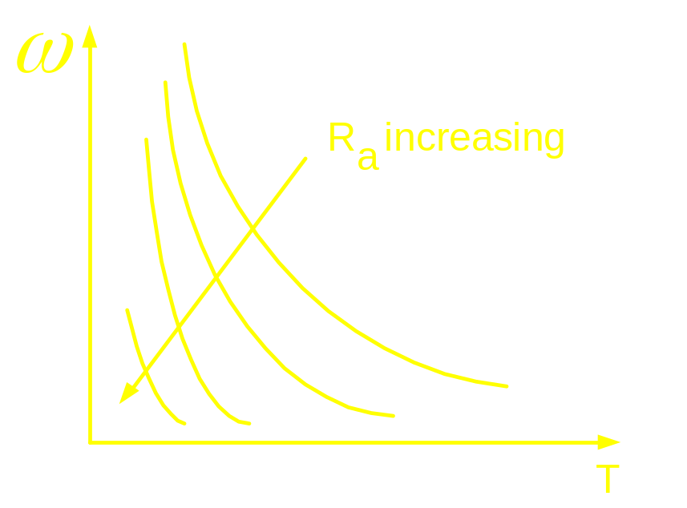
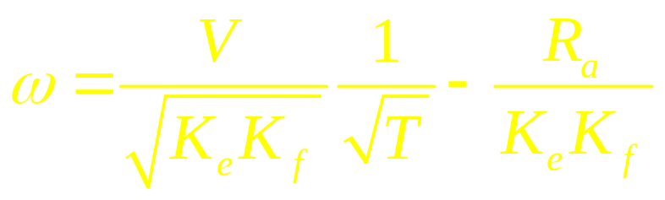
Speed Control of DC Series Motor
Armature Resistance Control

Slide 3
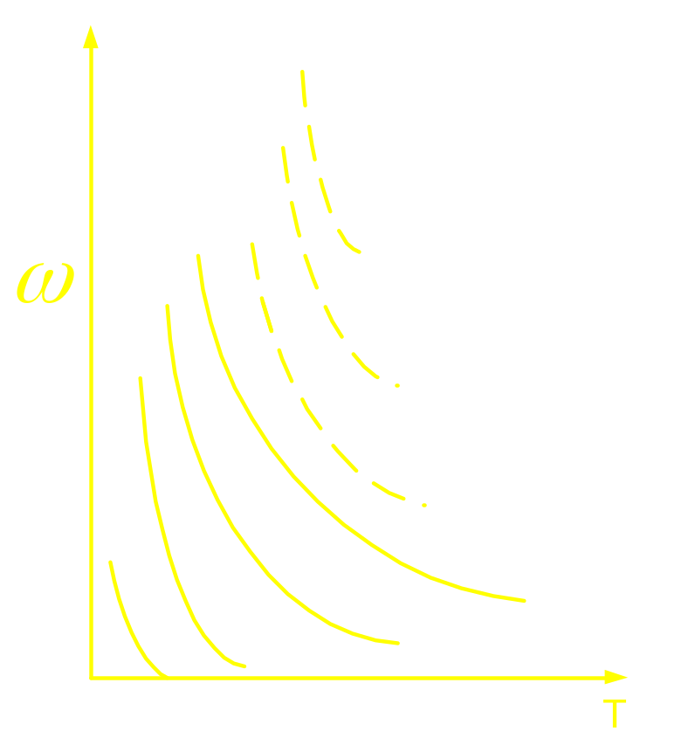
Speed Control of DC Series Motor
Combined Armature Voltage and Field
Control
Difficulty in
achieving
field
weakening

Slide 4
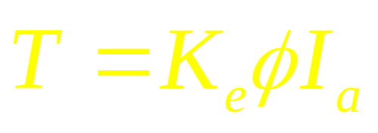
Braking in DC Series Motor
Regenerative Braking
Not Possible

Slide 5
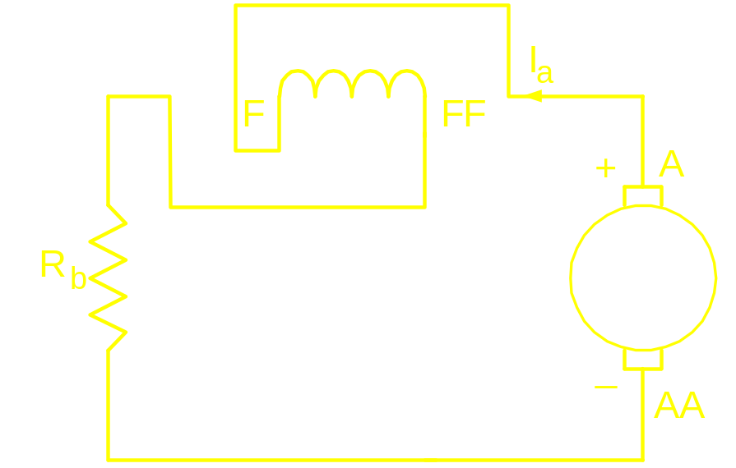
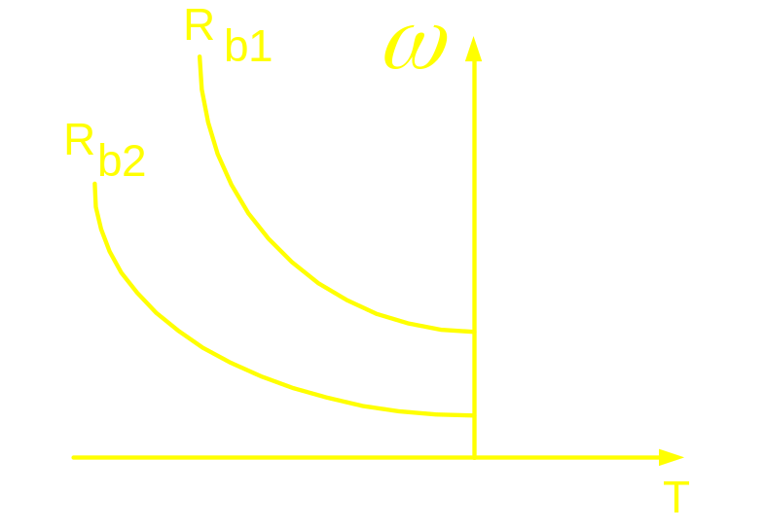
Braking in DC Series Motor
Dynamic Braking

Slide 6
Realization of the
Variable Voltage DC Source
(Power Modulator)
for the
Dc motor Drive
When the input source is AC

Slide 7
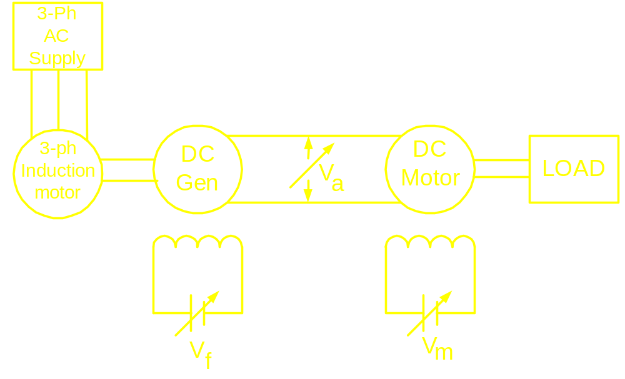
Conventional Method:
Ward-Leonard Schemes

Slide 8
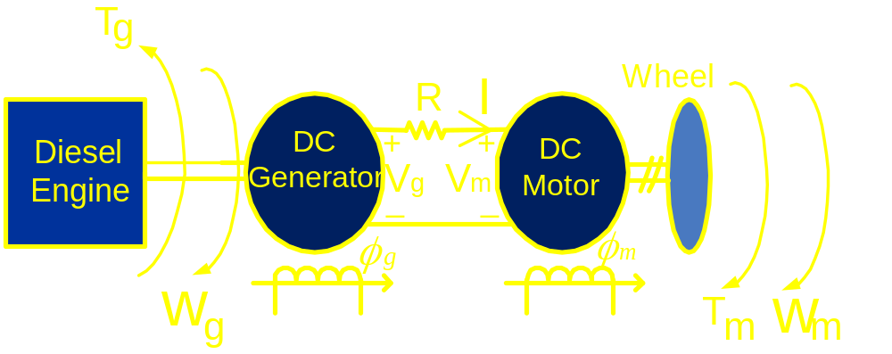
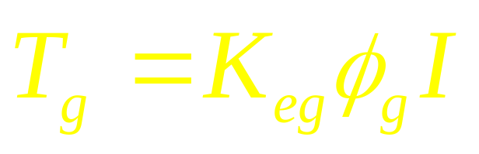
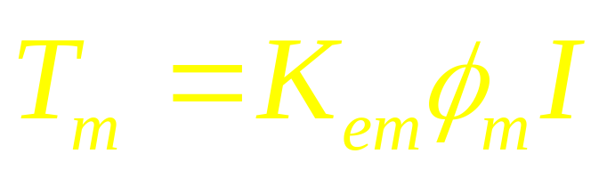
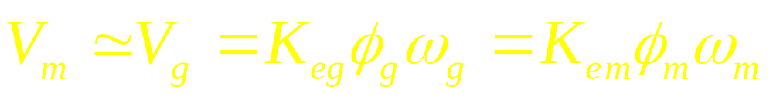
Diesel Electric Locomotive

Slide 9
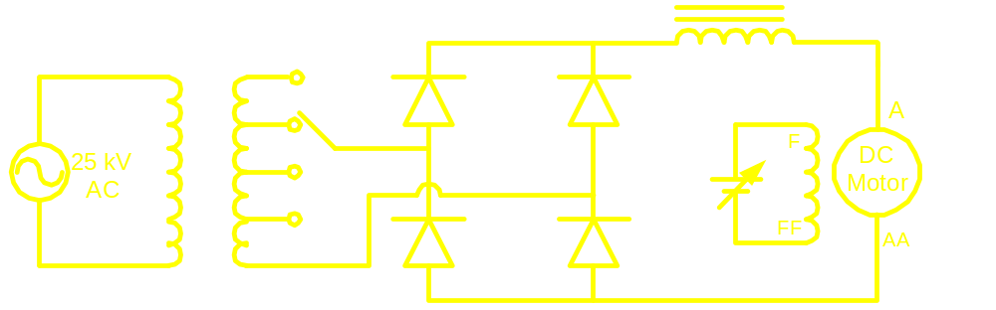
French System: For speed control of
Conventional ac traction

Slide 10
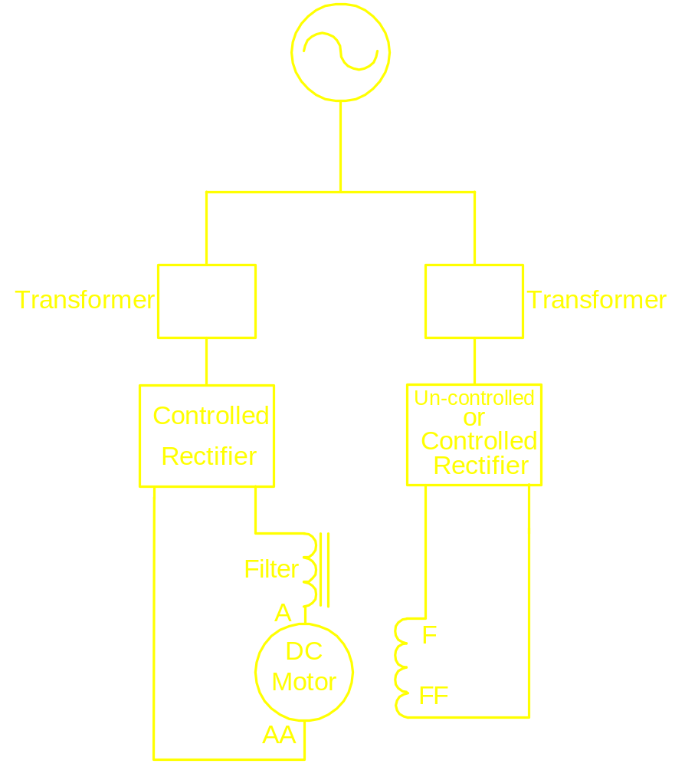
Static Ward-Leonard Scheme
Single Phase
Three Phase

Slide 11
Induction Motor Drive

Slide 12
Induction Motor
Absence of Brushes and Commuter:
Simple construction
Rugged
Cheap
Design available for high power
applications
Low mechanical time constant

Slide 13
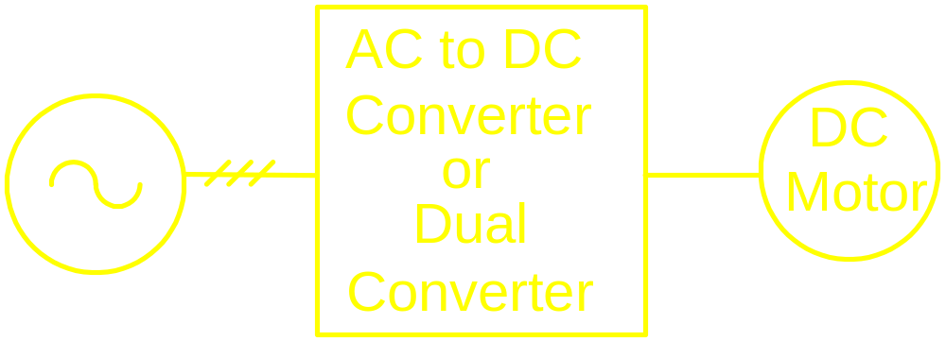
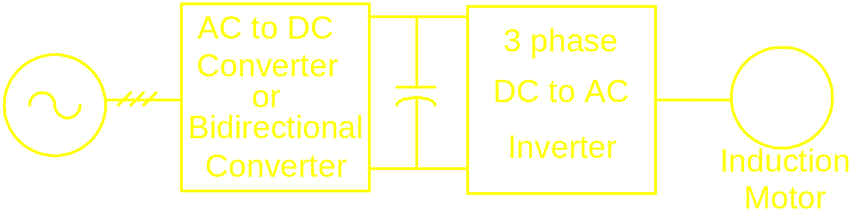
DC Motor Drive
Induction Motor Drive

Slide 14
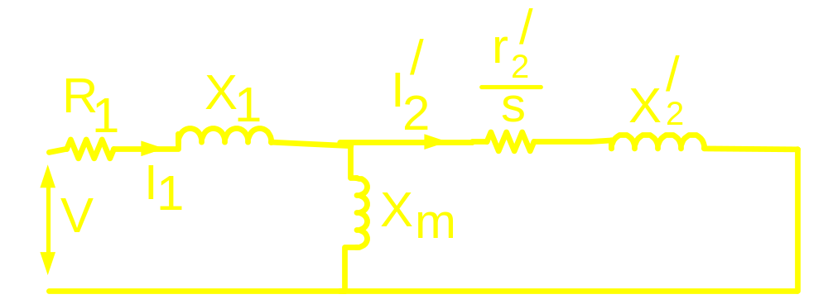
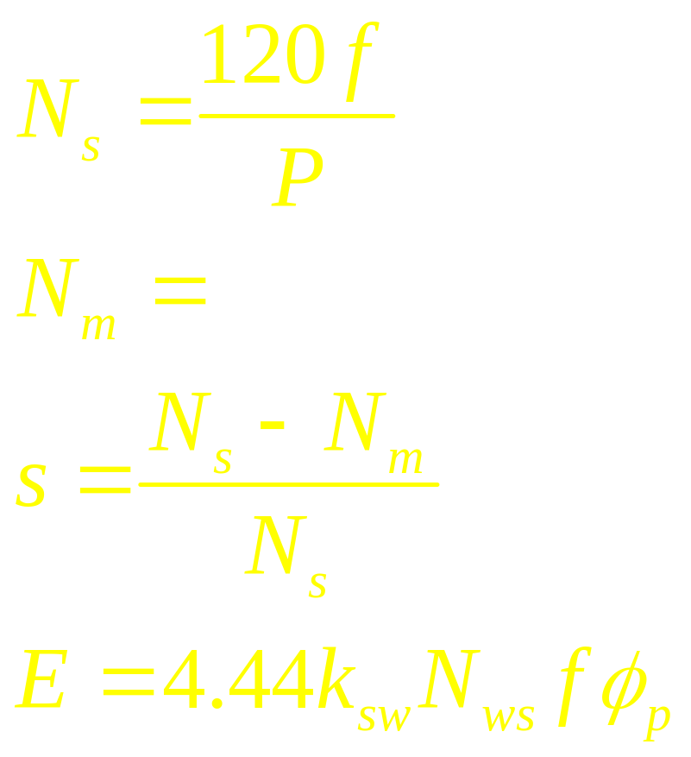
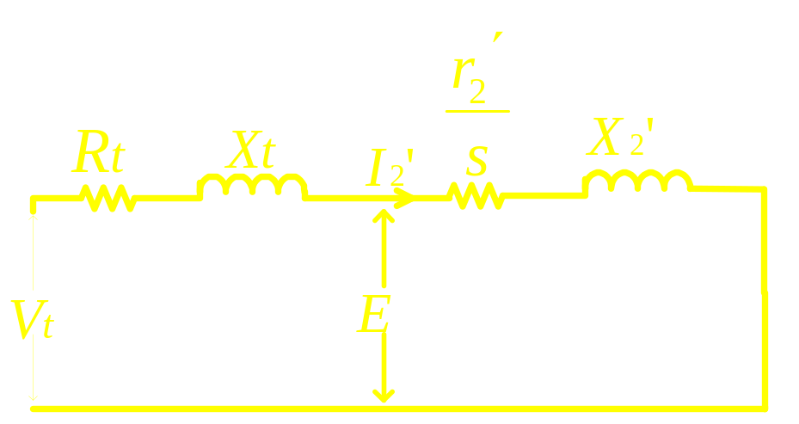
Rotor Speed

Slide 15
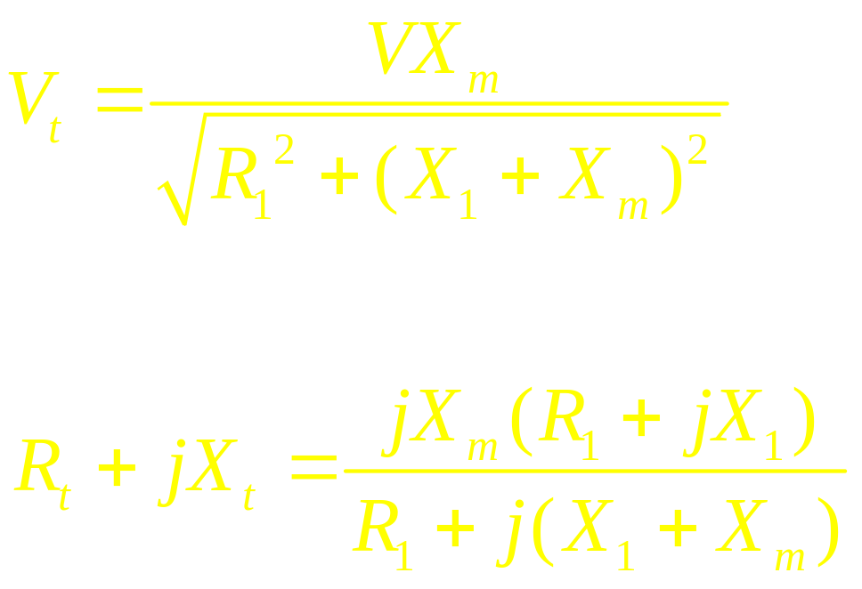

Slide 16
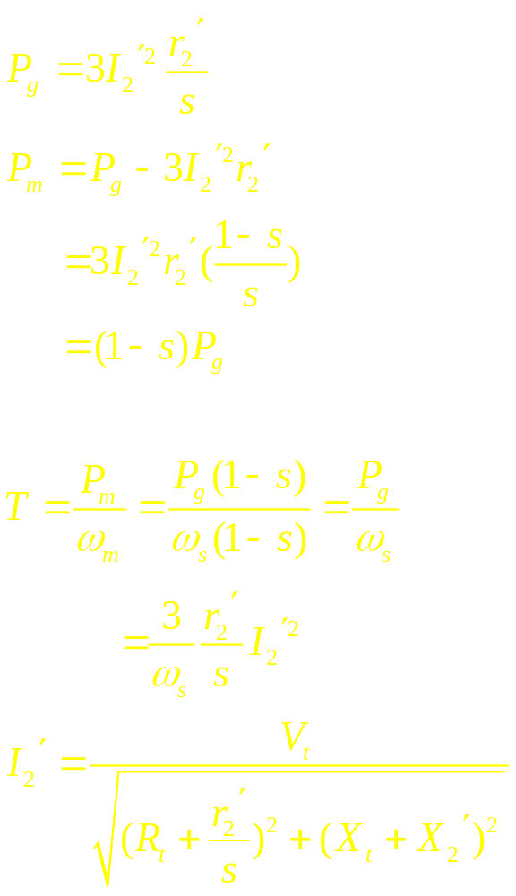
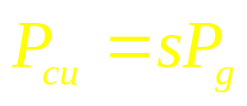
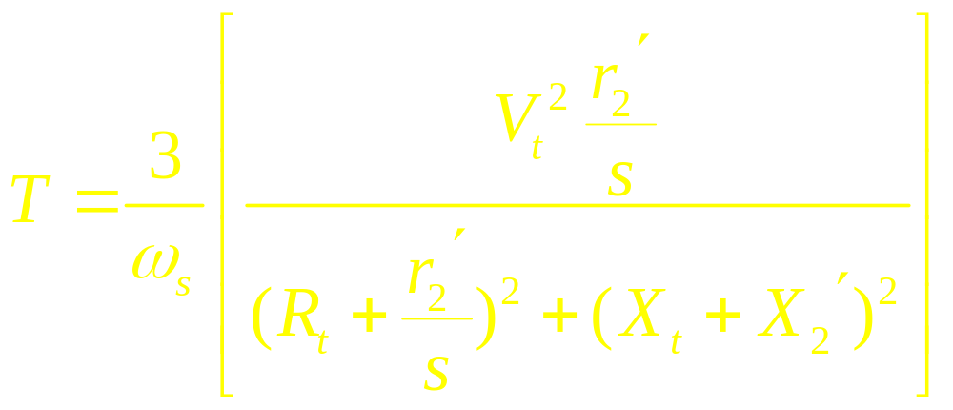

Slide 17
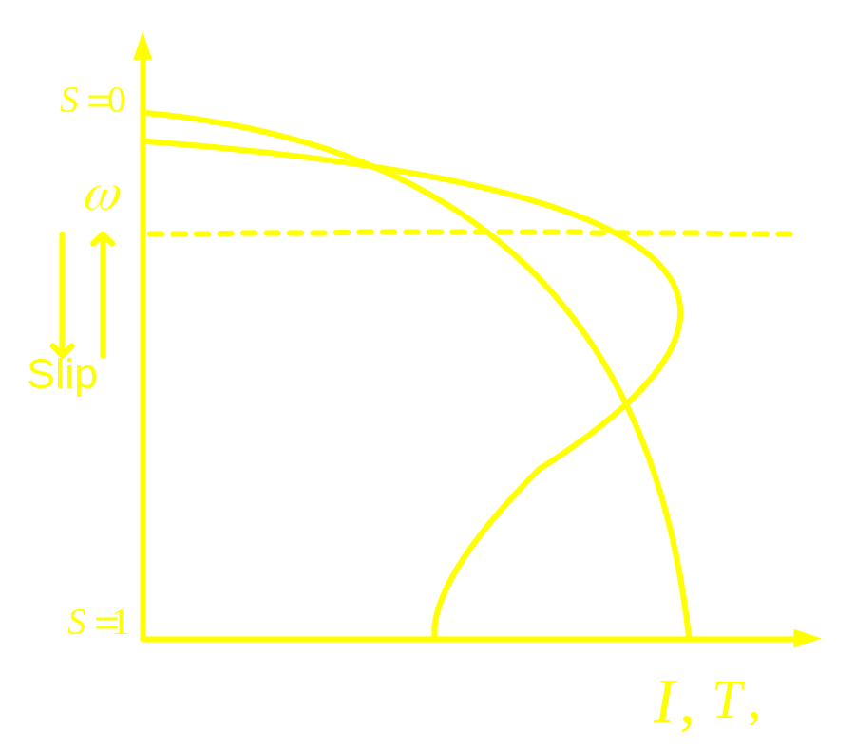
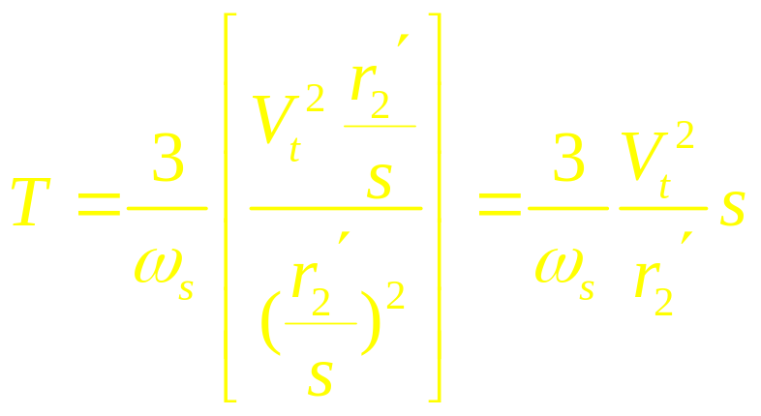
At low values of slip

