Slide 1
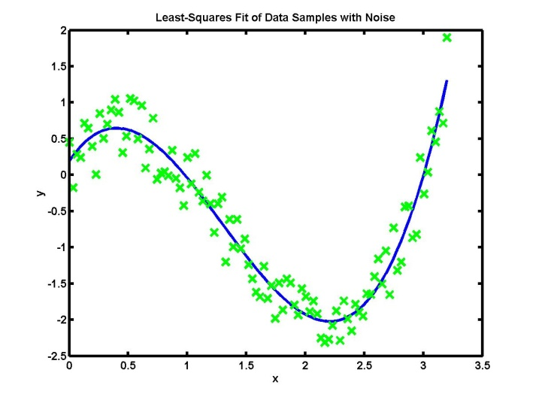
Noise Modeling of Sensors: The Allan Variance Method
Siddharth Tallur, 31/08/2020 EE617 Sensors in Instrumentation
Modifications to slides found here: https://eecs.wsu.edu/~taylorm/16_483/Jerath.pptx

Slide 2
You should be able to answer these questions…
PART I: MOTIVATION
What is noise?
What is noise modeling and why is it required?
PART II: BASICS
How is noise characterized?
How is noise in sensors quantified?
PART III: ALLAN VARIANCE ANALYSIS
What is Allan Variance?
How can it be used to specify sensor characteristics?
Notes:
The students should be able to answer the following questions at the end of the class

Slide 3
Noise models can be useful
Think of the sensing process
MOTIVATION: NOISE MODELING
Environment
(Phenomenon)
Environment
(Other phenomena)
Sensor
Output
(Sensed Signal)

Slide 4
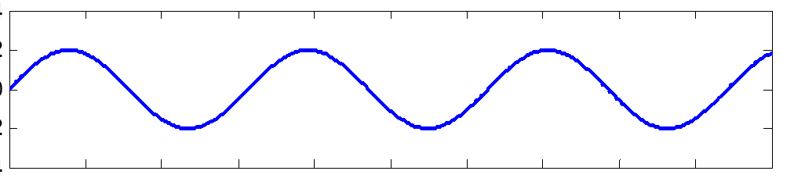
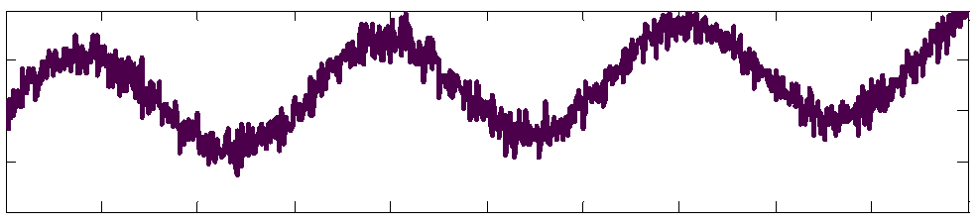
Noise models are useful in signal filtering
Signal filtering or recovery: E.g. Noise canceling hardware may utilize knowledge of noise models for signal filtering
MOTIVATION: NOISE MODELING
Environment
(Phenomenon)
Environment
(Other phenomena)
Sensor
Output
(Sensed Signal)
Perfect process
Process noise
Perfect sensor
Signal recovery
Noise due to extraneous signals
Signal processing

Slide 5
Noise models are useful in sensor selection
Sensor design, selection and performance mapping: Identifying performance of various “virtual” sensors for a given sensing task requires knowledge of noise models
MOTIVATION: NOISE MODELING
Environment
(Phenomenon)
Environment
(Other phenomena)
Sensor 1
Output
(Sensed Signal)
Sensor 2
Sensor 3
Sensor N
Performance metric
Perfect process
Perfect environs
‘Virtual’ sensors
Varying degrees of measurement noise

Slide 6
You should be able to answer these questions…
PART I: MOTIVATION
What is noise?
What is noise modeling and why is it required?
PART II: BASICS
How is noise characterized?
How is noise in sensors quantified?
PART III: ALLAN VARIANCE ANALYSIS
What is Allan Variance?
How can it be used to specify sensor characteristics?

Slide 7
Question…
BASICS: NOISE CHARACTERIZATION
Can you think of some tools used to characterize noise?

Slide 8
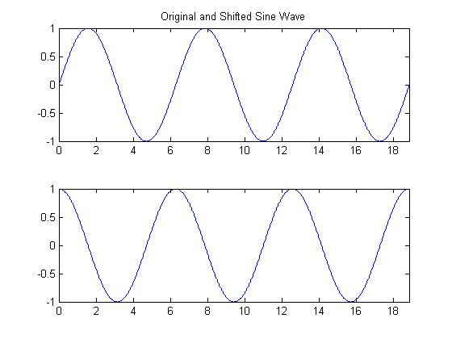
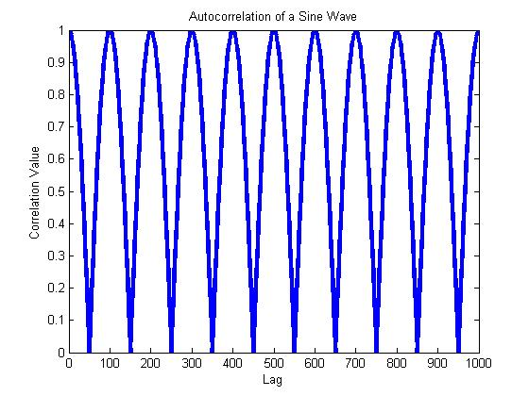
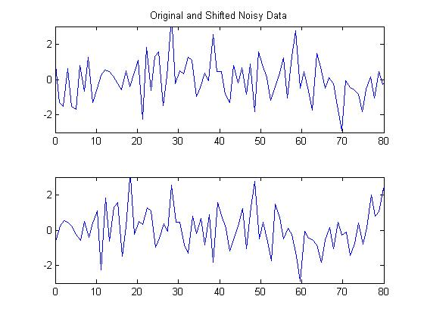
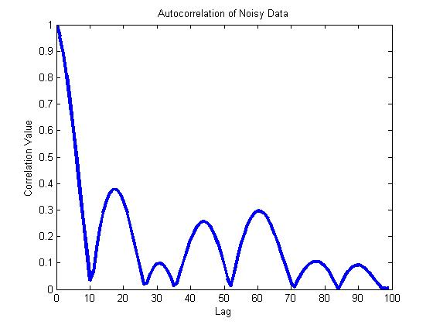
What is autocorrelation?
Infinite Perfect Correlations
As you change the data’s phase, how probable is correlation with the original data?
Only 1 Perfect Correlation

Slide 9

Noise characterization tools: Autocorrelation
Time-domain representation
Let $X(t)$ be a stochastic variable:
$$R_{XX}\left(t,τ\right)=\lim_{T→∞}{\frac{1}{2T}\int_{−T}^{T}{f\left(τ\right)\overline{f}\left(t−τ\right)dτ}}$$
BASICS: NOISE CHARACTERIZATION

Slide 10

Noise characterization tools: Autocorrelation
If $X(t)$ represents white noise, $R_{XX}\left(t_{1}, t_{2}\right)=δ(t_{1}−t_{2})$
BASICS: NOISE CHARACTERIZATION
Dirac delta function
MATLAB code
%% White noise autocorrelation
clear all
clc
close all
N = 10000;
w = randn(N,1);
t = linspace(0,N,N);
[c,lags] = xcorr(w,w);
plot(lags,abs(c./max(c)),'Linewidth',2);

Slide 11
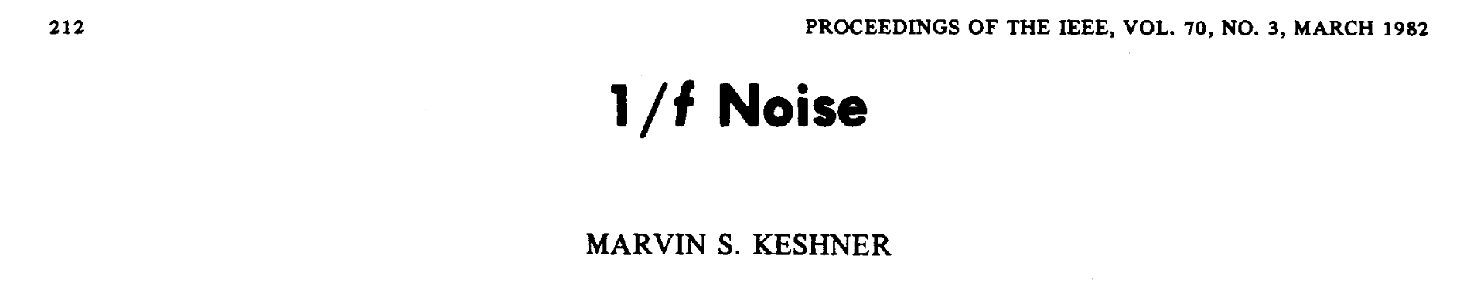
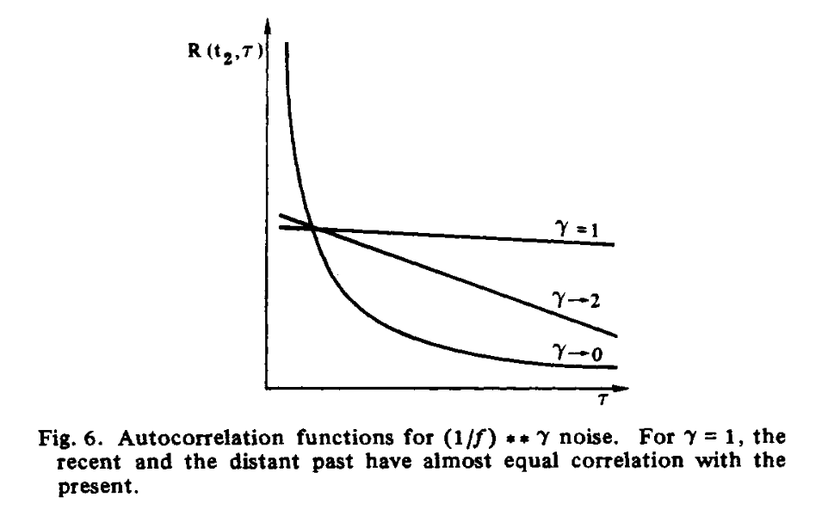
Autocorrelation of colored noise

Slide 12
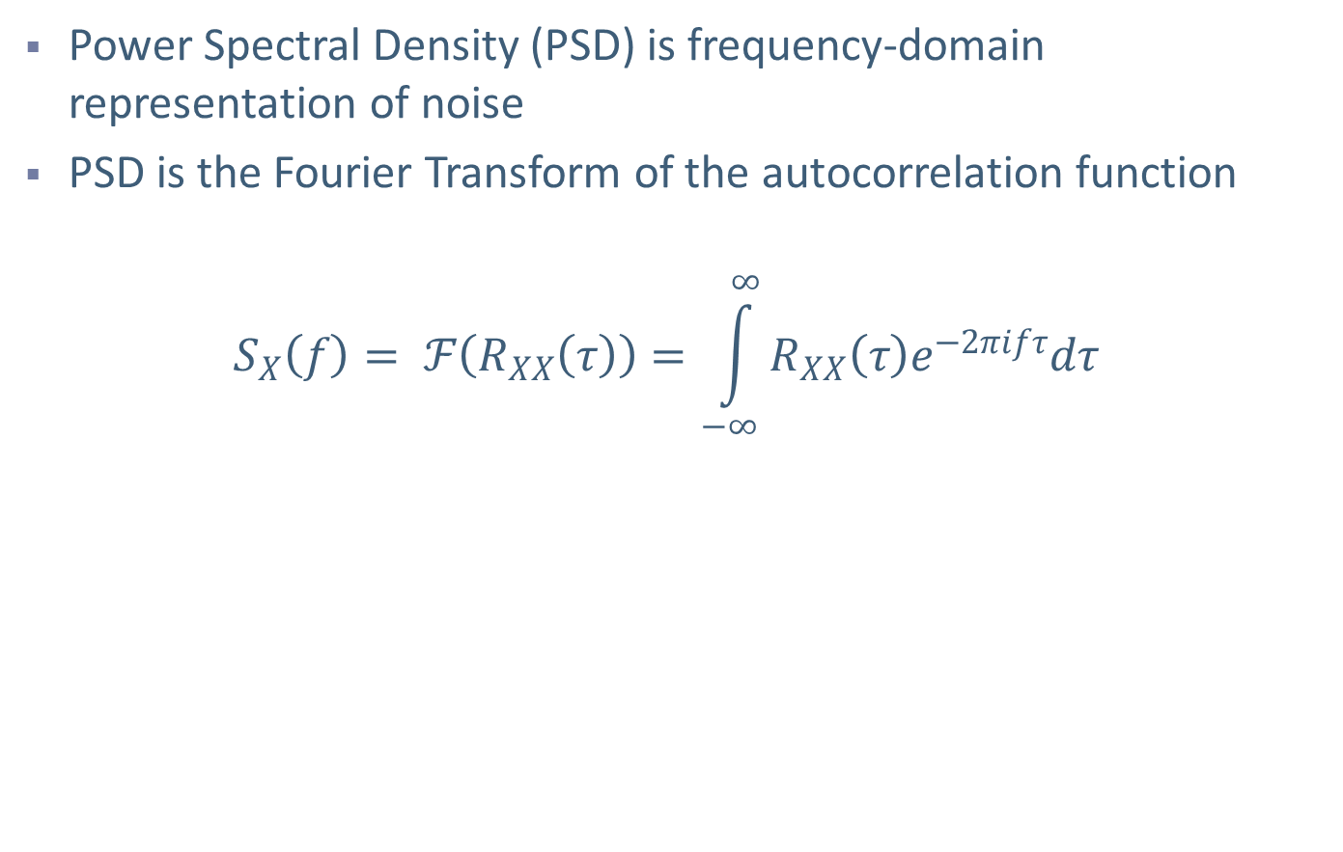
Noise characterization tools: PSD
Power Spectral Density (PSD) is frequency-domain representation of noise
PSD is the Fourier Transform of the autocorrelation function
$$S_{X}\left(f\right)= ℱ\left(R_{XX}\left(τ\right)\right)=\int_{−∞}^{∞}{R_{XX}\left(τ\right)e^{−2πifτ}dτ}$$
BASICS: NOISE CHARACTERIZATION

Slide 13

Noise characterization tools: PSD
If $X(t)$ represents white noise, $S_{X}\left(f\right)=N_{0}$
BASICS: NOISE CHARACTERIZATION
MATLAB code
%% Power Spectral density
N = 10000;
w = randn(N,1);
n = 256;
W = fft(w,n);
% Method 1
Pww = W.*conj(W)/n;
% Method 2
Pww_welch = pwelch(w);
% Method 3
Pww_cov = pcov(w,3);
% See Mathworks help for more details

Slide 14
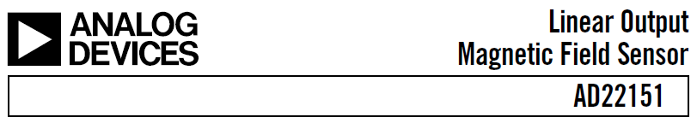
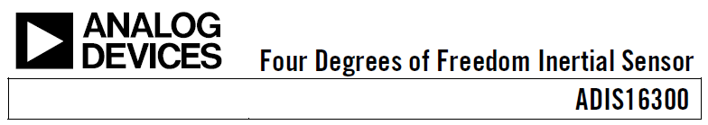



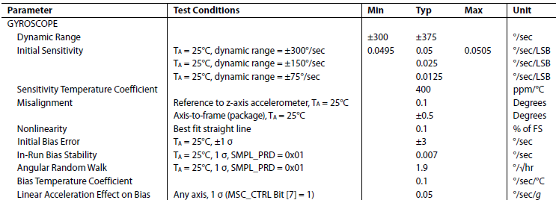
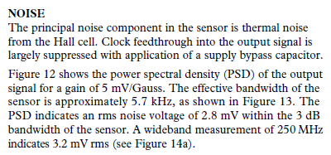
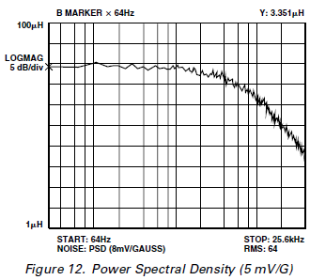
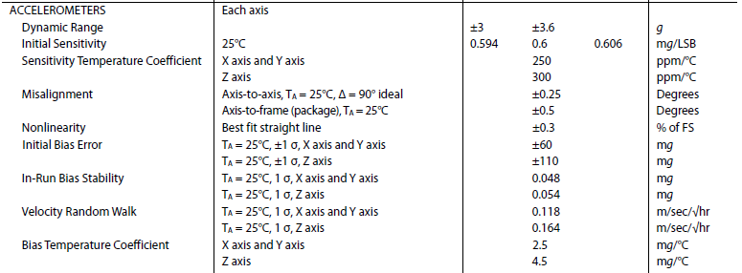
Sensor characterization: Check the datasheet!
BASICS: NOISE CHARACTERIZATION

Slide 15
You should be able to answer these questions…
PART I: MOTIVATION
What is noise?
What is noise modeling and why is it required?
PART II: BASICS
How is noise characterized?
How is noise in sensors quantified?
PART III: ALLAN VARIANCE ANALYSIS
What is Allan Variance?
How can it be used to specify sensor characteristics?

Slide 16
Make an educated guess…
Which of the following technologies in the 1950s necessitated the development of a new measure of variance, i.e. the Allan variance?
Solar-powered batteries
Precision atomic clocks
Leak-free ball point pens
Flexible optical fibers
ALLAN VAVRIANCE ANALYSIS: ORIGINS

Slide 17
Origins: Frequency stability of atomic clocks
1950s-1960s: Development of precise atomic clocks – issues pertaining to frequency stability arise
Preliminary work: D W Allan, “Statistics of Atomic Frequency Standards”, Proceedings of the IEEE, 1966
ALLAN VAVRIANCE ANALYSIS: ORIGINS

Slide 18
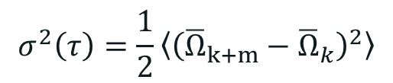
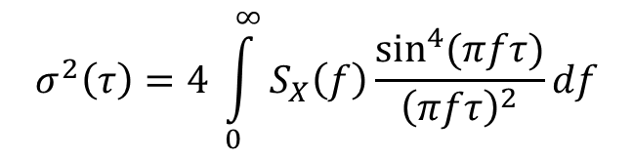
Allan Variance
Allan variance is defined as one half of the time average of the squares of the differences between successive readings of the frequency deviation sampled over the sampling period.
NOTE:
Allan variance analysis is always performed for zero input to the sensor. In this situation, any sensor output is due to noise arising from the sensor.
See next slide to understand variables in the equation
$$σ^{2}\left(τ\right)=\frac{1}{2}\left\langle {\left({\overline{Ω}}_{k+m}−{\overline{Ω}}_{k}\right)}^{2}\right\rangle$$
ALLAN VAVRIANCE ANALYSIS: DEFINITION
$$σ^{2}\left(τ\right)=4 \int_{0}^{∞}{S_{X}\left(f\right)\frac{\sin^{4}{(πfτ)}}{{\left(πfτ\right)}^{2}}}df$$

Slide 19
How is Allan Variance computed?
Allan Variance (σ²(m)) is a function of a parameter m.
Partition the data such that each section has ‘m’ samples
Ω_{k} is the mean of points in k^{th} partition
Compute the difference: Ω_{k} - Ω_{k-1}
For example: Choose m = 200
Compute the mean of data points in each partition
1
2
3
4
5
Evaluate difference of the means of adjacent sections
Square the value each difference
Ω₁
Ω₂
Ω₃
Ω₄
Ω₅
Compute the average of these squared values
Allan Variance: σ²(m) = ½(Average Value)
(Ω₂-Ω₁)²
(Ω₄-Ω₃)²
(Ω₃-Ω₂)²
(Ω₅-Ω₄)²
<(Ω_{i+1}-Ω_{i})²> = [(Ω₂-Ω₁)² + (Ω₂-Ω₁)² + (Ω₂-Ω₁)² + (Ω₂-Ω₁)²] /4 Also, known as the Expected value.
Repeat for different values of m
Notes:
Note: All partitions are of equal size, but, if data length is not a multiple of “m”, the last partition is not used in calculations .

Slide 20
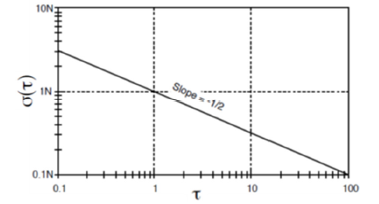
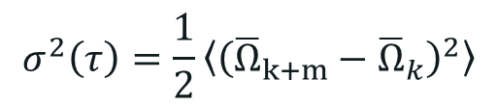
Allan Variance – Angle random walk
$$σ^{2}\left(τ\right)=\frac{1}{2}\left\langle {\left({\overline{Ω}}_{k+m}−{\overline{Ω}}_{k}\right)}^{2}\right\rangle$$
ALLAN VAVRIANCE ANALYSIS: DEFINITION
Simulated white noise
Correlation time = 10 seconds
Correlation time = 0.1 second
Correlation time = 1 second
Correlation time = 0.02 seconds
Notes:
Why was a new measure required? For noise sources other than white noise, the RMS value or the standard deviation is not stable as you try to calculate using ever more number of sample data points. Thus in order to be able to compare the performance of various atomic clocks with different

Slide 21
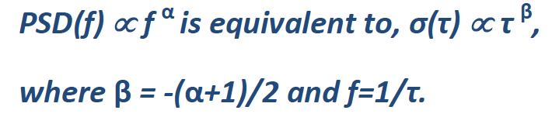
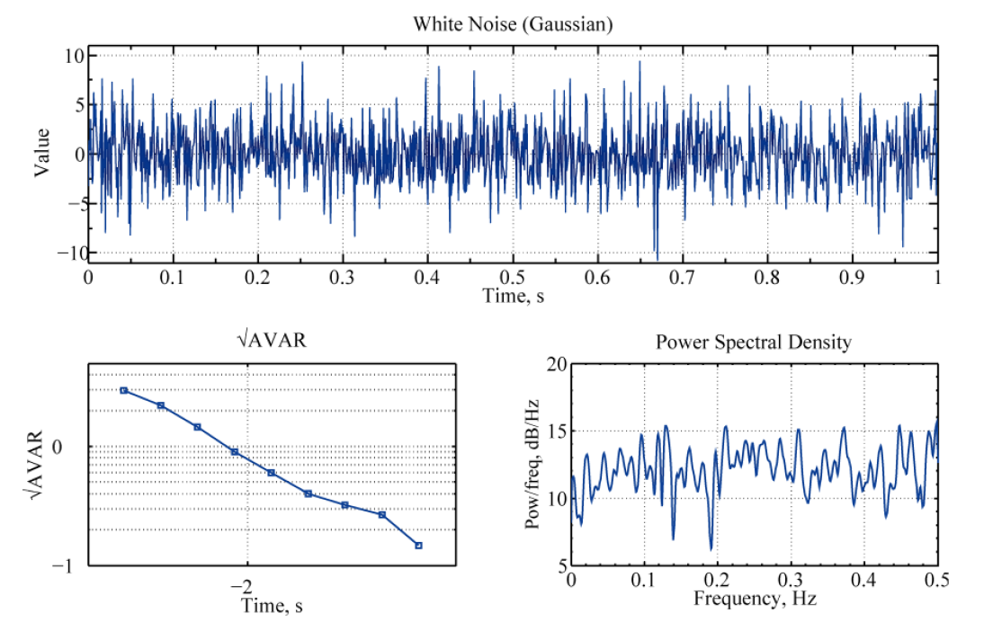
Allan Variance – Noise sources
ALLAN VAVRIANCE ANALYSIS: DEFINITION

Slide 22
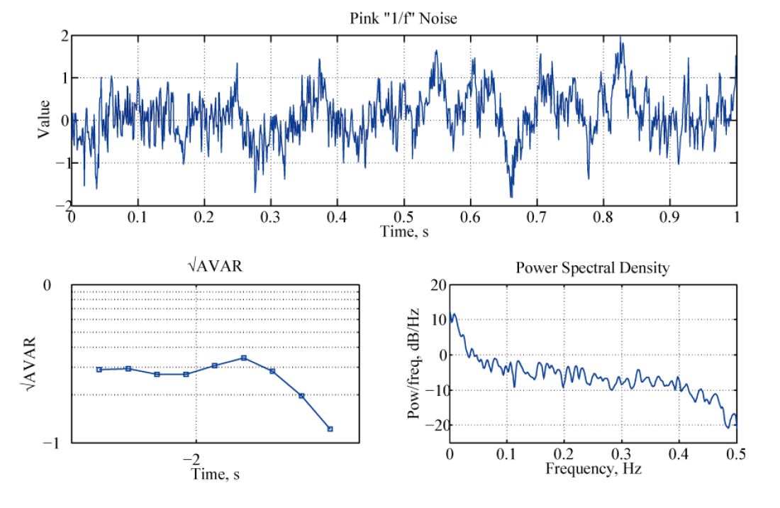
Allan Variance – Noise sources
ALLAN VAVRIANCE ANALYSIS: DEFINITION

Slide 23
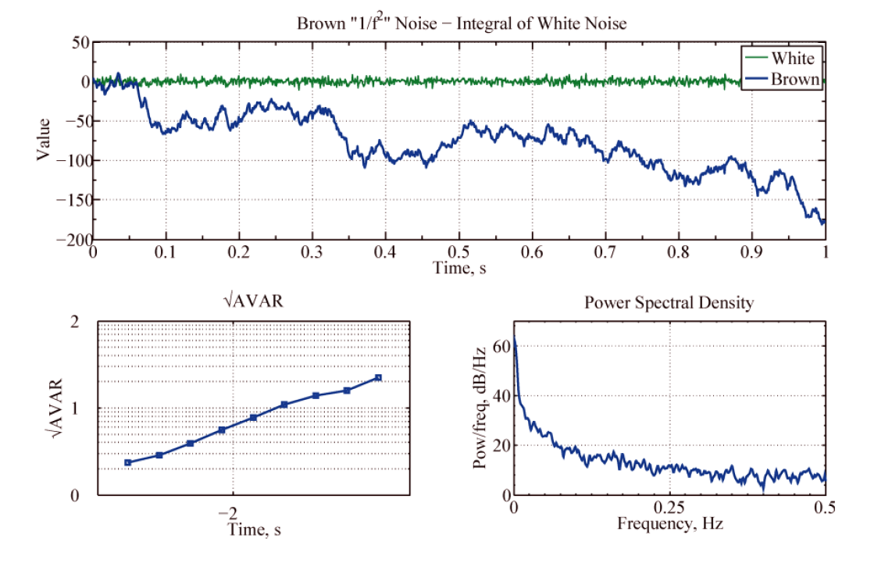
Allan Variance – Noise sources
ALLAN VAVRIANCE ANALYSIS: DEFINITION

Slide 24
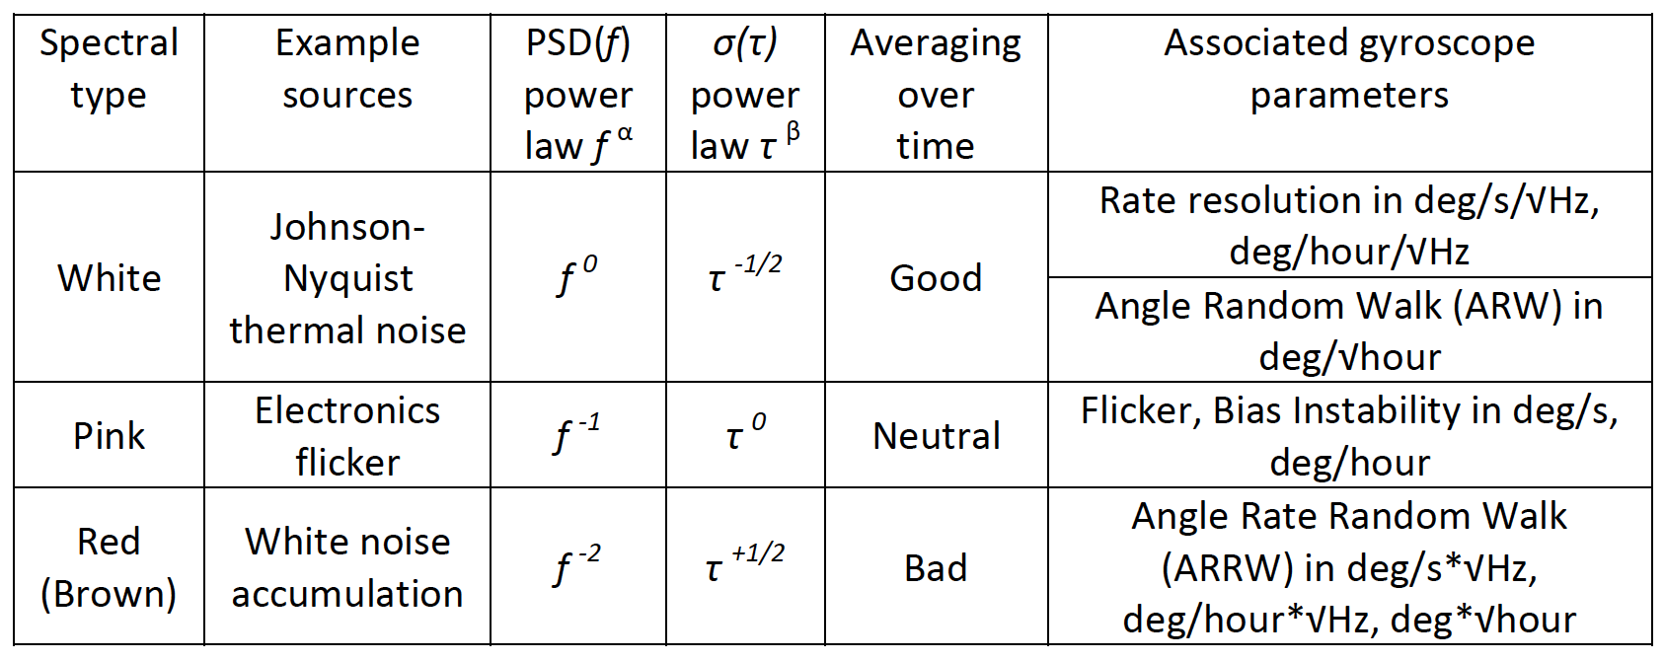
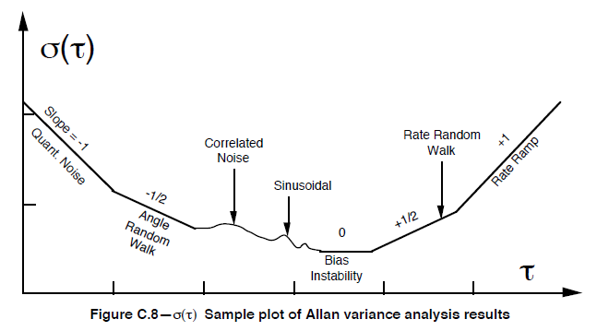
Allan Variance – Noise sources
ALLAN VAVRIANCE ANALYSIS: DEFINITION

