Slide 1
Enhanced E-commerce Sales Analysis
With additional charts & insights

Slide 2
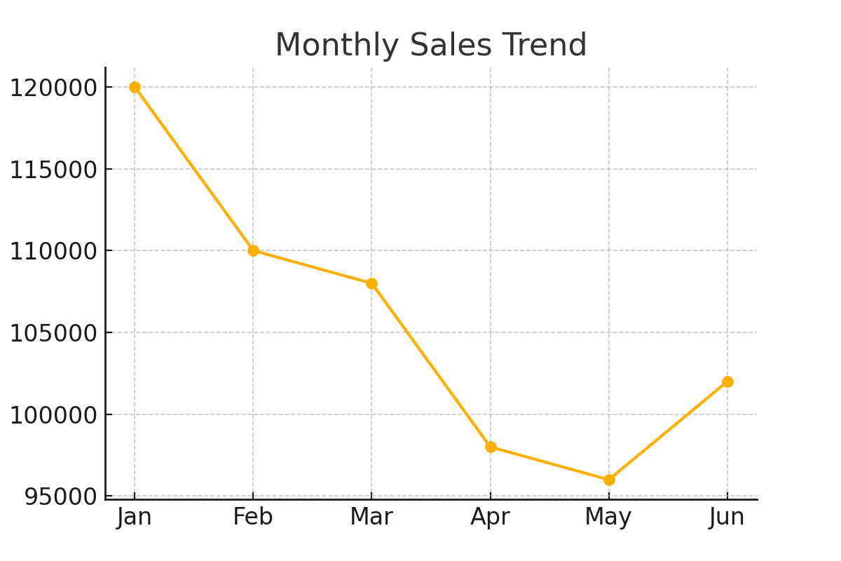
Monthly Sales Trend

Slide 3
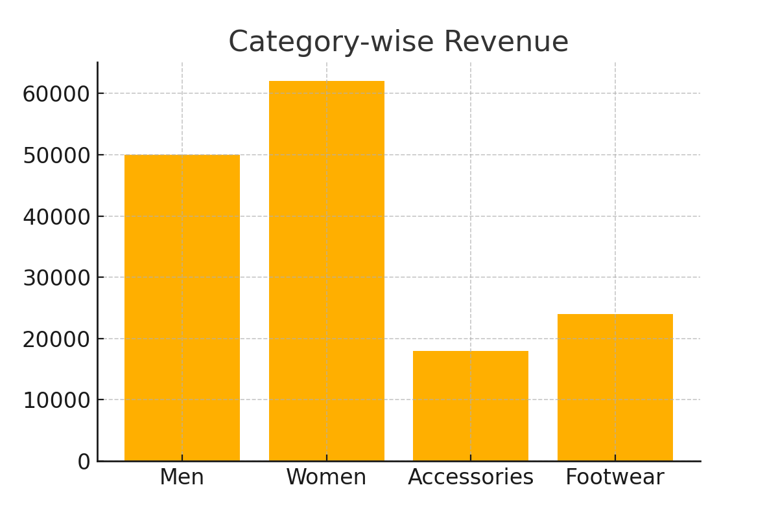
Revenue Breakdown by Category

Slide 4
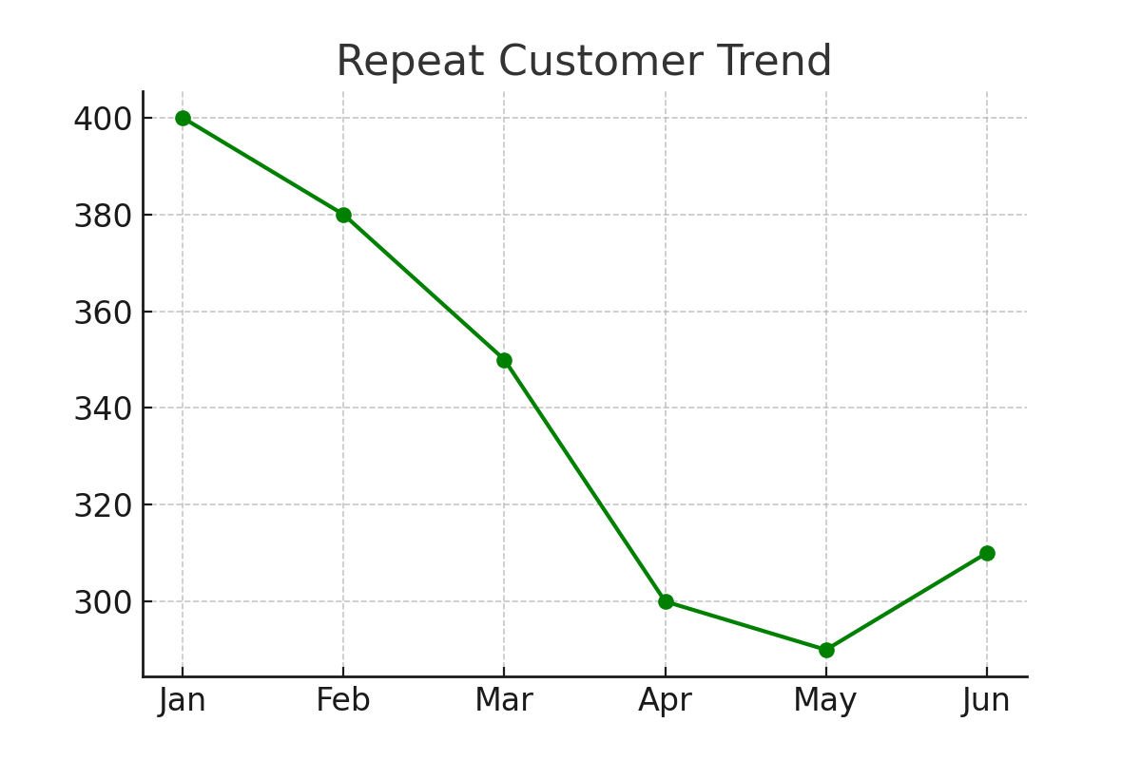
Repeat Customer Decline Pattern

Slide 5
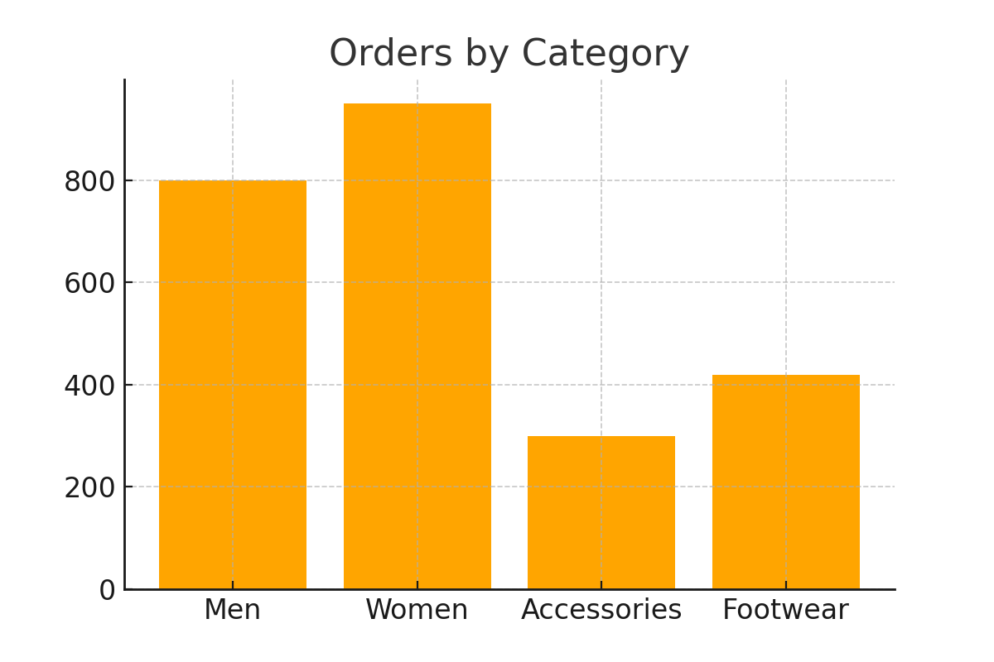
Order Volume by Product Category

Slide 6
Additional Insights
- Sales show a consistent decrease from Jan to May before slight recovery.
- Repeat customers dropping indicates weakening customer loyalty.
- Women’s category contributes the highest revenue and orders.
- Accessories perform poorly in both revenue and order count.
- Increasing promotions for top categories can drive faster recovery.

