Slide 1
General Assembly - DSI Capstone Project
“Securing Your Human”
(Proof of Concept)
Aaron Kim

Slide 2
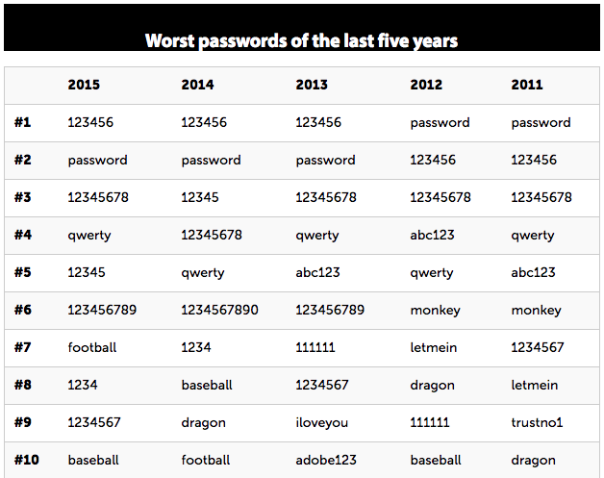
Introduction
Password compromise a constant security risk
Repeated password resets can lead to insecure reminders (post-its) or weak passwords (ie: password, 123456)
Source: http://www.computerworld.com/article/3024404/security/worst-most-common-passwords-for-the-last-5-years.html

Slide 3
Introduction
how can we minimize recall failures / clicking on “forgot/reset password”?
Proposed solution:
adjust passwords based on User behavior

Slide 4
Project Objectives
Reduce/eliminate “forgot password” requests
Replace current concept of a “password”
Improve security by ”training” security to the user

Slide 5
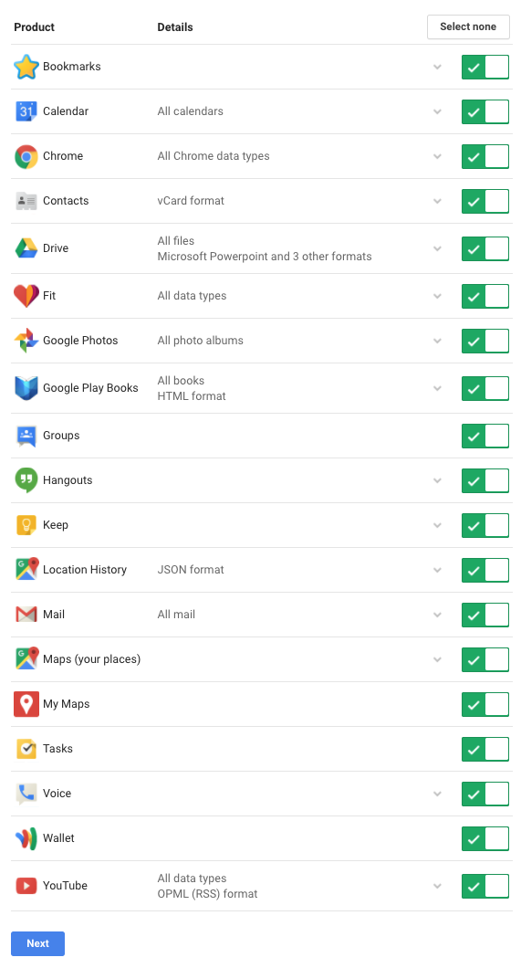
Data
Companies like google already aggregate a considerable amounts and dimensions of user data across their products/services

Slide 6
Data
For the scope of the proof-of-concept, focus on developing a challenge based on user location patterns.
Data collection through background location history via google maps app

Slide 7
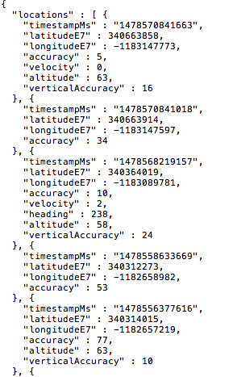
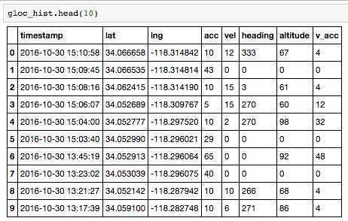
Data
Google maps locations data in JSON format

Slide 8
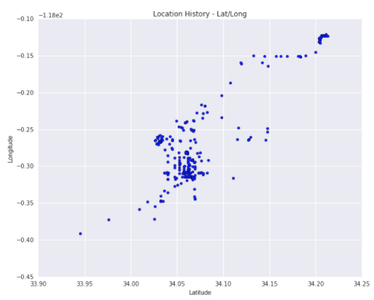
EDA
Plotting of coordinates reveals a general pattern of travel, but difficult to determine any possible points of interest (POI) from this visualization

Slide 9
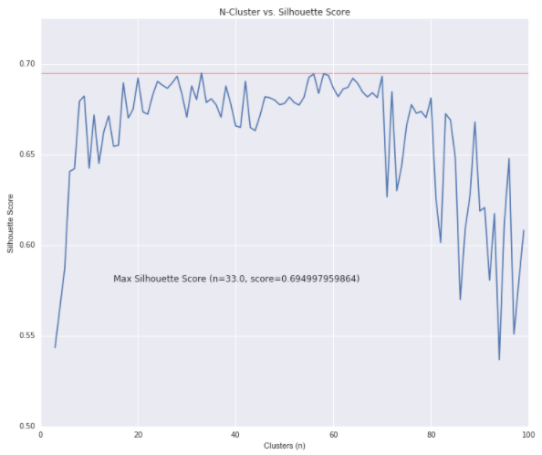
EDA
Used K-means on an estimated range of 2 to 100 possible POI
In this dataset, optimal number of clusters chosen at n=33 based on silhouette score.

Slide 10
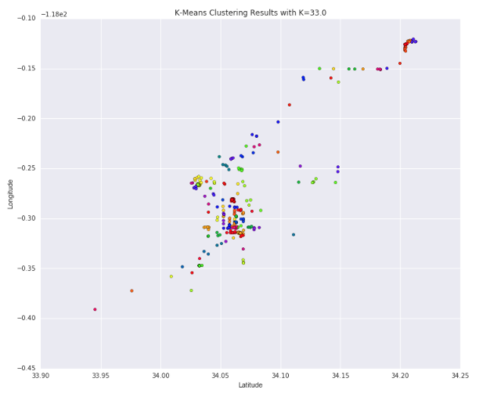
EDA
Grouping on n=33 results in a visualization that starts to show some possible hidden poi
Other options to improve clustering visualization? TSNE!

Slide 11
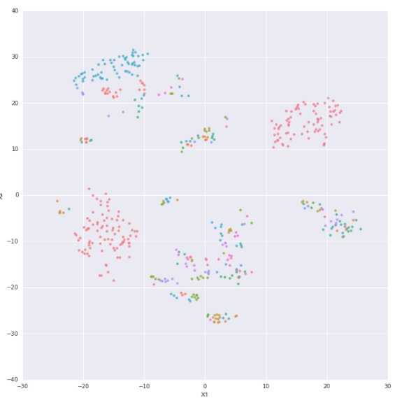
EDA
Re-plotting after using TSNE reveals definite poi, whether clustered in a particular area, or specific poi which the user appears to frequent often

Slide 12
process
Procedurally identify poi (minimize need for human intervention/variable manipulation)
Identify features of poi for challenge extraction

Slide 13
process
POI features selected:
# of datapoints
Standard deviation (lower=better)
Days visited (weekday vs weekend)
Weekday/Weekend only

Slide 14
process
POI features selected:
# of datapoints
Standard deviation (lower=better)
Days visited (weekday vs weekend)
Weekday/Weekend only

Slide 15
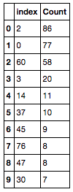
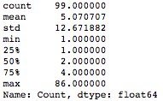

Poi selection
1. After assignment of poi id (based on cluster labels), group and order by count.
2. get distribution stats via the .describe() method, look for data points between 2~3 std deviations from the mean towards the max
3. selected poi ids considered significant (likely to be recalled correctly)

Slide 16
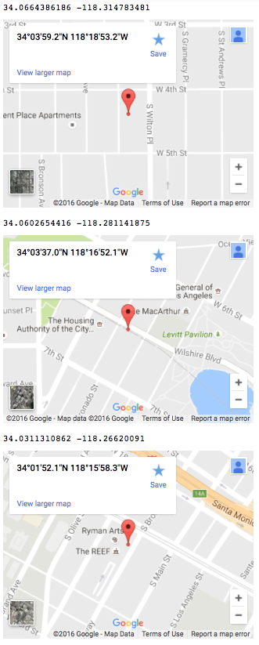
Poi selection
Visualization of geographical coordinates of the top three poi using google maps
Given that the location data is based on my own location history, I can verify that these locations are significant

Slide 17
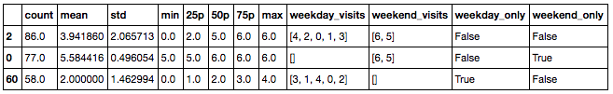
Poi selection
How do we narrow down our challenge from the set of significant poi?
DAYS LISTED IN
ORDER OF FREQUENCY
CHALLENGE GENERATOR
FEATURES OF INTEREST
SELECTOR

Slide 18
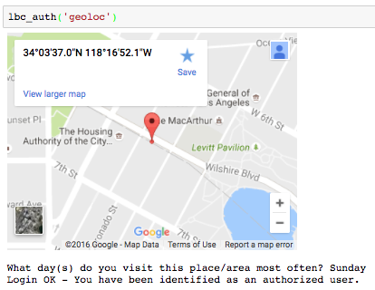
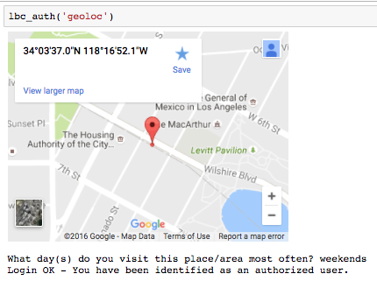
DEMO

Slide 19
DEMO
Not limited to a single answer
Challenge questions and responses are meaningful only to the user
Challenge responses will change depending on user behavior

Slide 20
Challenge logic (v1)
User
Activity
User
Data
Initiate
Auth Req.
Pull Challenge
Pass/Fail
Feedback and Pull new Challenge
API
Data Processing
Lockout

Slide 21
Thank You

